Slide 1
Understanding and prioritising child protection challenges in your community
www.couragechildprotection.com
Notes:
This Courage Presentation explains how to understand and prioritise the child protection challenges happening in your community.

Slide 2
Now that we have identified that there are child protection challenges happening in our community
Notes:
Now that we have identified that there are child protection challenges taking place in our community…

Slide 3
We need to understand what these challenges are and what impact they are having on us and the community around us
Notes:
We need to understand what these challenges are and what impact they have having on us and the community around us?

Slide 4
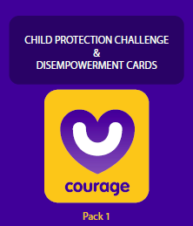
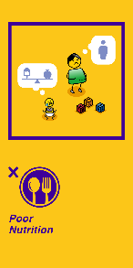
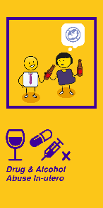
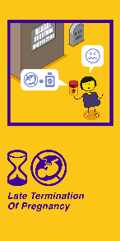
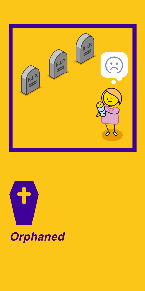
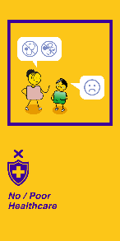
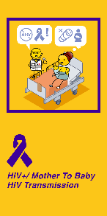
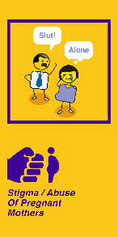
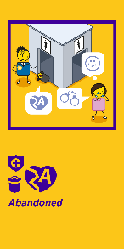
Useful courage tools
courage disempowerment cards (purple pack)
or
video or presentation of child protection challenges
Notes:
Some useful tools to help you to identify, understand and prioritise your child protection challenges, which you can download from the Courage Child Protection Website or order a printed version online, include:
A pack of Courage disempowerment cards (which is the purple pack)
Watching this Courage movie,
Or downloading and present the courage child protection challenges presentation.

Slide 5
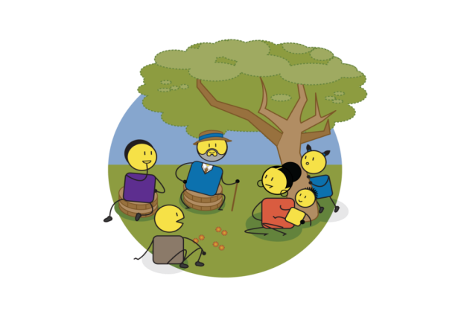
Knowledge & insight
Notes:
The purpose of this exercise is to empower your participants and community with knowledge and insight about the child protection challenges happening around you.
Knowledge and insight are critical to solving any problem, and are an important driver of personal and community empowerment.
They are about learning and education, about openness and transparency,
Knowledge and insight helps us to support concepts such as human diversity and rights.
In the world of child protection, they often come from the monitoring, measurement and evaluating what is happening around us.
Knowledge and insight are about searching for the truth every day and being open to new ideas and new ways of thinking about the world.

Slide 6
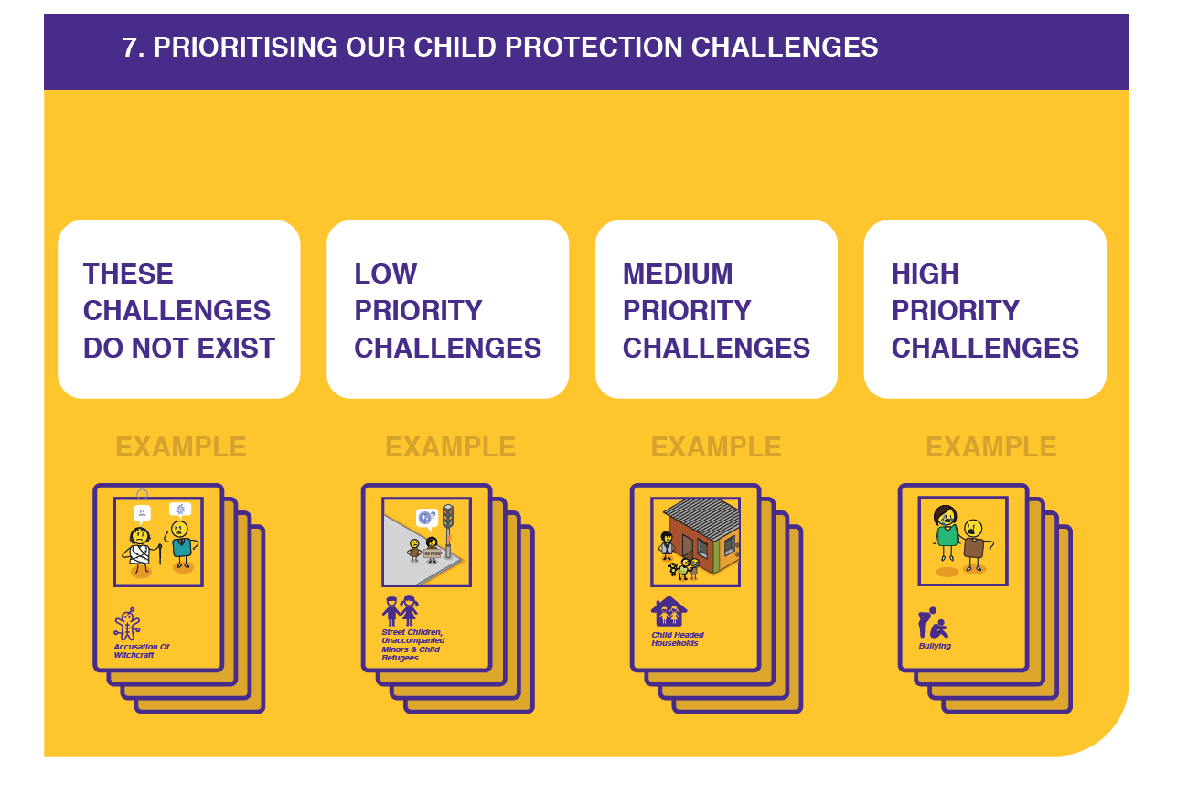
What should we ask?
Look at each child protection challenges card to understand what it is about
Place your cards in 4 piles, high, for the biggest problems, medium and low. And a pile for challenges that don’t exist in your community
Notes:
For this exercise, you will want to ask your participants to go through each child protection challenge card to understand what the challenge is all about.
The first question they should ask themselves is whether this child protection challenge is happening in their community or not.
If it is not happening, they should place the card in a “does not exist” pile.
If the challenge does exist, they should ask themselves if this is a high, medium or low priority challenge in their community, and then place the card in the appropriate pile.
This is a very subjective exercise, as community members are being asked for their opinion, on the impact or severity of the child protection challenge, so if there is disagreement they should discuss why they think the way they do as a group.
At the end of the day, each participant is an expert on their own community and their views matter.

Slide 7
How should you answer?
HIGH
PRIORITY
MEDIUM PRIORITY
LOW
PRIORITY
DOES NOT EXIST
1.
2.
3.
4.
5.
6.
7.
8.
9.
10.
1.
2.
3.
4.
5.
6.
7.
8.
9.
10.
1.
2.
3.
4.
5.
6.
7.
8.
9.
10.
1.
2.
3.
4.
5.
6.
7.
8.
9.
10.
Notes:
If you have cards, you can just make 4 different piles, however, if you are writing your answers down, write them into 4 separate columns as illustrated. At the end of the exercise you can then try to prioritise them from highest to lowest in each of your high medium and low columns.

Slide 8
A cycle of disempowerment
20
21
- 2
19
- 1
18
YOUNG ADULT
IN-UTERO
0
17
1
OLDER TEEN
BABY
16
2
15
3
14
4
YOUNGER TEEN
TODDLER
13
5
12
6
TWEEN
CHILD
11
7
10
9
8
Notes:
Different child protection challenges happen at different stages in a child’s life, from in-utero, to when they are born, become a toddler, a child, a tween, a young teen, an older teen or a young adult.

Slide 9
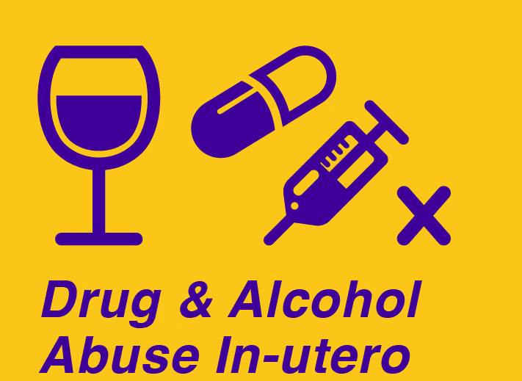
A cycle of disempowerment
20
21
- 2
19
- 1
18
YOUNG ADULT
IN-UTERO
0
17
1
OLDER TEEN
BABY
16
2
15
3
14
4
YOUNGER TEEN
TODDLER
13
5
12
6
TWEEN
CHILD
11
7
10
9
8
Notes:
Before children are born they are exposed to challenges such as drug and alcohol abuse by their mother in utero, which impacts on a baby’s mental and physical development in what is termed foetal alcohol spectrum disorder, there is also the challenge of 3rd trimester late abortion.
At birth children are at risk of being exposed to the HIV virus and to poor health services that place their life and wellbeing at risk.
They are also at risk of being orphaned given the high rate of maternal death for HIV positive mothers.
Small babies are also at risk of neglect,

Slide 10
A cycle of disempowerment
20
21
- 2
19
- 1
18
YOUNG ADULT
IN-UTERO
0
17
1
OLDER TEEN
BABY
16
2
15
3
14
4
YOUNGER TEEN
TODDLER
13
5
12
6
TWEEN
CHILD
11
7
10
9
8
Notes:
In the first weeks and months following birth, children are at their highest risk of being abandoned by their mothers in either safe or more often unsafe spaces, if they are unable to care for them often due to extreme poverty.
Child trafficking is a challenge due to their vulnerability, and abandoned children often denied birth certificates or identity documentation.

Slide 11
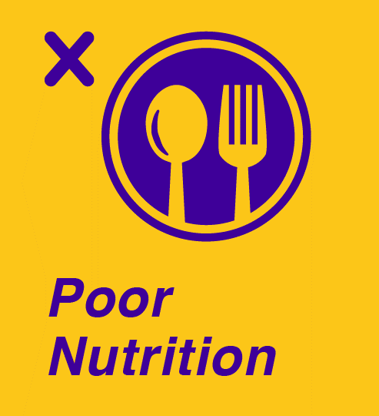
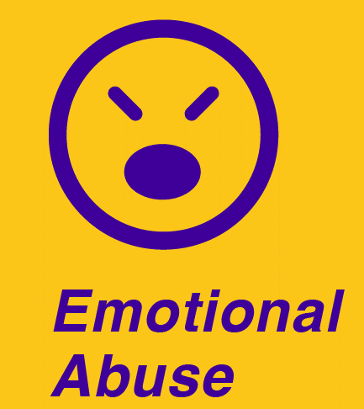
A cycle of disempowerment
20
21
- 2
19
- 1
18
YOUNG ADULT
IN-UTERO
0
17
1
OLDER TEEN
BABY
16
2
15
3
14
4
YOUNGER TEEN
TODDLER
13
5
12
6
TWEEN
CHILD
11
7
10
9
8
Notes:
As they become toddlers and start to question their parents or act out, children are more at risk of physical abuse, attempted murder and murder, and issues such as the impact of bad nutrition start to emerge..
When children start going to school they become subject to issues such as bullying, emotional abuse and corporal punishment, there are also issues around no special needs support for children with disabilities due to lack of resources.

Slide 12
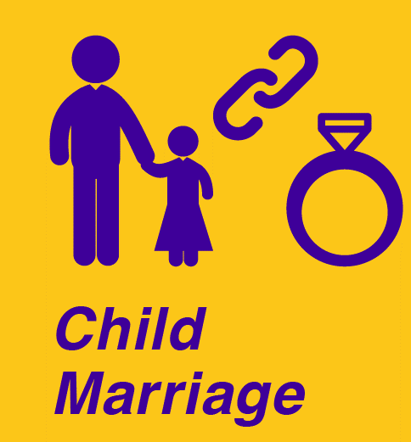
A cycle of disempowerment
20
21
- 2
19
- 1
18
YOUNG ADULT
IN-UTERO
0
17
1
OLDER TEEN
BABY
16
2
15
3
14
4
YOUNGER TEEN
TODDLER
13
5
12
6
TWEEN
CHILD
11
7
10
9
8
Notes:
As they move into their tween years issues such as sexual abuse and rape emerge as do child labour and commercial sexual exploitation.
As children reach puberty issues such as harmful cultural practices such as female genital mutilation or harmful male circumcision and child marriage become an issue.

Slide 13
A cycle of disempowerment
20
21
- 2
19
- 1
18
YOUNG ADULT
IN-UTERO
0
17
1
OLDER TEEN
BABY
16
2
15
3
14
4
YOUNGER TEEN
TODDLER
13
5
12
6
TWEEN
CHILD
11
7
10
9
8
Notes:
Other challenges such as street children, unaccompanied minors, refugees and child headed households emerge, and children are exposed to dangerous environments such as gangsterism and crime.

Slide 14
A cycle of disempowerment
20
21
- 2
19
- 1
18
YOUNG ADULT
IN-UTERO
0
17
1
OLDER TEEN
BABY
16
2
15
3
14
4
YOUNGER TEEN
TODDLER
13
5
12
6
TWEEN
CHILD
11
7
10
9
8
Notes:
As vulnerable children become older teens issues such as mental health, depression, anxiety and suicide attempts start to emerge.
It is also a time when vulnerable children start to engage in risky sexual behaviour, resulting in teen pregnancy, using drug and alcohol, and experiencing abuse in the justice care system when they fall foul of the law.

Slide 15
We will now go through each of the 49 child protection challenges identified by Courage to understand them and prioritise their impact on our community
Notes:
We will now go through each of the 49 child protection challenges identified by Courage to understand them and prioritise their impact on your community.
You will need to decide if they are happening in your community or not, and if they are, how you would prioritise them, as a high, medium or low problems.
It is also important to identify if there are any child protection challenges missing from all the ones that Courage have identified.
If there are, be sure to share these with your group and with the Courage team.

Slide 16
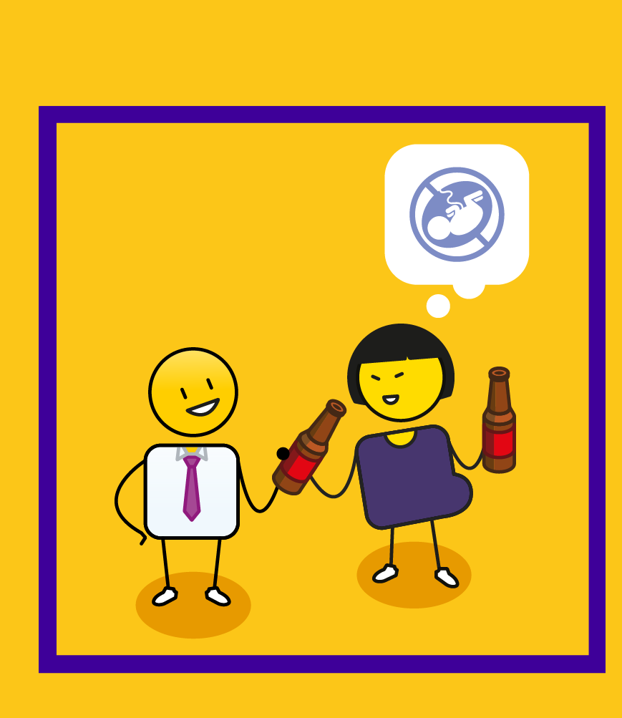
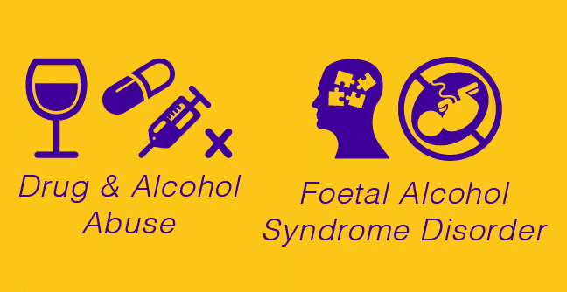
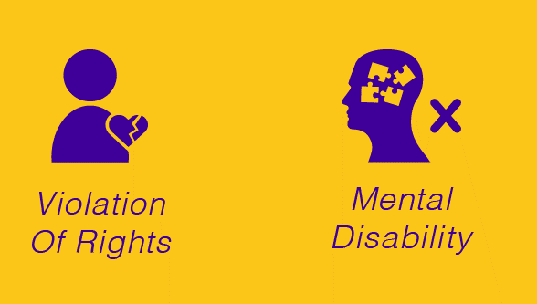
Notes:
The first challenge is drug and alcohol abuse in utero. This is when a mother consumes excessive amounts of alcohol or drugs whilst pregnant. This can lead to a brain disorder called foetal alcohol syndrome or spectrum disorder in an unborn child and is often a result of ignorance by the mother of how what she consumes impacts on her unborn child. An unborn child is still entitled to rights, and this is a violation of their right to live a full and happy life, as they will be born, and have to live with an incurable mental disability that will impact severely on the quality of their lives.

Slide 17
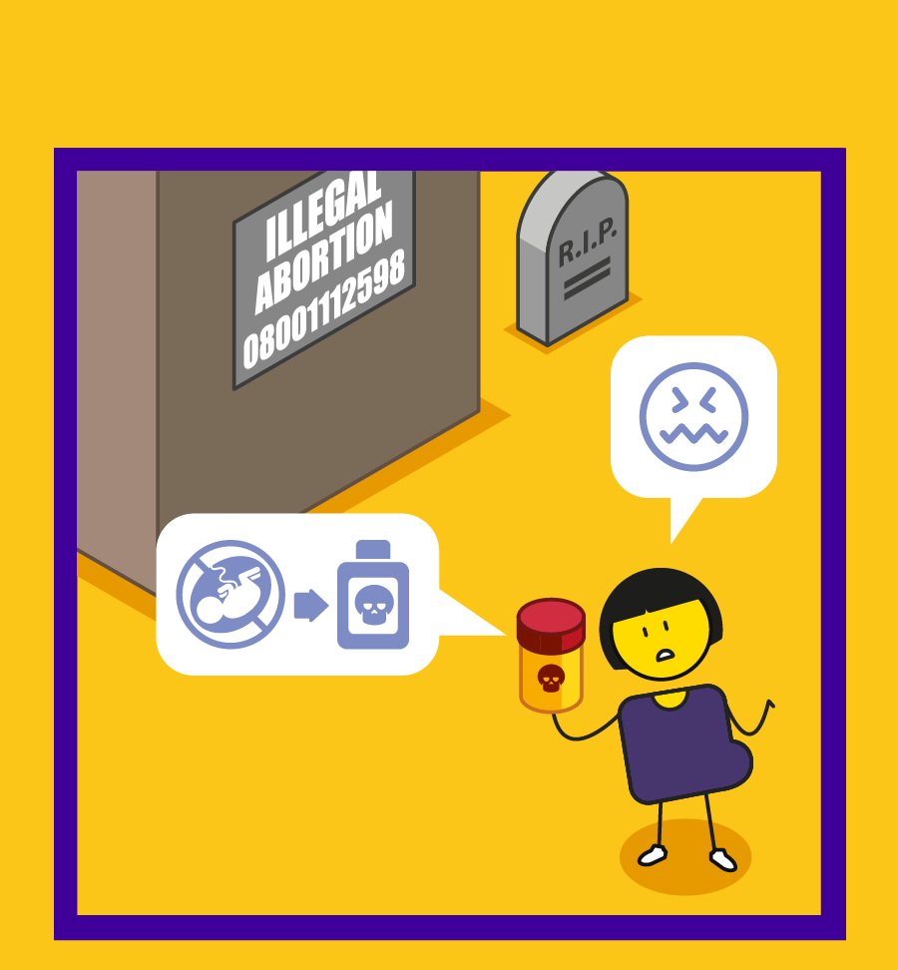
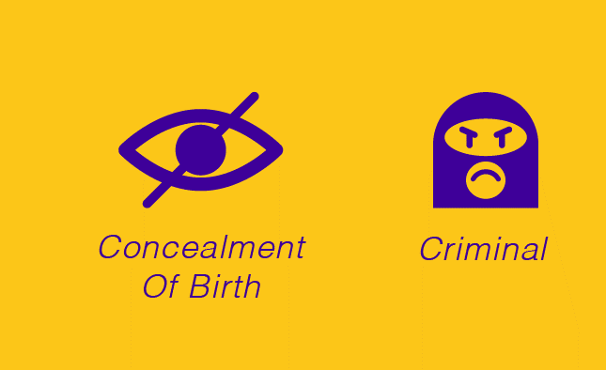
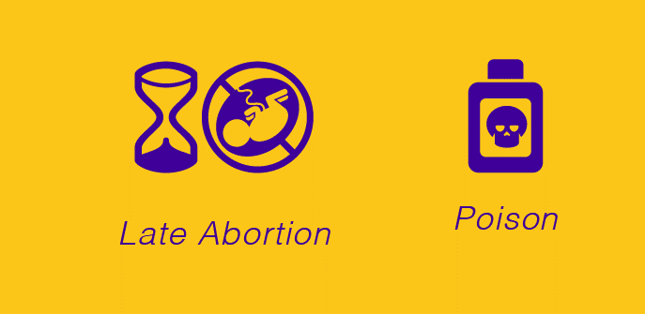
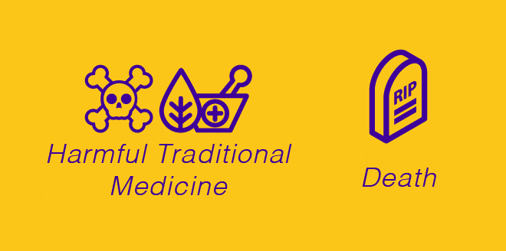
Notes:
Late termination of pregnancy is the legal term for a late abortion, or an abortion that takes place in the third trimester of pregnancy after 6 months gestation. The mother is often given pills by illegal abortion practitioners, poison or harmful traditional medicine that brings on contractions. It can sometimes lead to the death of the mother and very often the death of the child. It is a criminal act, and the mother can be charged with ‘concealment of birth’ if the child dies.

Slide 18
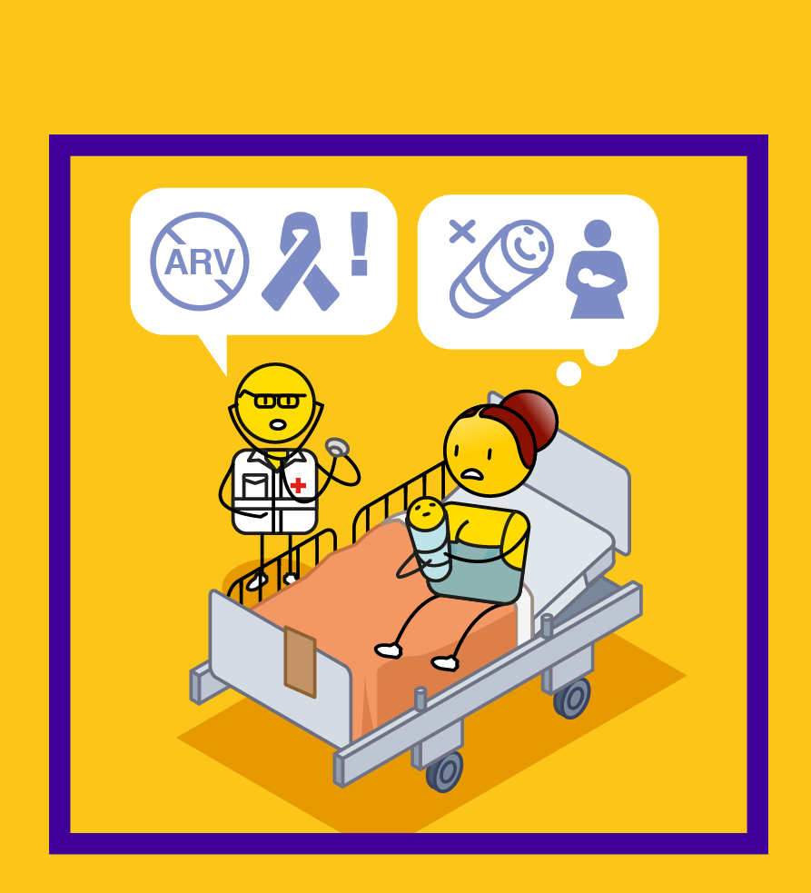
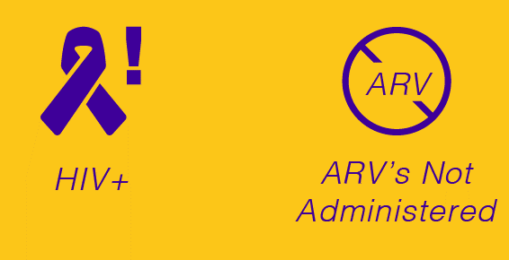
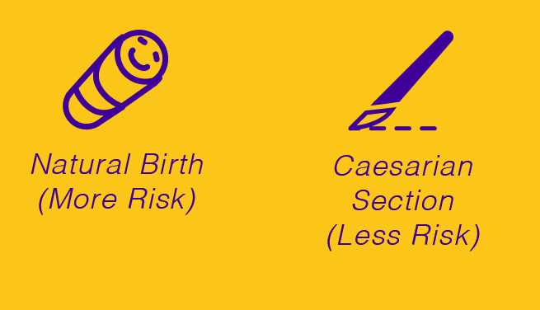
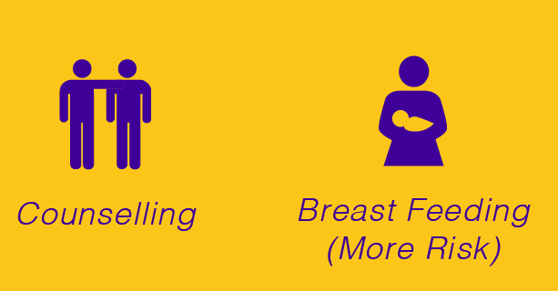
Notes:
Mother to baby HIV transmission which renders a child HIV positive can happen through the birth process if the mother is HIV positive, however, this can be prevented with anti-retroviral or ARV treatment. Natural birth has a higher risk of HIV transmission than Caesarian section, as the child does not pass through the birth canal when born this way. It is important that mothers who are HIV positive are counselled before and after they give birth to ensure that they protect their child from getting HIV. Breastfeeding can also be a risk, but this risk is prevented through exclusive breast feeding (rather than mixed feeding) and with the support of ARV medication.

Slide 19
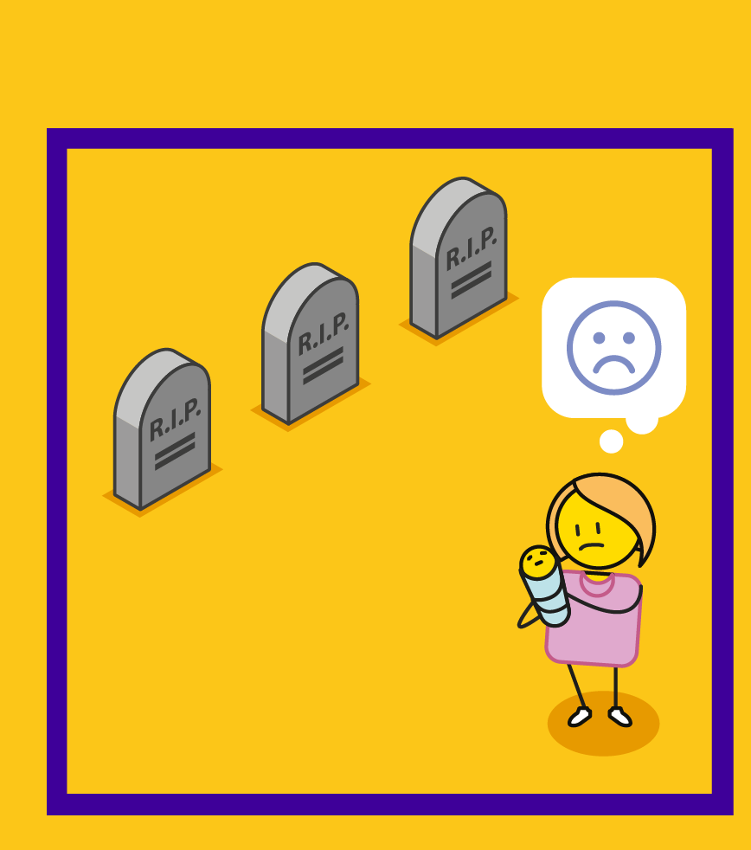
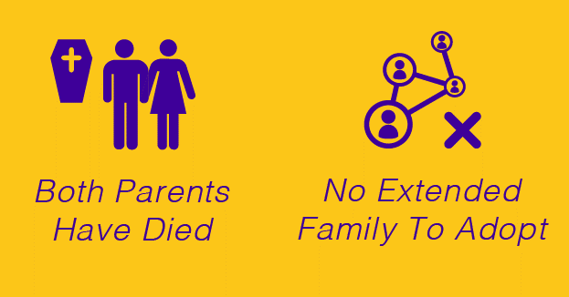
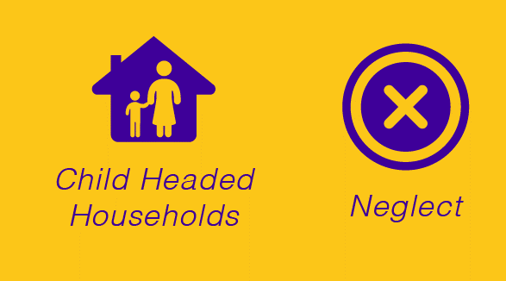
Notes:
A child becomes a full orphan when both of their parents have died. If there is no extended family to take care of the child, it is better for the child to be adopted into a family where they can be looked after and belong. The HIV/AIDS pandemic has resulted in many orphans around the world. The challenge with parents dying of HIV and AIDS is that their children often have to live with the stigma of this disease. In some instances, children have been left in homes to look after themselves in what are termed ‘child headed households’, where older children look after younger children in a family. Children who have been orphaned, are at risk of neglect as they have lost their primary care givers.

Slide 20
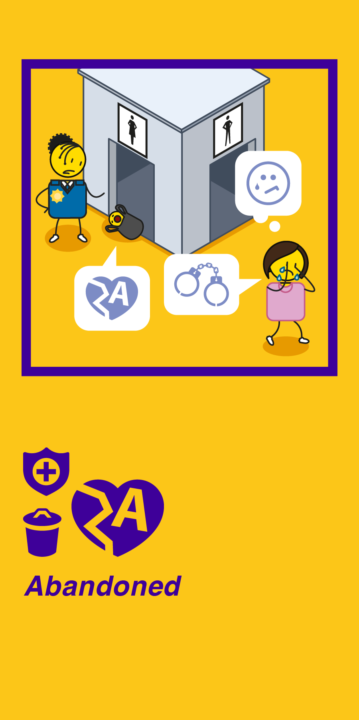
Notes:
Abandonment is when a child has been left by their biological parents or caregivers in a safe or unsafe space for a period of more than three months without any care. In some countries, child abandonment is a criminal act. Unsafe abandonment can often lead to the death of the child.

Slide 21
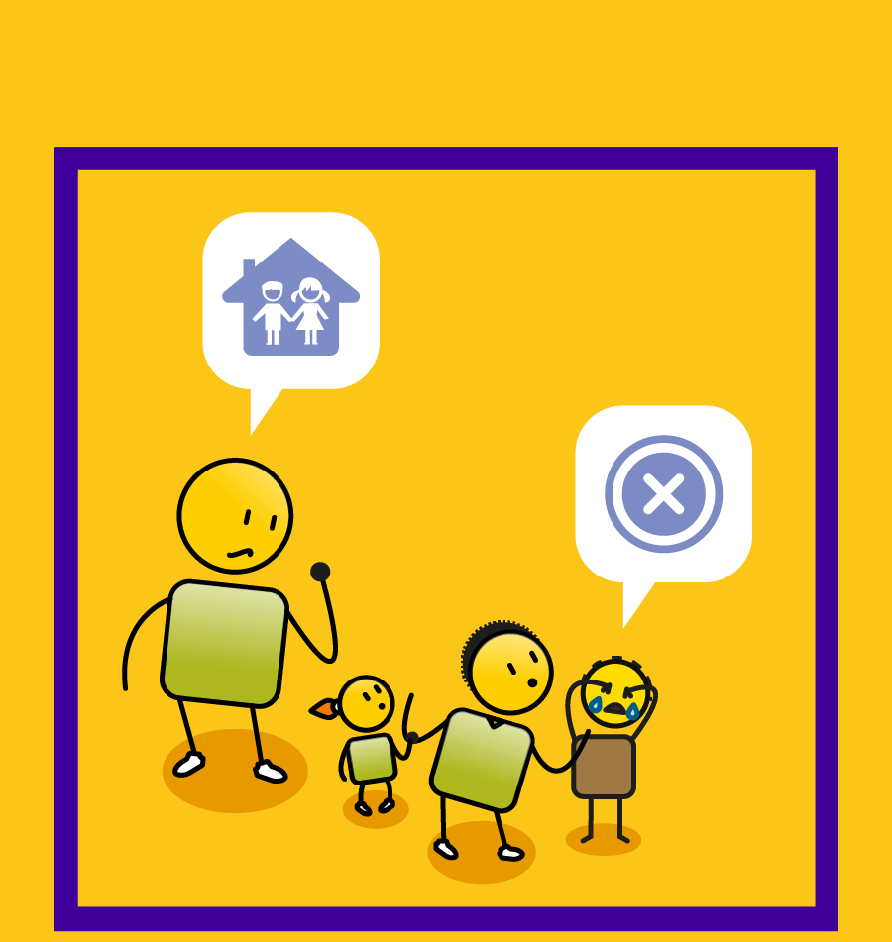
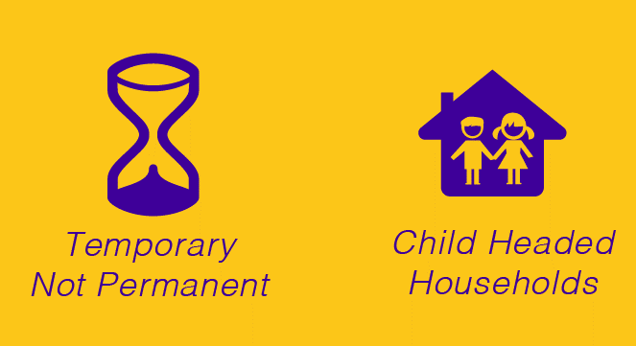
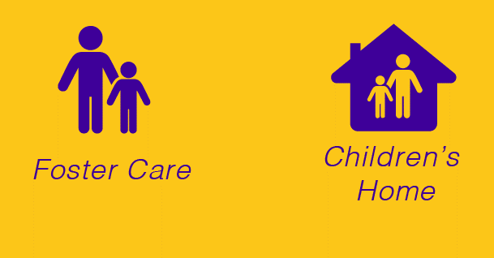
Notes:
No primary love or attachment is when a child does not have a family or a primary care giver who takes care of them and their needs. The child develops no primary attachment to a care giver, and this can lead to long term psychological trauma and mental health challenges. Children are at risk of not developing primary attachment in places of temporary rather than permanent care such as in the foster care system, children’s homes and child headed households.

Slide 22
Notes:
No registration or identity happens when children are denied a birth certificate, identification documentation or citizenship through a passport. This is a basic children’s right, but it is a major problem for children who have been abandoned, or who are refugees. It can lead to feelings of rejection and neglect and a lack of personal identity. It also prevents the children from gaining access to important child protection systems in health, education and welfare.

Slide 23
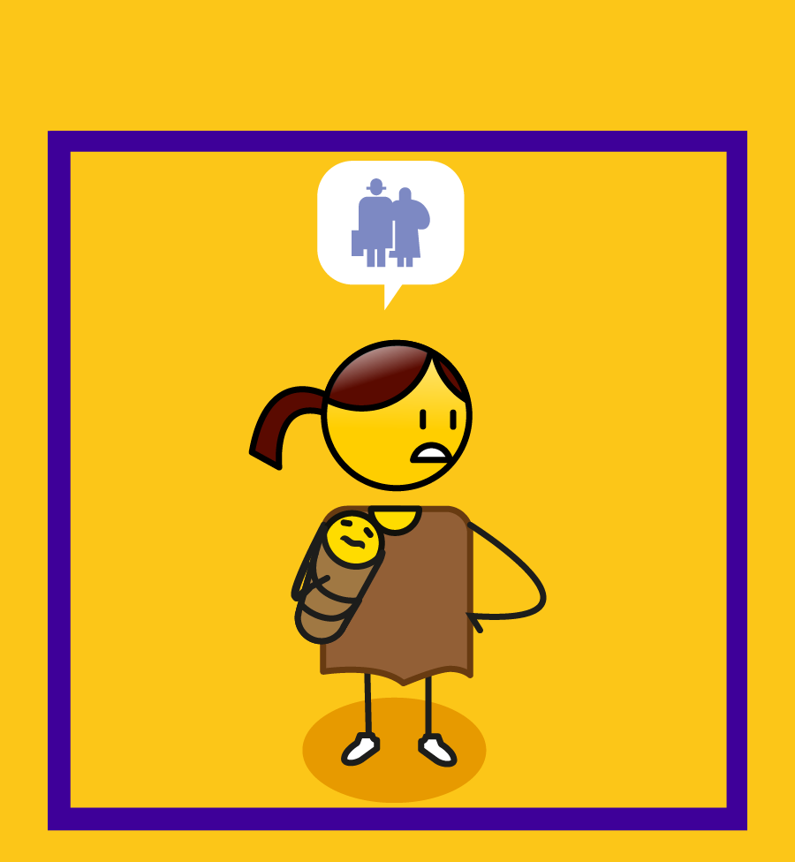
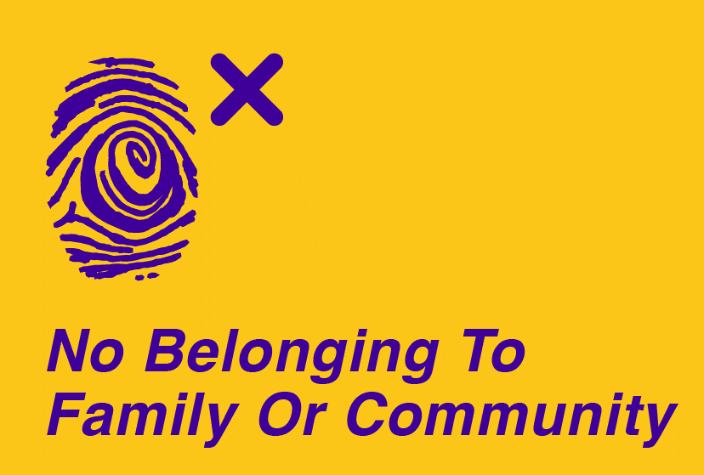
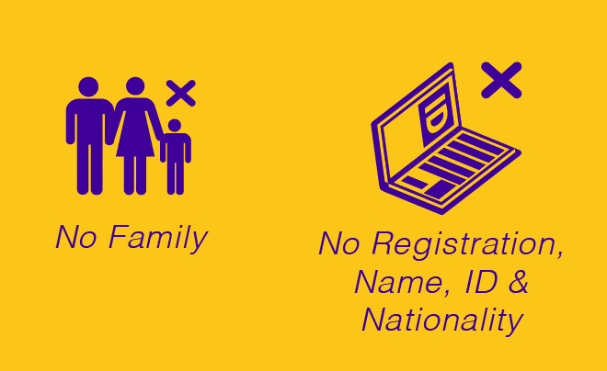
Notes:
No belonging to a family or community is when a child is denied access to a family, registration, a name, identity or nationality. They are denied the right to belong to a community and are treated as refugees who don’t belong anywhere. They are often cut off from their cultural roots and are denied access to services.

Slide 24
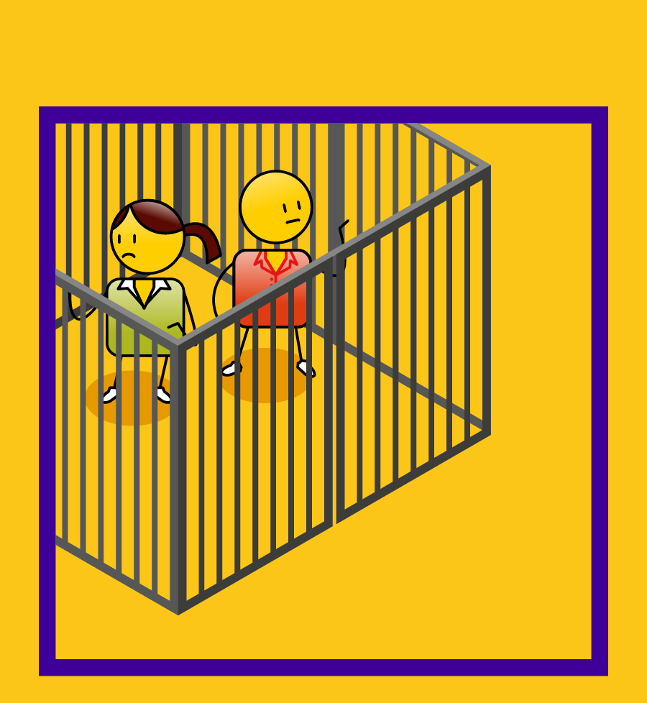
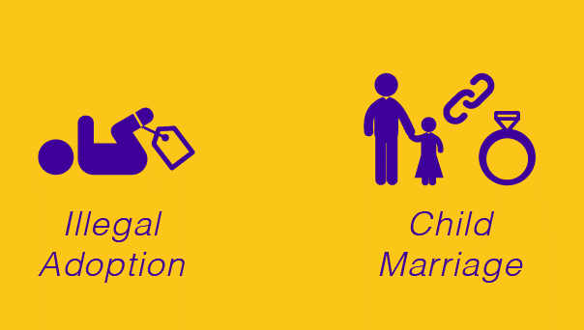
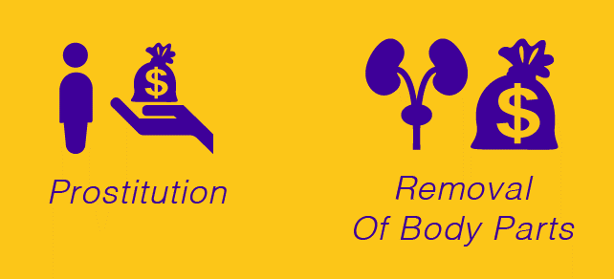
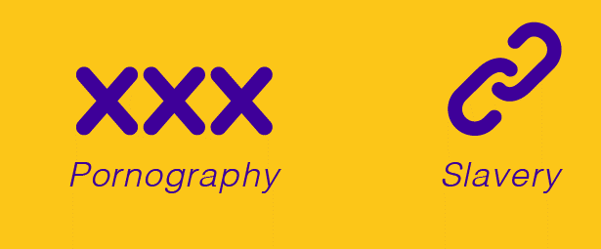
Notes:
Child trafficking is when a child is treated as a commodity that can be bought or sold. It can include illegal adoption, child marriage, prostitution, the removal of a child’s body parts for sale, using a child to create pornographic material or enslaving a child for the purposes of sexual abuse or child labour.

Slide 25
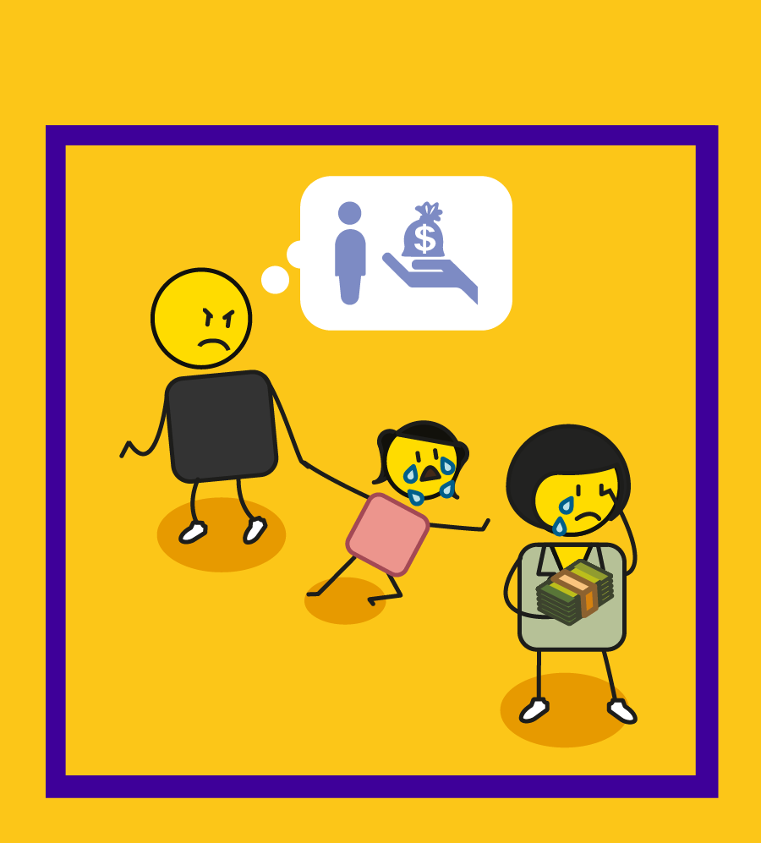
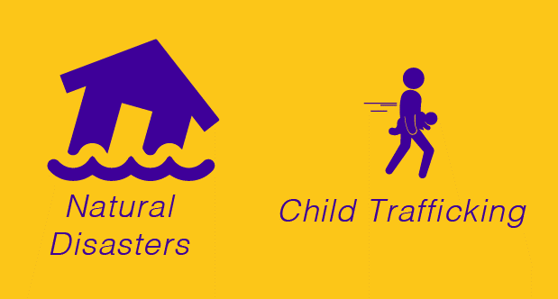
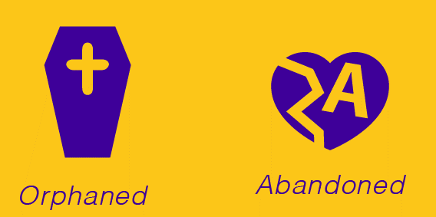
Notes:
A child lacks safety and security when they have no care or protection. Children are especially vulnerable in the wake of natural disasters, civil unrest and war. Vulnerable children are also at risk of being trafficked if they have been orphaned, abandoned or if they have no access to personal registration or identity documentation.

Slide 26
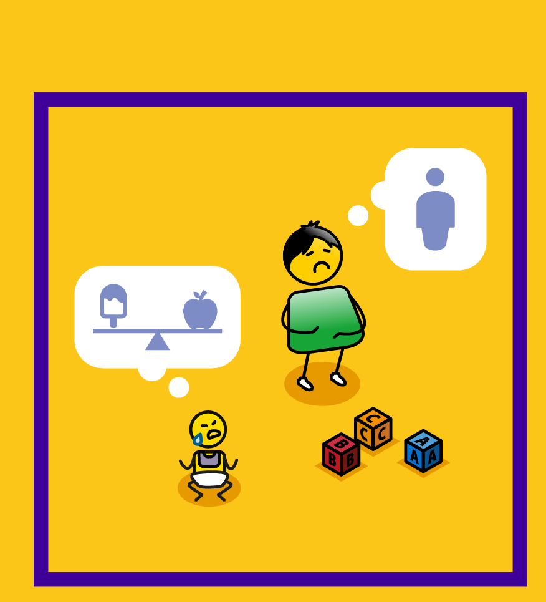
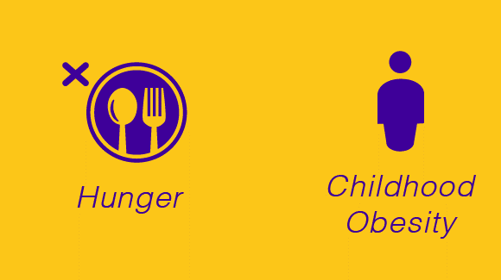
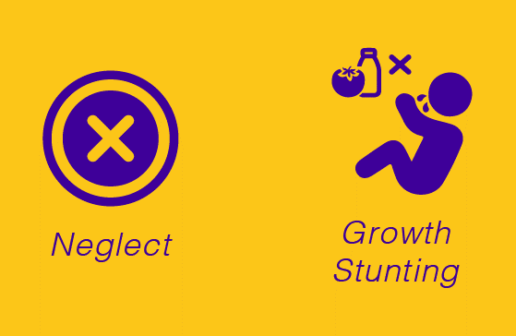
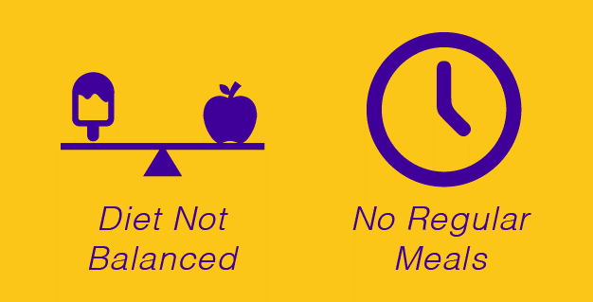
Notes:
Poor nutrition is a major challenge for children around the world. This can include hunger due to not having anything to eat, often driven by poverty, but also relates to being fed the wrong food or not being given a balanced diet, which can lead to childhood obesity or nutritional deficiencies. If a child is not given regular meals and their nutritional needs are neglected it can lead to long term growth stunting and a range of physical and psychological challenges.

Slide 27
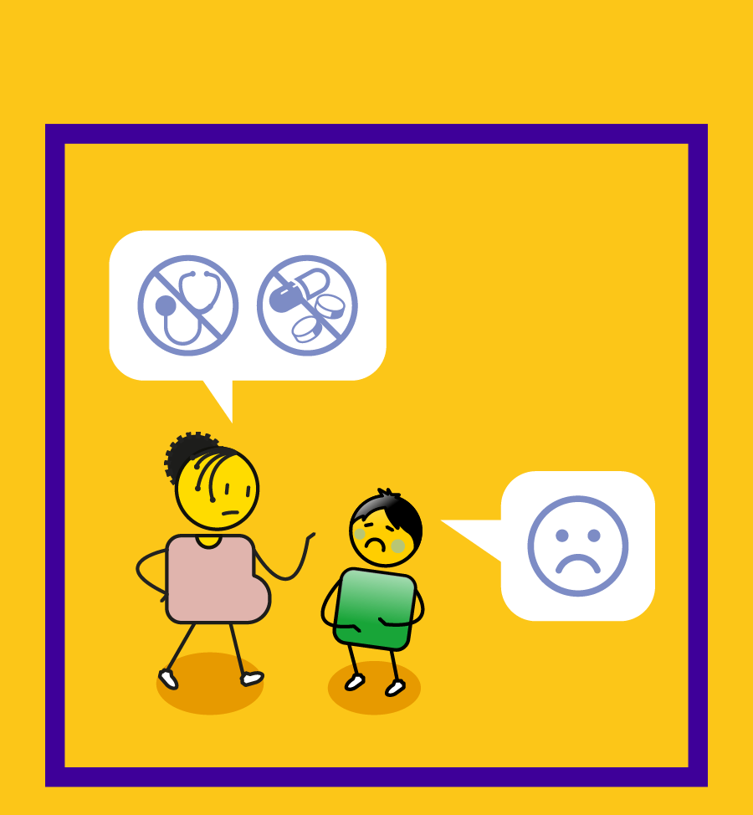
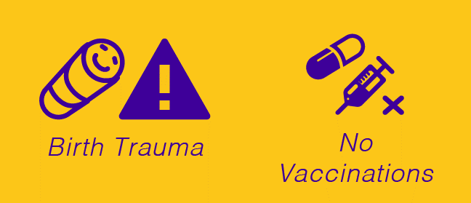
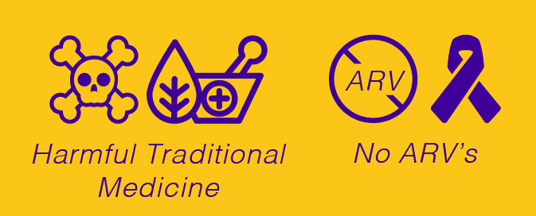
Notes:
All children have a right to basic health care, however, this right is often denied even at birth where many children experience trauma or are not given access to anti-retroviral treatment if they have been exposed to HIV or AIDS. No or poor health care also includes not vaccinating your child against harmful diseases or giving them unregulated harmful traditional medicines.

Slide 28
Notes:
Probably the greatest child protection challenge experienced by children around the world is that of poverty and inequality. Many children are born into households that live below the poverty line, they have no access to food, a stable home, healthcare or reliable care and support. Their poverty also makes them the subject of inequality and discrimination.

Slide 29
Notes:
Physical abuse relates to hitting a child with an object, with your hands or feet, burning a child or shaking a child, often a toddler, excessively so that it causes them physical harm. Physical abuse is often a result of general domestic violence and where children are afforded no care or protection in their home.

Slide 30
Notes:
Murder and attempted murder relates to killing a child or attempting to kill a child either through using a firearm, strangling them, hitting them, poisoning them or abandoning them in an unsafe space when they are unable to look after themselves. A perpetrator will be found guilty of murder or attempted murder if they intended to harm the child and/or end their lives.

Slide 31
Notes:
Neglect relates to not caring for a child that you are responsible for either as their parent or caregiver. It involves not feeding a child sufficiently or correctly, not taking them to a doctor, clinic or hospital for regular check ups or when they are sick, exposing them to drugs and alcohol and not looking after a child’s personal hygiene when they are too young to do it themselves. It also relates to not registering and taking them to school, and generally not supervising, caring or providing for them as they develop and grow.

Slide 32
Notes:
Emotional abuse relates to not caring for or loving a child that is your responsibility. This can also relate to not feeding, changing or holding a baby or child. It also includes threatening, scaring or discriminating against a child, ignoring or isolating them or restricting their movement. Emotional abuse is often a result of domestic violence and where a child is afforded no care or protection in their home.

Slide 33
Notes:
Sexual abuse or assault refers to fondling or unwanted sexual touching of a child, forcing a child to perform sexual acts, such as oral sex or penetrating their perpetrator’s body. Rape refers to any penetration of a child’s vagina or anus with any body part or object, or oral penetration by a sex organ without the child’s consent. Each country has a legal age of consent, in most cases this is 16 years of age or younger. This means that if a person older than 16 years has sex with a child who is 16 years or younger, they can be found guilty of statutory rape. Incest refers to sexual abuse or rape conducted by a close family member such as a parent, sibling or grandparent. Sexual abuse can also refer to the sexual harassment of a child, the creation of child pornography or forcing a child to watch pornography. Sometimes sexual abuse and rape is linked to harmful cultural practices such as the incorrect belief that raping a child will cure a disease such as HIV and AIDS.

Slide 34
Notes:
All children have a right to education, but this right is often denied either through not offering access to educational institutions or discriminatory practices such as denying school to girl children or undocumented refugees. A child is also denied an education if they experience abuse at their school such as through the use of corporal punishment. Not registering or taking your child to school is a form of neglect.

Slide 35
Notes:
Denying a child access to play or recreation is a form of abuse and neglect. All children need to play to develop into well rounded human beings, it is a critical part of child development. Denying children access to recreational facilities, to safe and secure places to play, or opportunities for physical development is a major child protection challenge that also restricts their social interaction and development with other children.

Slide 36
Notes:
All children have a right to personal development at a physical, mental, emotional and social level. Children also need to develop morally, and it is the responsibility of their parents or care-givers to ensure that they have opportunities for personal development and growth throughout their childhood.

Slide 37
Notes:
If a child is born with, or develops, a physical, mental, learning or social disability they are entitled to special needs support. This also includes ensuring access to public institutions and environments such as ramps for wheel-chair users, additional support for blind and deaf children that accommodates for their lack of sight or hearing, and the equipment or therapeutic support they need in health, education and society, to become full and participating members of their community. A lack of service delivery when it comes to special needs support is an infringement of their basic human rights.

Slide 38
Notes:
Child labour is work that deprives children of their childhood, their potential and their dignity, and that is harmful to their physical and mental development. It refers to work that interferes with their schooling or education, and that leads to physical, mental and/or moral decline. It also refers to work that is dangerous to the child, or that is conducted in a hazardous workplace. Not all work conducted by children is considered child labour, as it can be a means for personal development and family support, however, if the work impacts negatively on the wellbeing of the child it should be assessed accordingly. .

Slide 39
Notes:
Corporal punishment refers to the physical punishment, often through flogging or caning with an object, of a child in the home, school or intuitional environments. It is illegal in many countries. Corporal punishment is often associated with victimization, abuse and domestic violence, where a child is afforded no care or protection in their home.

Slide 40
Notes:
Bullying is when a person, who can be another child, seeks to threaten, harm, intimidate or coerce a child. It is a form of abuse and harassment and can be done in person or via the internet or social media. It can involve digital pornography such as posting intimate pictures of a child on the internet. It can also involve ignoring or isolating a child and often leads to mental health challenges such as depression.

Slide 41
Notes:
Children with disabilities are often subjected to higher rates of physical, emotional and sexual abuse due to their vulnerability. They are also often subjected to bullying due to their disability and difference. Abuse of children with disabilities occurs when they are not cared for and protected properly and when they are not given the services and support, they need to become full and equal members of their community and society.

Slide 42
Notes:
Commercial sexual exploitation relates to any sexual activity involving a child in exchange for something of value or the promise of something of value. This includes prostitution, pornography, including digital or internet based pornography, stripping, erotic or nude massage, phone sex, escort services, gang based prostitution, interfamilial pimping and any form of internet-based exploitation. This can also include child marriage, where a child is exchanged for a bride price, which is a form of harmful cultural practices.

Slide 43
=
Notes:
Female genital mutilation or circumcision involves the surgical removal of all or part of a girl’s external female genitalia, or other injury to the female genital organs for non-medical reasons. It is a form of harmful cultural practices as it discriminates against girls and women and is driven by traditional beliefs in patriarchy and gender inequality. The surgery is medically unnecessary, but driven by cultural beliefs, and often causes a number of problems for the girl including infection and death. In the long term it can lead to significant health challenges especially when it comes to childbirth and female reproductive health.

Slide 44
=
Notes:
Harmful male circumcision refers to the unhealthy removal of a boy’s foreskin, usually during traditional manhood ceremonies. Male circumcision is not necessarily harmful to a child, but when it is conducted in unsafe and unhygienic environments it can lead to infection and possibly amputation or death if the boy is unable to access adequate health care.

Slide 45
Notes:
In some societies and communities, children can become victims of accusations of witchcraft due to superstition, cultural beliefs and fear. This can result in them being discriminated against, abused, stigmatized, isolated, neglected and even killed, and is an example of a harmful cultural practice.

Slide 46
=
Notes:
Virginity testing is the practice and process of determining whether a girl is a virgin through the physical examination of her hymen. This is driven by cultural beliefs in patriarchy. It is a harmful cultural practice as it discriminates against girls, it infringes on their personal dignity and is often unreliable which can lead to stigma and abuse.

Slide 47
Notes:
Child marriage is any marriage where at least one of the parties is under 18 years of age. Forced marriage is a marriage in which one or both parties have not personally expressed their full and free consent to the union. These unions often involve some form of financial or material gain for the parents or family of the children being forced to marry. And exposes the children to the possibility of slavery, rape, and being denied an education. Child marriage is often a result of cultural beliefs and is an example of harmful cultural practices.

Slide 48
Notes:
The use of body parts in the making of traditional medicine is a harmful cultural practice. These body parts are often harvested in traditional ceremonies that cause enormous pain, suffering and often death for the children involved. Children are often targeted for this form of traditional medicine due to their vulnerability and the incorrect belief that their innocence or purity will make the medicine or muti stronger. Creating or selling this medicine is a criminal offence. It is often linked to child trafficking and murder, and the medicine itself is often dangerous and poisonous when consumed.

Slide 49
=
Notes:
Harmful cultural practices is the umbrella term for all activities performed in the name of cultural beliefs that cause harm to a child. This includes the belief in patriarchy, or that men are more important and have more value than women or children, and practices such as female genital mutilation, harmful male circumcision, accusations of witchcraft, the use of body parts for harmful traditional medicine, virginity testing and child marriage.

Slide 50
Notes:
A child-headed household is one where there are no adult carers available, and children live on their own. Usually, an older child will care for siblings, cousins, nephews or nieces. These households are more common in areas with high AIDS mortality and regions affected by genocide or war. The challenge of having children taking care of children is that they often find it difficult to access social support due to their status as children. Child headed households are often affected by poverty and struggle to access food, healthcare and education. It is also difficult for children to take on the responsibility for the care and protection of their siblings, whilst also trying to study and develop themselves, this places an enormous amount of stress on the child caregiver.

Slide 51
Notes:
Street children leave their homes to live or work on the streets locally, remaining within their home countries, or traveling to bordering or other countries to seek employment opportunities. These children are often refugees living in poverty with no care or protection from their families, communities or the state. They are extremely vulnerable to exploitation through challenges such as child trafficking, child labour and prostitution.

Slide 52
Notes:
Physical, emotional and sexual abuse can also take place in the justice and care system such as in jail, in court or in a children’s home or foster care. Children can be victimised when trying to report abuse, as the investigative process is not designed to accommodate their vulnerability. Sometimes the criminal justice process can be abusive or amplify a child’s experience of abuse, such as when court cases are unreasonably prolonged, making the child re-live their traumatic experiences over and over again.

Slide 53
Notes:
Children can be exposed to many forms of discrimination, which is the unjust or prejudicial treatment of different categories of people. These different categories include sexual or gender-based discrimination often driven by beliefs in patriarchy, racial or cultural discrimination, agism where they are discriminated against by virtue of their status as a child, sexual orientation, nationality, economic status, religious affiliation, political status, as in the example of discrimination against refugees and immigrants, and discrimination against disabilities and different ways of being in the world.

Slide 54
Notes:
Not giving children access to justice or legal protection is a form of child abuse. This can include being denied access to legal identity documentation such as a birth certificate or a passport, not giving children access to legal recourse or representation, not respecting their right to privacy, not protecting them from harm, treating them as a criminal without cause and subjecting them to abuse in the justice care system.

Slide 55
Notes:
Gender Based Violence is violence directed against a person because of that person's gender, or violence that affects persons of a particular gender disproportionately, and is often a result of social norms about roles and behaviour expected of each gender. It often occurs within relationships, and can include physical, emotional and sexual abuse, domestic violence, harmful cultural practices such as virginity testing, female genital mutilation or circumcision, and forced marriage. It can also include stalking, sexual harassment, forced abortion or sterilisation and unacceptable justifications for crimes, including crimes committed in the name of so-called honour. Many of these challenges are a result of cultural beliefs where one gender is prioritised over another, as in the case of patriarchy.

Slide 56
Notes:
Violence against sexual minorities includes violence aimed at individuals who identify, or are perceived as lesbian, gay, bisexual, transgender or queer, sometimes referred to collectively as the LGBTQI+ community. It can include physical, verbal and sexual abuse, as in the case of ‘corrective rape’, bullying or isolation either in person or online, and is often a result of ignorance, or discriminatory cultural or religious beliefs.

Slide 57
Notes:
Many children are exposed to gangsterism, which is the culture of belonging to organized gangs of criminals, often from a very young age, in their own family or community. Gangsterism exposes children to extreme violence, rape, drug and alcohol abuse, criminal behavior, dangerous weapons and the practice of corruption.

Slide 58
Notes:
Self harming and suicide is the practice of injuring or hurting oneself either with or without the intent to die. A suicide attempt is when someone harms themselves with any intent to end their life, but they do not die as a result of their actions. A suicide is when their attempts to end their life are successful. Self harming can include eating disorders, or abnormal eating behaviour, cutting or burning oneself, drug or alcohol abuse and asphyxia, and is often associated with depression.

Slide 59
Notes:
Addiction is an inability to stop using a substance or engaging in a behaviour even though it is causing psychological and physical harm to oneself. A person can be addicted to drugs, alcohol, gaming and sex amongst other things. Addiction is associated with self harming behaviour and depression, and can lead to domestic violence and family strife.

Slide 60
Notes:
Teenage pregnancy is when a woman under 20 years of age gets pregnant. It usually refers to teens between the ages of 15 and19, but can include girls as young as 10. It is a result of young women who have started menstruating having sex without using any contraceptive protection. It is sometimes a result of consensual risky sexual behaviour but can also be a result of non-consensual incest or rape. Young girls often don’t know that they are pregnant until well into their second trimester, and don’t or can’t access appropriate medical care and support. They are often isolated and ridiculed by their family and community and it can have a detrimental impact on their ability to complete their schooling or education.

Slide 61
Notes:
Some young women are treated very badly when they fall pregnant, even if their pregnancy is a result of incest or rape. They can be physical and emotionally abused, lack financial and medical support and be isolated and stigmatized for their condition. At a time when they need more support than ever, they are often denied the love and care of their partner, family and community and this can result in them making desperate decisions such as late abortion and child abandonment.

Slide 62
Notes:
As children are vulnerable, they are often more at risk in times of social unrest. Social unrest includes acts of civil disorder, mass civil disobedience, riots, war or any armed conflict. This includes gangsterism and terrorism which are often a result of economic inequality, and political or religious intolerance or opposition. In these environments children are at risk of being exploited through challenges such as the use of children for acts of terrorism, as child soldiers or as participants in gangsterism and organized crime.

Slide 63
Notes:
Children are also vulnerable to radicalization and terrorism, which is the action or process of causing someone to adopt radical positions on political or social issues. Children are encouraged or forced to destroy property, harm other people or take part in armed conflict or organised crime and gangsterism, often under the guise of religious, cultural or political difference or intolerance.

Slide 64
Notes:
Not respecting or protecting children’s individual freedoms and liberties is also a child protection challenge often driven by a lack of respect for children and their role in society. This includes not allowing children freedom of expression, association, religion, sexual orientating or creativity. Children are often also unfairly discriminated against in the sphere of gaining financial freedom, through being denied educational or career opportunities.

Slide 65
Agree your high, medium and low priority challenges
Notes:
Once you have gone through all of the child protection challenges and prioritised them, you should have four piles of cards or four lists. These different piles or lists will help you to prioritise which problems needs to be addressed in your community. Starting with your high priority challenges, followed by medium priority challenges and finally your low priority challenges. The pile of challenges that do not exist can be put to one side, but it is useful to understand what these challenges are, so that if they do start to appear, you can recognise them and address them accordingly.

Slide 66
Notes:
Here we can see workshop participants placing their cards into high, medium, low or does not exist piles. This is an important step in building understanding in the process of change.

Slide 67
stay strong
take
www.couragechildprotection.com
Notes:
Thanks for watching.
For more information visit Courage Child Protection dot com
Be sure to like this video and subscribe to our Courage Channel.
Stay strong and take courage.

