Slide 1
Identifying the child protection challenges in your community
www.couragechildprotection.com
Notes:
This Courage Presentation helps you to identify the child protection challenges happening in your community.

Slide 2
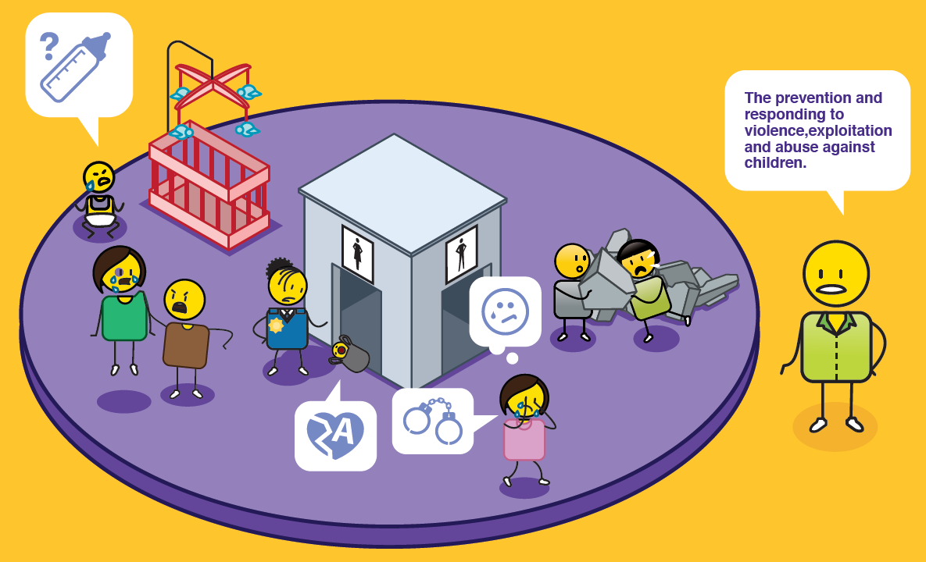
What is child protection?
Notes:
Child protection is the prevention and responding to violence, exploitation and abuse against children.

Slide 3
Identifying the child protection challenges happening in our community
Notes:
Before we can start to solve our child protection challenges, we need to identify what challenges are taking place in our community and why they are happening?

Slide 4
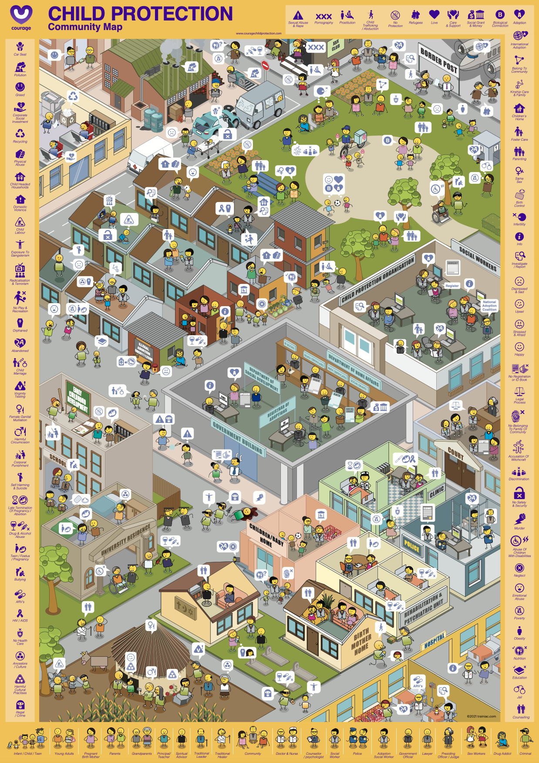
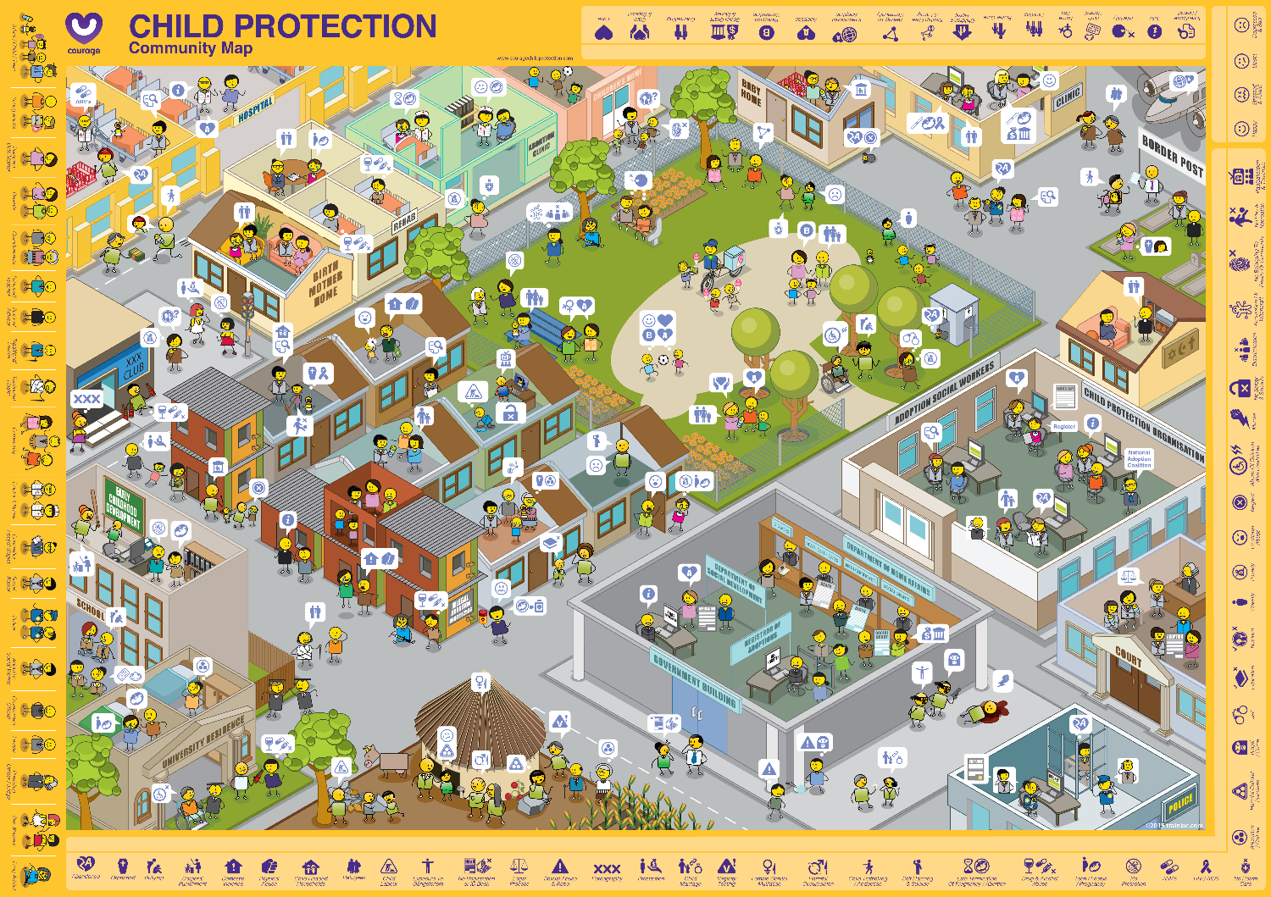
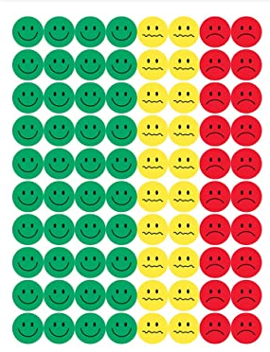
Useful courage tools
courage community map and stickers/buttons
Projection of map and white board markers
or
Notes:
These are some useful tools that will help you to identify the child protection challenges and their drivers in your community, which you can download from the Courage Child Protection Website or order a printed version online.
As stimulus for your child protection identification exercise you can either use:
An A1 Courage Community Map which is available in portrait or landscape format and some coloured buttons or stickers.
Or you can play this video and ask participants to list child protection challenges that they have seen in their community.
Or you can download and project the Courage Community Map from the presentation format off our website, and use coloured marker pens to identify your community’s child protection challenges.

Slide 5
Notes:
This is the Courage Community Map, and represents a community anywhere in the world.

Slide 6
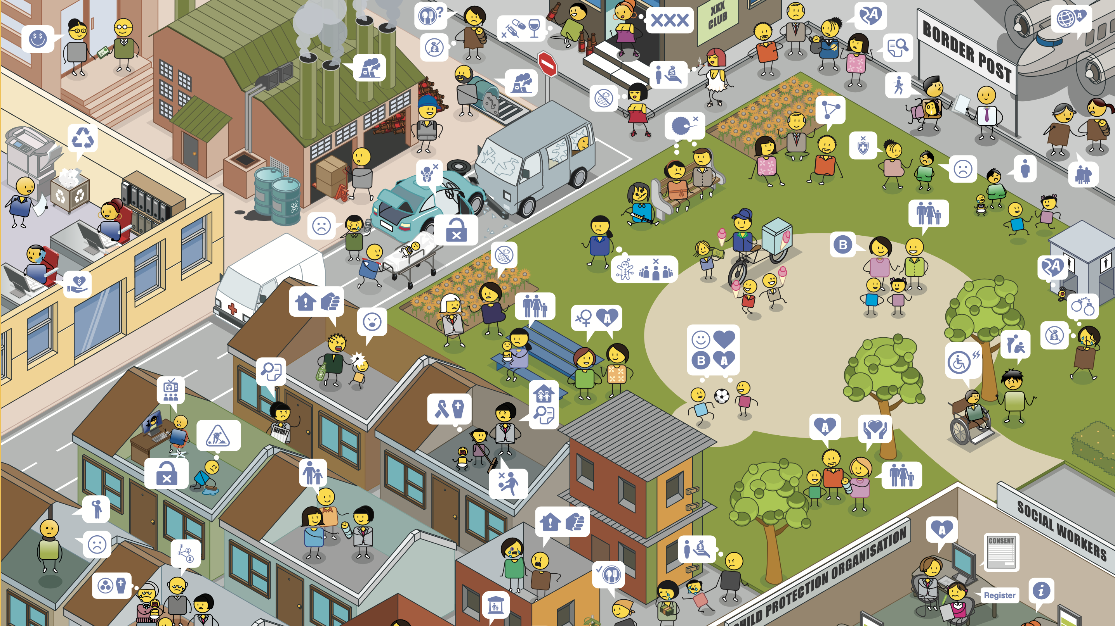
Notes:
Starting in the top left-hand corner and moving right, you will see different kinds of companies, main roads, night clubs, bars and border posts.
Moving down, you will see public spaces such as parks where people can relax and meet friends outside, and then there are different kinds of residential areas.

Slide 7
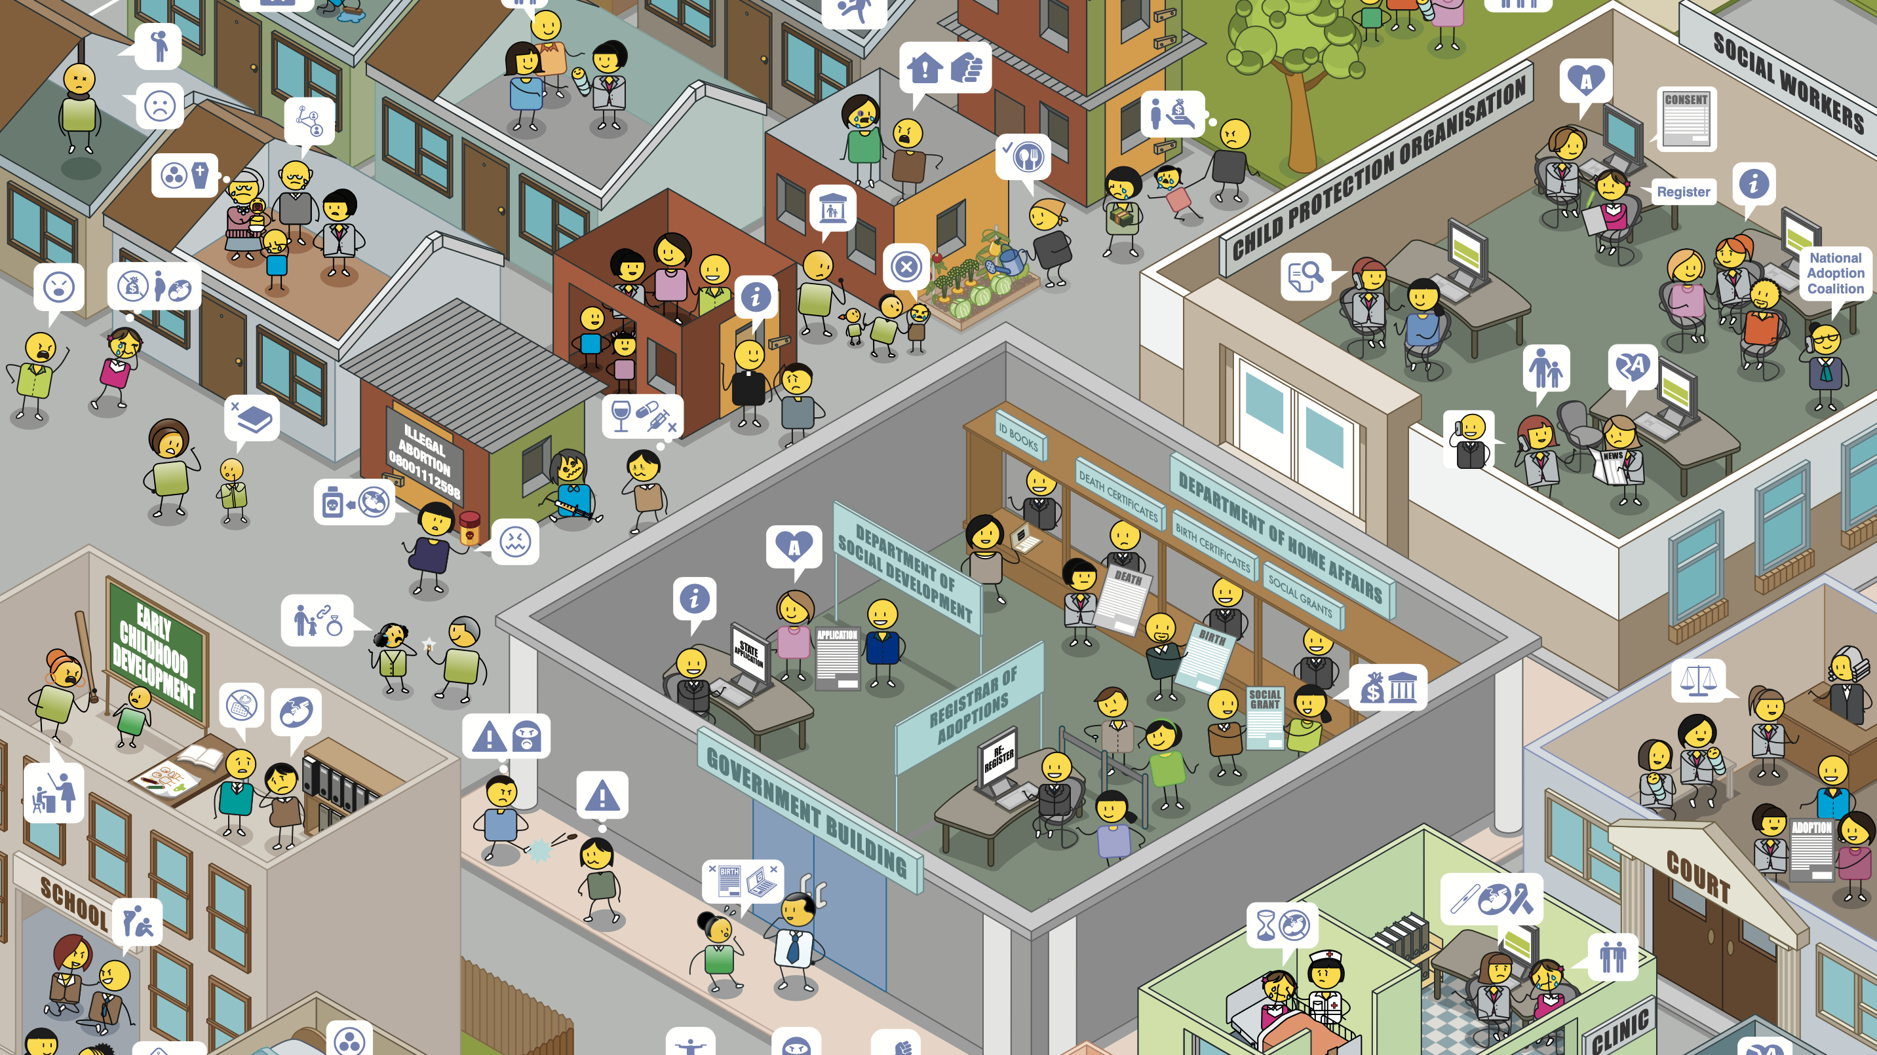
Notes:
Some residential areas have formal houses, and some have informal houses as you can see in the middle of this community map.
There are also child protection organizations, social workers, courts, clinics and government departments that span a number of different areas such as home affairs and social development.
Moving back to the left of the map, you will see early childhood development centres or creches and schools.

Slide 8
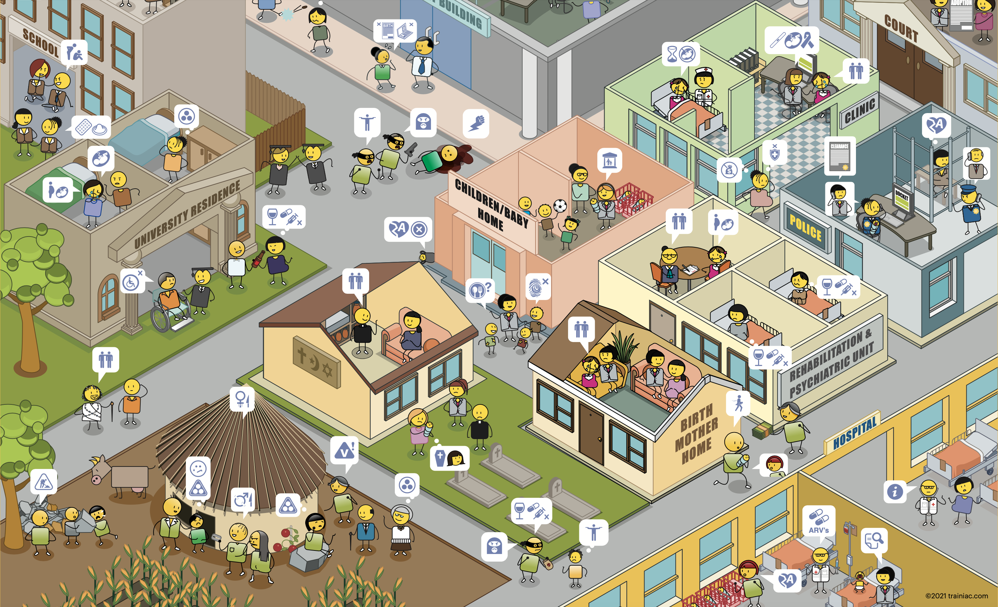
Notes:
In addition to schools there are universities and places of post graduate study.
You will also find religious intuitions, baby and children’s homes, a range of different health clinics, police stations, rehabilitation and psychiatric units, birth mother homes and hospitals.
Finally in the bottom left-hand corner you can see a home that is situated in a rural area, where people may go to visit their family and where they have come from.

Slide 9
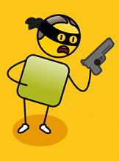
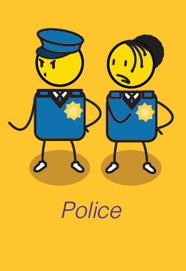
Community members
Criminal
Notes:
There are different kinds of people in this community from children to families, spiritual, traditional and community leaders, doctors, nurses, social workers, police officers and government officials. There are also people who struggle to fit into communities such as drug addicts or those with criminal intent.

Slide 10
Child protection conversations
Notes:
The people in the community are having lots of different conversations about the child protection challenges happening in their community. We have used a child protection emoji language to illustrate these conversations.

Slide 11
What challenge have we seen?
What are some of the child protection challenges that you have seen in your community?
Using the red stickers or buttons identify what these challenges are on the community map
Notes:
For this exercise, you will want to ask your participants to identify all of the child protection challenges that they have seen or observed in their community.
They can identify these using stickers, buttons, markers on a printed or projected community map, or just by listing them on a piece of paper.
If your participants are working in a group, suggest that they spend some time describing their community to the rest of the team, so that they understand the context of the challenges that they identify.

Slide 12
What promotes or prevents these challenges?
What do we think is causing these problems in our community?
What do we think could prevent these problems in our community?
Notes:
Once they have identified all of their challenges, ask them to make a list of all of the things that they think are causing the challenges in their community and another list of all of the things that they think can prevent these challenges from taking place.

Slide 13
Notes:
If you are using this presentation as the workshop stimulus, you may want to press pause now, so that participants can spend some time exploring the community map (Press Pause Now).

Slide 14
Notes:
This was a group of child protection officers identifying the child protection challenges in their community. Once they had acknowledged that the challenges existed, they could start to work towards solutions to solve them.

Slide 15
The process of change*
HOLDING ON
LETTING GO
MOVING ON
MOVING FORWARD
DENIAL
TESTING
SHOCK
* Inspired by Elisabeth Kubler Ross Stages of Grief
CONFIDENCE LEVELS
AWARENESS
UNDERSTANDING
ACCEPTANCE
TIME
Notes:
This exercise, of identifying child protection challenges and what promotes or prevents them, is very important if we want to solve these problems.
When something bad happens in a community such as the rape or abuse of a child. People will go through a number of stages in trying to make sense of this terrible event.
They will go through shock, “I can’t believe this has happened”.
They may even go through denial, “perhaps this didn’t happen and the child is lying?”
But often more evidence will emerge and the community will become aware and finally accept that there is a problem in their community and amongst their families.
Although child protection challenges such as abandonment, neglect, abuse and exploitation rock the very foundations of our communities, we cannot solve these problems until we accept that they are, in fact, taking place.
As quickly as possible, we need to move our communities into understanding and testing new ways of doing things to make sure that these kinds of challenges don’t happen again.
This exercise is critical, as it moves people on from holding onto the past, to letting go and finally moving forward as a stronger community intent on the care and protection of their children.

Slide 16
stay strong
take
www.couragechildprotection.com
Notes:
Thanks for watching.
For more information visit Courage Child Protection dot com
Be sure to like this video and subscribe to our Courage Channel.
Stay strong and take courage.

