Slide 1
take
www.couragechildprotection.com

Slide 2
take

Slide 3
If we have rights, what are our responsibilities and what should we believe in to ensure we deliver on our child protection vision?
Notes:
If we have rights, what are our responsibilities, and what should we believe in to ensure we deliver on our child protection vision?

Slide 4
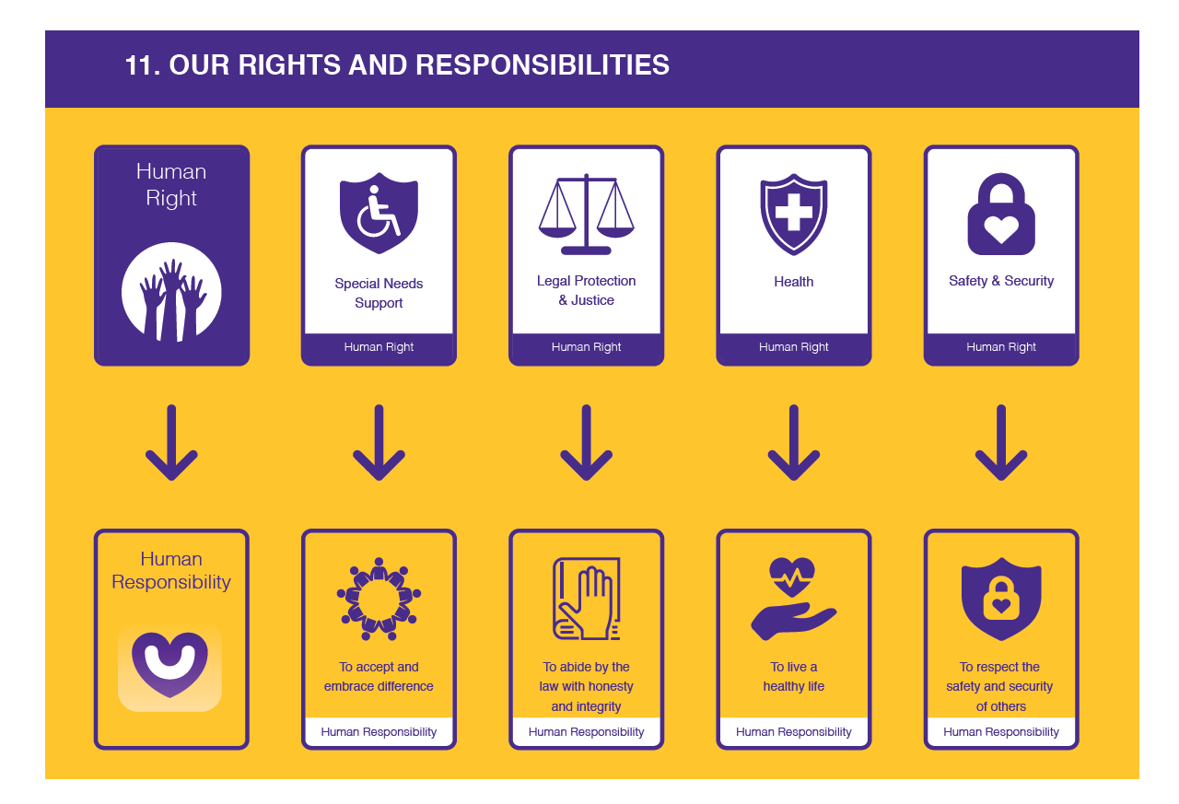
Notes:
Overview

Slide 5
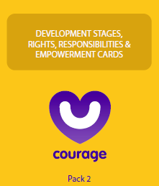
Useful courage tools
Courage child rights and responsibilities cards
or
Courage rights and responsibilities video or presentation
Notes:
Useful Courage tools to assist you in understanding both your rights and responsibilities can be found in the yellow Courage Empowerment Card pack. You will find 20 rights cards which can be matched to 20 responsibility cards. You can also watch the Courage rights and responsibilities video or presentation.

Slide 6
Self esteem & self worth
Notes:
This exercise relates to the empowerment driver of SELF ESTEEM & SELF WORTH.

Slide 7
What should we ask?
If these are our rights, what are our personal responsibilities to our community and the society in which we live?
Notes:
Match the human rights cards to human responsibilities.

Slide 8
Rights to responsibilities?
?

Slide 9
Rights to responsibilities?

Slide 10
Rights to responsibilities?
?

Slide 11
Rights to responsibilities?

Slide 12
Rights to responsibilities?
?

Slide 13
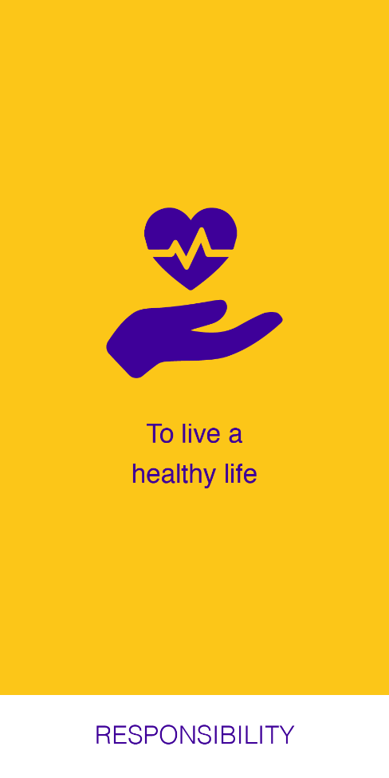
Rights to responsibilities?

Slide 14
Rights to responsibilities?
?

Slide 15
Rights to responsibilities?

Slide 16
Rights to responsibilities?
?

Slide 17
Rights to responsibilities?

Slide 18
Rights to responsibilities?
?

Slide 19
Rights to responsibilities?

Slide 20
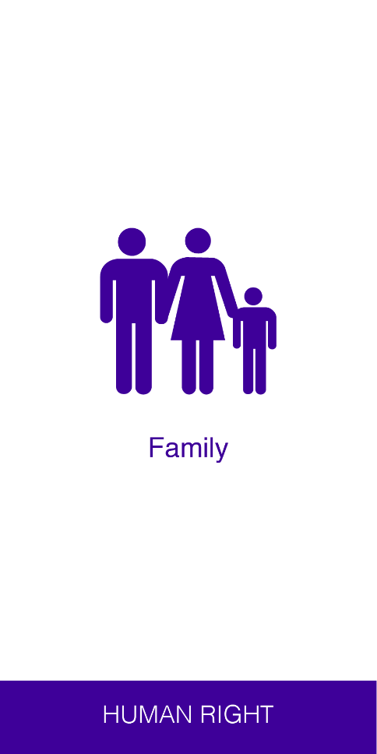
Rights to responsibilities?
?

Slide 21
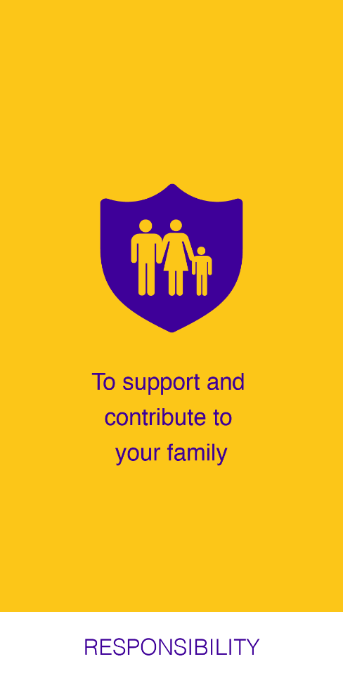
Rights to responsibilities?

Slide 22
Rights to responsibilities?
?

Slide 23
Rights to responsibilities?

Slide 24
Rights to responsibilities?
?

Slide 25
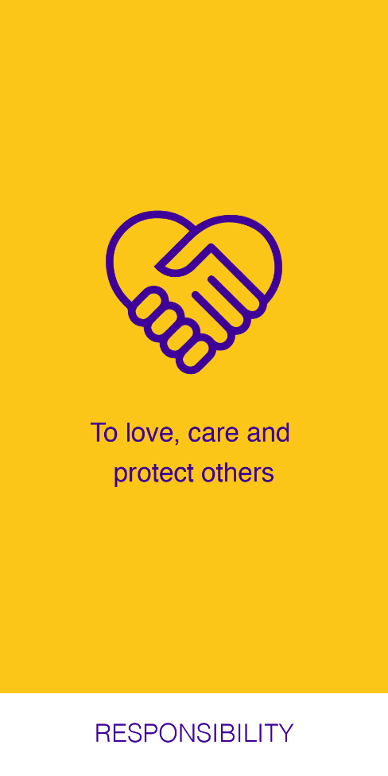
Rights to responsibilities?

Slide 26
Rights to responsibilities?
?

Slide 27
Rights to responsibilities?

Slide 28
Rights to responsibilities?
?

Slide 29
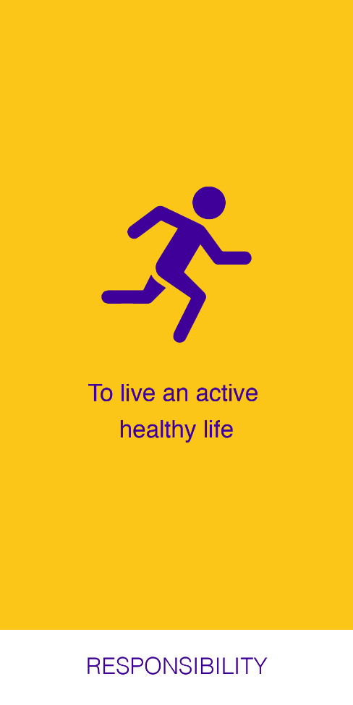
Rights to responsibilities?

Slide 30
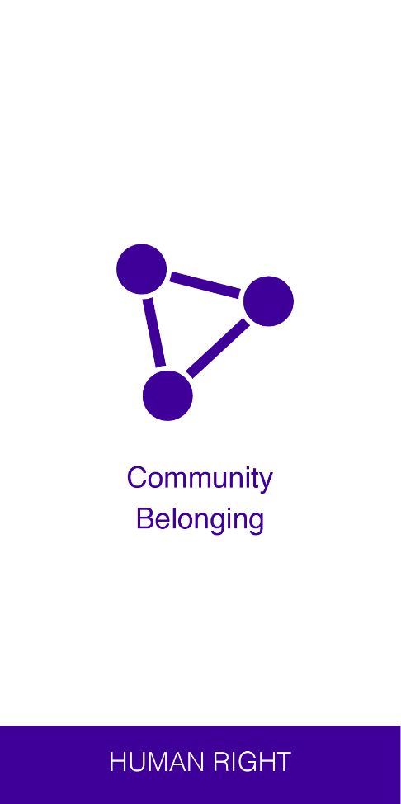
Rights to responsibilities?
?

Slide 31
Rights to responsibilities?

Slide 32
Rights to responsibilities?
?

Slide 33
Rights to responsibilities?

Slide 34
Rights to responsibilities?
?

Slide 35
Rights to responsibilities?

Slide 36
Rights to responsibilities?
?

Slide 37
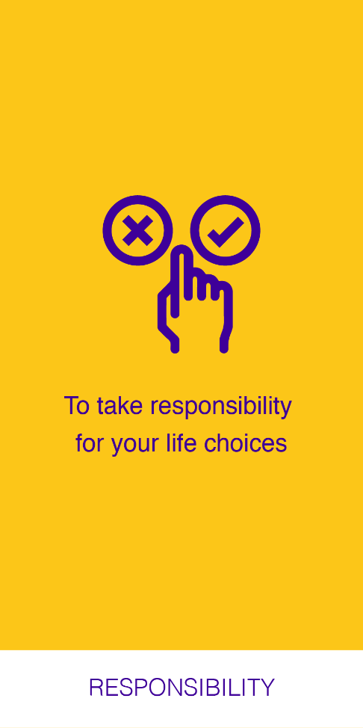
Rights to responsibilities?

Slide 38
Rights to responsibilities?
?

Slide 39
Rights to responsibilities?

Slide 40
Rights to responsibilities?
?

Slide 41
Rights to responsibilities?

Slide 42
Rights to responsibilities?
?

Slide 43
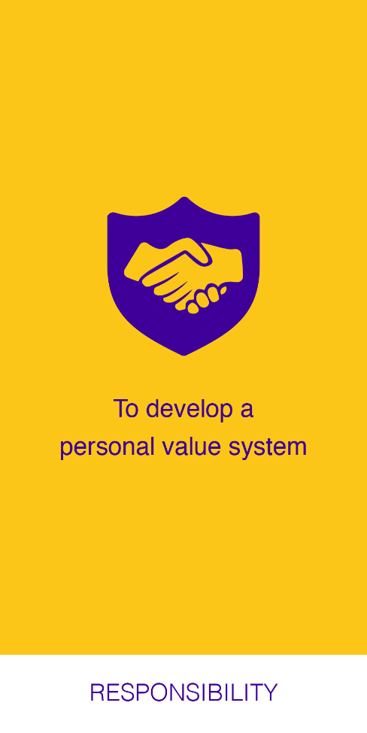
Rights to responsibilities?

Slide 44
Rights to responsibilities?
?

Slide 45
Rights to responsibilities?

Slide 46
Rights to responsibilities?
?

Slide 47
Rights to responsibilities?

Slide 48
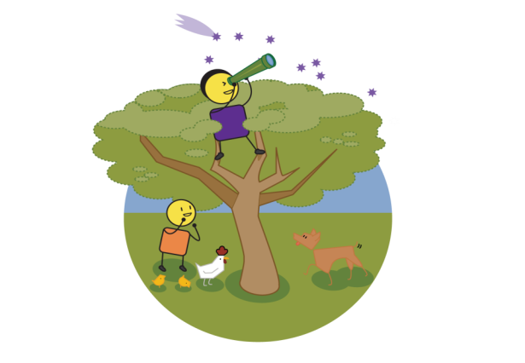
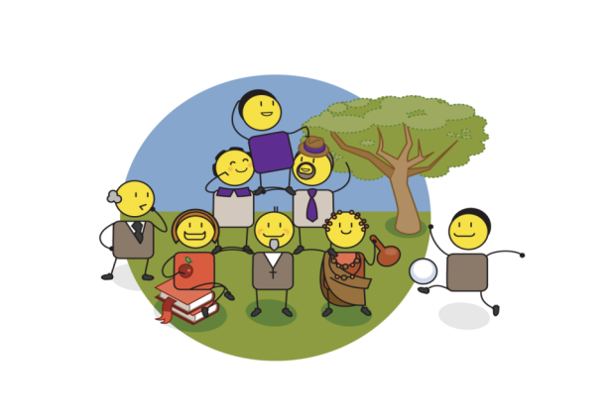
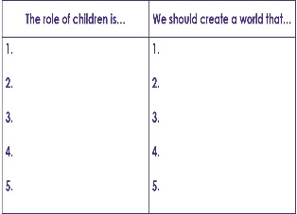
Defining our values
Values, or what we believe in, drive our day-to-day behaviour. What values will we need to believe in to ensure we achieve our child protection vision?
CHILD PROTECTION VISION
CHILD PROTECTION VALUES
Notes:
Using the insights you gained from the rights and responsibilities exercise to identify the 3 to 5 values that you think will drive the delivery of your child protection vision.

Slide 49
Values & beliefs
Notes:
This exercise relates to the empowerment driver of VALUES & BELIEFS.

Slide 50
Agree your values
These are the values we will we need to believe in to ensure we achieve our child protection vision?
CHILD PROTECTION VISION
CHILD PROTECTION VALUES
Notes:
Agree the 3 to 5 values that you, your family, your community or your organisation will need to believe in to achieve your child protection values.

Slide 51
How should we answer?
To achieve our child protection vision of…
We will need to believe in the values of…
1.
2.
3.
4.
5.
1.
2.
3.
4.
5.
Notes:
This template should help you and your team or community to define which values you will need to believe in to achieve your child protection vision.

Slide 52
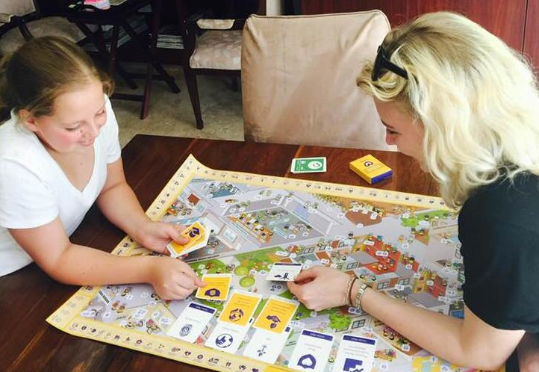
If these are our rights, what are our personal responsibilities?
Notes:
Matching rights to responsibilities.

Slide 53
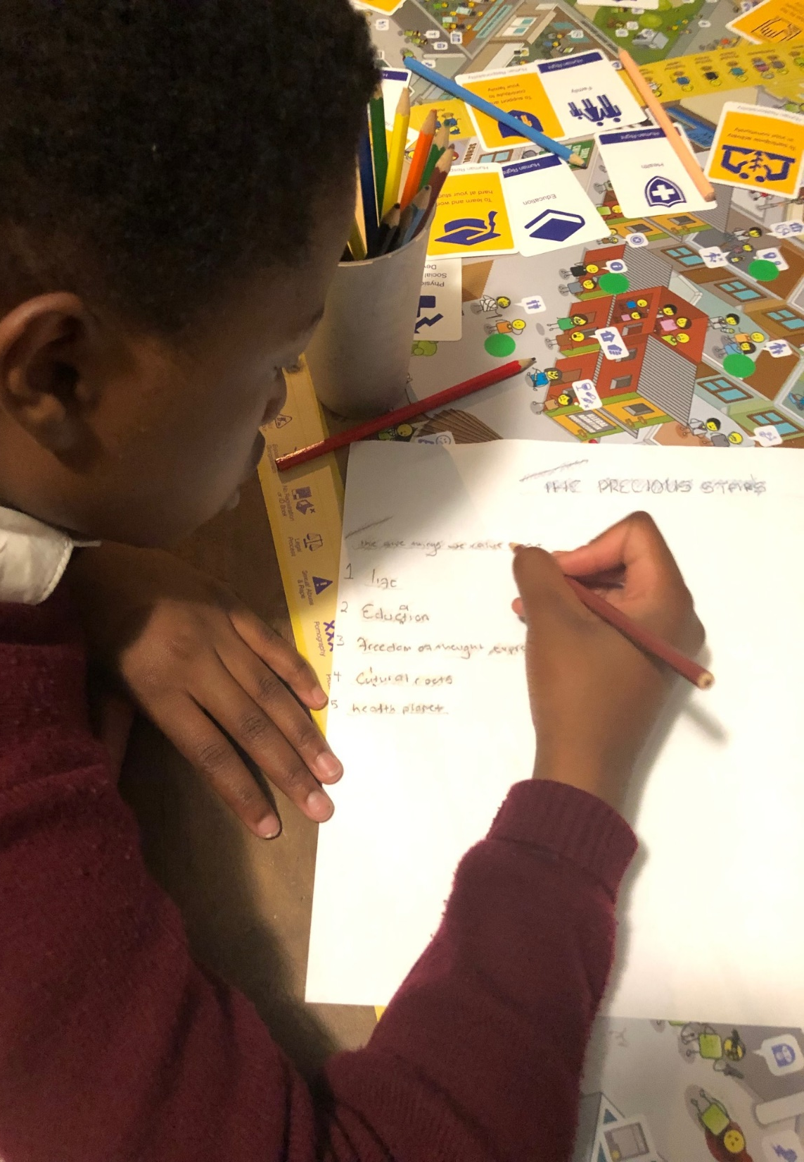
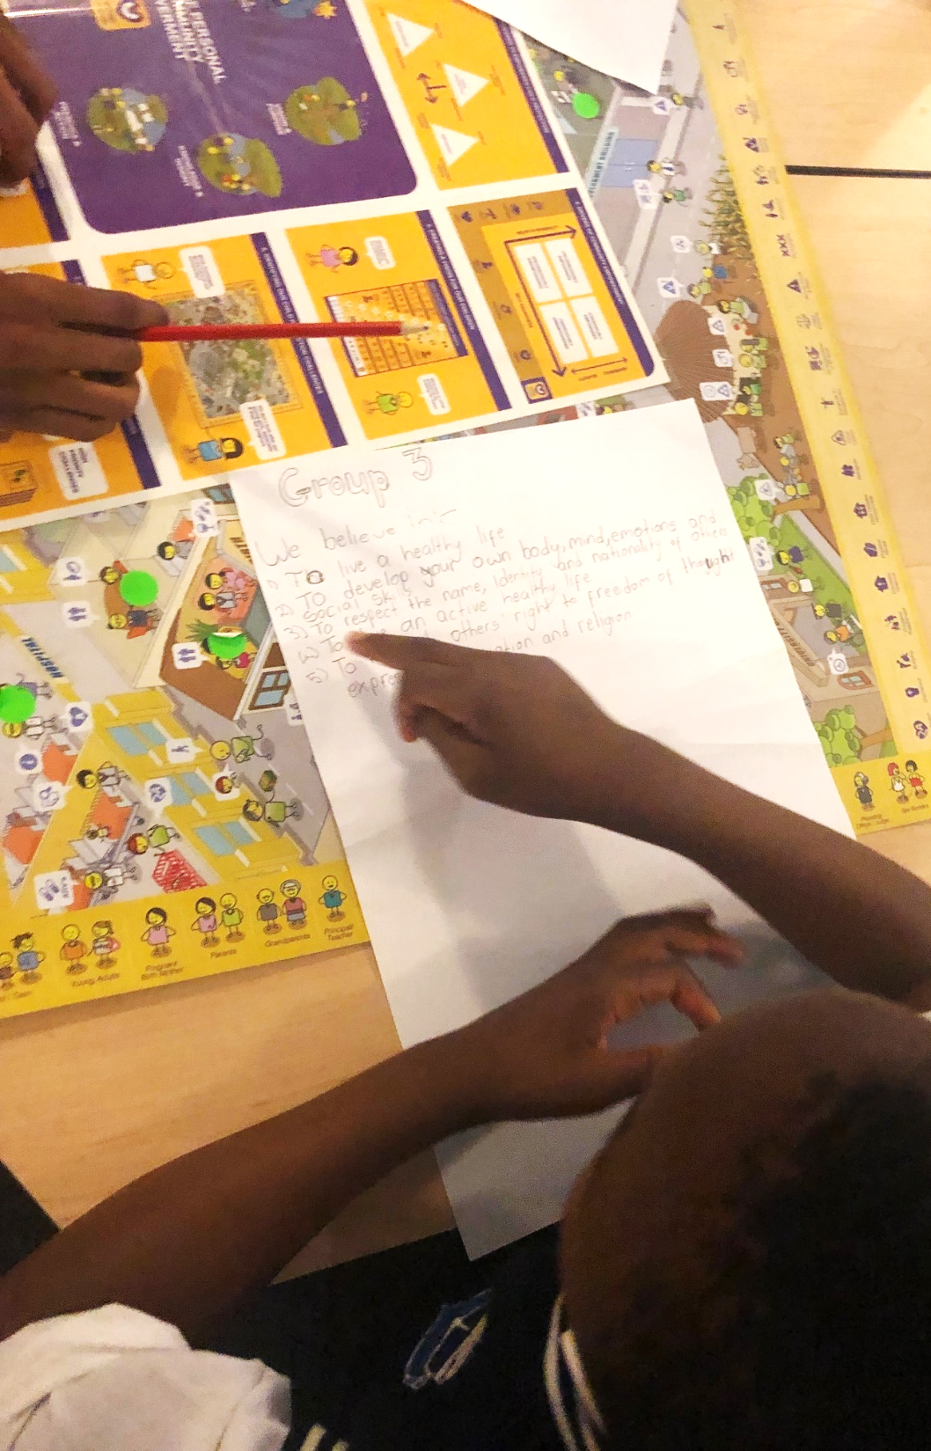
What should we value to ensure real behaviour change in our community?
Notes:
Defining the values that will help achieve a defined vision.

Slide 54
stay strong
take
www.couragechildprotection.com
Notes:
Thanks for watching, stay strong and take courage.

