Slide 1
Child Protection
& Human Rights
www.courage-community.com
Notes:
This presentation explains child protection and what your human rights are.

Slide 2
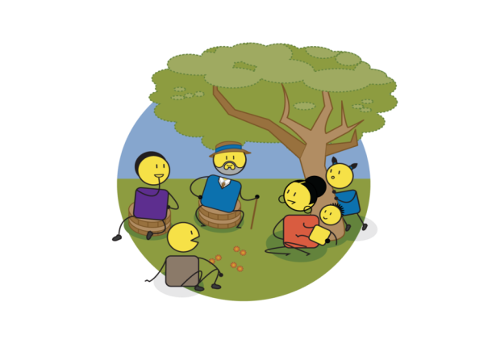
There can be no keener revelation of a society's soul than the way in which it treats its children.
Nelson Mandela
Notes:
Nelson Mandela once said, ”There can be no keener revelation of a society’s soul than the way in which it treats it’s children.

Slide 3
Notes:
Sadly, many societies and communities don’t understand this.
Instead, children are exposed to violence, neglect, abuse, abandonment and exploitation.

Slide 4
Child protection?
The prevention and responding to violence, exploitation, neglect and abuse against children
Notes:
This is why, we need child protection.
Child protection is the prevention and responding to violence, exploitation, neglect and abuse against children.

Slide 5
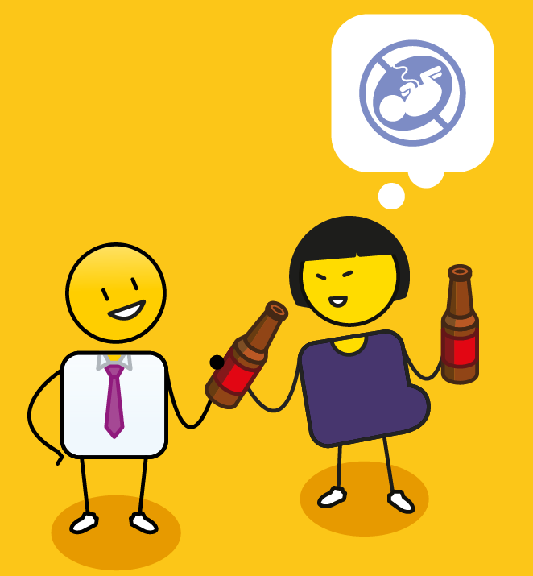
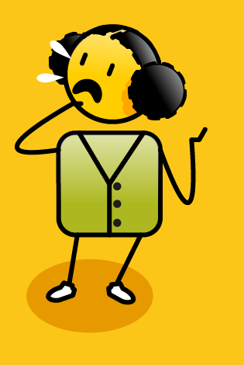
Why is it important?
anxiety
depression
learning disorders
poor self regulation
post traumatic stress
suicide
developmental challenges
substance abuse
risky sexual behaviour
toxic stress
violence
Notes:
Child protection is very important, as abuse, neglect and exploitation can lead to many challenges such as learning disorders, developmental challenges, post traumatic stress, anxiety, depression and suicide. In the long term, a life of violence, can result in substance abuse, poor self regulation, risky sexual behaviour and toxic stress that impacts negatively on a person's health and wellbeing.

Slide 6
Child Rights
vs
Notes:
All children are entitled to human rights. These rights were first identified at the United Nations Convention on the Rights of the Child in 1990. Children’s Rights have been defined at a global level by UNICEF. At a continental level, by the African & European Unions, and by individual countries in their Bill of Rights and Children’s Acts. These ‘Rights Documents’ detail what should, or should not be happening to children in families, communities or society at large.

Slide 7
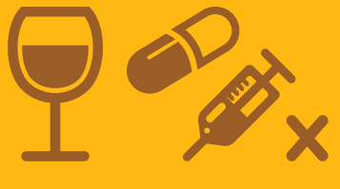
They have rights to live
vs
Notes:
All children have a right to live…
These rights include a right to life,
Safety and security.
To be registered and have a name, an identity and a nationality.
A right to health care.
A right to legal protection and justice.
And a right to support if they have any special needs.
This is in contrast to a world of no rights…
Where children are rejected or neglected.
Subjected to abuse, whether physical, emotional or sexual.
To substance abuse, sometimes even in utero.
Have no access to justice
Or are trafficked as a commodity to be bought or sold.

Slide 8
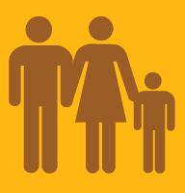
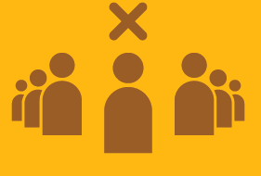
They have rights to love
vs
Notes:
They have rights to love…
Which include a right to a family.
And parental love and care.
To honour, respect and dignity.
And to privacy.
Versus a world where they are subjected to.
Harmful cultural practices
Armed conflict.
Race, gender, age, sexual, or any form of discrimination.
Where they are refugees..
And have no care or protection.

Slide 9
They have rights to learn
vs
Notes:
They have rights to learn…
Through community participation and belonging
Through education.
Leisure and recreation.
Where they have freedom of thought, expression, association and religion.
And knowledge of their cultural roots.
Versus a world where they have no access…
To play.
To education.
To personal development.
And are subjected to harmful cultural practices

Slide 10
They have rights to leave a legacy
vs
Notes:
And finally they have a right to leave a legacy…
To have a unique identity.
To have physical, mental and emotional development.
To have moral development.
To live a full and happy life.
On a healthy planet
Versus a world where they …
Have no belonging or identity.
They are not developed or nurtured
They are Isolated and ignored.
And live an unhappy life
On an unhealthy planet.

Slide 11
Child protection Process
The prevention and responding to violence, exploitation, neglect and abuse against children
Notes:
So what is the process of child protection?

Slide 12
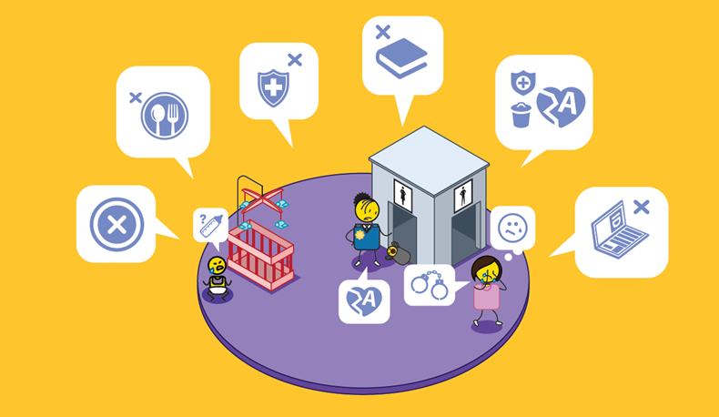
Child abandonment & neglect?
Notes:
If a child has been abandoned or neglected, which includes not being fed, given access to healthcare, schooling or adequate personal identity documentation.

Slide 13
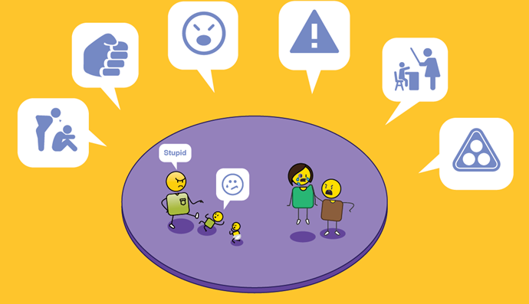
Child abuse?
Notes:
Abused, which includes physical, mental, emotional and sexual abuse, bullying, corporal punishment or subjected to harmful cultural practices.

Slide 14
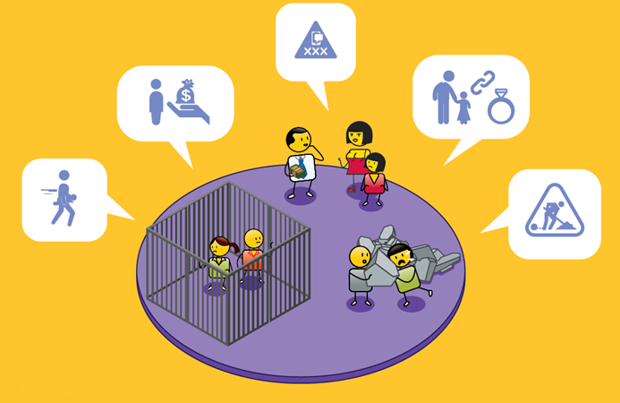
Child exploitation?
Notes:
Or exploited, which includes child trafficking, prostitution, pornography, child marriage or child labour.

Slide 15
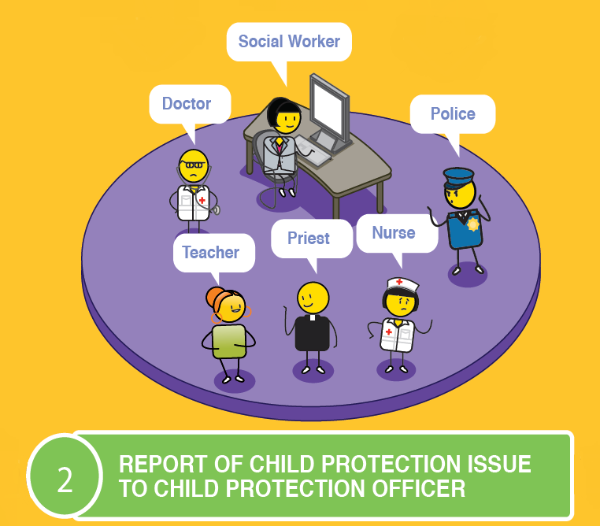
Report to a child protection officer
Notes:
The first step is to report this problem to a child protection officer, who could be a social worker, the police, a doctor or nurse, a teacher, a sports coach, a counsellor, or a community or religious leader.

Slide 16
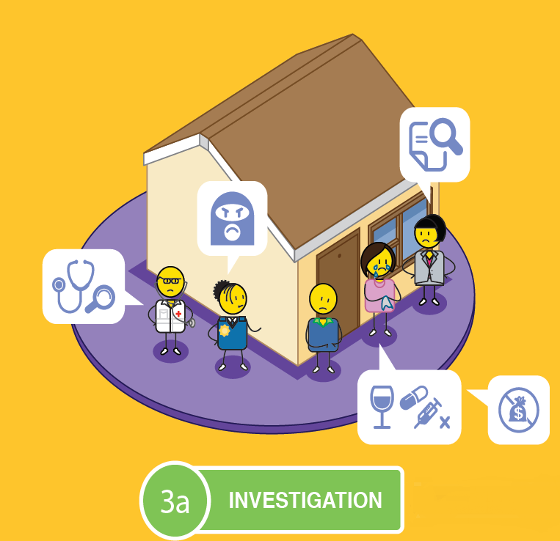
Investigation
Notes:
The child protection officer must report the neglect, abuse or exploitation to the police and a social worker, who must then conduct a full investigation, which includes visiting the child’s home, school or where the abuse is reported to be taking place.

Slide 17
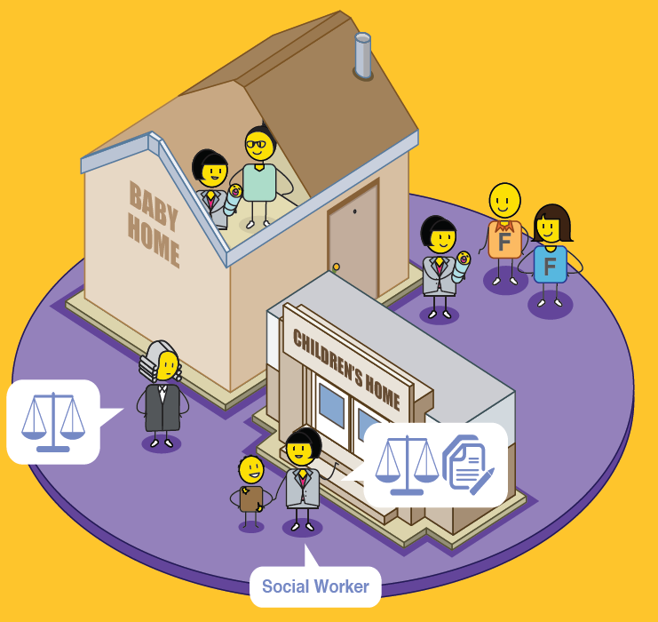
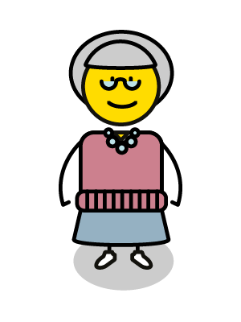
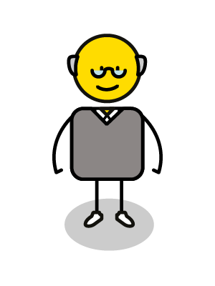
Place of safety
Notes:
The safety of the child must be ensured. If there is any risk to the child, they must be removed from their home, place of residence, or risky environment, and placed legally in temporary care, either with other family members, or formal places of safety such as a baby or children’s home, foster care or a registered place of safety.

Slide 18
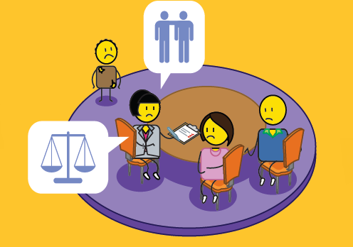
Family counselling
Notes:
The social worker will then need to assess what has been happening, and to counsel and support the family.

Slide 19
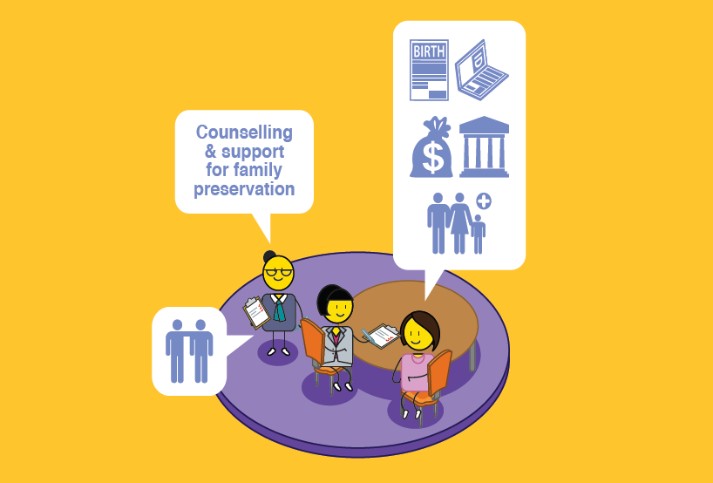
Family support
Notes:
Family support can be undertaken by a social worker or family support organisation, who can also assist parents in getting the correct documentation for their child, and with financial or social support if needed.

Slide 20
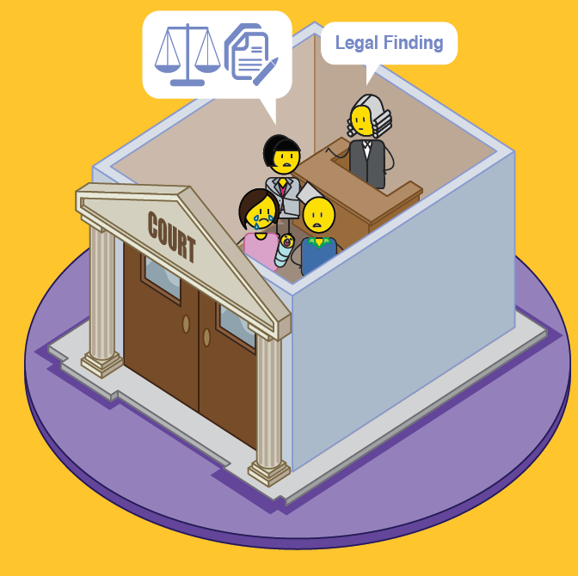
Best interests of the child
Family court
Notes:
If the level of abuse, neglect or exploitation is very bad, the social worker will need to prepare and take the child and relevant perpetrators to court and a legal finding will be made to ensure the child’s best interests are met.

Slide 21
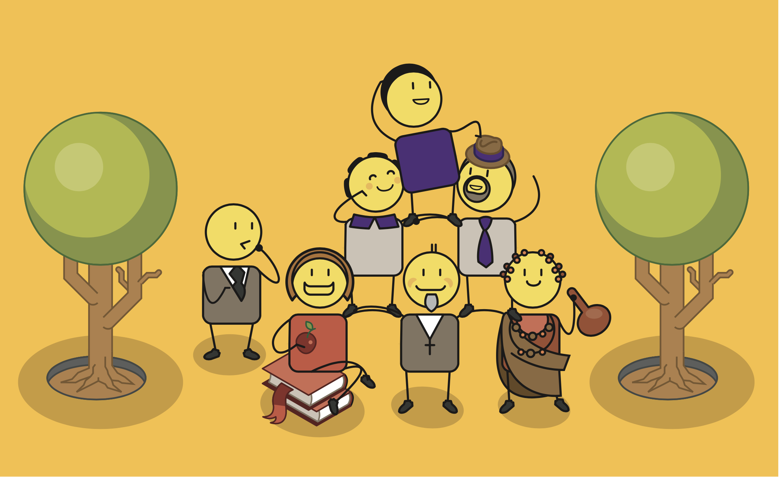
All children have the right to live a full and happy life
Supported by family & community
Notes:
Ultimately, all children have the right to live a full and happy life, supported by their family and community.

Slide 22
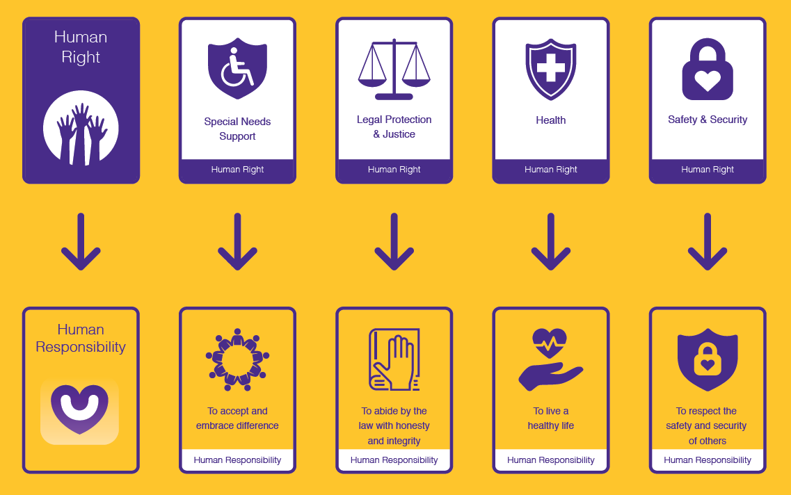
Notes:
With great power, such as having human rights, comes great responsibility.
This means that for every right you are given by your society, you also have an important responsibility to support those rights.
We are now going to go through all of your human rights and I want you to call out what you think your human responsibility is for each.

Slide 23
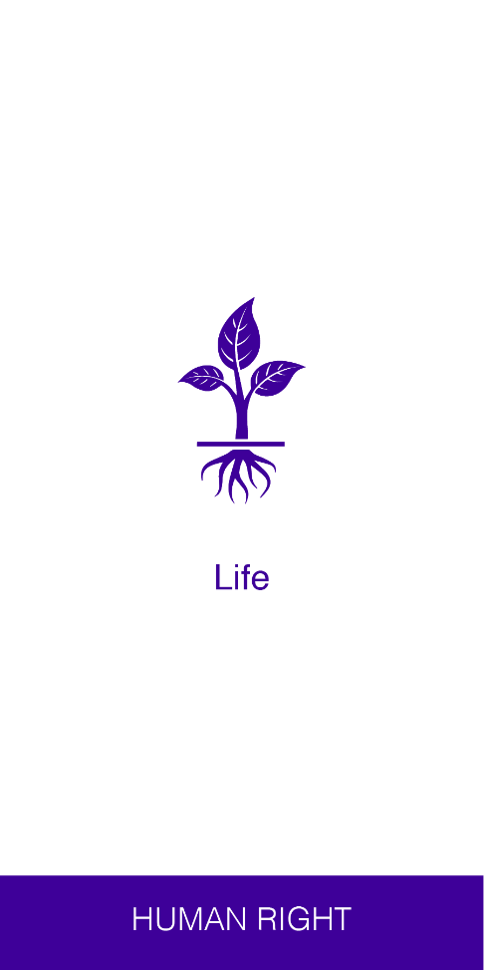
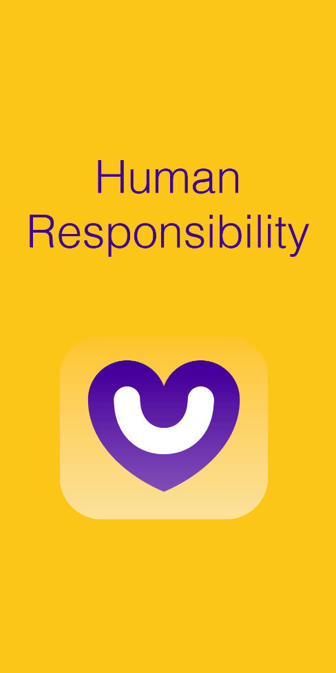
From rights…
?
Life
Notes:
If you have a human right to life, your human responsibility is? (wait 5 seconds)

Slide 24
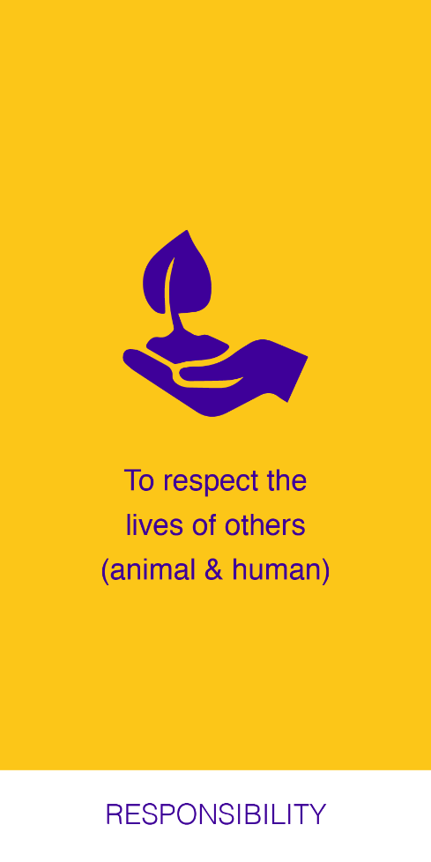
…to responsibilities
Life
To respect the lives of others (Animal & Human)
Notes:
To respect the lives of others both animal and human.

Slide 25
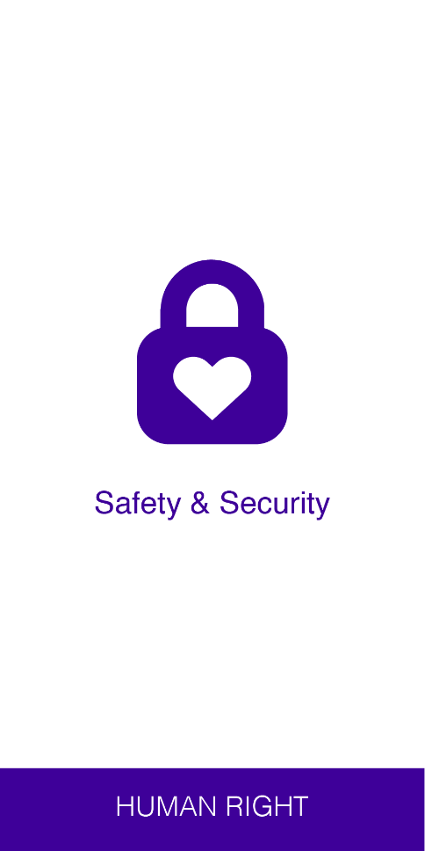
From rights…
?
Safety & Security
Notes:
If you have a human right to safety and security, your human responsibility is? (Wait 5 seconds)

Slide 26
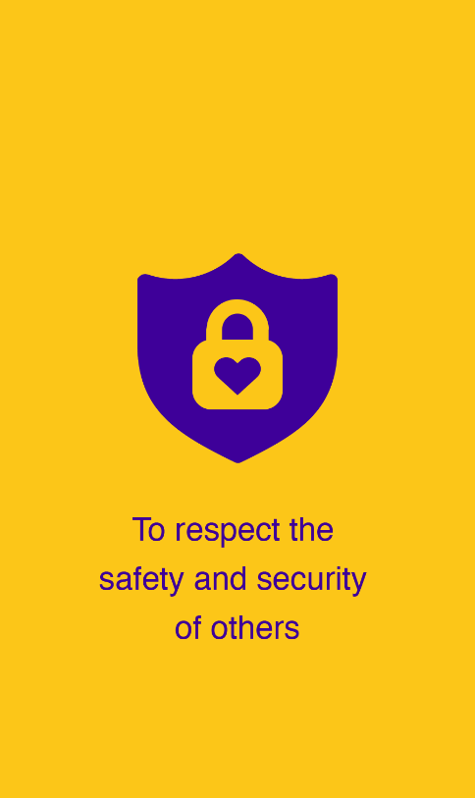
…to responsibilities
Safety & Security
To respect the safety & security of others
Notes:
To respect the safety and security of others.

Slide 27
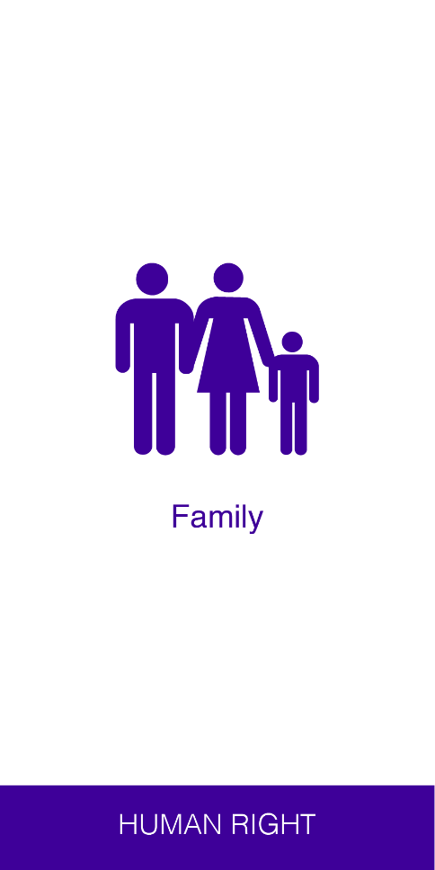
From rights…
?
Family
Notes:
If you have a human right to family, your human responsibility is? (Wait 5 seconds)

Slide 28
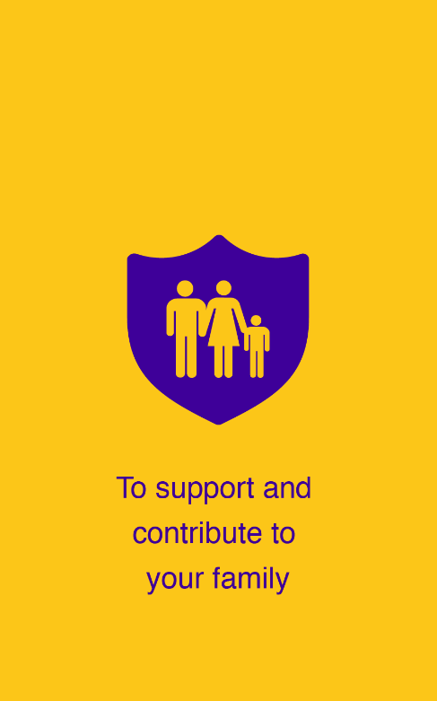
…to responsibilities
Family
To support & contribute to your family
Notes:
To support and contribute to your family.

Slide 29
From rights…
?
Registration, name, identity & nationality
Notes:
If you have a human right to registration, a name, identity and nationality, your human responsibility is? (Wait 5 seconds)

Slide 30
…to responsibilities
Registration, name, identity & nationality
To respect the name, identity & nationality of others
Notes:
To respect the name, identity and nationality of others.

Slide 31
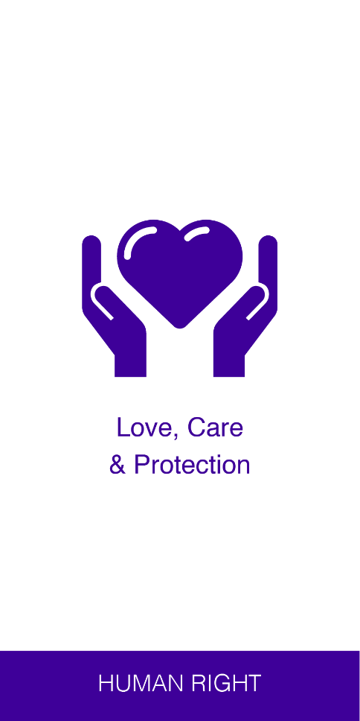
From rights…
?
Love, care & protection
Notes:
If you have a human right to love, care and protection, your human responsibility is? (Wait 5 seconds)

Slide 32
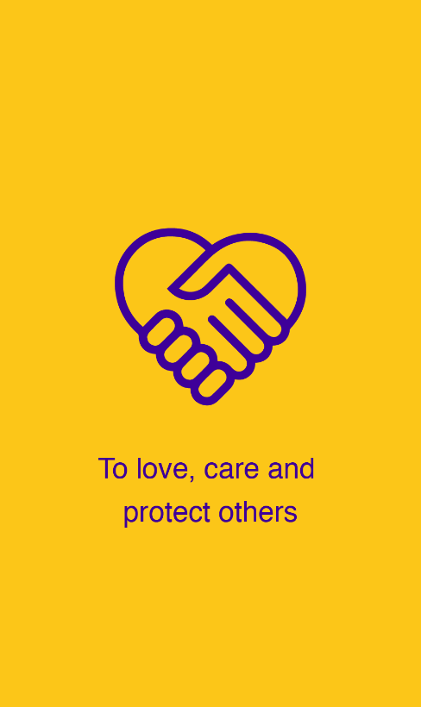
…to responsibilities
Love, care & protection
To love, care & protect others
Notes:
To love, care and protect others.

Slide 33
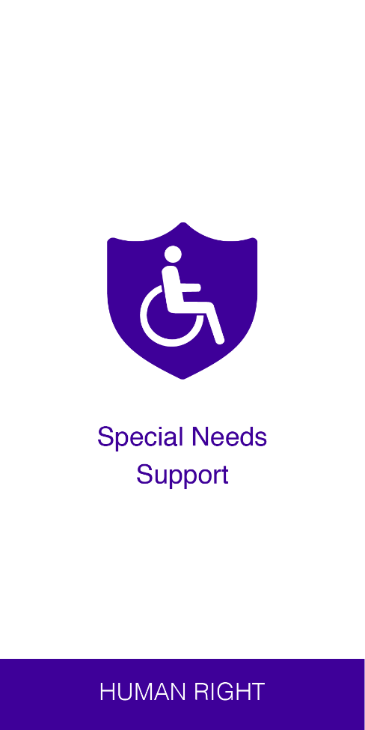
From rights…
?
Special needs support
Notes:
If you have a human right to special needs support, your human responsibility is? (Wait 5 seconds)

Slide 34
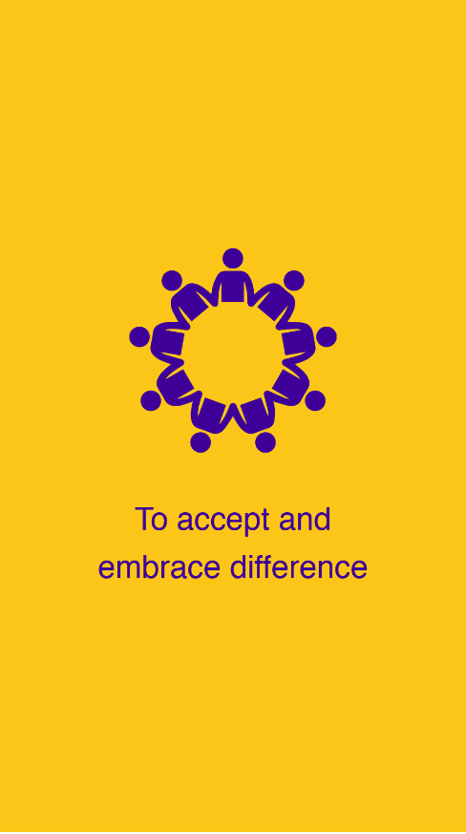
…to responsibilities
Special needs support
To accept & embrace difference
Notes:
To accept and embrace differences and diversity in others.

Slide 35
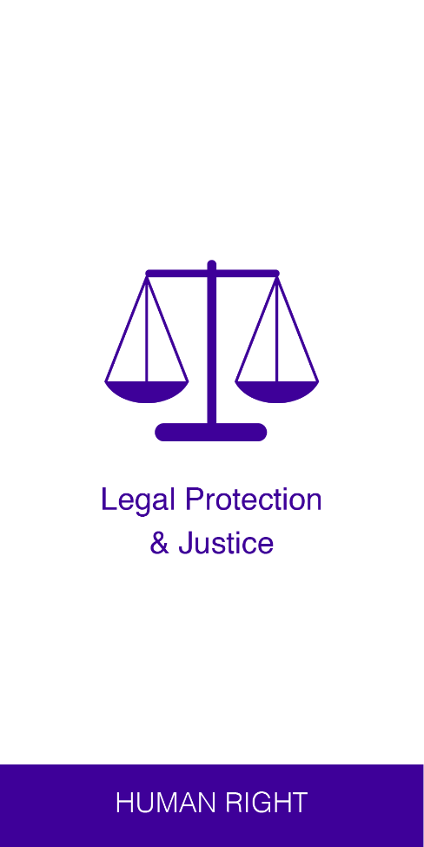
From rights…
?
Legal protection & justice
Notes:
If you have a human right to legal protection and justice, your human responsibility is? (Wait 5 seconds)

Slide 36
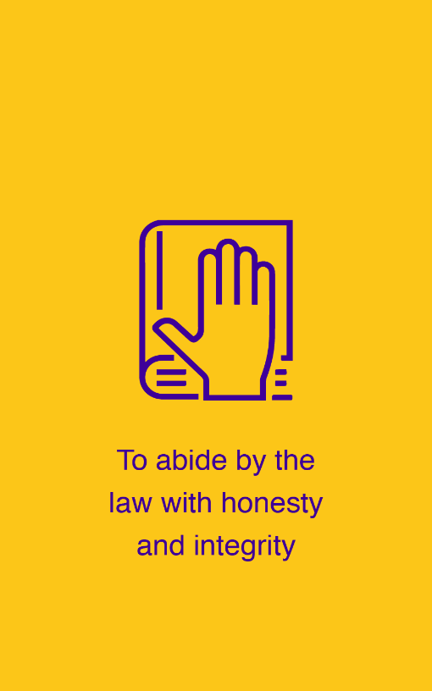
…to responsibilities
Legal protection & justice
To abide by
the law with honesty & integrity
Notes:
To abide by the law with honesty and integrity.

Slide 37
From rights…
?
Health
Notes:
If you have a human right to health, your human responsibility is? (Wait 5 seconds)

Slide 38
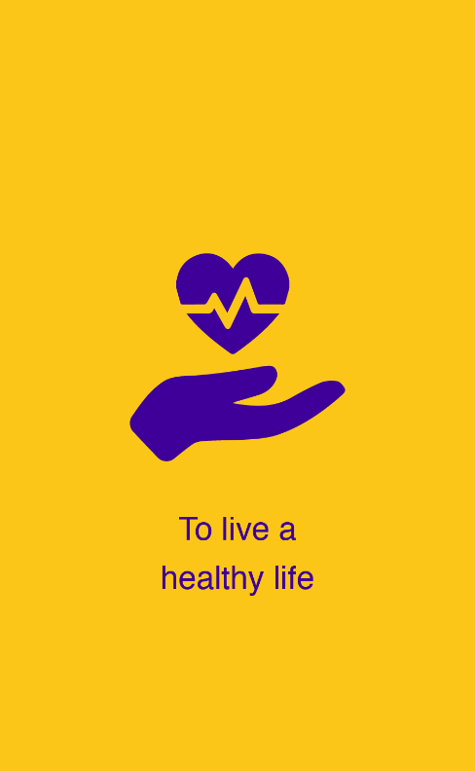
…to responsibilities
Health
To live a
healthy life
Notes:
To live a healthy life.

Slide 39
From rights…
?
Honour, respect & dignity
Notes:
If you have a human right to honour, respect and dignity, your human responsibility is? (Wait 5 seconds)

Slide 40
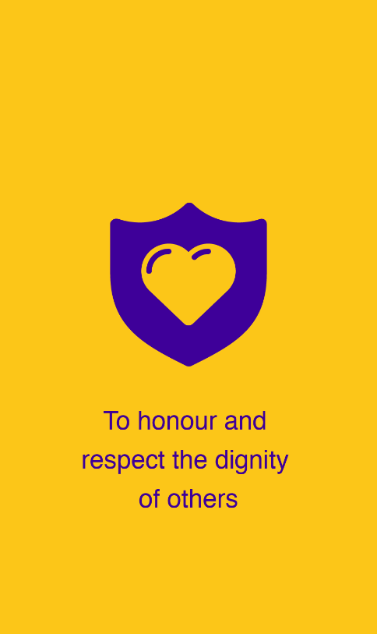
…to responsibilities
Honour, respect & dignity
To honour and respect the dignity of others
Notes:
To honour and respect the dignity of others.

Slide 41
From rights…
?
Privacy
Notes:
If you have a human right to privacy, your human responsibility is? (Wait 5 seconds)

Slide 42
…to responsibilities
Privacy
To respect the privacy of others
Notes:
To respect the privacy of others.

Slide 43
From rights…
?
Education
Notes:
If you have a human right to education, your human responsibility is? (Wait 5 seconds)

Slide 44
…to responsibilities
Education
To learn and work hard at your studies
Notes:
To learn and work hard at your studies.

Slide 45
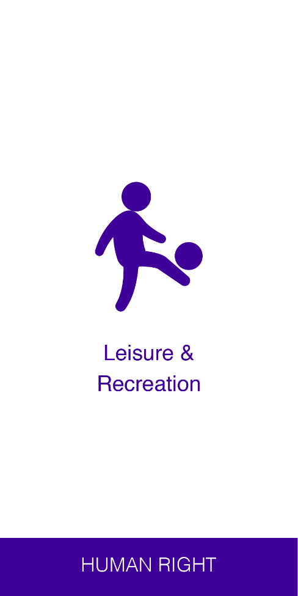
From rights…
?
Leisure & recreation
Notes:
If you have a human right to leisure and recreation, your human responsibility is? (Wait 5 seconds)

Slide 46
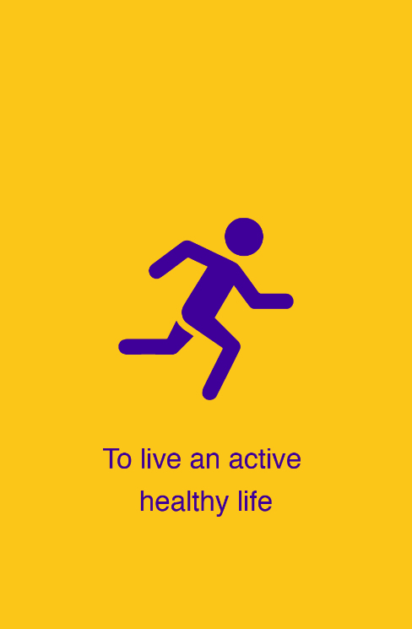
…to responsibilities
Leisure & recreation
To live an active healthy life
Notes:
To live an active and healthy life.

Slide 47
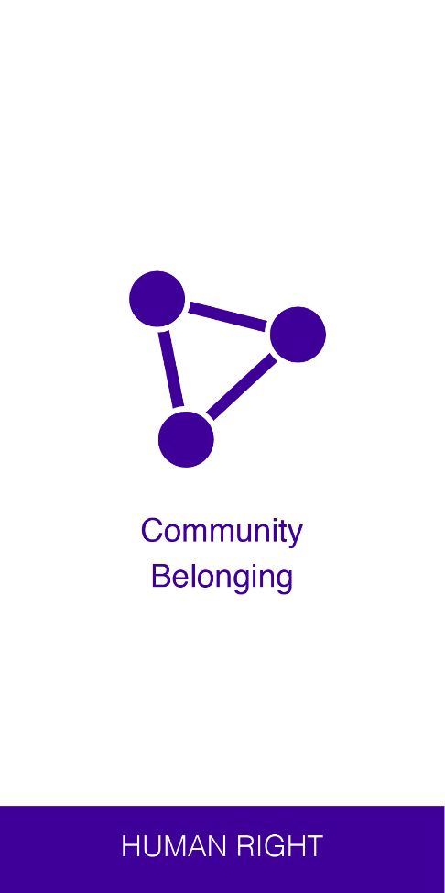
From rights…
?
Community belonging
Notes:
If you have a human right to community belonging, your human responsibility is? (Wait 5 seconds)

Slide 48
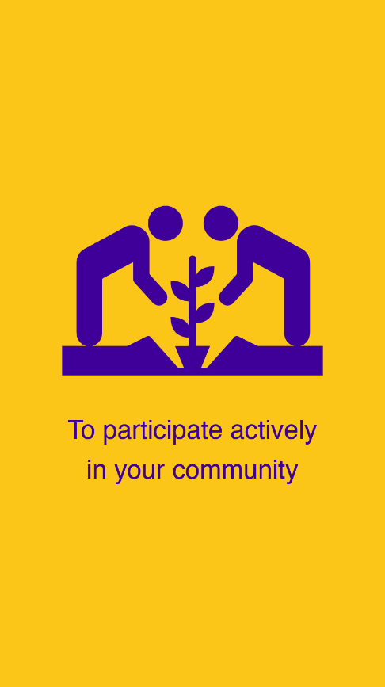
…to responsibilities
Community belonging
To participate actively in your community
Notes:
To participate actively in your community.

Slide 49
From rights…
?
Freedom of thought, expression, association & religion
Notes:
If you have a human right to freedom of thought, expression, association and religion, your human responsibility is? (Wait 5 seconds)

Slide 50
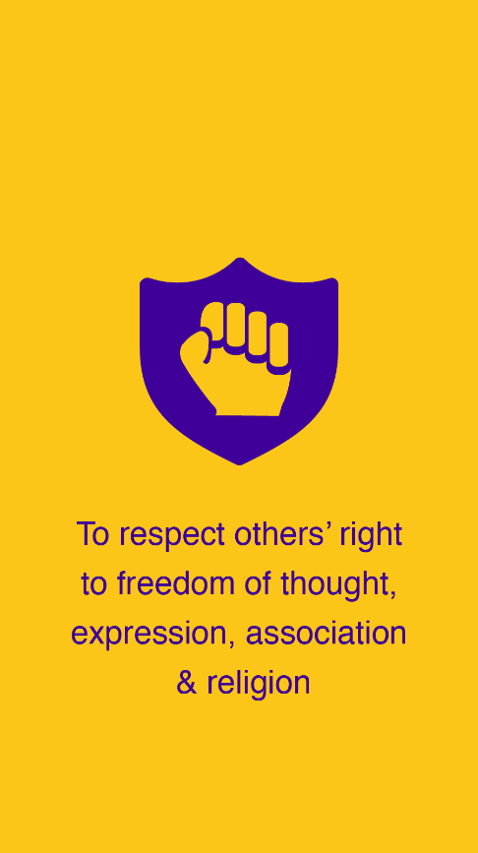
…to responsibilities
Freedom of thought, expression, association & religion
To respect other’s right to freedom of thought, expression, association & religion
Notes:
To respect other’s right to freedom of thought, expression, association and religion. (Wait 5 seconds)

Slide 51
From rights…
?
Cultural
roots
Notes:
If you have a human right to cultural roots, your human responsibility is? (Wait 5 seconds)

Slide 52
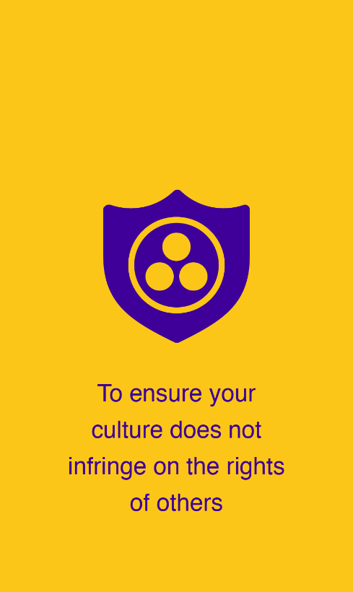
…to responsibilities
Cultural
roots
To ensure your culture does not infringe on the rights of others
Notes:
The ensure your culture does not infringe on the rights of others.

Slide 53
…to responsibilities
?
Unique identity
Notes:
If you have a human right to a unique identity, your human responsibility is? (Wait 5 seconds)

Slide 54
From rights…
Unique identity
To respect the unique identity of others
Notes:
To respect the unique identity of others.

Slide 55
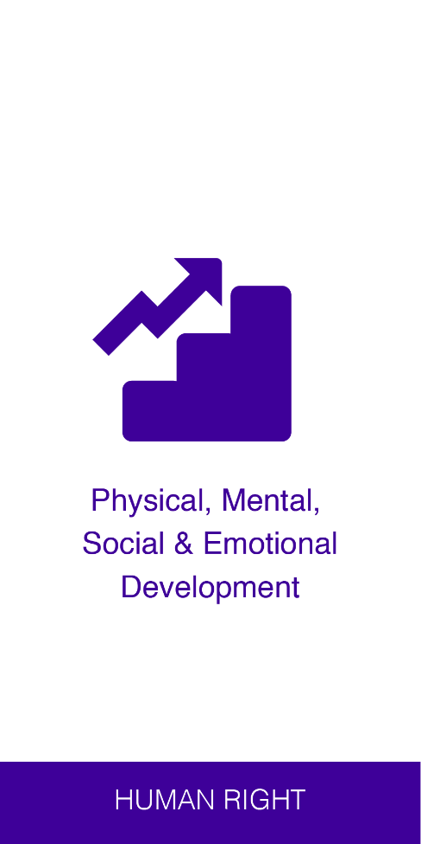
From rights…
?
Physical, mental, social & emotional development
Notes:
If you have a human right to physical, mental, social and emotional development, your human responsibility is? (Wait 5 seconds)

Slide 56
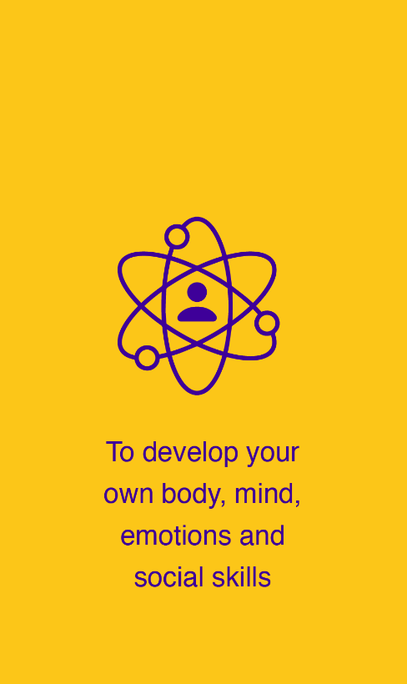
…to responsibilities
Physical, mental, emotional & social development
To develop your own body, mind, emotions & social skills
Notes:
To develop your own body, mind, emotions and social skills.

Slide 57
From rights…
?
Moral development
Notes:
If you have a human right to moral development, your human responsibility is? (Wait 5 seconds)

Slide 58
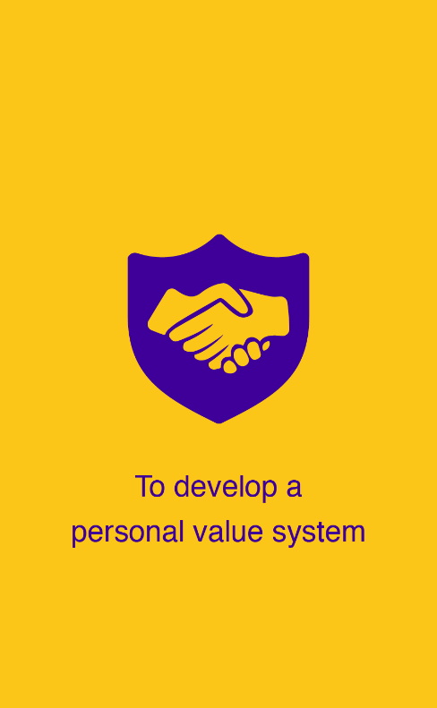
…to responsibilities
Moral development
To develop a personal value system
Notes:
To develop a personal value system that doesn’t infringe on the rights of others.

Slide 59
From rights…
?
Healthy
planet
Notes:
If you have a human right to a healthy planet, your human responsibility is? (Wait 5 seconds)

Slide 60
…to responsibilities
Healthy
planet
To respect & care for the environment
Notes:
To respect and care for the environment.

Slide 61
From rights…
?
Full happy life
Notes:
If you have a human right to live a full and happy life, your human responsibility is? (Wait 5 seconds)

Slide 62
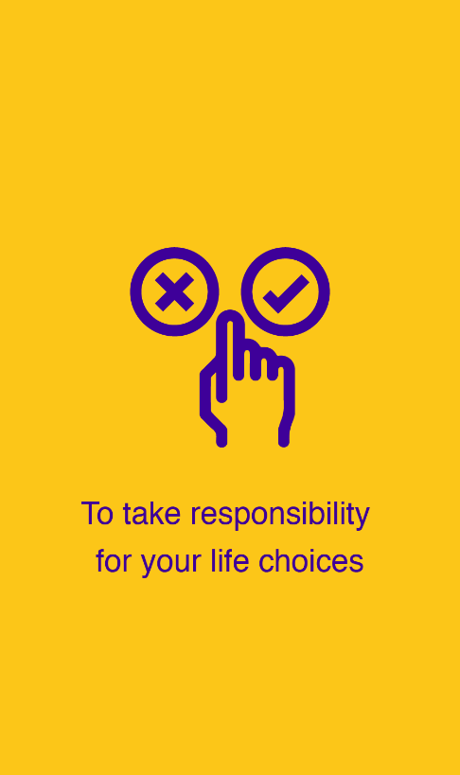
…to responsibilities
Full happy life
To take responsibility for your life choices
Notes:
To take responsibility for your life choices.

Slide 63
If you see something?
Please say something!
Notes:
The most important thing when it comes to child protection, if you see something, please say something.

Slide 64
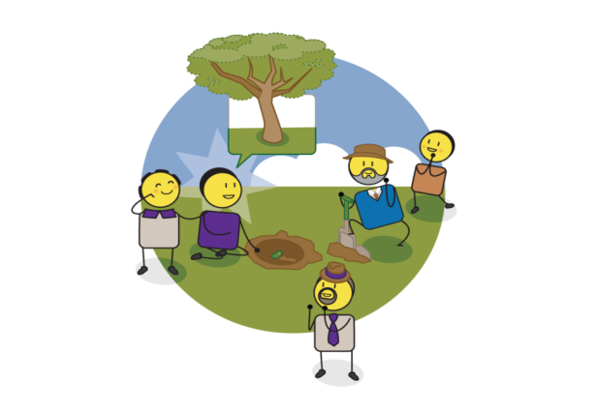
We all need to take action today for a better tomorrow
Notes:
We all need to take action today for a better tomorrow.

Slide 65
stay strong
take
www.courage-community.com
Notes:
Thank you for watching
For more information visit www.courage (dash) community.com
Stay strong and take courage.

