Slide 1
take
www.couragechildprotection.com

Slide 2
What should you do if you observe or have knowledge of a child who is being abused, neglected or exploited?
Notes:
What should you do if you have observed or have knowledge of a child or children being abused, neglected or exploited?

Slide 3
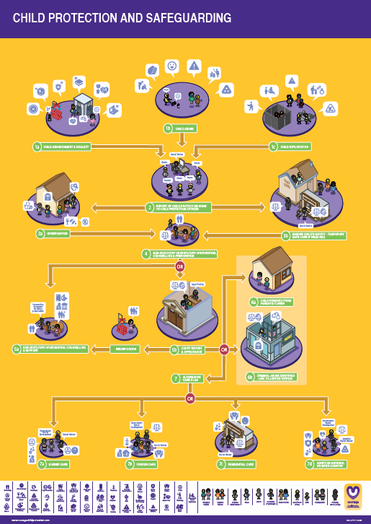
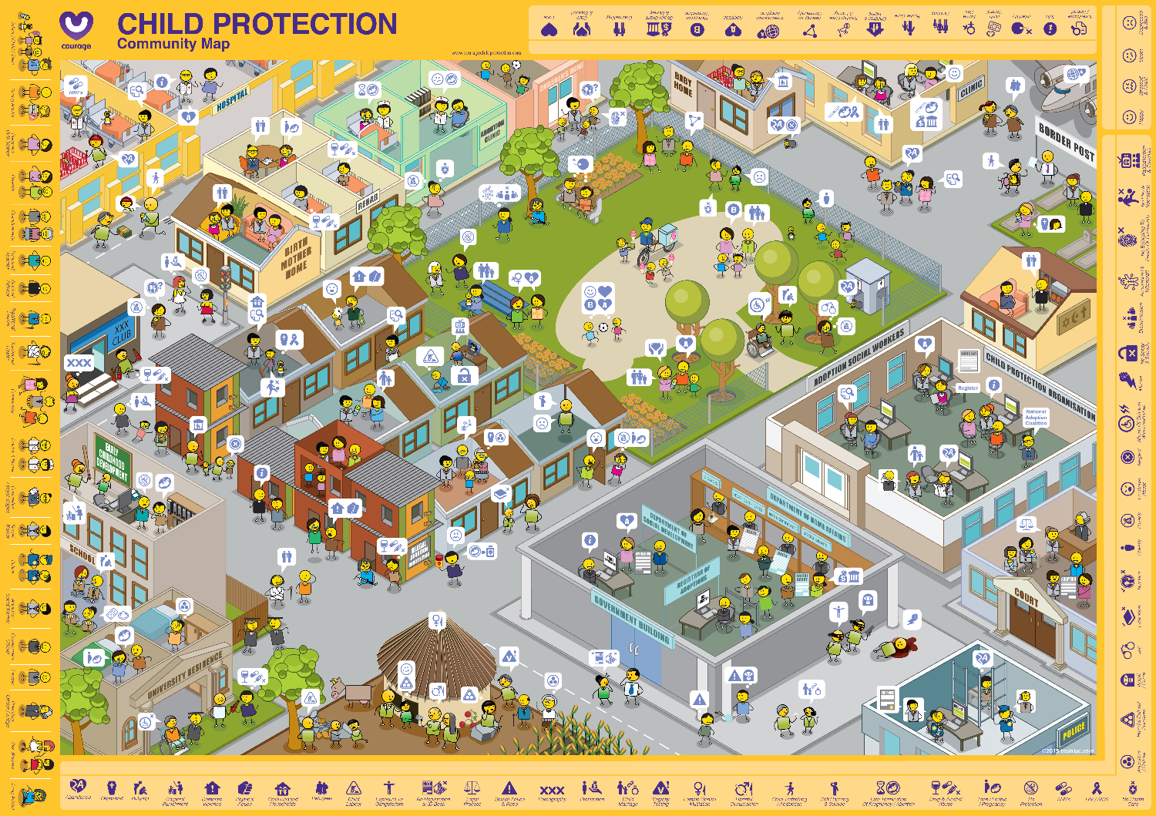
Useful courage tools
Courage child protection and safeguarding poster & Community Map
or
The Courage child protection and safeguarding video or presentation
Notes:
Before we begin, some useful tools to help create your vision include a pack of Courage empowerment cards or a Courage child development needs and rights poster or this movie and the Courage Vision presentation with templates.

Slide 4
Notes:
Overview

Slide 5
What should we ask?
What should you do if you see child protection challenges in your community, follow the Courage Child Protection & Safeguarding process.
Link this process to the Courage Child Protection Community Map to understand which stakeholders are involved.
Notes:
Follow the Courage Child Protection & Safeguarding process to understand what you should do if you see or know of a child or children who have been abused, neglected or exploited. To link this process to your community, try to identify who the key stakeholders are on your community map.

Slide 6
Now let’s understand the process you should follow…
Notes:
No let’s understand the process you should follow…

Slide 7
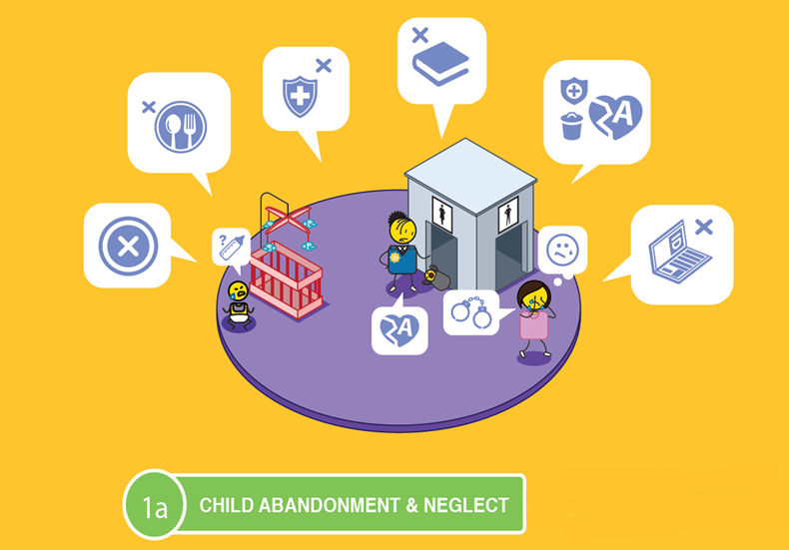
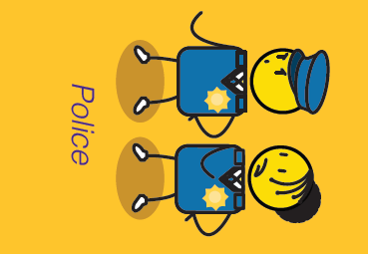
CHILD PROTECTION AND SAFEGAURDING

Slide 8
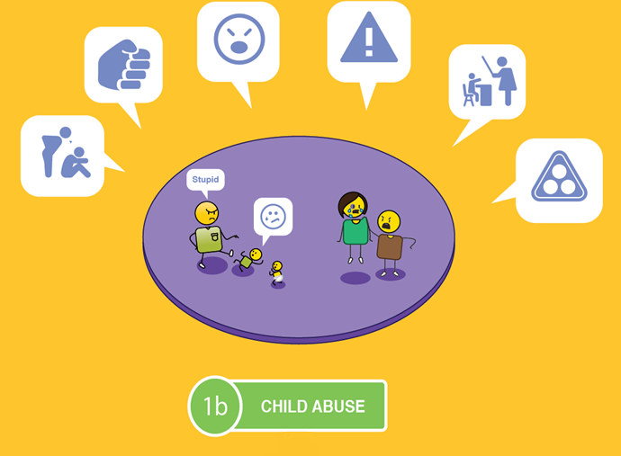
CHILD PROTECTION AND SAFEGAURDING
Abusive Parents, Partners or Adults

Slide 9
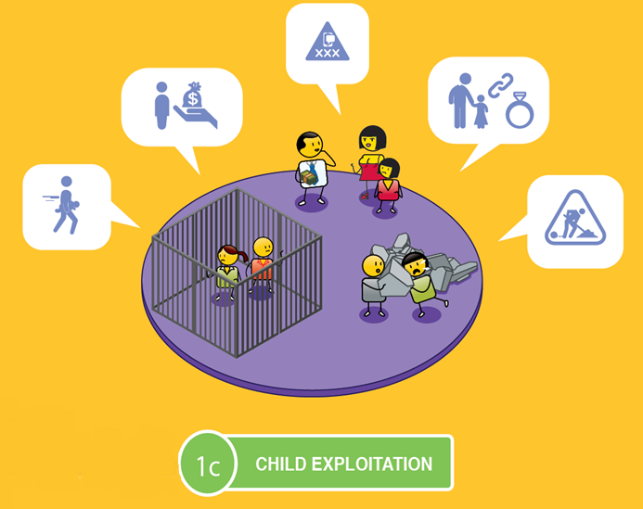
CHILD PROTECTION AND SAFEGAURDING
Child Traffickers

Slide 10
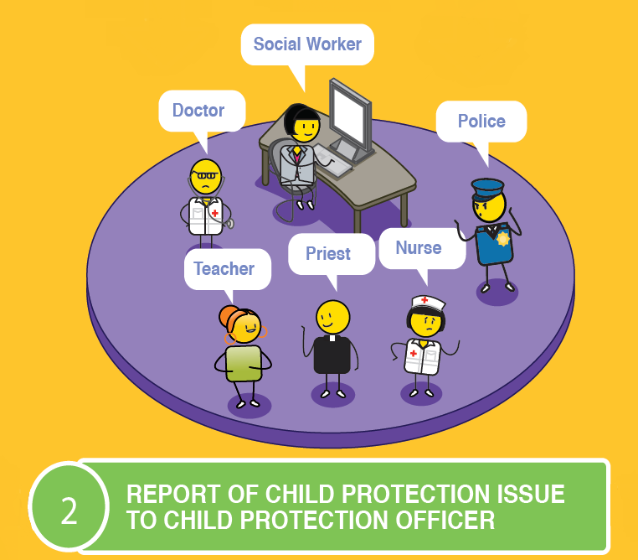
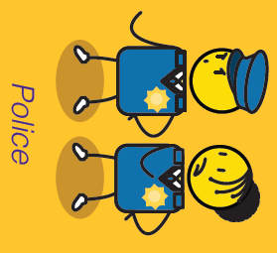
CHILD PROTECTION AND SAFEGAURDING

Slide 11
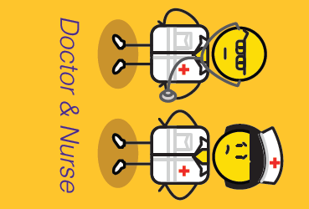
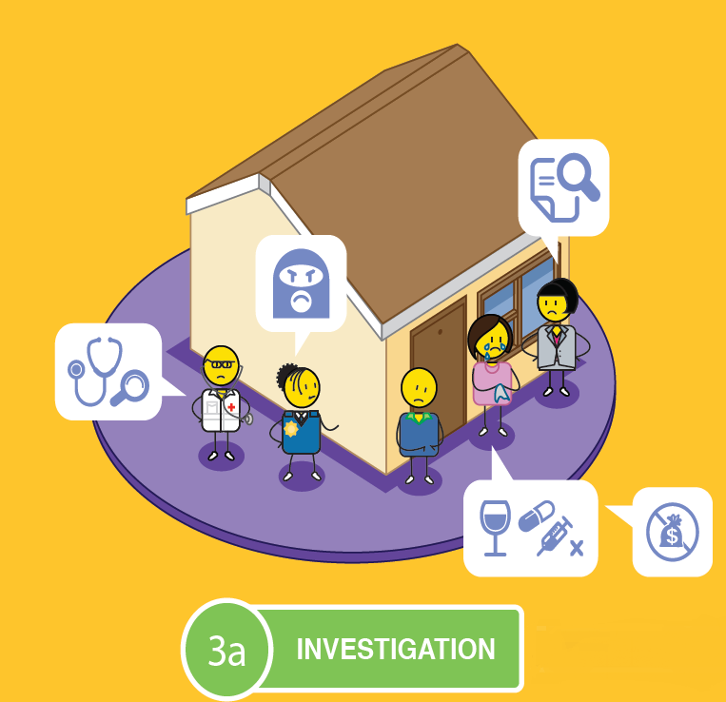
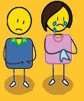
CHILD PROTECTION AND SAFEGAURDING
Parents

Slide 12
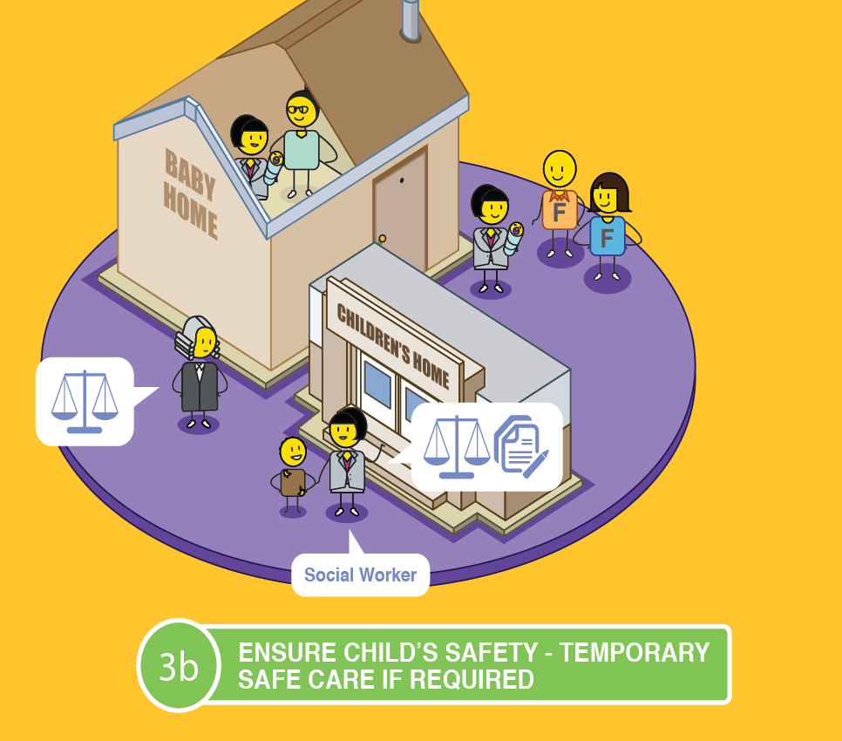
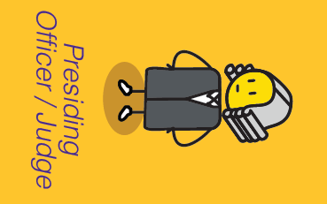
CHILD PROTECTION AND SAFEGAURDING
Foster Parents

Slide 13
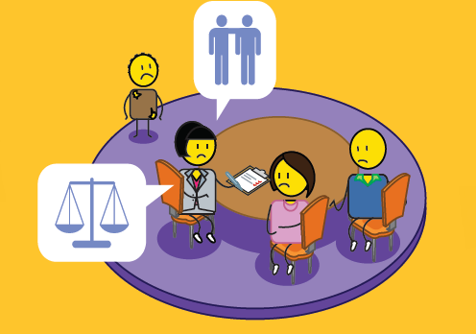
CHILD PROTECTION AND SAFEGAURDING
Parents

Slide 14
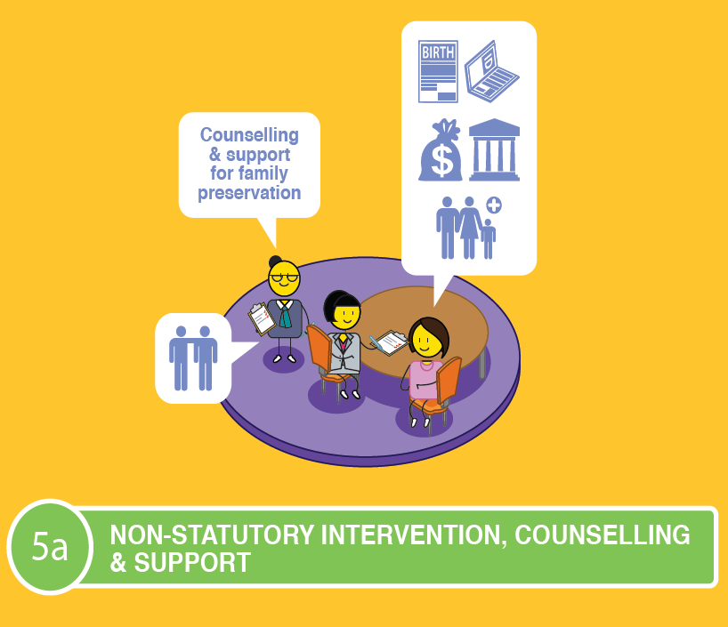
CHILD PROTECTION AND SAFEGAURDING
Parents
OR

Slide 15
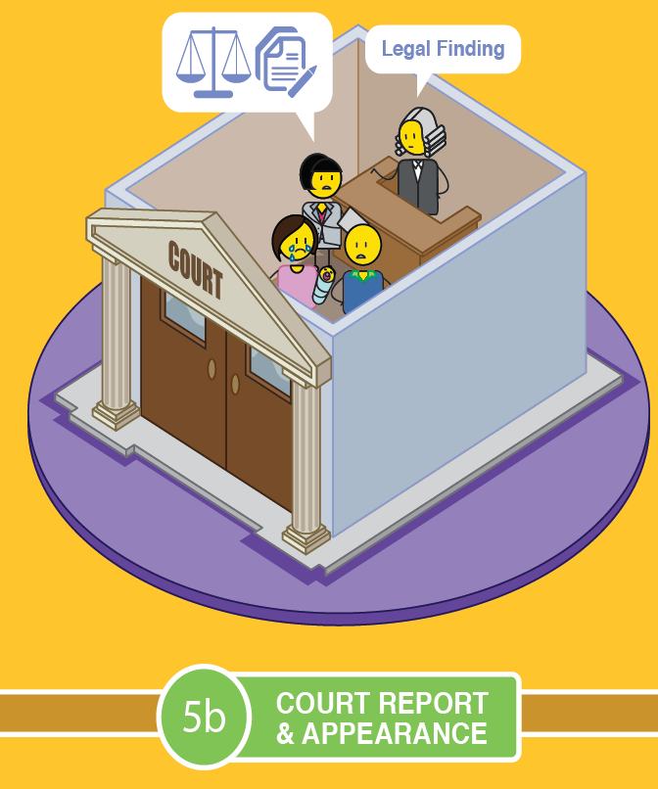
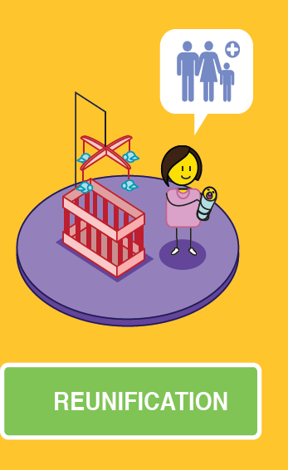
CHILD PROTECTION AND SAFEGAURDING
Parents
OR

Slide 16
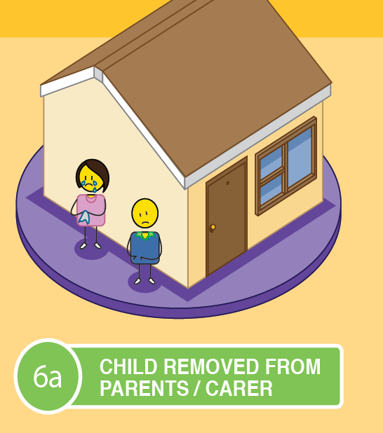
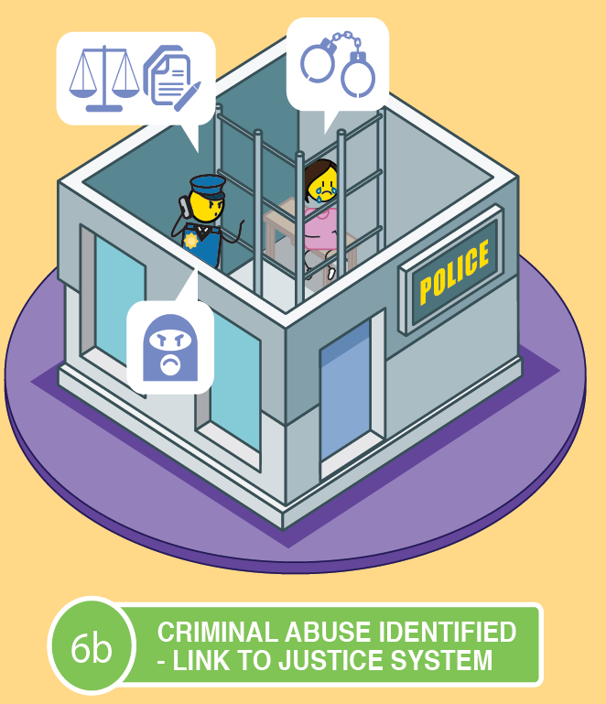
CHILD PROTECTION AND SAFEGAURDING
Parents
OR

Slide 17
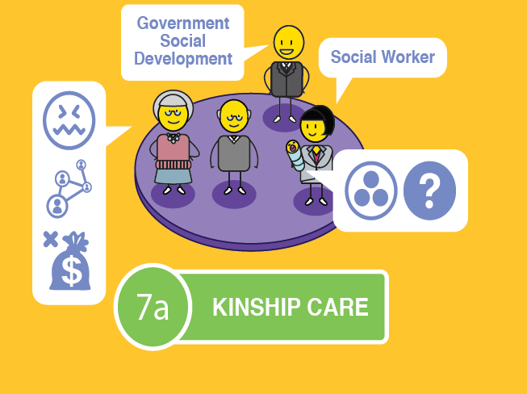
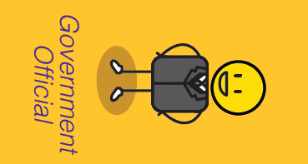
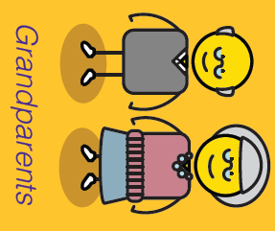
CHILD PROTECTION AND SAFEGAURDING

Slide 18
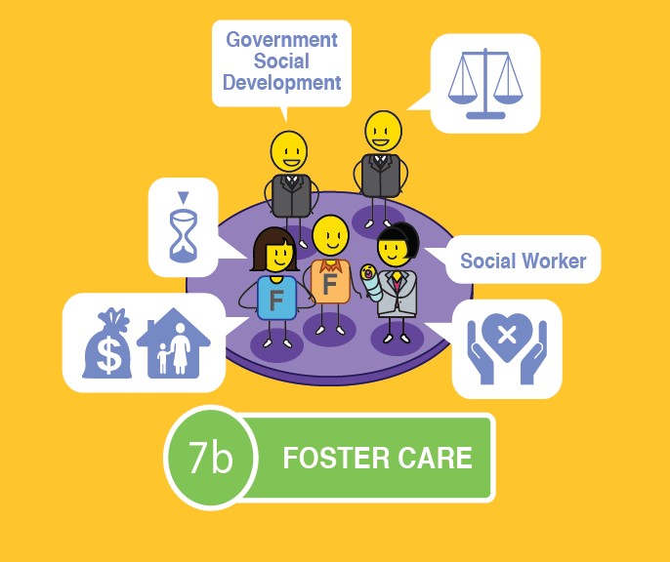
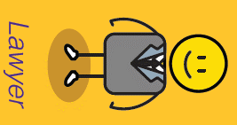
CHILD PROTECTION AND SAFEGAURDING
Foster Parents

Slide 19
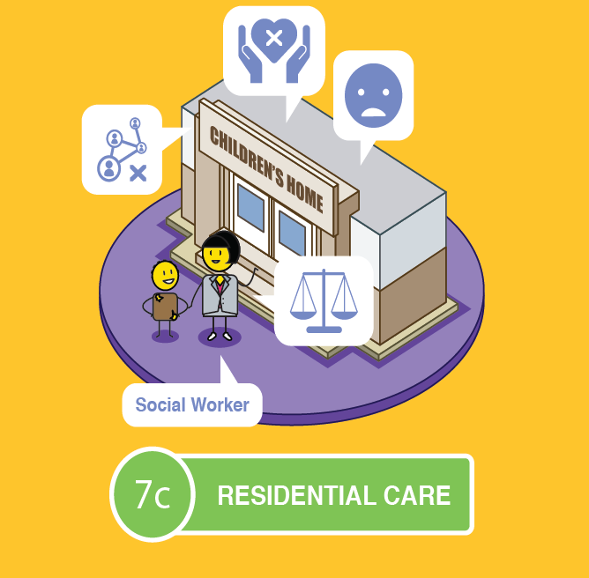
CHILD PROTECTION AND SAFEGAURDING
No

Slide 20
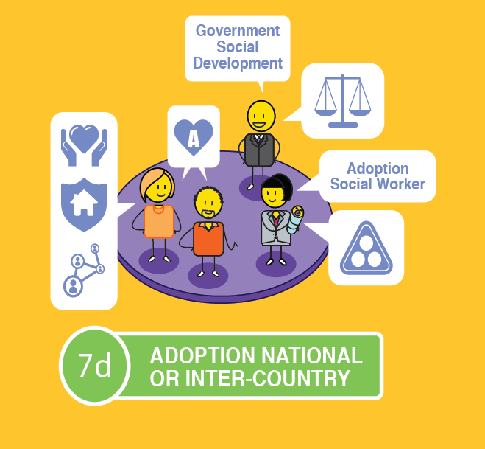
CHILD PROTECTION AND SAFEGAURDING
Adoptive Parents

Slide 21
Take action
The most important thing you can do to prevent or stop child neglect, abuse or exploitation is to take action by speaking up!
Notes:
The most important thing you can do to prevent or stop child neglect, abuse or exploitation is to take action by speaking up!

Slide 22
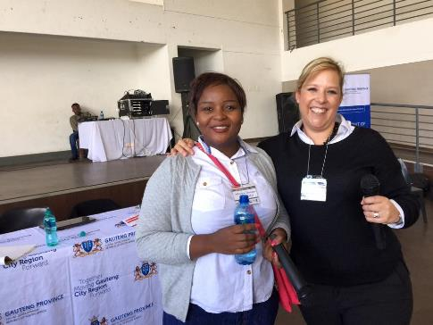
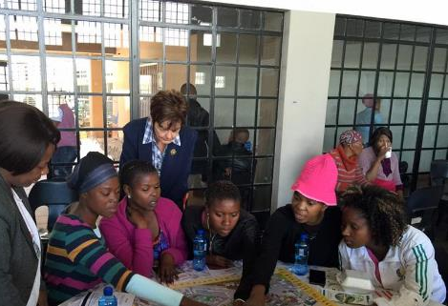
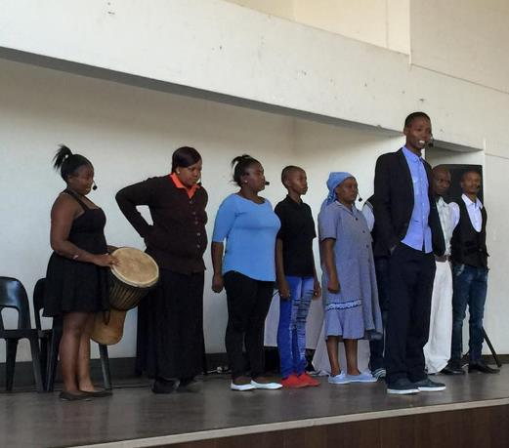
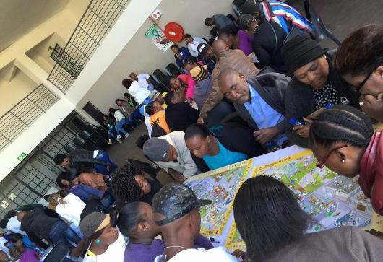
Notes:
Understanding the process at a community workshop in Evaton, Sedibeng.

Slide 23
stay strong
take
www.couragechildprotection.com
Notes:
Thanks for watching, stay strong and take courage.

