Slide 1
take
www.couragechildprotection.com

Slide 2
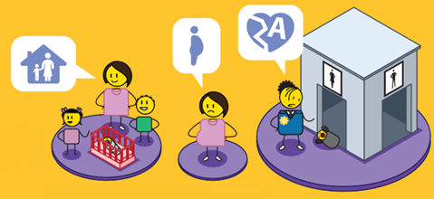
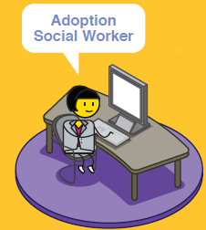
CHILD PLACEMENT THROUGH ADOPTION
universal needs of the child

Slide 3
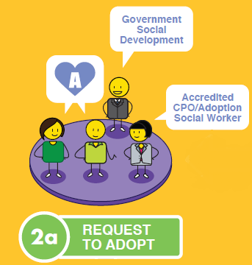
CHILD PLACEMENT THROUGH ADOPTION
universal needs of the child

Slide 4
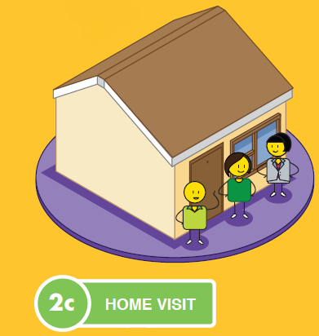
CHILD PLACEMENT THROUGH ADOPTION
universal needs of the child

Slide 5
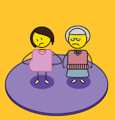
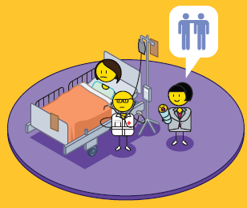
CHILD PLACEMENT THROUGH ADOPTION
universal needs of the child

Slide 6
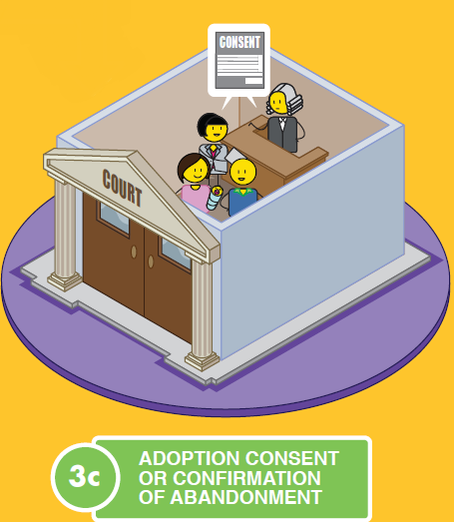
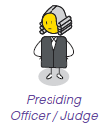
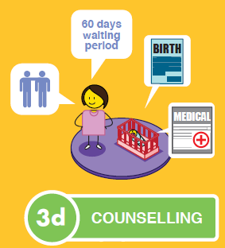
CHILD PLACEMENT THROUGH ADOPTION
universal needs of the child

Slide 7
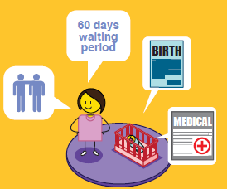
CHILD PLACEMENT THROUGH ADOPTION
universal needs of the child

Slide 8
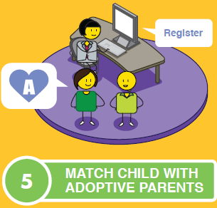
CHILD PLACEMENT THROUGH ADOPTION
universal needs of the child
OR

Slide 9
CHILD PLACEMENT THROUGH ADOPTION
universal needs of the child

Slide 10
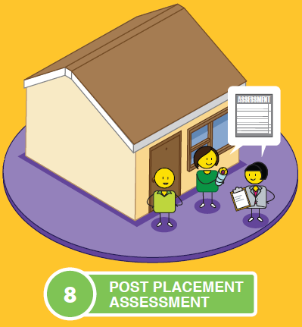
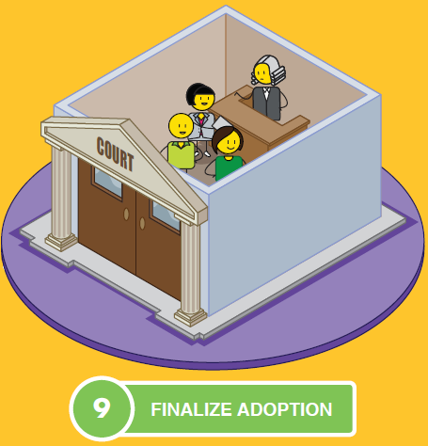
CHILD PLACEMENT THROUGH ADOPTION
universal needs of the child

Slide 11
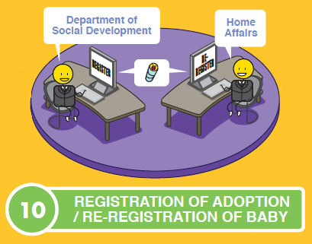
CHILD PLACEMENT THROUGH ADOPTION
universal needs of the child

Slide 12
stay strong
take
www.couragechildprotection.com
Notes:
Thanks for watching, stay strong and take courage.

