Slide 1
take
www.couragechildprotection.com

Slide 2
Now that we understand the importance of child protection what can we do to differently?
Notes:
Now that we understand the importance of child protection what can we do differently?

Slide 3
Notes:
Overview

Slide 4
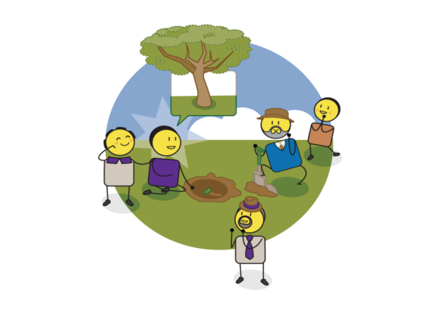
Presence & action
Notes:
This exercise relates to the empowerment driver of PRESENCE & ACTION.

Slide 5
What should we ask?
Notes:
What should we ask?

Slide 6
How should we answer?
From today what will can we stop doing? What can we start doing? What can we continue doing? In the protection of our children and achievement of our child protection vision?
ACTION PLANNING
Notes:
The first question you should ask yourself and your team or community is what is going to change? Ask yourselves, from today, what will I stop doing? What will I start doing? And what am I/we already doing that we should continue doing?

Slide 7
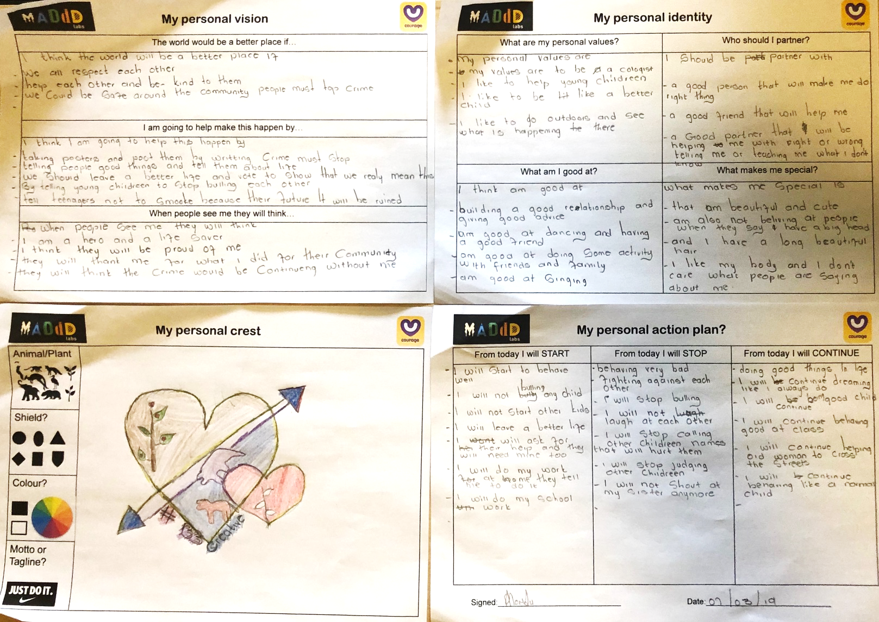
Notes:
Turning our action plan into a personal vision statement, identity, crest and pledge that is signed and dated.

Slide 8
CHILD PROTECTION STRATEGY OVERVIEW
Overarching
Vision & Values for your
Child Protection Plan
What do we want to achieve?
(Child Rights & Needs)
What is the reality
of our children?
(Child Protection Challenges)
Quarterly Review
Identify & Prioritise
Strategy Objectives
Annual
Strategic Planning
Process
Action Plan
(What, Who, When,
Where, Why & How)
Partnership Plan
(Roles & Responsibilities)
Implementation &
Measurement/Evaluation
Notes:
Developing your child protection strategy.

Slide 9
CHILD PROTECTION VISION & VALUES
OUR CHILD PROTECTION VISION (The world we would like to create for the children in our community) | CHILD PROTECTION VALUSE (The values we believe in that will help us achieve our vision
1. | 1.
2. | 2.
3. | 3.
4. | 4.
5. | 5.

Slide 10
RANKING OF CHILD PROTECTION CHALLENGES (MEASUREMENT)
CHILD PROTECTION CHALLENGE | R A N K | CHILD PROTECTION CHALLENEG | R A N K | CHILD PROTECTION CHALLENGE | R A N K | CHILD PROTECTION CHALLENGE | R A N K | CHILD PROTECTION CHALLENGE | R A N K
Poverty & Inequality |  | Abandoned |  | No Registration or Identity |  | Child Trafficking |  | Street Children, Unaccompanied Minors & Refugees
Teenage Pregnancy |  | Abuse in the Justice Care System |  | Poor Nutrition |  | Child Marriage |  | Bullying
Late Termination of Pregnancy |  | Physical Abuse |  | No/Poor Healthcare |  | Virginity Testing |  | Abuse of children with disabilities
Stigma/Abuse of Pregnant Mothers |  | Corporal Punishment |  | No Education or Schooling |  | Female Genital Mutilation & Circumcision |  | Violence against Sexual Minorities
Drug & Alcohol Abuse In-Utero (FASD) |  | Murder & Attempted Murder |  | Sexual Abuse & Rape |  | Harmful Male Circumcision |  | Exposure to Gangsterism
Mother to Baby HIV Transmission |  | Emotional Abuse |  | Child Labour |  | Body Parts used for Traditional Medicine |  | Self Harming & Suicide
Orphaned |  | Neglect |  | Commercial Sexual Exploitation |  | Child Headed Households |  | Addiction

Slide 11
CHILD PROTECTION PRIORITIES
HIGH PRIORITY CHALLENGES? | MEDIUM PRIORITY CHALLENGES? | LOW PRIORITY CHALLENGES?
1. | 1. | 1.
2. | 2. | 2.
3. | 3. | 3.
4. | 4. | 4.
5. | 5. | 5.
6. | 6. | 6.
7. | 7. | 7.
8. | 8. | 8.
9. | 9. | 9.
10. | 10. | 10.

Slide 12
IDENTIFYING STRATEGIC PRIORITIES
SHORT TERM
MEDIUM TERM
LONG TERM
Priority 1
Priority 3
HIGH
Priority 2
WHAT IMPACT WILL THIS HAVE ON MY COMMUNITY?
MEDIUM
LOW
LOW
MEDIUM
HIGH
HOW DIFFICULT WILL THIS BE TO IMPLEMENT/SOLVE?

Slide 13
CHALLENGES, DISEMPOWERMENT & EMPOWERMENT THEMES
1. | 1. | 1. | 1. | 1. | 1. | 1.
2. | 2. | 2. | 2. | 2. | 2. | 2.
3. | 3. | 3. | 3. | 3. | 3. | 3.
4. | 4. | 4. | 4. | 4. | 4. | 4.
5. | 5. | 5. | 5. | 5. | 5. | 5.

Slide 14
CHILD PROTECTION EMPOWERMENT STRATEGIES
What is/are the empowerment driver/s that will ensure a meaningful change inbehaviour/s? (Describe as a tangible programme, campaign or specific actions you can take in your community)
1.
What is/are the disempowerment driver/s? (Describe these in the context of your community)
3.
What is/are my child protection challenge/s? (Describe how the challenge/s shows up in your community)
5.

Slide 15
STRATEGIC CHILD PROTECTION PARTNERSHIPS OVERVIEW

Slide 16
CHILD PROTECTION WIN/WIN PARTNERSHIP PLANS
What do I/we need to get? |  |  | What do I/we need to get?
1. |  | 3. | 1. |  | 3.
2. |  | 2. | 2. |  | 2.
3. |  | 1. | 3. |  | 1.
 |  | What do I/we need to give? |  |  | What do I/we need to give?
What do I/we need to get? |  |  | What do I/we need to get?
1. |  | 3. | 1. |  | 3.
2. |  | 2. | 2. |  | 2.
3. |  | 1. | 3. |  | 1.
 |  | What do I/we need to give? |  |  | What do I/we need to give?

Slide 17
CHILD PROTECTION STRATEGIC ACTION PLANS
CHILD PROTECTION PRIORITY:
WHAT & WHY | MEASUREMENT & EVALUATION
Define what you want to achieve with this goal or priority? Define why you are doing it, in relation to achieving your child protection vision? Remember your empowerment drivers to ensure that you are using an empowered mindset to solve this challenge. | Identity they key measures of success for this priority? (Ask yourself, ‘what would success look like if we achieved this?’) How would you measure whether you have achieved this priority or not? How often and when would you measure whether you have achieved this priority?
HOW | WHO | WHEN
How are you going to achieve this priority? (Use the Child Protection Strategy Maps to help you answer this question) | Who is responsible for delivery? Remember to include your child protection partners. | When must it be delivered by?

Slide 18
CHILD PROTECTION BEHAVIOUR CHANGE
FROM TODAY I WILL STOP? | FROM TODAY I WILL START? | FROM TODAY I WILL CONTINUE?
1. | 1. | 1.
2. | 2. | 2.
3. | 3. | 3.
4. | 4. | 4.
5. | 5. | 5.

Slide 19
dee@bobi.co.za
stay strong
take
www.couragechildprotection.com
Notes:
Thanks for watching, stay strong and take courage.

