Slide 1
take
www.couragechildprotection.com

Slide 2
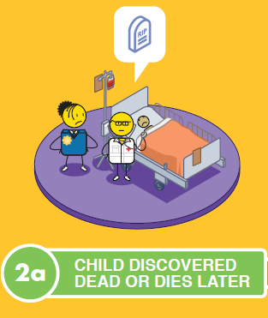
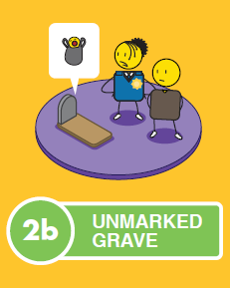
ABANDONED CHILD PROTECTION PROCESS
universal needs of the child

Slide 3
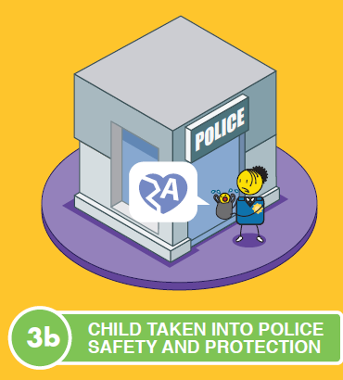
ABANDONED CHILD PROTECTION PROCESS
universal needs of the child

Slide 4
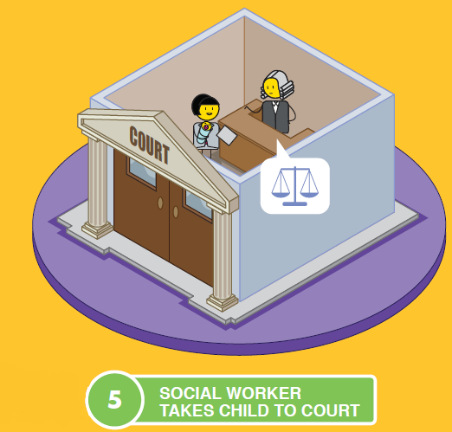
ABANDONED CHILD PROTECTION PROCESS
universal needs of the child

Slide 5
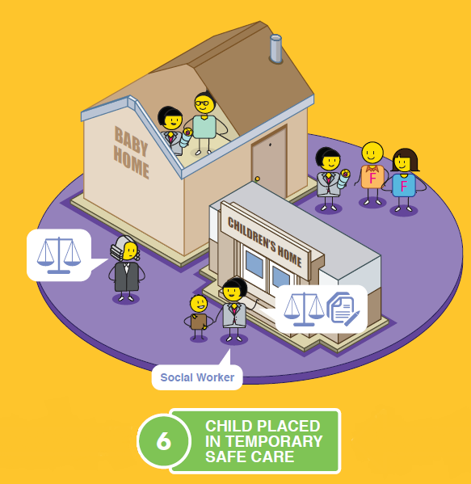
ABANDONED CHILD PROTECTION PROCESS
universal needs of the child

Slide 6
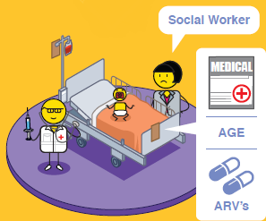
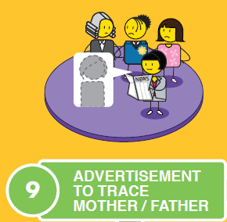
ABANDONED CHILD PROTECTION PROCESS
universal needs of the child
AGE
Assessment
Medical Assessment
Advertisement

Slide 7
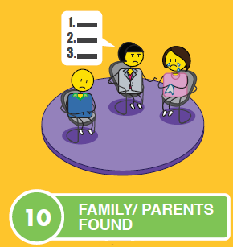
ABANDONED CHILD PROTECTION PROCESS
universal needs of the child

Slide 8
ABANDONED CHILD PROTECTION PROCESS
universal needs of the child

Slide 9
ABANDONED CHILD PROTECTION PROCESS
universal needs of the child

Slide 10
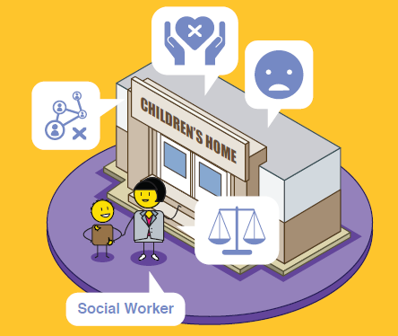
ABANDONED CHILD PROTECTION PROCESS
universal needs of the child
INSTITUTIONAL

Slide 11
ABANDONED CHILD PROTECTION PROCESS
universal needs of the child

Slide 12
ABANDONED CHILD PROTECTION PROCESS
universal needs of the child

Slide 13
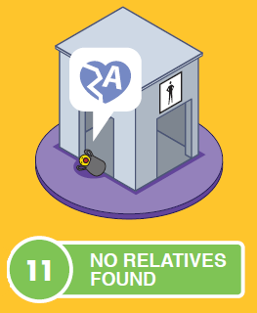
ABANDONED CHILD PROTECTION PROCESS
universal needs of the child

Slide 14
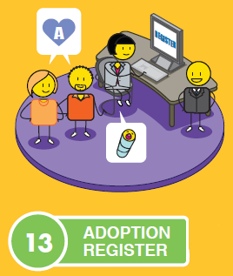
ABANDONED CHILD PROTECTION PROCESS
universal needs of the child

Slide 15
stay strong
take
www.couragechildprotection.com
Notes:
Thanks for watching, stay strong and take courage.

