Slide 1

The story of
Notes:
This is the story of how I developed Courage, a child protection community engagement programme aimed at empowering individuals, families and communities around the world.

Slide 2
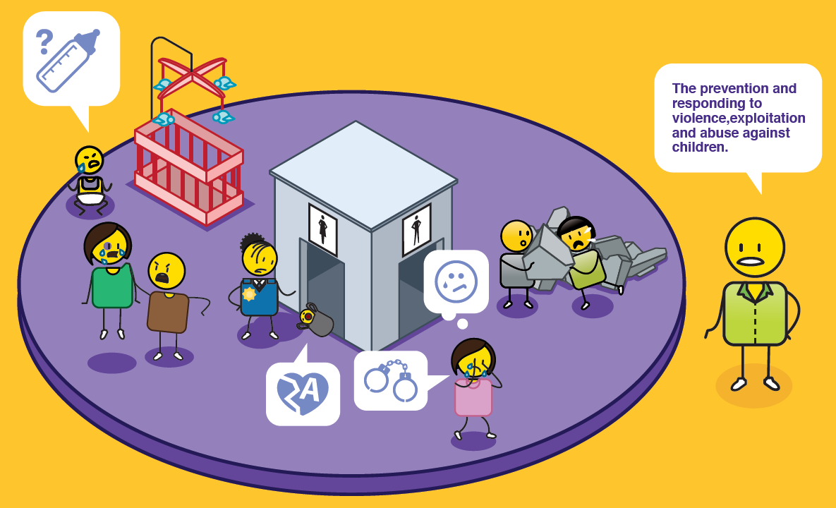
What is child protection?
Notes:
Child protection is the prevention and responding to violence, exploitation and abuse against children.

Slide 3


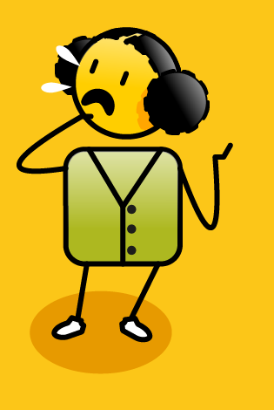
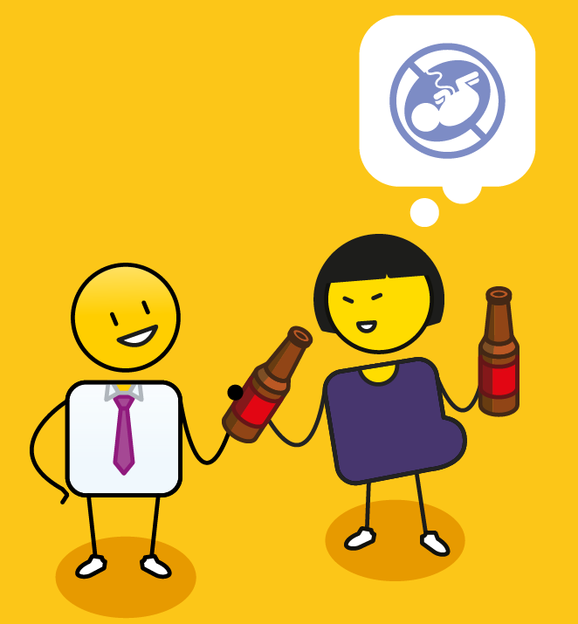
Why is it important?
depression
anxiety
post traumatic stress
learning disorders
suicide
toxic stress
substance abuse
developmental challenges
violence
poor self regulation
risky sexual behaviour
Notes:
It is VERY important, as issues such as child abuse, neglect and exploitation can lead to anxiety, depression, suicide, learning disorders, post traumatic stress and developmental challenges. In the long term, a life of violence, can result in substance abuse, poor self regulation, risky sexual behaviour and toxic stress that impacts negatively on a person's health and wellbeing.

Slide 4



















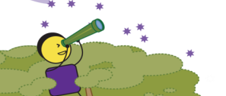



Hi I’m Dee Blackie
Notes:
My name is Dee Blackie, and in the 90’s and 2000’s I spent most of my time helping some amazing South African and Global brands to develop their visions.

Slide 5
Understanding the
process of change
Notes:
The problem is, when you introduce something new, even if it is an inspiring new vision, people get scared. Change is scary after all. So by default, in the process of developing all of these inspiring visions, I had to become an expert in change management.

Slide 6
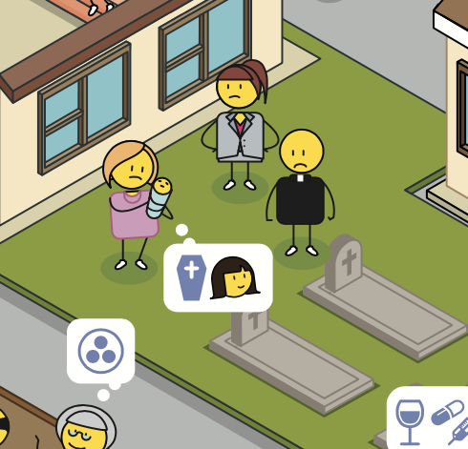
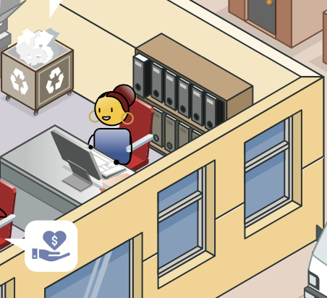
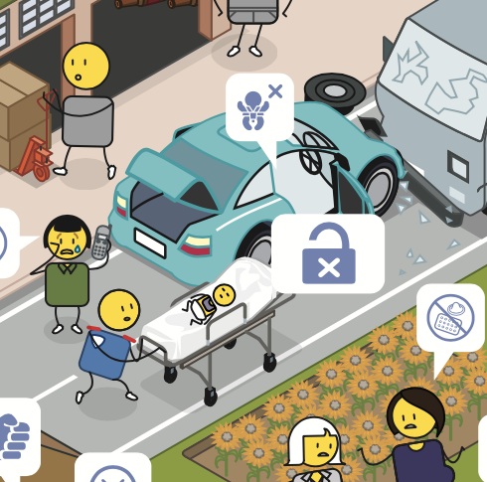
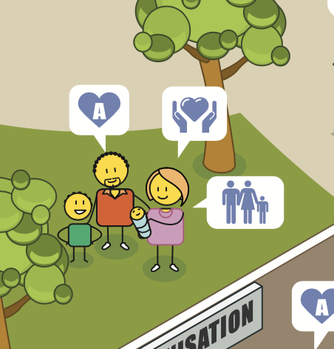
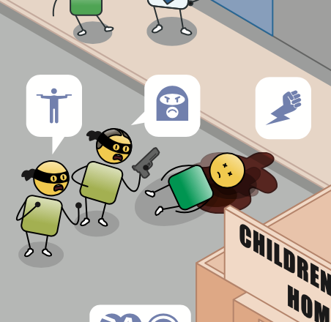
Notes:
In this I was inspired by Elizabeth Kubler Ross, a Swiss psychiatrist who studied the how people grieve, and identified a number of stages that people go through when they lose someone close to them. Any change is actually a loss and is experienced as this. So whether you lose a loved one, or you change your job, or your company gets bought out by a new brand, you are still going to go through these stages of change.

Slide 7





The process of change*
HOLDING ON
LETTING GO
MOVING ON
* Inspired by Elisabeth Kubler Ross Stages of Grief
CONFIDENCE LEVELS
TIME
Notes:
I have summarised the stages and added a few more of my own, but essentially people go through three major phases. A holding on phase, where you hold onto the past, a letting go phase, where you let go of the past, and a moving forward phase where you have engaged with the change, and grown through the process. These phases happen over time and impact dramatically on your levels of self confidence.

Slide 8







The process of change*
HOLDING ON
LETTING GO
MOVING ON
MOVING FORWARD
DENIAL
TESTING
SHOCK
* Inspired by Elisabeth Kubler Ross Stages of Grief
CONFIDENCE LEVELS
AWARENESS
UNDERSTANDING
ACCEPTANCE
TIME
Notes:
So when something new happens that has a profound impact on you and your life, the first response is that of shock – I can’t believe this has happened. Then we go into denial – I refuse to believe this has happened. But slowly but surely it dawns on us that our world has changed and we move into awareness and finally acceptance. The important point to note at this stage is that it is a very health phase as we are moving from holding onto the past to letting go, the only problem is our confidence levels are very low – what does this mean for me, my job, how should I behave? As quickly as possible a good change management process will get you to the phase of understanding and testing – this is what it means, this is how your job will change and this is how you should behave. Finally you move forward, and it’s important to note that you will always be in a better position when you move forward, as people grow through change. One of the biggest issues I encountered in these visioning processes is that a company’s leadership would develop a new vision, they would go through shock, denial, awareness, acceptance and understanding and at the point of testing they would tell the rest of their organisation. They would then find it really frustrating when their people started to go through shock, denial, and so on, so this is a useful picture to remind people that change is a process.

Slide 9



Model for change management
BYSTANDERS
STARS
DO I UNDERSTAND THE VISION & MY ROLE IN DELIVERING IT
LOST SOULS
LOOSE CANNONS
DO I LIVE THE VISION WITH PASSION & COMMITMENT
(VALUES INTO BEHAVIOURS)
Notes:
In the early days, I used a really simple model to help people engage with change, which looked at two key dimensions. The first was, “do the employees understand what the company vision is” and secondly, “do they live this vision with passion and commitment”. Simply put, we needed to make sure everyone knew what the vision actually was and secondly, we needed to make sure that they had converted the organization's values into specific behaviours, that they could deliver on every day. On these two dimensions, you had four kinds of people, the poor old ‘lost souls’, who neither knew what the vision was nor the values and were therefore coming to work every day for a paycheck. The second group were the ‘bystanders’, who knew what the vision was, but believed that the reason people bought into the brand was because of them, not this amazing organisations they worked for. The third group, the ’loose cannons’, were extremely passionate about the company they worked for, but unfortunately, were often saying all the wrong things to all the right people most of the time as they did not know what the unifying vision was. And finally, there were the stars who lived the vision with passion and commitment. The only problem was, I found in more and more organisations that even if people knew their vision and values, many were so disempowered that they did not know how to effect real change.

Slide 10

What drives
personal & community empowerment?
Notes:
So I sent myself a challenge, I asked myself, ”what drives personal and community empowerment”, and I then spent the next few years exploring this. Having read tons of books on personal empowerment, infinite possibility, leadership, and spiritual enlightenment, I noticed that the same seven themes came up over and over again. Interestingly they were tools that I used in the world of branding, and the more I talked to people about them, the more I could tell when an organisation and the people within it were empowered and when they were not.

Slide 11
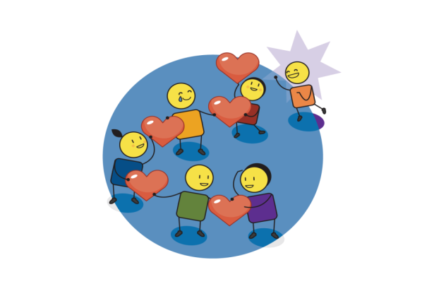
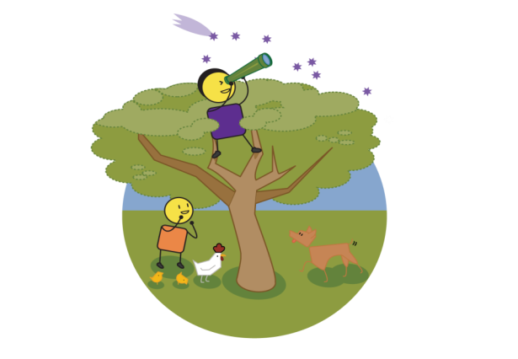
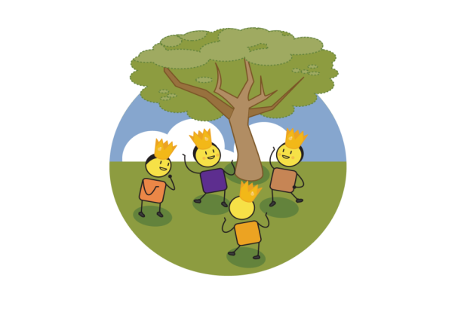
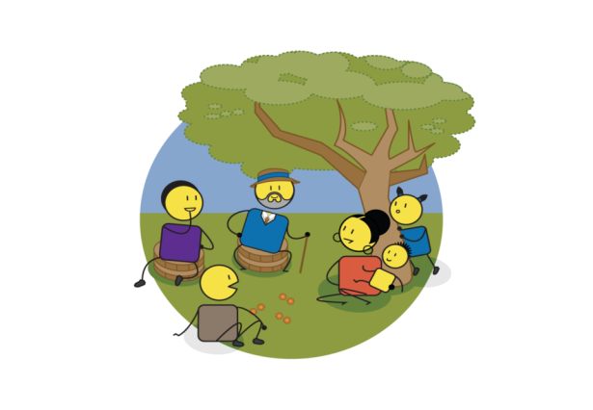
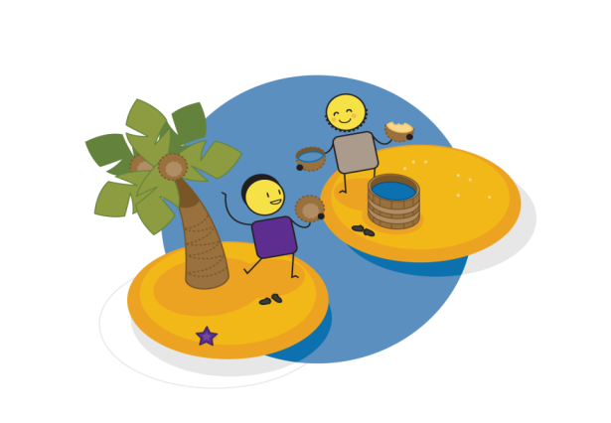
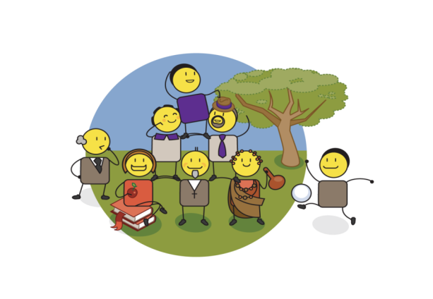
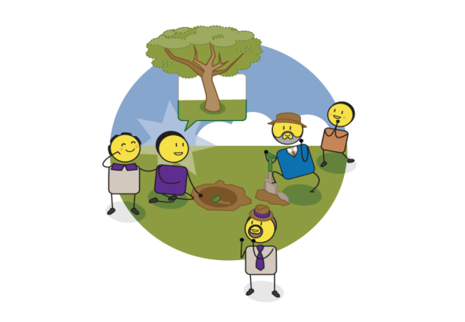
LOVE & HARMONY
VISION & PURPOSE
SELF ESTEEM & SELF WORTH
Are you empowered?
PARTNERSHIP & COLLABORATION
KNOWLEDGE & INSIGHT
VALUES & BELIEFS
PRESENCE
& ACTION
Notes:
As an individual, a company or a community, answering these seven questions will help you to understand how empowered you are. 1) Firstly, what are your values and beliefs? 2) Who do you partner with and how do you partner them? 3) What is your level of self esteem and self worth? 4) How are you building love, harmony and a sense of togetherness in your organisation, rather than getting everyone to compete against each other for your favour? 5) What is your vision and purpose? 6) How do you continue to build this through ongoing knowledge and insight? 7) And finally, how are you turning all of these good things into real and tangible actions every day? As the picture illustrates, if you want to grow a tree tomorrow, you have to plant a seed today!

Slide 12
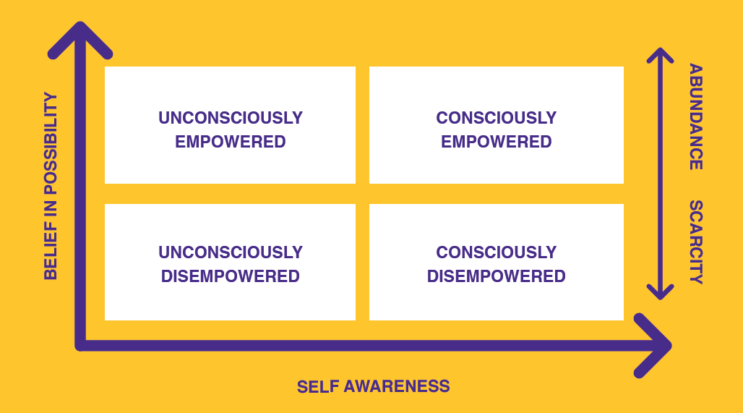
To build personal & community empowerment
3 simple steps:
1. Believe in possibility
2. Build self awareness
3. Focus on abundance
Notes:
And this was how I explained it to people. Simply put, building personal and community empowerment takes 3 steps, firstly, you need to believe in possibility, secondly, you need to have some level of self awareness and finally you need to do these two things in the context of abundance.

Slide 13
To build personal & community empowerment
Notes:
If you think about it, when we are young, we all have a relatively high level of belief in possibility, but we are not particularly self aware. We are what I term ‘unconsciously empowered’, we believe we can be anything and do anything, we are just not sure how at this point.

Slide 14
To build personal & community empowerment
Notes:
Then different people arrive in our lives and tell us, well you can’t actually be what you want to be, because of your age, or the colour of your skin, or the fact that you are a girl, or a boy, or you are too old, you get the picture. Suddenly we find ourselves in the space of being ‘unconsciously disempowered’, we no longer believe anything is possible and we don’t know why we are in such a dark hole.

Slide 15
To build personal & community empowerment
Notes:
Interestingly, the people that put us in these dark holes are the ‘consciously disempowered’, and this is the third dimension we need to be aware of. These people have a high degree of self awareness, they are often very clever, but their vision is based on scarcity rather than abundance. They believe that there will never be enough for everyone in the world, and so the only way to get what they want, is to take it away from other people.

Slide 16
To build personal & community empowerment
Notes:
And obviously where we want to be is consciously empowered, so how do we do this?

Slide 17
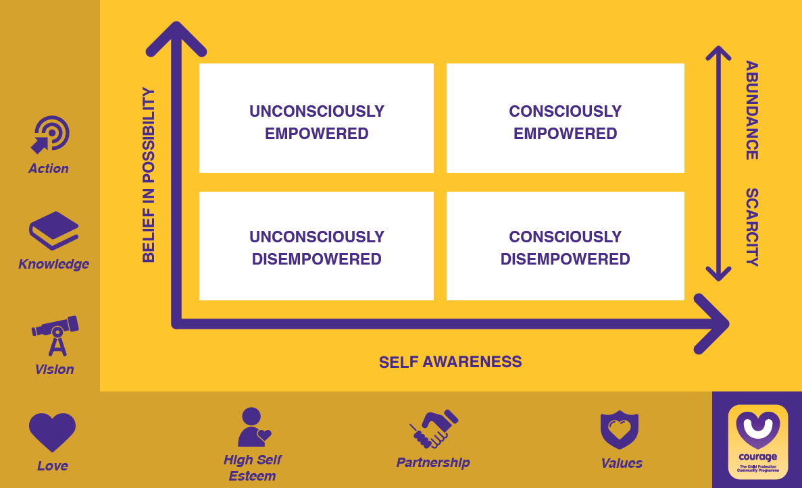
To build personal & community empowerment
Notes:
Well, to build self awareness, we need to know what our values and beliefs are, we need to partner with other people to test these values and beliefs, and we need to ensure that we have a healthy sense of self esteem and self worth and that we are adding value to the world around us.

Slide 18
To build personal & community empowerment
Notes:
To build our belief in possibility, we need to have a vision for ourselves, a purpose for our lives. We need to build on this constantly through gaining knowledge and insight and finally we need to turn this vision, knowledge and insight into action, preferably on a daily basis.

Slide 19
To build personal & community empowerment
Notes:
And finally we need to build our self awareness and belief in possibility in the context of love and abundance, with the knowledge that there is more than enough for everyone to live their best life in this world.

Slide 20
To build personal & community empowerment
Notes:
So this was my new approach to business and brand engagement and the impact was quite frankly profound in every organisation I engaged with.

Slide 21

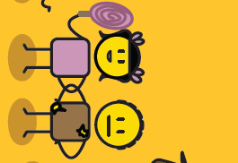
Personal level of grief & profound change
Notes:
At the time of all of this consulting work, I was, however, also going through some profound grief and change of my own. I have two beautiful children, but I also lost seven little stars through miscarriage, the final one in 2009 which left me infertile and struggling with post-partum depression.

Slide 22

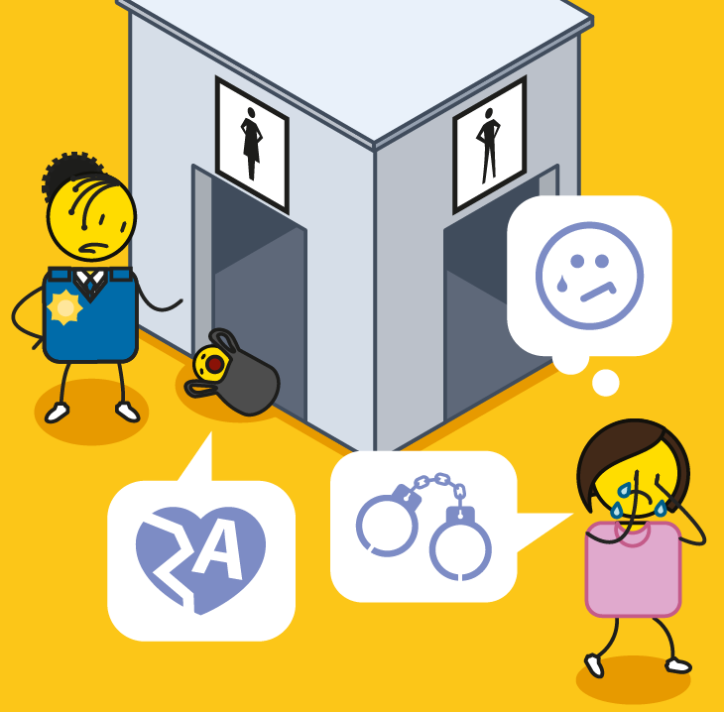

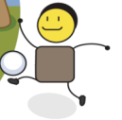


2010
Notes:
I decided to take a break from consulting in 2010 and spend some time with my family. It was World Cup year so we had a wonderful time making Makarapas, learning the Diski dance and blowing our vuvuzelas for Bafana Bafana our soccer team. In July, however, just as the tournament had started, I was shocked to see a picture in a local news paper of a new born baby who had been abandoned and died on a rubbish heap on the outskirts of a township in Johannesburg where I live. I was heart broken! I decided to contact some of the child protection organisations I had worked with in the past and to ask them what was going on. They were in despair and told me that in the past they would get a few children abandoned every month into their care, but now they were getting 5 or 6 children abandoned every week… this was a real problem!

Slide 23



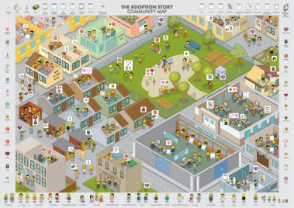
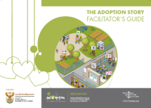


Notes:
I decided to roll up my sleeves and get involved in the chid protection community, which led to a number of new adventures. In 2011 I helped to facilitate the formation of a National Adoption Coalition for South Africa. Why adoption you may ask, well when you have been abandoned and there is no way to track down your biological family, the best long term outcome for a child is to be adopted into a family where they can belong. We defined a new vision which was about empowering the child protection community, to create positive and permanent change in the lives of our children, and I developed a range of community engagement posters which we used to talk to people about crisis pregnancy, child abandonment and adoption with a wonderful picture based training company called Trainiac . I also decided to go back to university to complete my masters degree exploring the lived experience of child abandonment in South Africa.

Slide 24


To develop a programme that helps to improve the gatekeeping function of child protection officers around the world?
Notes:
Whilst presenting on my research and training programme at the Nordic Adoption Conference of 2013, I was approached by the Swedish Foundation for Children without Parental Care, to develop a new community engagement programme. Unbeknownst to me, my existing training was being used across Africa on the theme of child protection. The Foundation asked whether I could develop a programme that would help to improve the gatekeeping functions of child protection officers around the world.

Slide 25
Where to start?
Notes:
The first question was where do I start?

Slide 26
Segmenting Child Protection
WHO
WHAT
HOW
Child?
Perpetrator?
Protector?
Child protection challenges?
Interventions?
Reason for child protection challenge?
When do these challenges occur?
Where do these
challenges
occur?
WHY
WHEN
WHERE
Notes:
I decided to use the trusted business tool of segmentation to understand the world of child protection better. This involved exploring this world from a number of different perspectives, which included the WHO, who is the child, the perpetrator, the child protection officer? The WHAT, what are all the child protection challenges that exist out there in the world today? The HOW, what are all of the current child protection solutions currently supporting child protection officers? The WHERE, where do most child protection challenges to place, the home, the school, the community? The WHEN, when do different child protection challenges take place, in utero, as a new born, as a toddlers, as children, teens and so on, and finally, the WHY, or more specifically what reasons perpetrators of child protection challenges give for abusing, neglecting or exploiting a child? And finally how do all of these issues relate to each other?

Slide 27
This exercise revealed a number of key insights into the world of child protection and where this new programme could add value
Notes:
This revealed a number of key insights into the world of child protection and where this new programme could add value.

Slide 28

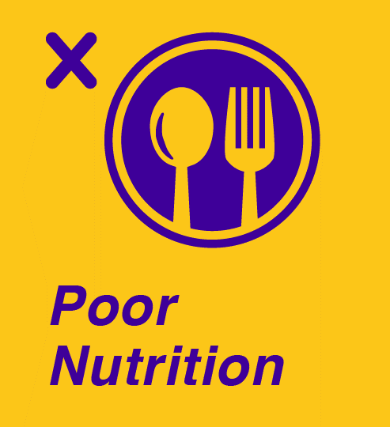



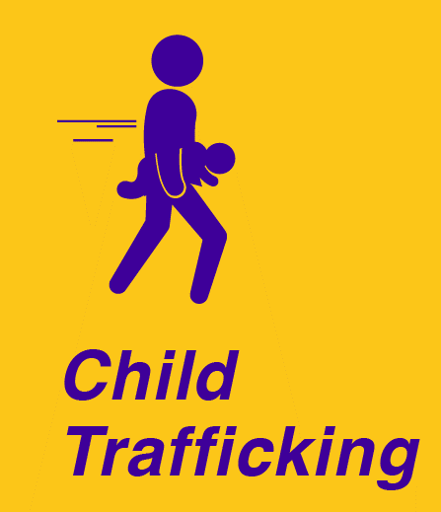

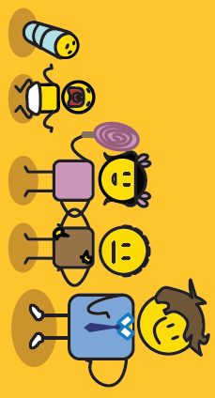
Most programmes place the problem rather than the child at the centre of their solution
Notes:
The first insight was that most of the existing programmes place the problem rather than the child at the centre of their solution, so you will have a poverty alleviation solution, or a nutrition solution, or an abuse solution or a trafficking solution. But what happens when you get a child who has been abandoned at a very young age, they are HIV positive as they were trafficked into the sex industry, they have not attended school and they have never eaten a decent meal. It changes our perspective when we build our solutions around the child rather than trying to see who fits into which child protection programme.

Slide 29
All child protection challenges are based
on some form of disempowerment
Notes:
The second key insight was that all child protection challenges are based on some form of disempowerment.

Slide 30
NEGLECT & NON-DELIVERY | Lack of or no infrastructure, resources or service delivery | Lack of social services and support to those at risk | Lack of legislative framework and protection | Lack of convictions or consequences for perpetrators | Ongoing urbanisation and migration
IGNORANCE & CORRUPTION | No insight, measurement or evaluation of child protection challenges | No monitoring of the quality or quantity of child protection solutions | Lack of reporting of child protection challenges (due to fear or accessibility) | Lack of awareness or agreement of what constitutes child protection challenges | Lack of education and understanding of what children need/want
APATHY & ADDICTION | No leadership within the family (Absent mother, father or both) | No role models or inappropriate role models & Group ID (Gangsterism) | No shared vision on the role of children and societies need to protect them | Problematic view on right and wrong by leadership (political, soc, cult, religious) | No shard vision of child rights, needs and protection (Best interests)
ABUSE, HATE & NO FORGIVENESS | Fragmented families – lack of involvement and supervision (no sense of belonging) | Abuse Parental conflict Domestic violence | Inability to forgive and the desire for revenge | Children socialised into violence as primary means to resolve conflict | Unable to empathise with victim (Lack of social attachment)
LOW SELF ESTEEM | Low self esteem & disempowerment | No internal locus of control & deluded view of children | Harsh and inconsistent discipline | Poor school attachment | Impact of HIV & AIDS (Social stigma)
ISOLATION & EXPLOITATION | Break down in family relations across & between generations | Breakdown or lack of communication within family (close & extended) | Community fear of law enforcement | Lack of partnership in communities (working together to solve problems) | Lack of partnership in government (no inter-sectorial collaboration)
VIOLENCE & INEQUALITY | Poverty & inequality | Drug & alcohol abuse | Social, religious & cultural norms and practices (patriarchy & masculinity) | Discrimination: Gender/women Age/children Race (Apartheid) Nationality (Xenophobia) Sexual orientation | Tolerance of/ or exposure to violence in home, community, society & easy access to weapons
Notes:
I realised this when I was trying to explore the area of WHY in my segmentation process. What was fascinating was that all of the reasons that perpetrators gave for abusing, exploiting or neglecting children fit almost perfectly into the opposite driver of the seven empowerment areas I discussed before. Instead of values, there was general violence and inequality. Instead of partnership, you had isolated individuals who were often exploited. Instead of high self esteem you had low self esteem. Instead of love and harmony, you had hate and fear and a lack of forgiveness. Instead of having a vision you had people who were apathetic and often addicted to drugs or alcohol. Instead of knowledge and insight, you had ignorance and corruption. And instead of presence and action, you had neglect and non-delivery. And while it was very depressing to read about all of these different reasons for enacting violence against children, I was suddenly very excited, as if we know the disempowerment driver, then we also know the opposite and equally powerful empowerment driver that we can use to solve the problem.

Slide 31

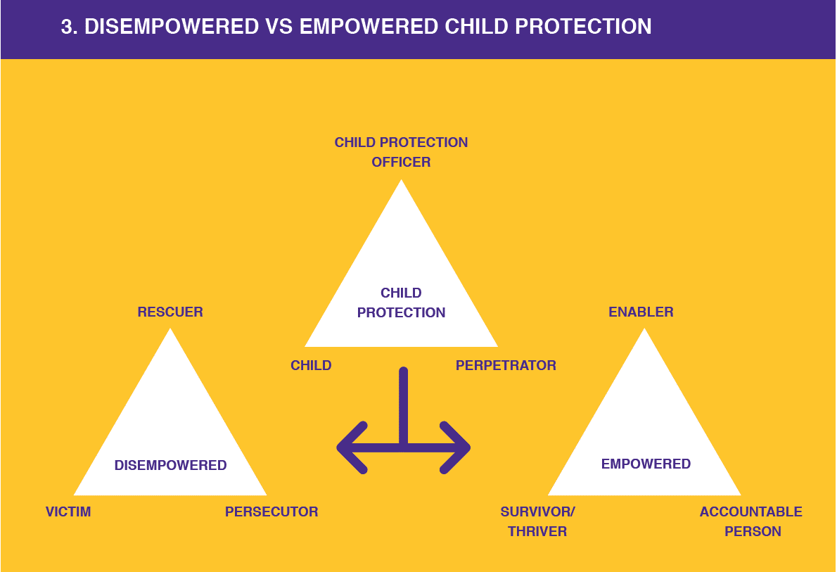
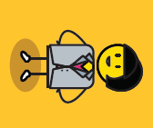
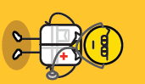
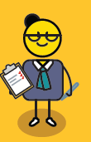


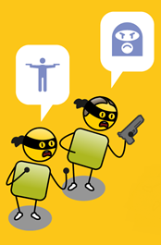


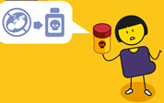

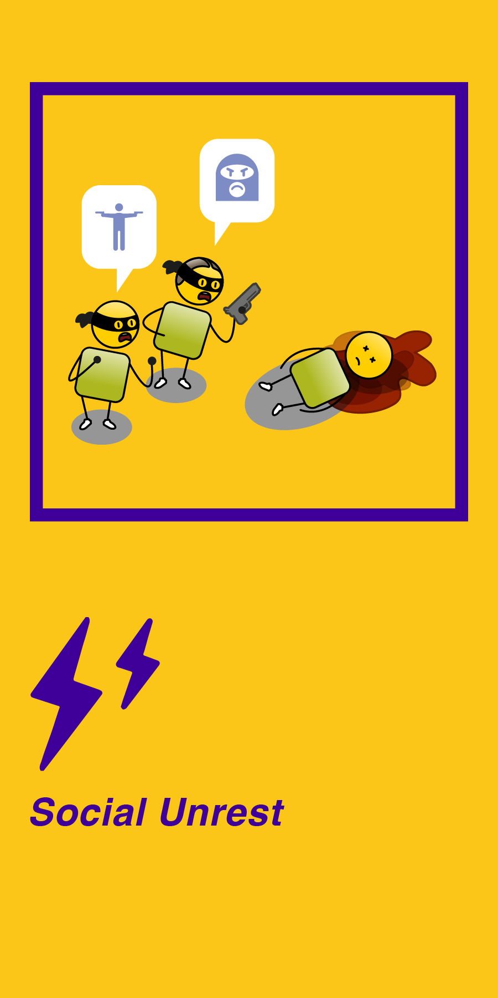
Notes:
What was also interesting was that this sense of disempowerment had infiltrated our very way of protecting children. In child protection you get three kinds of people, a child protection officer, a child, and a perpetrator, or someone who has done something wrong to a child.

Slide 32
Notes:
What often happens in the world of child protection is that in the process of tyring to protect the child, this group of people often descend into what Stephen Karpman refers to as a ‘Drama Triangle’. In this drama, the child protection officer becomes a rescuer who tries to save the child. The child becomes a victim, and the perpetrator becomes a persecutor. Because everyone is disempowered, the drama tends to go round and round in a circle, where victim becomes persecutor, persecutor becomes rescuer and rescuer becomes victim, and so on.

Slide 33
Notes:
The key is to move out of this drama, and into a space of empowerment, where the child protection officer become an enabler, they are not rescuing the child, they are providing the child or parents with choices, and then empowering them to make the right choices. The victim becomes a survivor or thriver, and the persecutor becomes an accountable person who knows the difference between right and wrong.

Slide 34
The final insight was that this was a massive change management project that spanned individuals, families, communities and societies at large.
Notes:
The final insight was that this was a massive change management project that spanned individuals, families, communities and societies at large.

Slide 35
The process of change*
HOLDING ON
LETTING GO
MOVING ON
MOVING FORWARD
DENIAL
TESTING
SHOCK
* Inspired by Elisabeth Kubler Ross Stages of Grief
CONFIDENCE LEVELS
AWARENESS
UNDERSTANDING
ACCEPTANCE
TIME
Notes:
Finding out that someone in your community or family has raped or abused a child is as much of a shock as losing a loved one. We also go through those stages of change, from shock… “I can’t believe this happened in our family or community”, to denial… ”perhaps the child is lying”, to awareness… “there are clear signs of abuse”, to acceptance…“what are we going to do about this”, to understanding and testing…“how do we make sure that this never happens again”. This meant that the engagement programme would have to take people as quickly as possible through these different stages to ensure real and sustainable changes in behaviour.

Slide 36
So how do we do this?
Notes:
So how do we do this

Slide 37
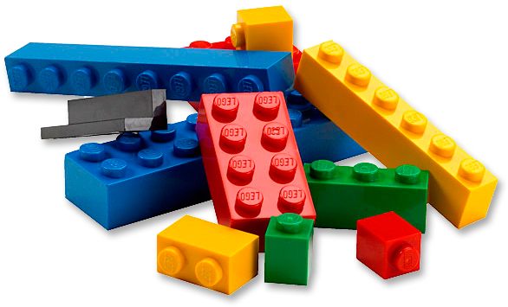
Notes:
I was inspired by Lego for the solution. The idea was to create a number of different toolkit elements and depending on what challenges are showing up in a community, the participants can identity and build a solution that is unique to their environment and the problems within it. The pieces would be the same, but the outcome could be completely different depending on how the pieces are applied.

Slide 38
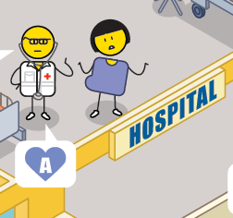
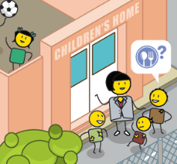
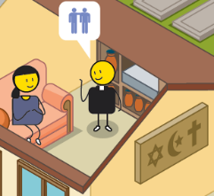
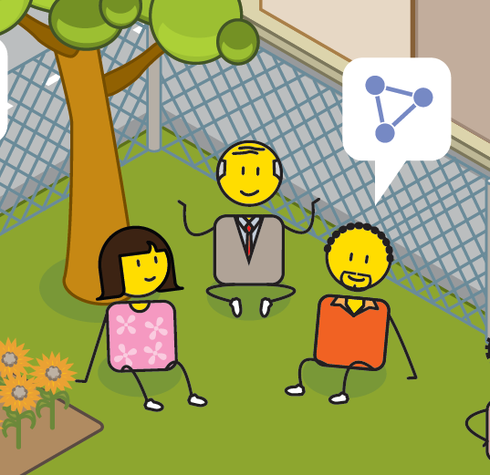

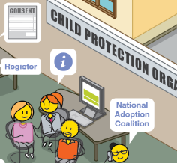
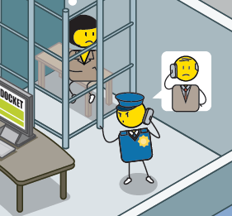
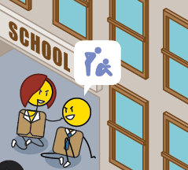
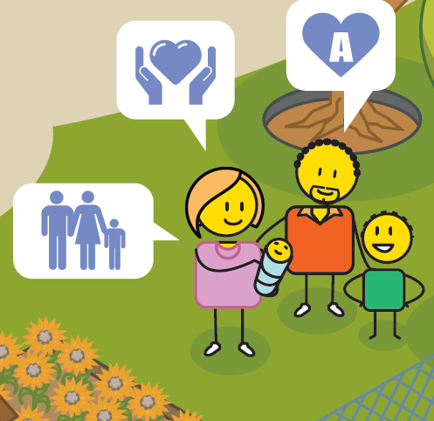
An ingredient brand
Notes:
From a branding perspective, I positioned Courage as an ”ingredient brand”, meaning that it can only exist inside other partner organisations or institutions. When I was doing my research, I asked all of the child protection officers I worked with… “if you could take a pill to help you do what you do every day, what would like inside it?” Without exception, all of the doctors, nurses, social workers, religious leaders, police officers, teachers and community members young and old stated that they would like more courage, and so the brand was born.

Slide 39
What does this look like in practice?
Notes:
So what does this look like in practice?

Slide 40
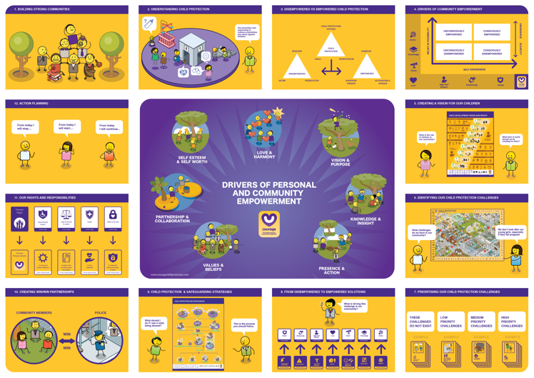
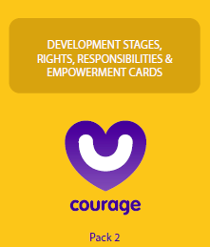
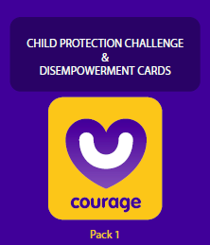
The toolkit
Notes:
The basic toolkit is made up of 4 picture based posters, the first illustrating a typical community anywhere in the world, complete with people, spaces and the child protection challenges they are dealing with. The second illustrates children’s rights and needs based on developmental stages, essentially how a child should grow up. The third illustrates the shift from disempowerment to empowerment drivers of change. And the final poster illustrates the step by step approach to child protection and safeguarding. There are also two packs of cards, a disempowerment pack, that details every single child protection challenge that exists in the world today and the seven disempowerment drivers that cause them. And an empowerment pack that details the empowerment drivers, child developmental stages, children’s rights and importantly the responsibilities that come with those rights. Finally the is an easy to use train the trainer poster.

Slide 41
The workshop
Notes:
For the workshop, facilitators can run all or some of the following exercises with their participants.

Slide 42
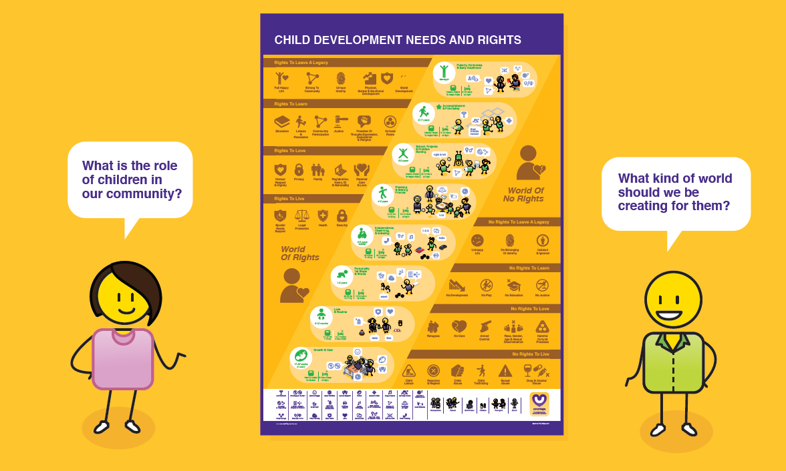
Defining your vision
Notes:
All workshops starts with a visioning session, where we ask participants what kind of world they would like their child to grow up in.

Slide 43







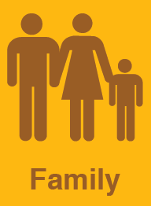




VS
Notes:
As stimulus input we share children’s rights as defined by the United Nations, UNICEF, the African Union and our own South African Children’s Act. We illustrate a world of rights where children are safe and secure, are registered and have an identity and a family, versus a world of no rights where children have no access to education, are abused and neglected and have no sense of belonging or identity.

Slide 44
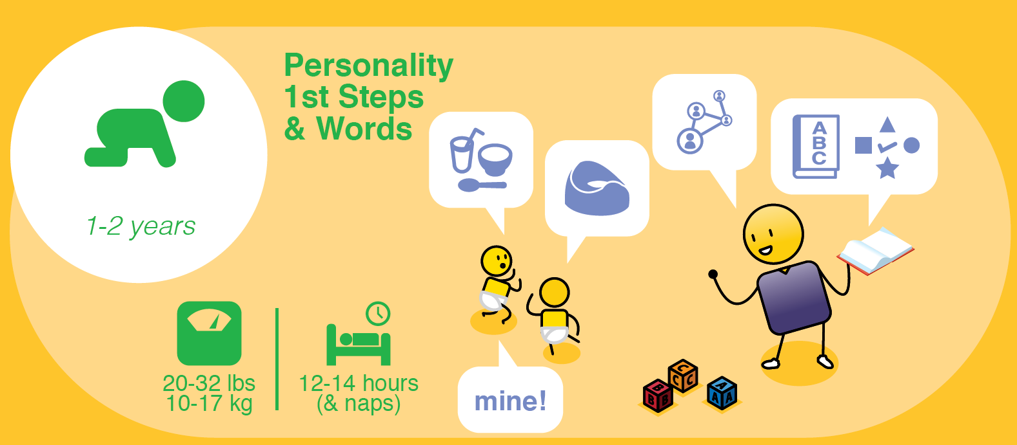
Notes:
We also look at how they should be be developing from in-utero, and their first year of life…

Slide 45
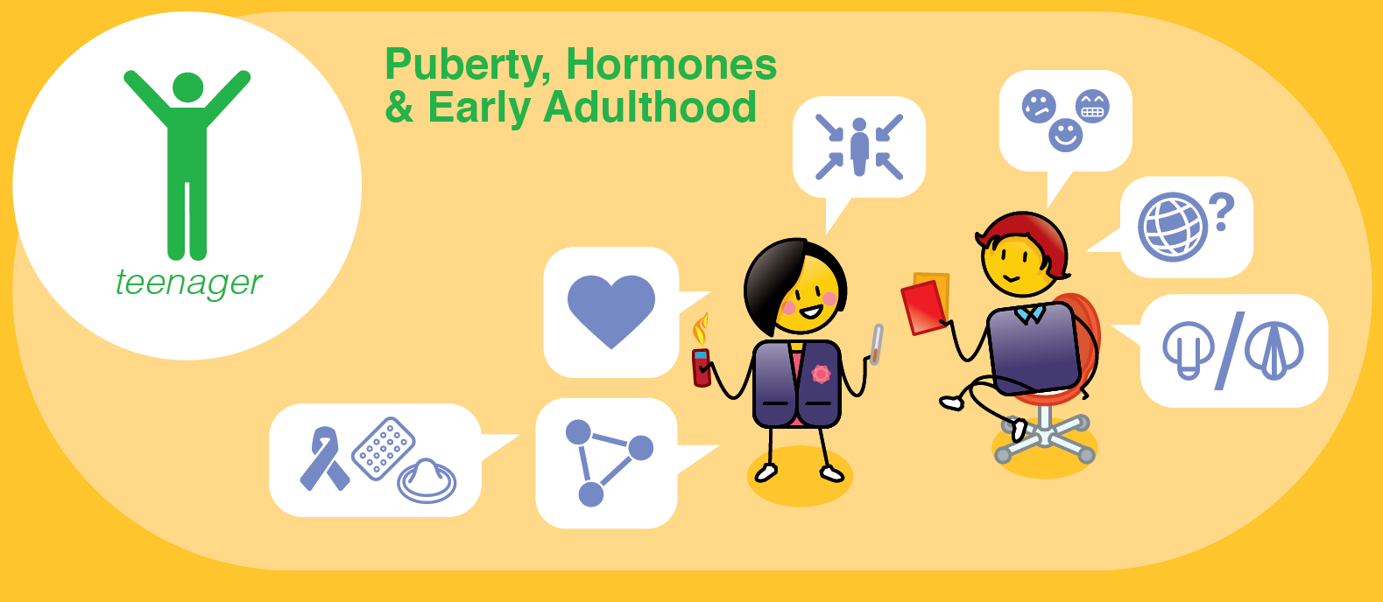
Notes:
All the way to puberty, hormones and early adulthood.

Slide 46
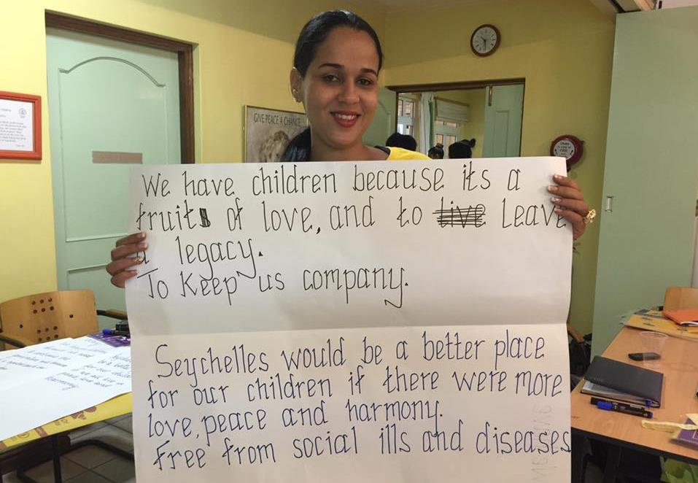
Notes:
This was an example from the Seychelles, where the National Council for Children managed to get the entire country to engage in developing a new vision for their children coordinated through their national newspapers.

Slide 47

Notes:
Sometimes it’s the children themselves who get define their the ideal community that they would like to live in. In this workshop with a school in the Johannesburg inner city, I remember being particularly shaken by the number of children who just wanted a safe place to go to the bathroom.

Slide 48

Identifying challenges
Notes:
The next step is critical in moving participants beyond shock and denial into awareness and acceptance. We use the community map for this exercise and ask participants to identify all of the child protection challenges they have observed in their community. This is a powerful exercise as if we don’t acknowledge that there are challenges, we cannot start to fix them.

Slide 49

Notes:
This was a group of psychiatrists and nurses identifying the child protection challenges in their community at a psychiatric hospital in Johannesburg. They noted how Courage operates in the ‘grey area’ where challenges present at a community level, but certain individuals start to emerge as having real mental health concerns.

Slide 50

Notes:
This illustrates the community map up close, we can see how challenges such as drug and alcohol abuse, child abuse, crisis pregnancy and depression or suicide can show up in a community.

Slide 51

Understanding & prioritising
Notes:
There are 48 unique child protection cards in the Courage toolkit, and therefore challenges that children are experiencing around the world. Each card details what the challenge is and what needs to be considered in terms of its impact on children and the community they live in. At this point in the workshop, participants are encouraged to go through all the cards, to understand what the challenge is, if it is happening in their community and if it is, to prioritise the challenge as a low, medium or high problem.

Slide 52





Notes:
This is an example of the late termination of pregnancy or late abortion card, which is often not understood as a child protection challenge, as the child has yet to be born.

Slide 53




Notes:
This illustrates how child protection challenges can manifest, as in the example of physical abuse.

Slide 54





Notes:
And how the challenge impacts negatively on a child’s rights and psychosocial development.

Slide 55

Notes:
Participants discuss each challenge in the context of their community and then decide what impact it is having. This is the first step in building understanding in the process of change.

Slide 56

From disempowered to empowered solutions
Notes:
Now that problems have been identified, understood and prioritised, it is important that solutions are found. Participants get to map their high priority challenges to the disempowerment drivers causing them, based on their experience in their community. Then using the opposite empowerment driver, they start to create solutions.

Slide 57

Notes:
The key to this exercise is getting participants to think through an empowered approach to problem solving, by firstly identifying what the problem is, then understand what is driving the problem, and finally looking at empowered solutions to solve it.

Slide 58


Notes:
In this particular example, children from a school noted how their teachers often emotionally abused the learners. The children associated the challenge with the disempowerment driver of abuse and then decided that the best way to solve the problem was to use love. They came up with an in-class campaign entitled “love your teacher, and your teacher will love you”, learning that love is often a far more powerful way to solve conflict than violence.

Slide 59

Understanding the process
Notes:
The next set of tools is about sharing pragmatic step-by-step approaches to solving child protection challenges as defined by our Children’s Act. From safeguarding in the event of child abandonment, neglect, abuse or exploitation.

Slide 60




Sex, conception & pregnancy
Notes:
To discussing sex, birth control, conception and pregnancy

Slide 61








Option counselling
OPTION COUNSELLING
X ILLEGAL OPTION
Notes:
To option counselling for crisis pregnancy.

Slide 62










Positive Parenting
Notes:
To positive parenting approaches.

Slide 63





Adoption
Notes:
And the process of adoption, several detailed programmes have been developed.

Slide 64

Notes:
Once we have defined the process, community members are encouraged to link this back to their community map and specific people and spaces that they will need to engage with to ensure the protection of their children, as illustrated in this community workshop focused on the need for adoption in Sebokeng.

Slide 65

Community Partnerships
Notes:
One of the most important things to remember in child protection, is that no person is an island. It is crucial to identity and then develop relationships with community partners that can support you in your efforts. Developing a partnership strategy is a two step approach, first you must identity your partners and then you must develop win/win relationships with each of them.

Slide 66

Notes:
These post graduate social work students in the North West are using the community map to identify possible partnerships that they can develop in the communities they have been deployed to for the practical component of their degree.

Slide 67

Notes:
In this example from the Seychelles, these two community partners were initially unhappy with having to work together on this exercise, but by the end, they had defined a shared vision and detailed what they needed and expected from each other to achieve their goals moving forward. The partnership exercise is often one of the most powerful in the Courage Toolkit as it gets communities to start working together.

Slide 68

Rights & responsibilities
Notes:
Towards the end of the workshop we return to our vision statement that we defined at the start and ask ourselves, “what values will drive the behaviours that will help us achieve our vision”. As stimulus for this exercise, participants are encouraged to look at the children’s rights that were defined at the start of the workshop and understand that for every right, such as a right to education or legal protection, there is an equally important responsibility, such as working hard or abiding by the law.

Slide 69

Notes:
This is an especially fun but important exercise to do with children.

Slide 70


Notes:
Once they have understood how rights link to responsibilities, participants define and agree the values that will help them achieve their vision for themselves and their community.

Slide 71

Action planning
Notes:
The final step in the Courage Community workshop is defining what actions people will take once the workshop is over. Participants agree what they will need to stop doing, now that they understand children’s rights and child protection, what they will need to start doing, and importantly what they will need to continue doing, which are things they were already doing and are still relevant to achieving their child protection vision. The most common response from participants at the close of a workshop is, “I will speak up more”, which indicates how many challenges are happening all around us, that we are not addressing.

Slide 72

Notes:
Sometimes the action planning is done at a very personal level, as with this personal vision plan that we used with some of our high-school workshops. What was important in this exercise, is that each child signed and dated a personal action plan which they could use to hold themselves to account.

Slide 73
LOVE & HARMONY
SELF ESTEEM & SELF WORTH
VISION & PURPOSE
What drives
personal & community empowerment?
PARTNERSHIP & COLLABORATION
KNOWLEDGE & INSIGHT
VALUES & BELIEFS
PRESENCE & ACTION
Notes:
Beyond understanding how these concepts drive personal and community empowerment, the aim of Courage workshops is to use practical exercises that can easily be adapted to participants personal lives and circumstances.

Slide 74


Courage around the world
Notes:
Beyond South Africa, Courage has been used by child protection organisations around the world, sometimes just within a particular area of focus area such as child trafficking in India, and at other times as an approach to child protection at a country level, as in the case of Zambia and the Seychelles. We have engaged with over 600 child protection organisataions, 2500 child protection officers and over 2000 children and students using the Courage toolkit and process since 2015. As we focus on a train-the-trainer approach, Courage Community Coaches are empowered to continue to take Courage’s message to as many people as possible around the world.

Slide 75


stay strong
take
www.couragechildprotection.com
Notes:
If you would like to download a free Courage Toolkit and understand how to run a Courage Workshop please visit Courage Child Protection Dot Com. Be sure to like this video and subscribe to our Courage Channel. Thanks for watching, stay strong and take courage.

