Slide 1
Understanding the child protection and safeguarding process
www.couragechildprotection.com
Notes:
This Courage presentation will help you to understand the formal legal child protection and safeguarding process.

Slide 2
What you should do
if you observe or have knowledge of a child who is being abused, neglected or exploited
Notes:
This is a step by step explanation of what you should do if you observe or have knowledge of a child who is being abused, neglected or exploited.

Slide 3
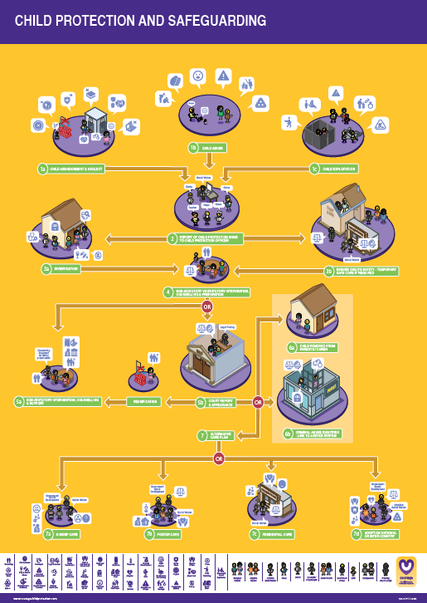
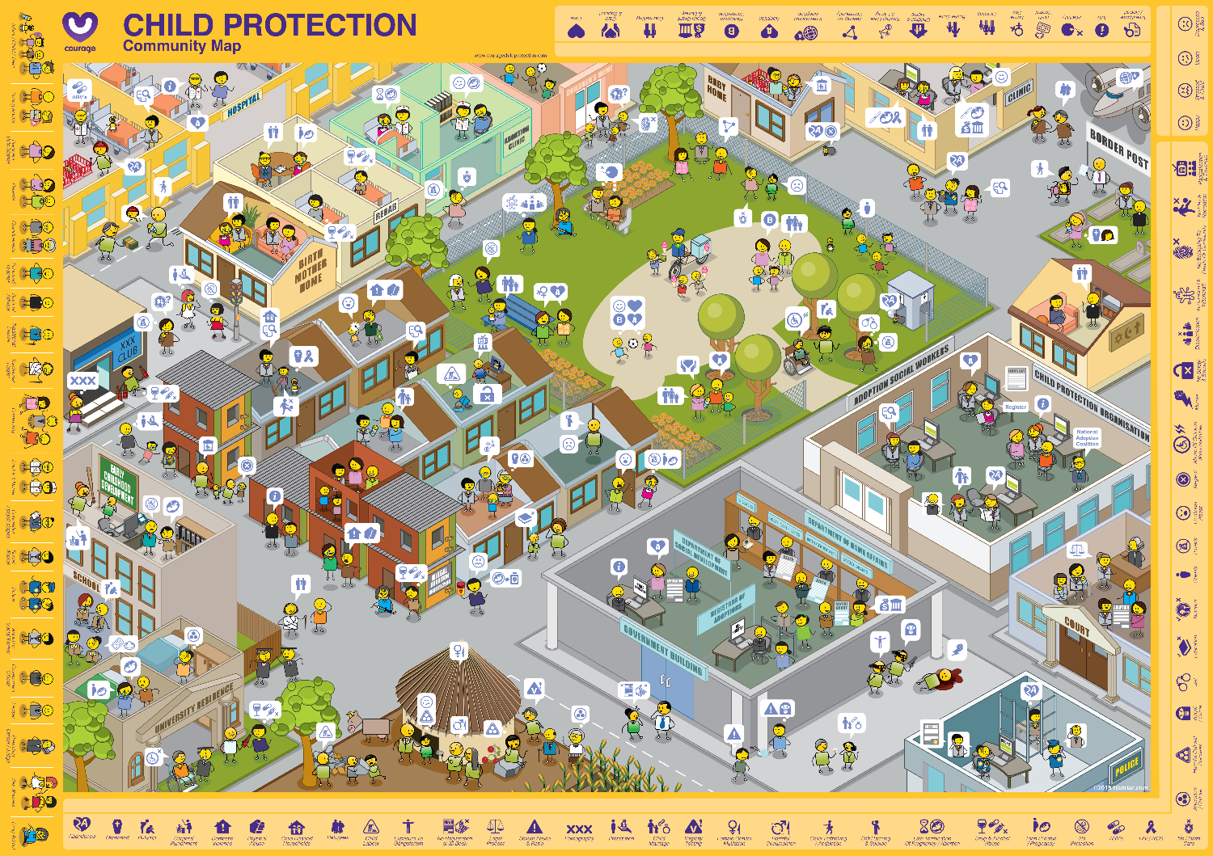
Useful courage tools
Courage child protection and safeguarding poster & Community Map
or
The Courage child protection and safeguarding video or presentation
Notes:
Some useful tools to help you to understand and follow the child protection and safeguarding process in your community include:
The Courage Child Protection and Safeguarding A1 Poster and the Courage Community Map, or
Watching this Courage movie or presentation all of which you can download from the Courage website.

Slide 4
Why it important to stand up for children?
Notes:
So why is it so important to stand up for children and safeguard them?

Slide 5
Building self esteem & self worth
Notes:
When we stand up for children, we are not only ensuring their protection and wellbeing, we are also teaching them that we think they are important, how to stand up for themselves, how to be assertive and to advocate for their own rights as human beings. Most importantly, when we stand up for children, we help to build their self esteem and self worth. Building a strong sense of self worth and self esteem is about developing a strong personal identity. Its about teaching children to care for themselves and for others. Self esteem can be about personal achievement, but it is also about simply making good choices or decisions that are in your, your family or your communities' best interest. Its about having a focus and direction and taking personal responsibility for your life and how you live it.

Slide 6
Now let’s understand the process you should follow…
Notes:
Now let’s understand the process you should follow…

Slide 7
The Child Protection Process
What should you do if you see child protection challenges in your community, follow the Courage Child Protection & Safeguarding process.
Link this process to the Courage Child Protection Community Map to understand which stakeholders are involved.
Notes:
Your child protection and safeguarding process will be set out by your country’s Children’s Act and should detail the different steps you should take if you have seen or have knowledge of a child or children who are being abused, neglected or exploited. Whilst following the process, try to identify the different stakeholders on the Courage Community map so that you can connect the formal process to real people and places in your community.

Slide 8
Let’s understand this process in more detail?
Notes:
Let’s understand this process in more detail.

Slide 9
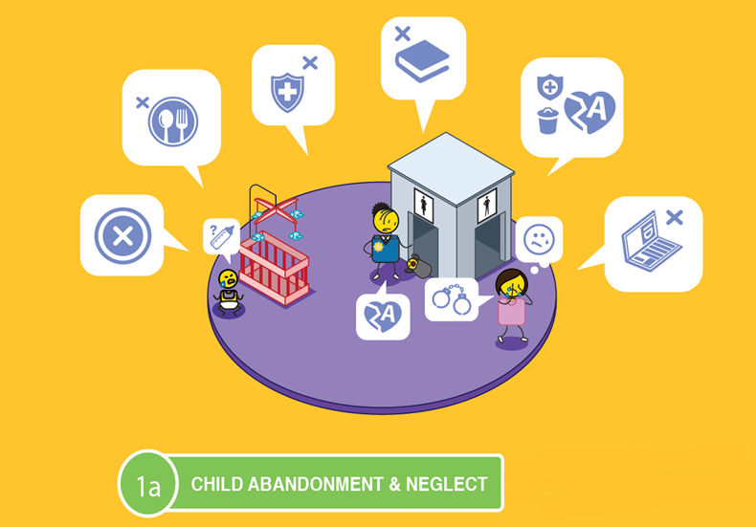
Notes:
If a child has been abandoned or neglected, which includes not being fed, given access to healthcare, schooling or adequate personal identity documentation.

Slide 10
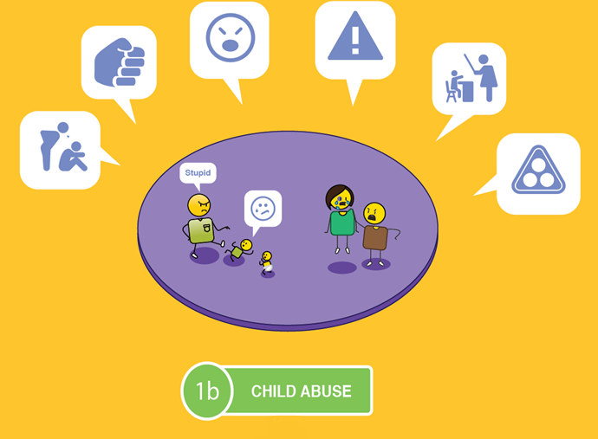
Notes:
Abused, which includes physical, mental, emotional and sexual abuse, bullying, corporal punishment or subjected to harmful cultural practices.

Slide 11
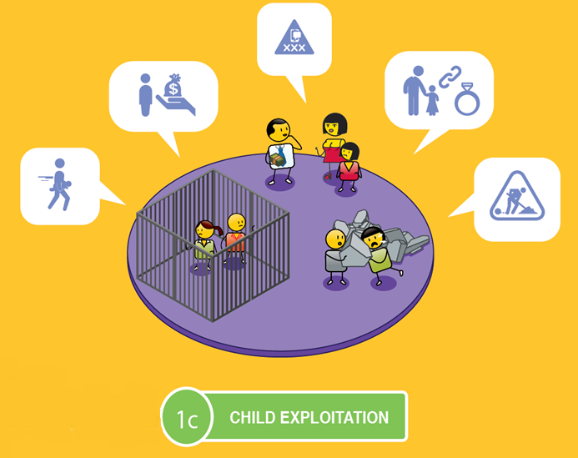
Notes:
Or exploited, which includes child trafficking, prostitution, pornography, child marriage or child labour.

Slide 12
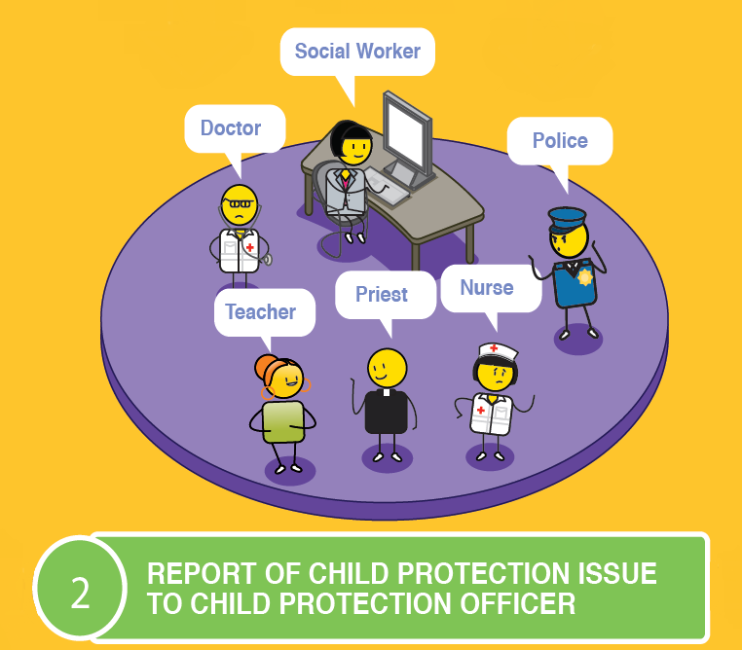
Notes:
The first step is to report this problem to a child protection officer, who could be a social worker, the police, a doctor or nurse, a teacher, a sports coach, a counsellor, or a community or religious leader.

Slide 13
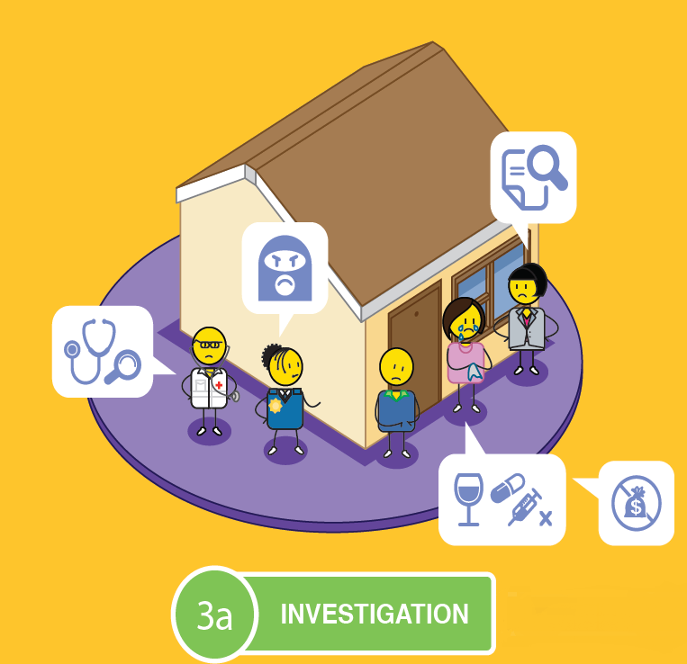
&
Notes:
The child protection officer must report the neglect, abuse or exploitation to the police and a social worker, who must then conduct a full investigation, which includes visiting the child’s home, school or where the abuse is reported to be taking place.

Slide 14
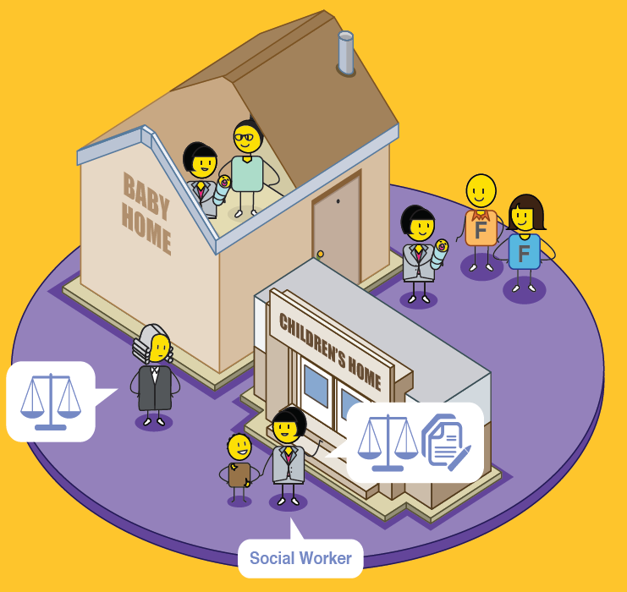
Notes:
The safety of the child must be ensured.
If there is any risk to the child, they must be removed from their home, place of residence, or risky environment, and placed in temporary care such as a baby or children’s home, in foster care or a registered place of safety. This removal will require formal legal intervention.

Slide 15
Notes:
The social worker will then need to assess if the issue reported can be dealt with through counselling and family support, or if statutory intervention is required through the Children’s Court, in which case, the parents, child and relevant perpetrators must be prepared. If the abuse, neglect or exploitation took place in a formal school, cultural or sporting environment or event, it must be reported to the relevant oversight or professional body for investigation as well.

Slide 16
OR
Notes:
If the formal decision is that counselling and support is sufficient to solve the problem, this can be undertaken by a social worker or family support organisation, who can also assist parents in getting the correct documentation for their child, and financial or social support if needed.

Slide 17
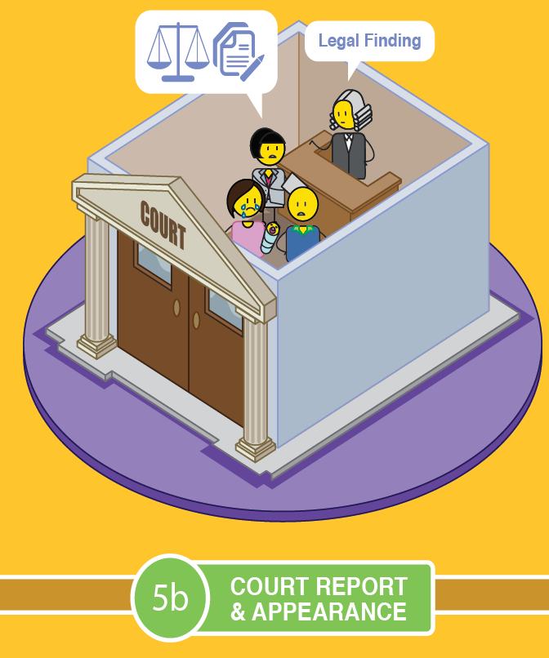
Notes:
If a statutory intervention is required, the child, parents or relevant perpetrator will be taken to court and a legal finding will be made.

Slide 18
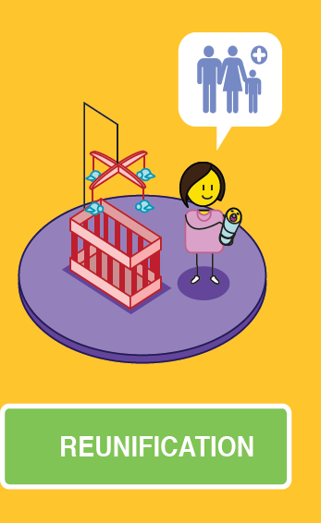
OR
Notes:
In this legal finding, the court may rule that the child be reunified with their parents, with appropriate support, or they could decide to remove the child form their parents’ or guardian’s care.

Slide 19
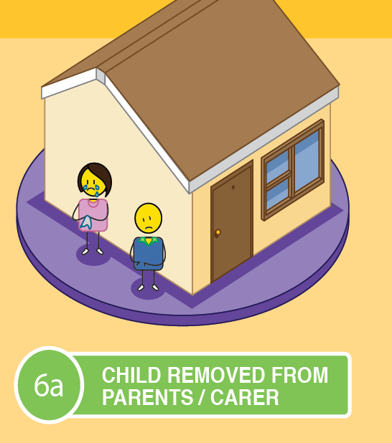
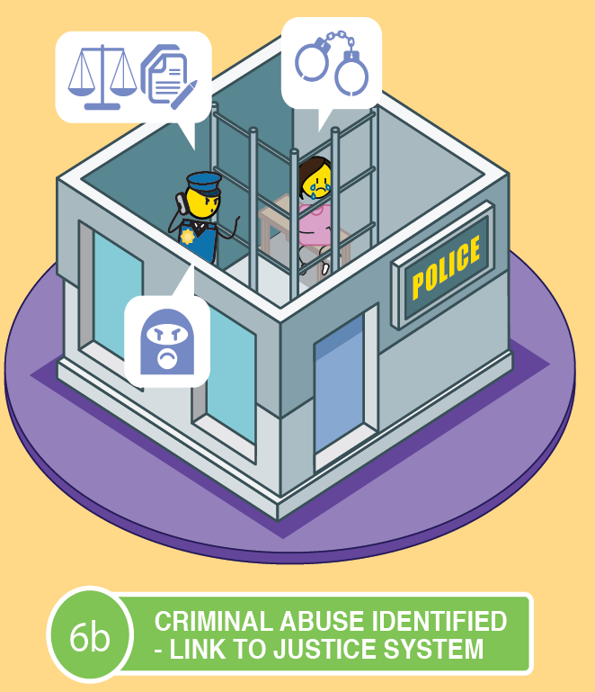
OR
Notes:
If there was no criminal intent, the child will be removed from the parent's care, however, if the parents or other relevant perpetrator INTENTIONALLY abused, neglected or exploited the child, they will be referred to the criminal justice system for prosecution.

Slide 20
ALTERNATIVE CARE PLAN
Notes:
If a child is removed from their parent’s care, an alternative care plan will be needed. These can include placing the child with other family members in a kinship care arrangement, placing the child into foster care, institutional care or placing the child up for adoption.

Slide 21
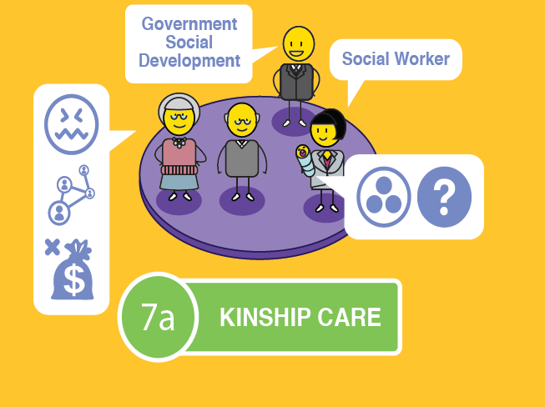
Notes:
Kinship care refers to placing a child into the care of another family member, such as the child’s grandparents or a close relative.
The courts and child protection officers must ensure that these family members are fit to care for the child in question.
This can be done through a formal foster care placement or adoption, or through an informal arrangement between family members.
It is important to note that Kinship care can have a negative impact on older family members as they are expected to take care of young children, well into old age, which can lead to high levels of stress and anxiety.
Financial considerations also need to be taken into account and whether the family member is in a financial position to take on another dependent.
This option does ensure that the child is still connected to their biological family which can support the cultural needs of the child.

Slide 22
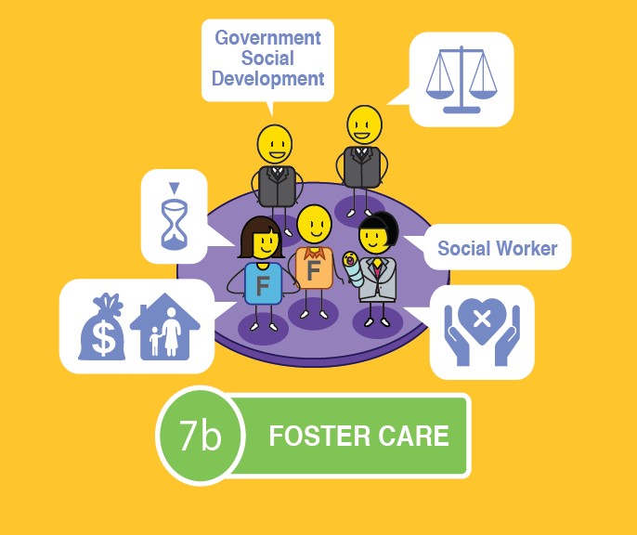
Notes:
Foster care is a temporary child protection solution to give parents or guardians an opportunity to remediate the challenges that led to their child’s removal in the first place.
Foster care is legal, when conducted in accordance with the Children’s Act, and is a good temporary solution for keeping a child safe and secure.
The child can remain in contact with their parents if they desire this, usually under supervision.
Foster parents are entitled to a foster care grant which they can apply for at their local Department of Social Development.
As it is a temporary solution, however, there are some concerns that need to be raised.
Foster care can never replace a family environment where a child has a sense of permanence and feels like they belong.
The child may struggle with the issue of having an inconsistent carer, they may not be able to bond with a primary care giver and as a result they could feel insecure and struggle with their sense of identity as they grow up.

Slide 23
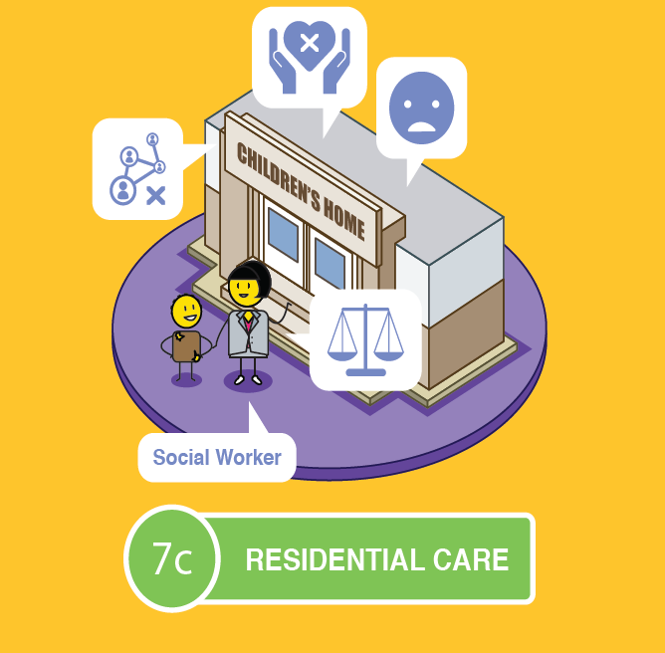
Notes:
Institutional or residential care is when a child is placed in a children’s home, or a group foster care home after going through the necessary process in court.
As with foster care, this option is a temporary child protection solution to give parents or guardians an opportunity to remediate the challenges that led to their child’s removal in the first place.
The child can remain in contact with their parents if they desire this, usually under supervision.
The home will take full responsibility for the care and education of the child whilst he or she is in their care.
As it is a temporary solution, however, there are some concerns that need to be raised.
As with Foster Care, a children’s home can never replace a family environment where a child has a sense of permanence and feels like they belong.
The child may struggle with the issue of having an inconsistent carer as children’s homes rely on shift workers.
They may not be able to bond with a primary care giver and as a result they could feel insecure and once again struggle with their sense of identity as they grow up.

Slide 24
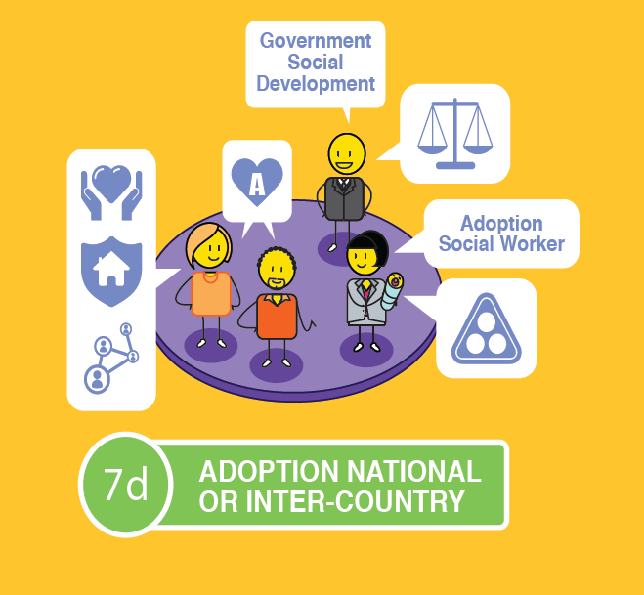
Notes:
Adoption is believed to be the best long-term solution for a child outside of being cared for by their own family.
It is a legal process that is conducted in accordance with the Children’s Act.
The child would get a new family that has been carefully selected to meet their needs in a stable, permanent and loving home.
Some adoptees struggle with their identity formation due to living with an adopted family, rather than their biological family.
The child may choose to meet their biological parents when they become an adult, but this is at their discretion.

Slide 25
Take action
The most important thing you can do to prevent or stop child neglect, abuse or exploitation is to take action by speaking up!
Notes:
The most important thing you can do to prevent or stop child neglect, abuse or exploitation is to take action by speaking up! If you are a child protection officer, such as a social worker, a police officers, a doctor or nurse, a teacher, a sports coach, a counsellor, or a community or religious leader, you have a legal duty to report any suspicions of child neglect, abuse or exploitation to the relevant authorities. If you do not report your suspicions, you can be prosecuted for your lack of action.

Slide 26
stay strong
take
www.couragechildprotection.com
Notes:
Thanks for watching.
For more information visit Courage Child Protection dot com
Be sure to like this video and subscribe to our Courage Channel.
Stay strong and take courage.

