Slide 1

The child protection &
empowerment
community programme
www.couragechildprotection.com
Notes:
This presentation introduces how to run a Courage workshop, the child protection and empowerment programme for communities around the world.

Slide 2
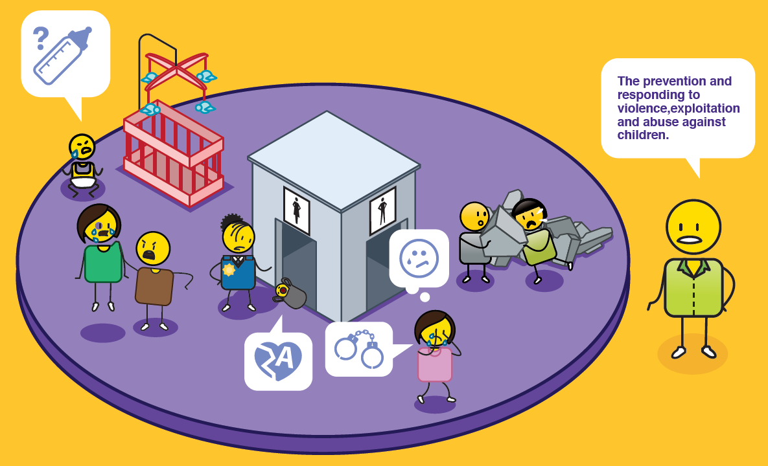
What is child protection?
Notes:
Child protection is the prevention and responding to violence, exploitation and abuse against children.

Slide 3
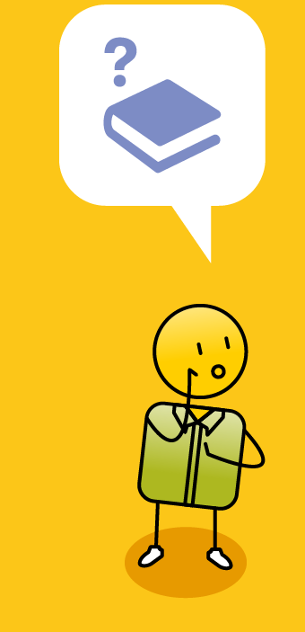
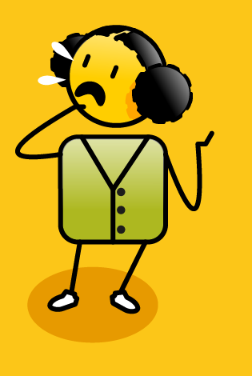
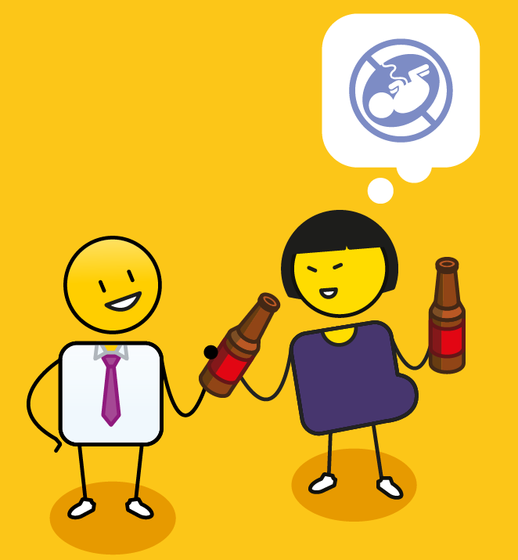
Why is it important?
depression
anxiety
post traumatic stress
learning disorders
suicide
toxic stress
substance abuse
developmental challenges
violence
poor self regulation
risky sexual behaviour
Notes:
It is VERY important, as issues such as child abuse, neglect and exploitation can lead to anxiety, depression, suicide, learning disorders, post traumatic stress and developmental challenges. In the long term, a life of violence, can result in substance abuse, poor self regulation, risky sexual behaviour and toxic stress that impacts negatively on a person's health and wellbeing.

Slide 4
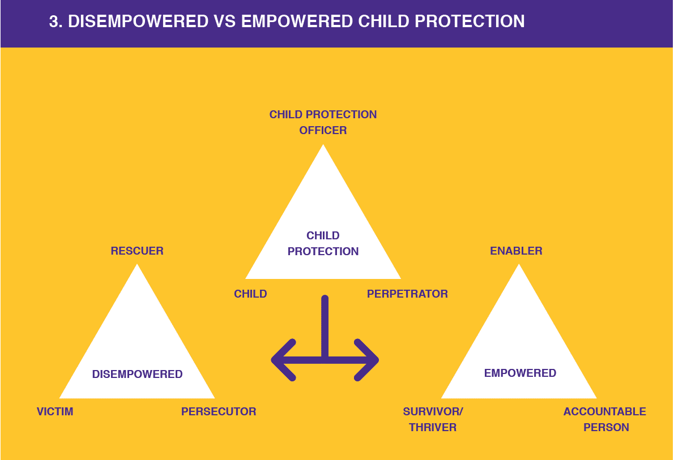
Notes:
When we started on our child protection journey at Courage, the first thing we noticed was how often people took a disempowered approach to solving their child protection challenges!

Slide 5

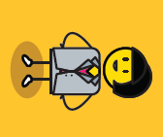
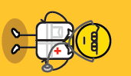
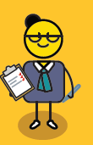


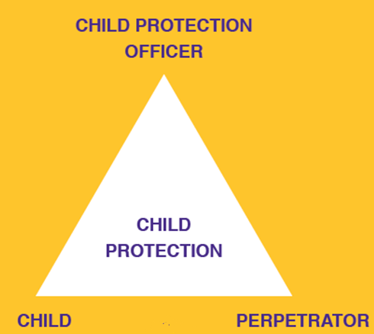
Who is involved?
Notes:
In child protection there are three different groups of people involved. The first are the child protection officers who can be teachers, police officers, social workers, doctors and nurses. In fact all adults have a responsibility to look after the children in their family and community.

Slide 6
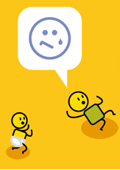

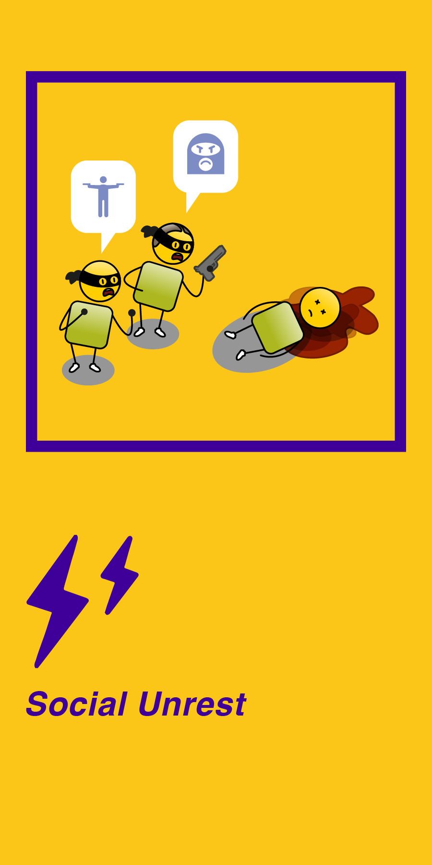
Who is involved?
Notes:
The second group are children. This starts at the point of conception, when a child is still growing in their mother’s womb and continues from their birth all the way up until they turn 18 years of age.

Slide 7
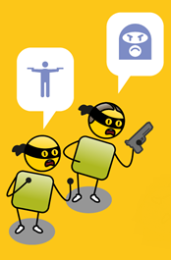

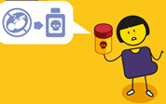
Who is involved?
Notes:
The last group of people are the perpetrators. These are people who have done something wrong to a child and can be strangers, members of their community, other children or a child’s parents.

Slide 8
The problem?
Notes:
The biggest problem, however, is that all these people often make disempowered choices.

Slide 9
Notes:
What happens is that in the process of tyring to protect the child, this group of people often descend into what Stephen Karpman refers to as a ‘Drama Triangle’. In this drama, the child protection officer becomes a rescuer who tries to save the child. The child becomes a victim, and the perpetrator becomes a persecutor. Because everyone is disempowered, the drama tends to go round and round in a circle, where victim becomes persecutor, persecutor becomes rescuer and rescuer becomes victim, and so on.

Slide 10
Notes:
The key is to move out of this drama, and into a space of empowerment, where the child protection officer become an enabler, they are not rescuing the child, they are providing the child or parents with choices, and then empowering them to make the right choices. The victim becomes a survivor or thriver, and the persecutor becomes an accountable person who knows the difference between right and wrong.

Slide 11
Mind-shift!
Notes:
A mind shift is needed in the child protection community, and this is what it looks like?

Slide 12
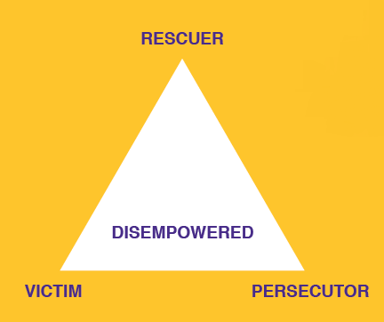
Disempowered
I feel so sorry for this child!
This child needs me.
I feel so guilty I should have done more!
I’m going to solve this problem for the child.
Notes:
The disempowered rescuer feels sorry for the child. Their desire to help is often driven by a sense of guilt. They believe the child needs them and they try to solve all the children’s problems for them.

Slide 13
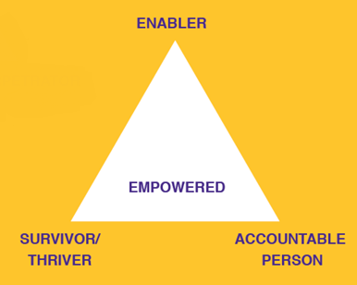
Empowered
This is not acceptable!
What are our choices?
We need to change this!
How can I empower action?
Notes:
The empowered child protection officer is an enabler. They are concerned for the vulnerable, but their focus is on identifying what needs to change, what choices are available, and how they can empower the child, parents or community members to act to prevent or stop the abuse from continuing.

Slide 14
Disempowered
I’m trapped and I’m suffering!
I don’t know what to do?
There is nothing I can do!
I have no choices!
Notes:
The disempowered child becomes a victim. They are suffering and feel trapped and helpless. They believe they have no choices and that they can’t solve their problems.

Slide 15
Empowered
What is happening to me is not right!
I need to do something about this!
What choices do I have?
Who can help me and what can I do?
Notes:
The empowered child becomes a survivor and hopefully thrives in the long term. They identify that the abuse, neglect or exploitation they are experiencing is wrong, and that they must act to change their situation. This could be a simple act of telling someone about what they are experiencing, or for older children, confronting their abuser. For babies, action is difficult, but their carers can be empowered to make different choices, that are in their child’s best interest,

Slide 16
Disempowered
This child doesn’t matter!
This child is not a person!
What about my struggles!
It's not my fault it’s the child’s fault!
Notes:
The disempowered perpetrator of child abuse, neglect or exploitation becomes a persecutor. The child does not matter to them, they have no empathy for the child and in some instances even blame them for what happened. They are very self centred and take no responsibility for their actions.

Slide 17
Disempowered
What I have done is wrong!
This could be my child, sister or brother!
What can I do to make up for my actions?
I must take responsibility for my actions.
Notes:
The empowered perpetrator becomes an accountability person, who acknowledges that what they have done is wrong. They empathise with the child, and realise that the child could be their sister or brother, their own child, or even themselves. They take responsibility for their actions and work hard to make amends.

Slide 18
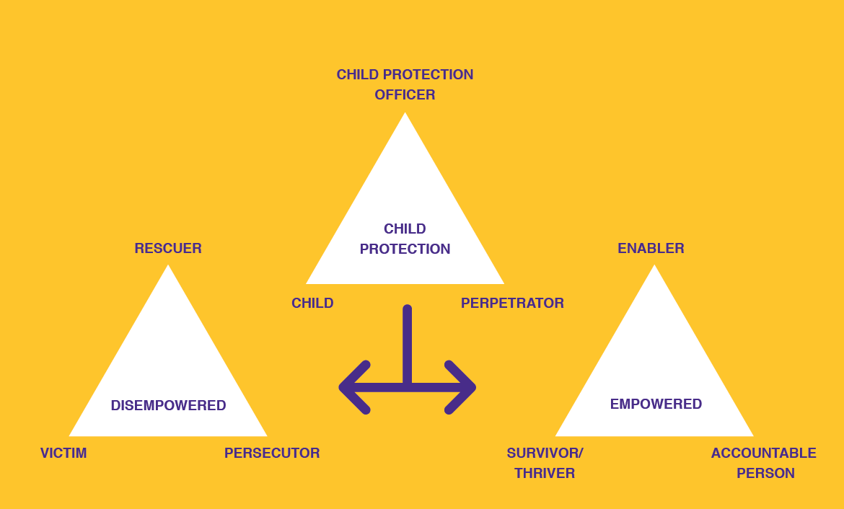
Empowered choices
Notes:
When we get stuck in the cycle of disempowerment, we never truly solve child protection challenges. It is only through making empowered choices that we can really bring about real and meaningful change.

Slide 19
What is empowerment?
Dictionary
noun
authority or power given to someone to do something.
the process of becoming stronger and more confident, especially in controlling one's life and claiming one's rights.
Notes:
So what does it mean to be empowered? The dictionary says it is when a person is given authority or power to do something. If we are empowered, we become stronger and more confident. We become the masters of our destiny and able to claim our rights as members of the human race.

Slide 20
How to build
personal & community empowerment?
Notes:
So how do we build personal and community empowerment?

Slide 21
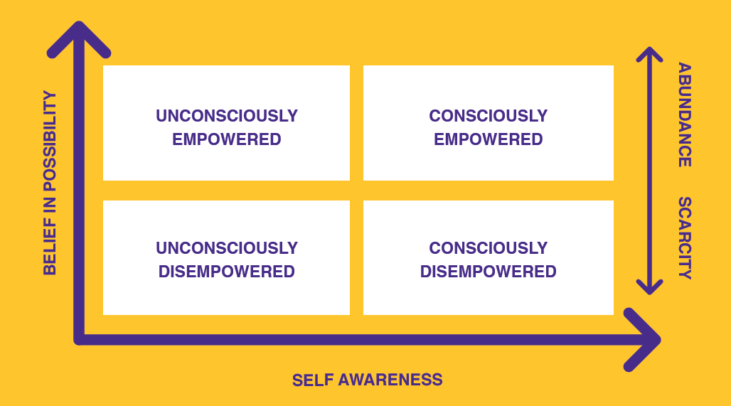
To build personal & community empowerment
3 simple steps:
1. Believe in possibility
2. Build self awareness
3. Focus on abundance
Notes:
At Courage we believe this can be built in 3 steps. Firstly, you need to believe in possibility, secondly, you need to have some level of self awareness and finally you need to do these two things in the context of abundance.

Slide 22
To build personal & community empowerment
Notes:
If you think about it, when we are young, we all have a relatively high level of belief in possibility, but we are not particularly self aware. We are ‘unconsciously empowered’, we believe we can be anything and do anything, we are just not sure how at this point.

Slide 23
To build personal & community empowerment
Notes:
And then different people arrive in our lives and tell us, well you can’t actually be what you want to be, because of your age, or the colour of your skin, or the fact that you are a girl, or a boy, or you are too old, you get the picture. Suddenly we find ourselves in the space of being ‘unconsciously disempowered’, we no longer believe anything is possible and we don’t know why we are in such a dark hole.

Slide 24
To build personal & community empowerment
Notes:
Interestingly, the people that put us in these dark holes are often the ‘consciously disempowered’, and this is the third dimension we need to be aware of. These people have a high degree of self awareness, they are often very clever, but their vision is based on scarcity rather than abundance. They believe that there will never be enough for everyone in the world, and so the only way to get what they want, is to take it away from other people.

Slide 25
To build personal & community empowerment
Notes:
And obviously where we want to be is consciously empowered, so how do we do this?

Slide 26
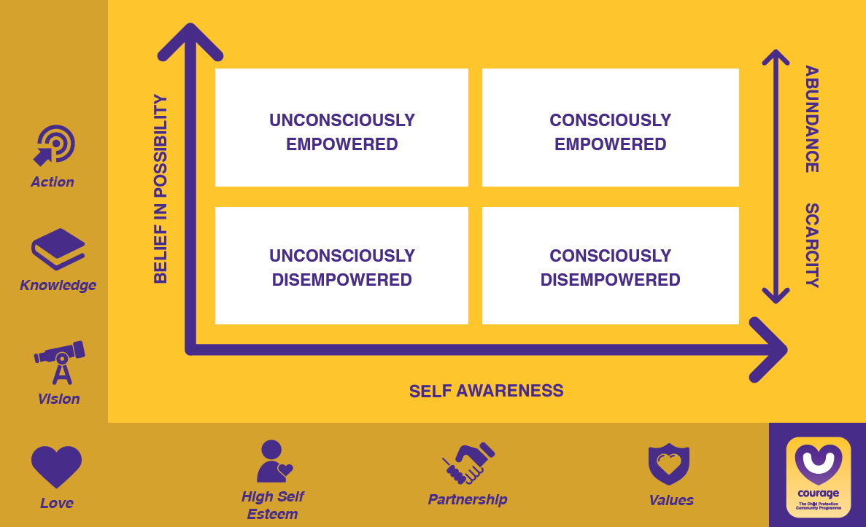
To build personal & community empowerment
Notes:
Well, to build self awareness, we need to know what our values and beliefs are, we need to partner with other people to test these values and beliefs, and we need to ensure that we have a healthy sense of self esteem and self worth and that we are adding value to the world around us.

Slide 27
To build personal & community empowerment
Notes:
To build our belief in possibility, we need to have a vision for ourselves, a purpose for our lives. We need to build on this constantly through gaining knowledge and insight and finally we need to turn this vision, knowledge and insight into action, preferably on a daily basis.

Slide 28
To build personal & community empowerment
Notes:
And finally we need to build our self awareness and belief in possibility in the context of love and abundance, with the knowledge that there is more than enough for everyone to live their best life in this world.

Slide 29
To build personal & community empowerment
Notes:
At Courage, personal and community empowerment is both a philosophy and a tangible step by step programme to address the many child protection challenges we see in our communities every day.

Slide 30
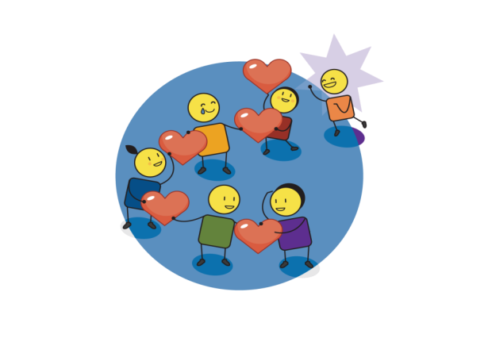
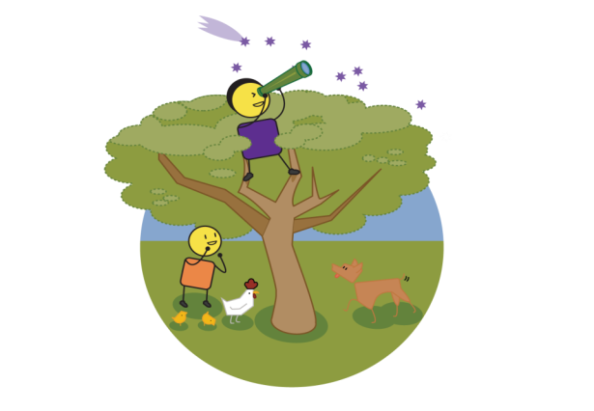
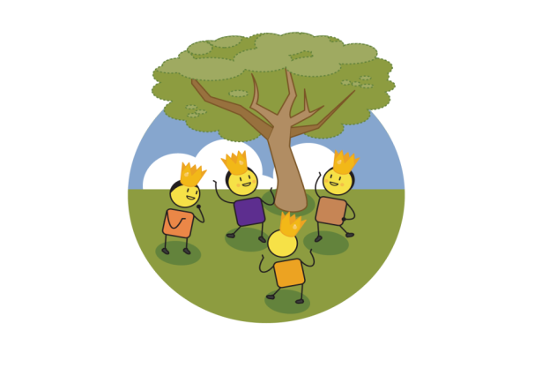
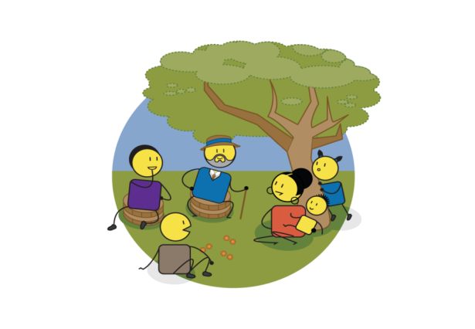
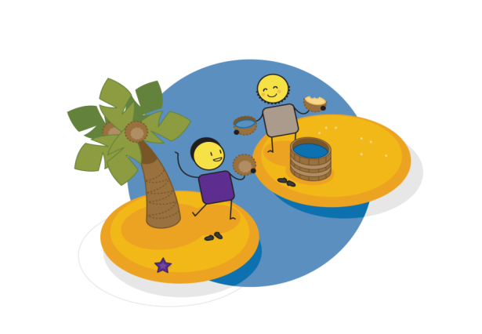
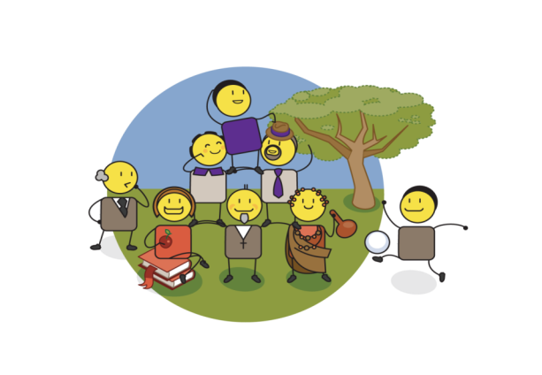
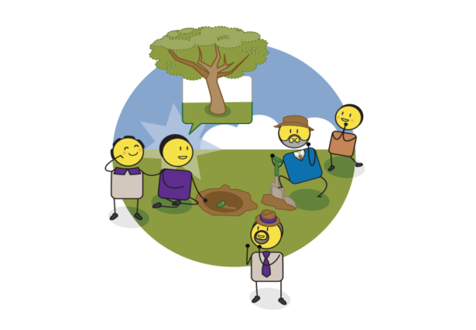
LOVE & HARMONY
VISION & PURPOSE
SELF ESTEEM & SELF WORTH
Are you empowered?
PARTNERSHIP & COLLABORATION
KNOWLEDGE & INSIGHT
VALUES & BELIEFS
PRESENCE
& ACTION
Notes:
We will now go through each of these seven different drivers of personal and community empowerment, to make sure we understand their relevance in our world and to child protection.

Slide 31
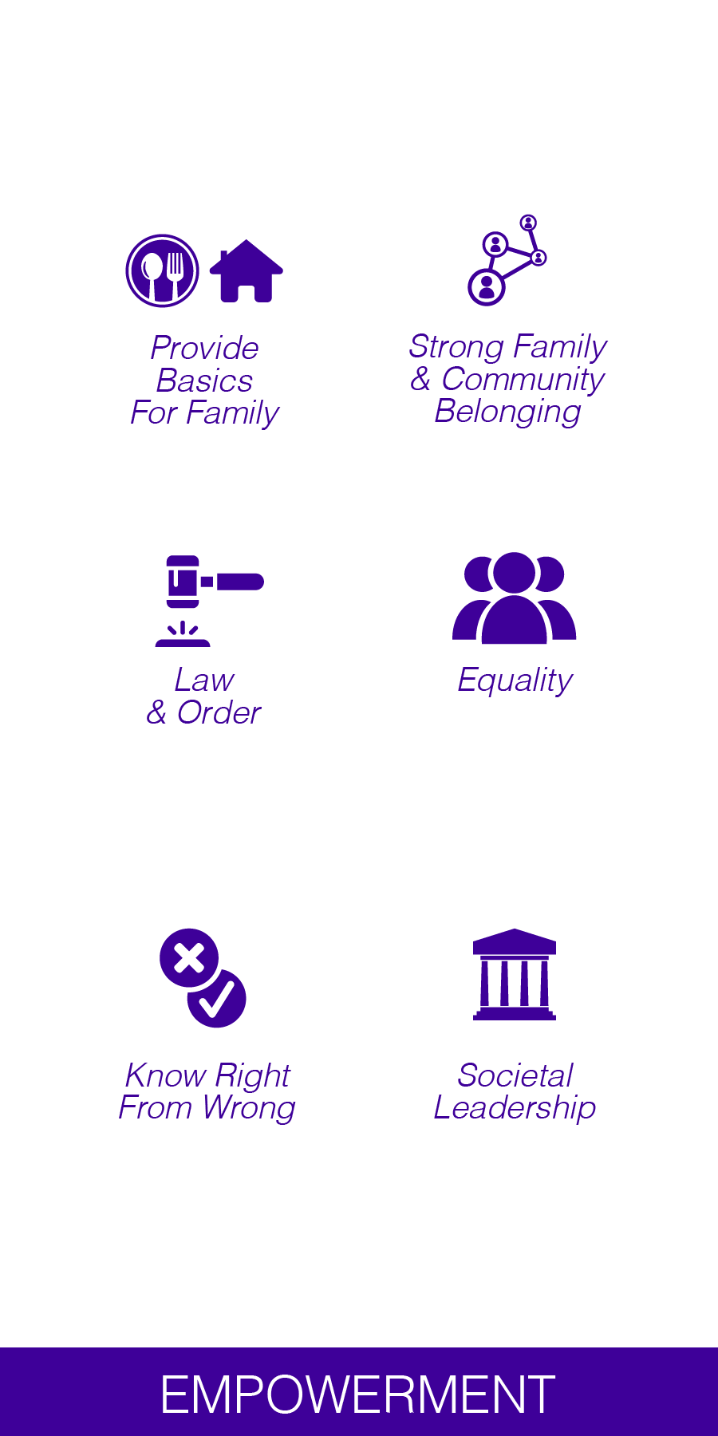
Values & beliefs
Notes:
The first step is to define your values and beliefs. These are the cornerstones of your identity, and should drive all of your day to day actions and choices. Values and beliefs in the context of child protection are about ensuring that we provide for the basic needs of all people in our community. Values are about creating a sense of law and order in our world, knowing right from wrong, and agreeing what is most important not just to you, but to your family and your community. One of the most important values is believing in the equality of all people, this is fundamental to personal, community and societal leadership.

Slide 32
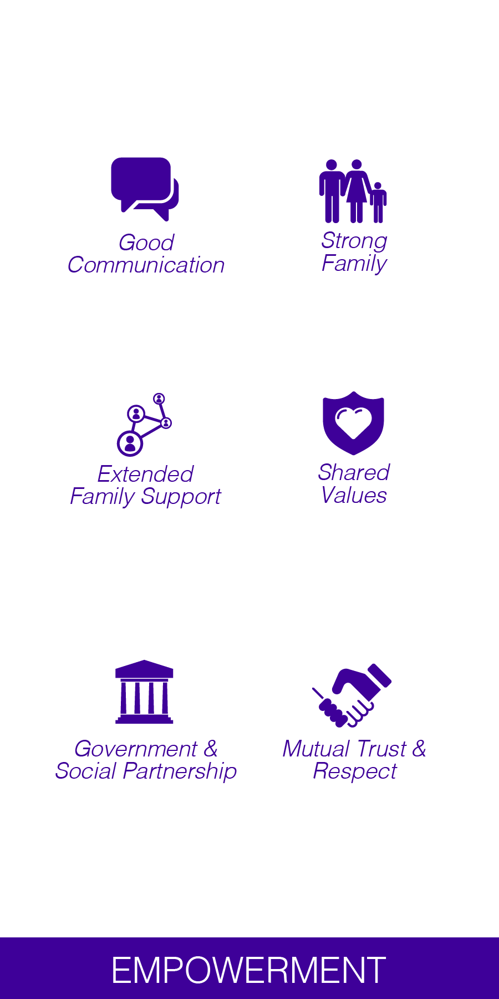
Partnership & collaboration
Notes:
The second step is to define who your community partners are and agreeing how you will work with them. Real partnership and collaboration cannot happen without shared values, mutual trust and respect, and good communication. Good partnership and collaboration, should happen at a family, extended family, community and societal level through government and social partnerships.

Slide 33
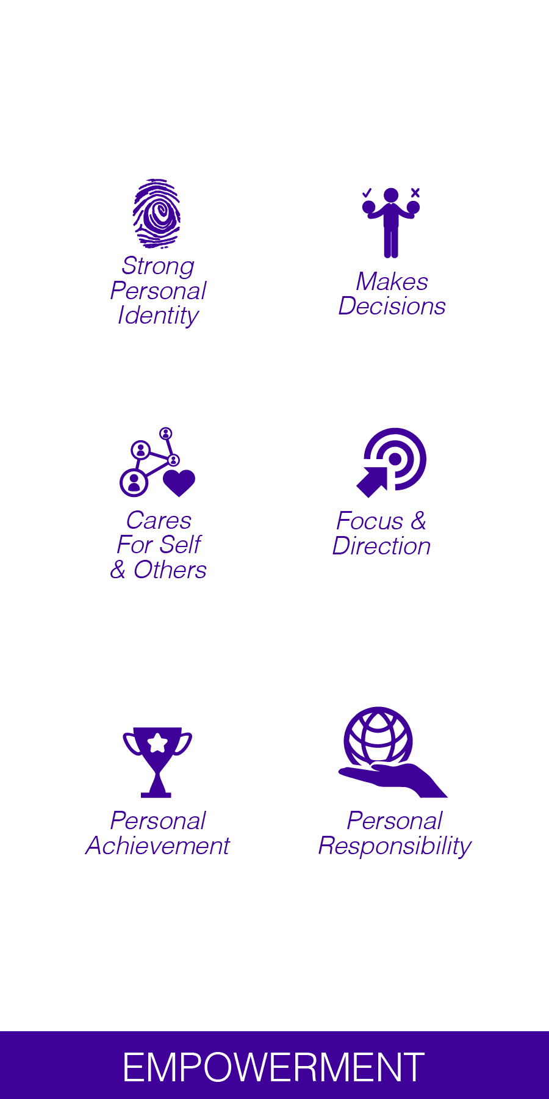

Self esteem & self worth
Notes:
The third driver is ensuring a positive sense of self worth and self esteem, which starts with creating a strong personal identity. Self esteem and self worth ensures that we care for ourselves and others around us. It can be about personal achievement, but it is also about simply making good choices or decisions that are in your, your family or communities' best interest. Its about having a focus and direction and taking personal responsibility for your life and how you live it.

Slide 34
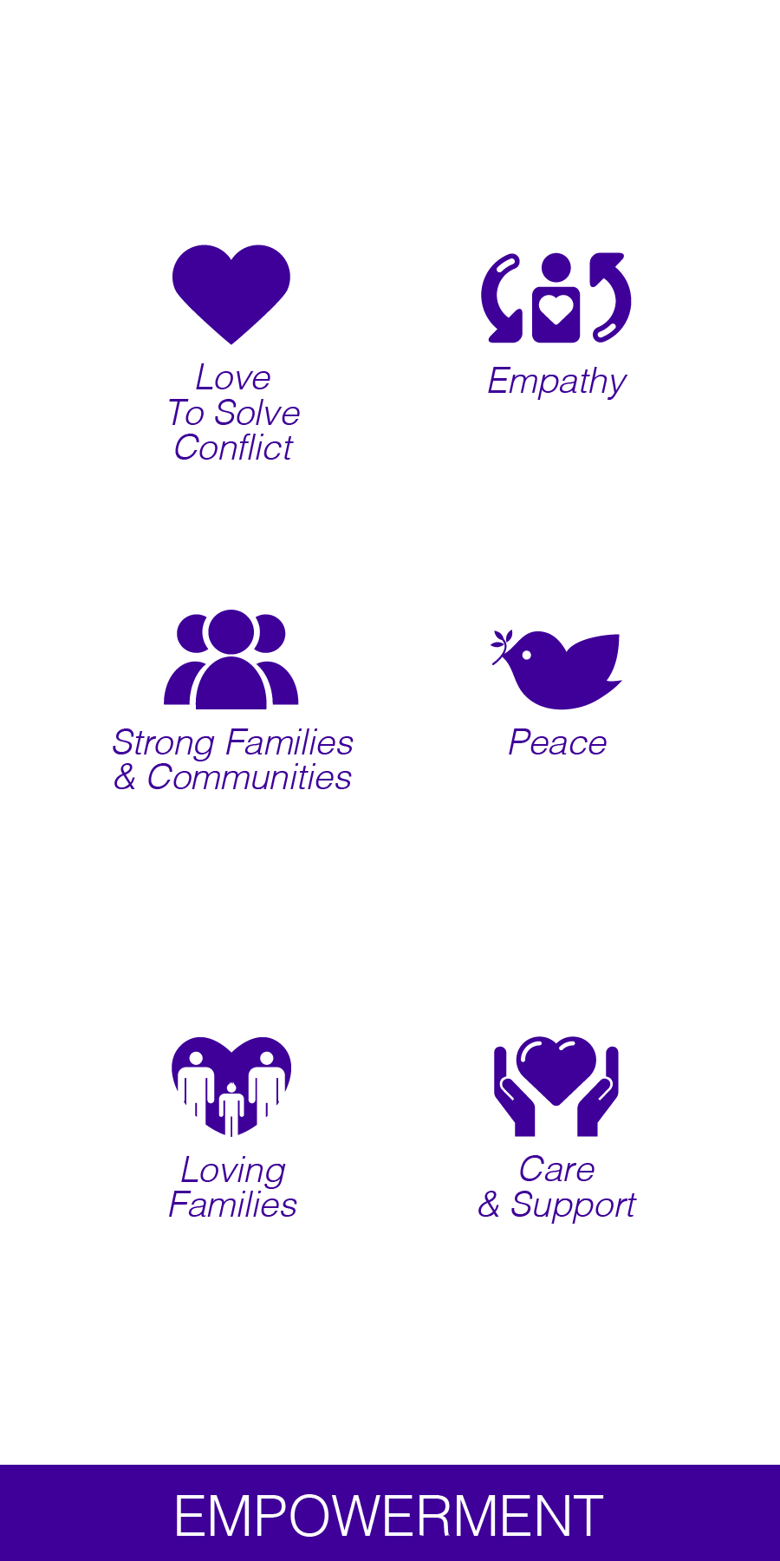
Love & harmony
Notes:
The glue that holds all of our personal and community empowerment drivers together is that of love and harmony. To ensure that we act with abundance rather than scarcity, we need to use love to solve conflict in our families and our communities. We need to practice empathy, and strive to build peace in our homes, which will ultimately lead to peace in the world around us. In abundant communities, all actions are driven by a desire to support and care for each other, rather than pushing each other apart.

Slide 35
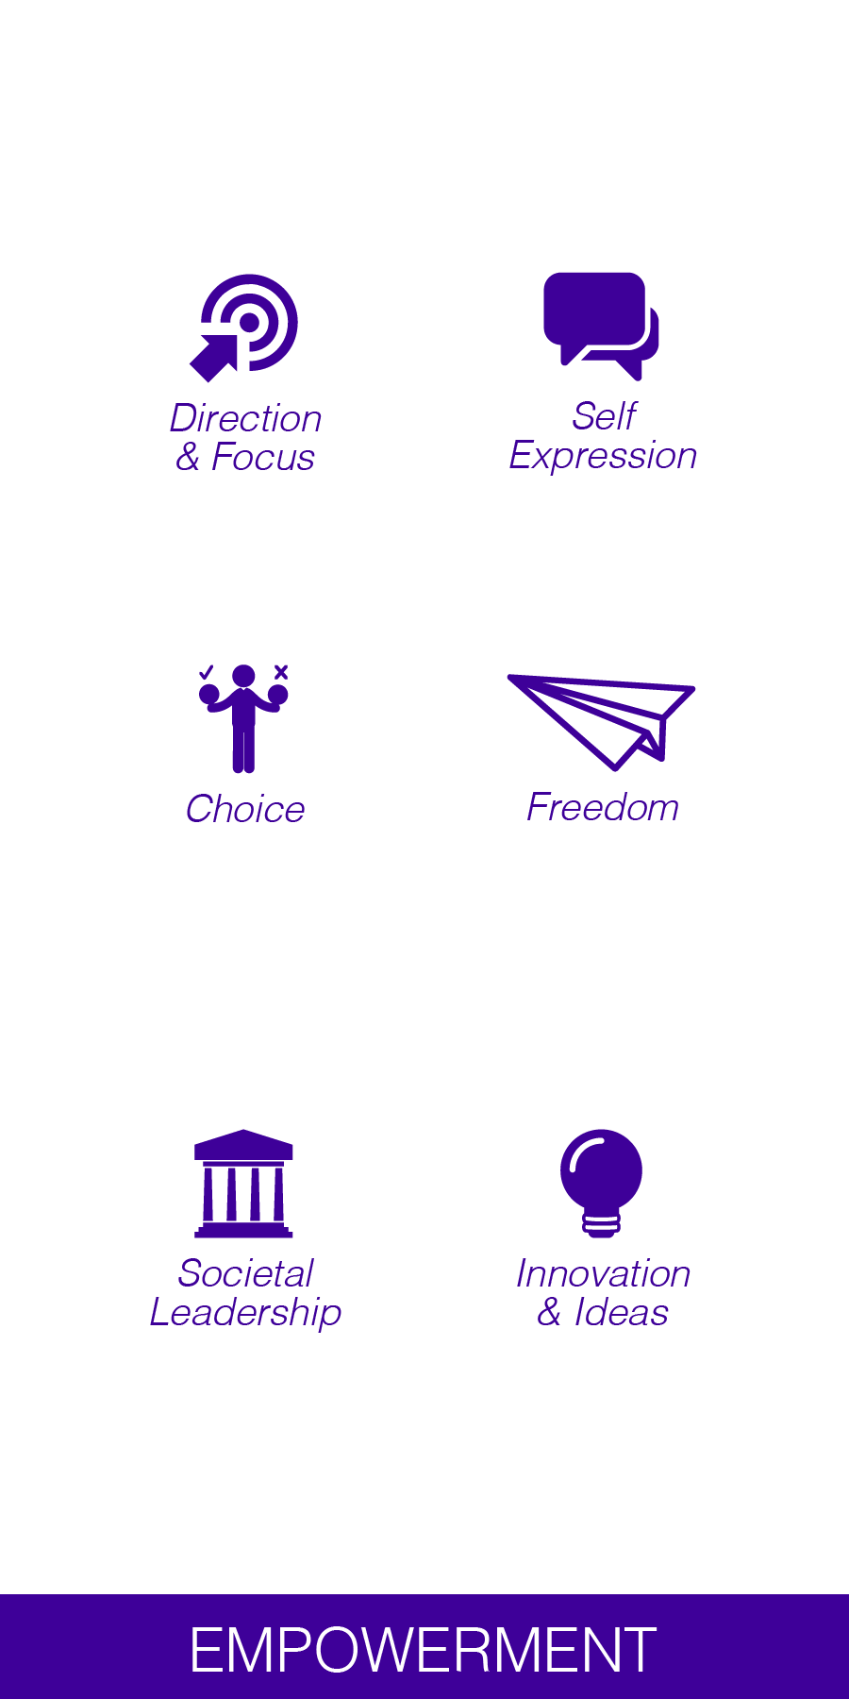
Vision & purpose
Notes:
The fifth driver is to define our vision or purpose. This is about having focus and direction in our lives. It is about making good choices and ensuring personal, community and societal leadership. A personal vision allows you to express who you are and what is important to you. Once you have defined your vision and purpose, you will feel the great sense of freedom that comes with turning hopes, dreams and imagination into innovation and new ideas.

Slide 36
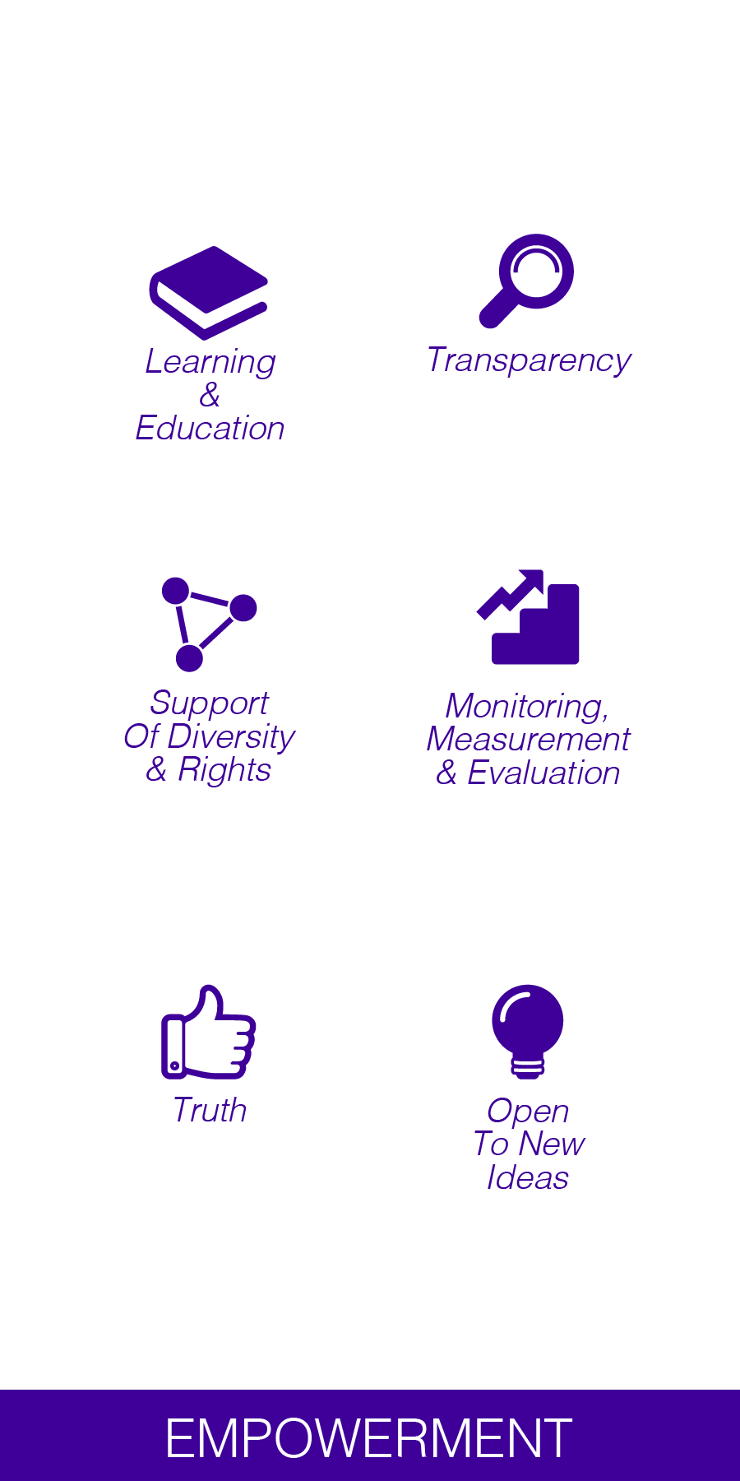
Knowledge & insight
Notes:
The sixth driver is about constantly building our knowledge and insight into our world. Its about learning and education, supporting everyone’s right to an opinion and seeking the truth in all that we do. Its about openness and transparency, monitoring, measuring and evaluating what has come before, but most importantly, it is about being open to new ideas and ways of seeing the world.

Slide 37
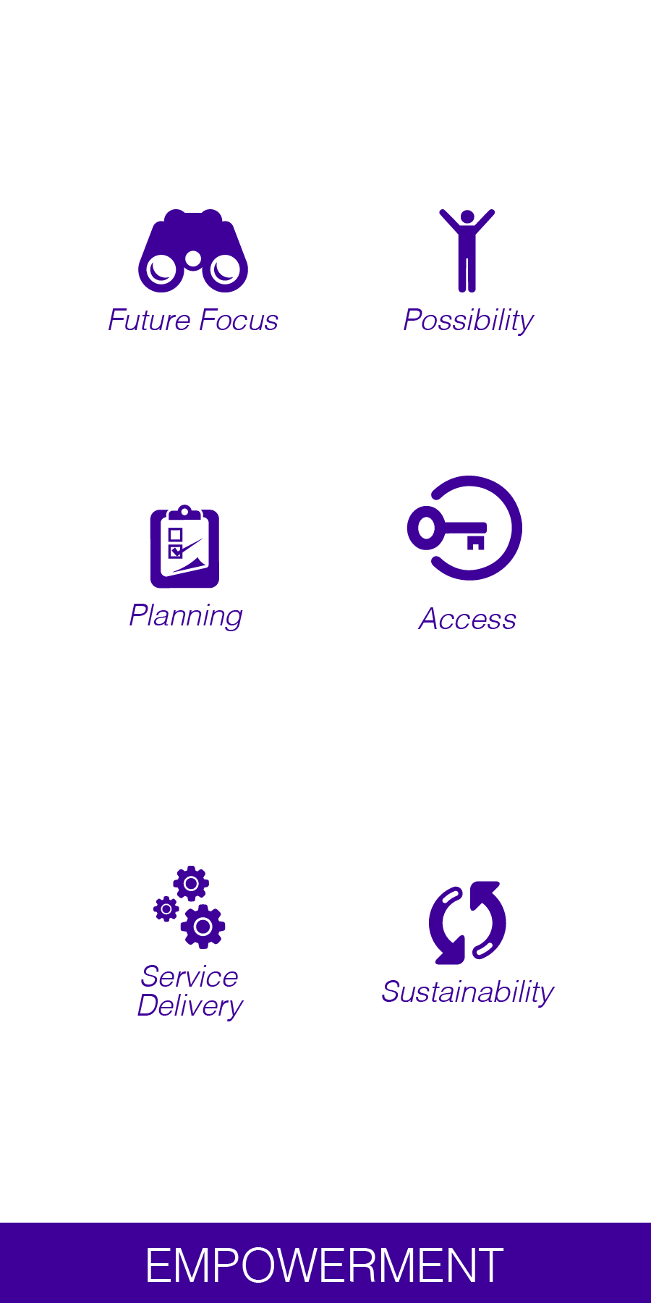
Presence & action
Notes:
The final driver is that of presence and action. This is about focussing on the future and understanding how to plan for this today. Its about delivering on what you promise. Its about believing in possibility, ensuring that everyone has access to making their dreams come true, and that the difference you create is sustainable for future generations.

Slide 38
What does this look like in practice?
Notes:
So what does a workshop look like in practice?

Slide 39
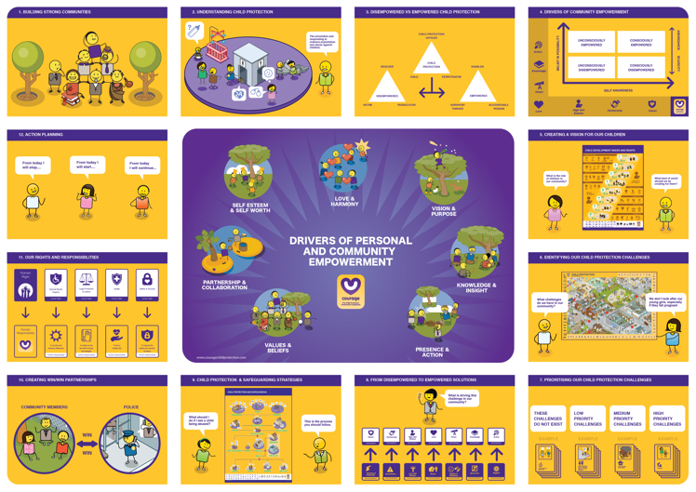
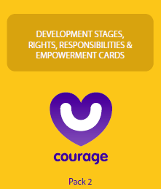
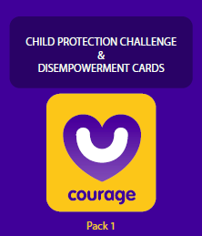
The toolkit
Notes:
The basic toolkit is made up of 4 picture based posters. The first illustrating a typical community anywhere in the world, complete with people, spaces and the child protection challenges they are dealing with. The second illustrates children’s rights and needs based on developmental stages, essentially how a child should grow up. The third illustrates the shift from disempowered to empowered drivers of change. And the final poster illustrates the step by step approach to child protection and safeguarding. There are also two packs of cards, a disempowerment pack, that details every single child protection challenge that exists in the world today and the seven disempowerment drivers that cause them. And an empowerment pack that details the empowerment drivers, child developmental stages, children’s rights and importantly the responsibilities that come with those rights. Finally there is an easy to use train the trainer poster.

Slide 40
Notes:
Rather than a thick training manual, Courage has a simple poster that helps you to navigate your way around the workshop process which you can download from our website. The top 4 blocks explain the Courage purpose and philosophy, the middle picture illustrates our various drivers of individual and community empowerment, which we have just discussed, and the rest of the blocks from 5 to 12 explain each exercise visually. We will now touch on each of these exercises to give you an overview of the whole process. Detailed explanations for each exercise can be found on our website or Courage channel.

Slide 41
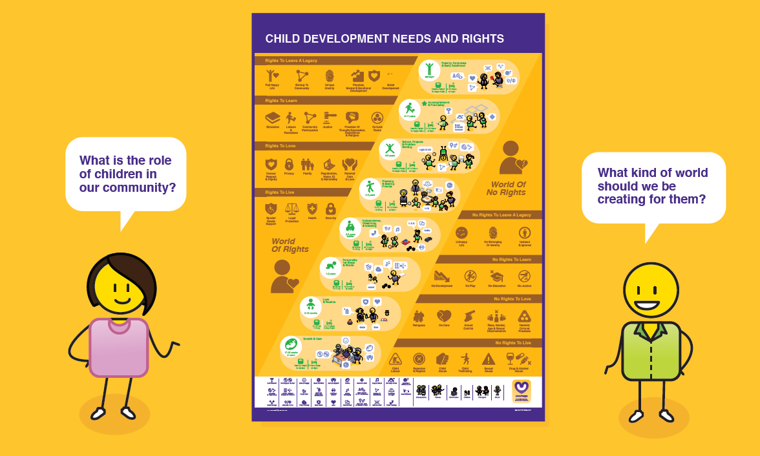
Defining your vision
Notes:
All workshops start with a visioning session, where we ask participants what kind of world they would like children to grow up in.

Slide 42







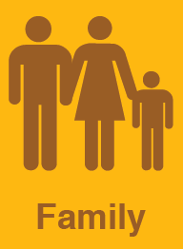




VS
Notes:
As stimulus input we share children’s rights as defined by the United Nations, our continental declaration on the rights and needs of children and our country's Children’s Act. We illustrate a world of rights where children are safe and secure, are registered, have an identity and a family, versus a world of no rights where children have no access to education, are abused and neglected, and have no sense of belonging or identity.

Slide 43
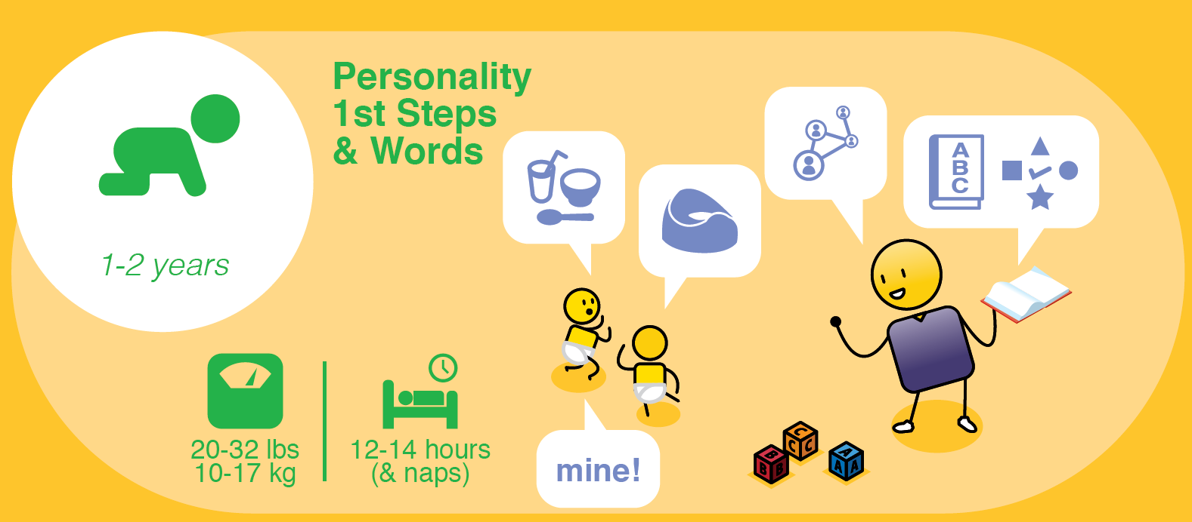
Notes:
We also look at how they should be be developing from in-utero, and their first year of life…

Slide 44
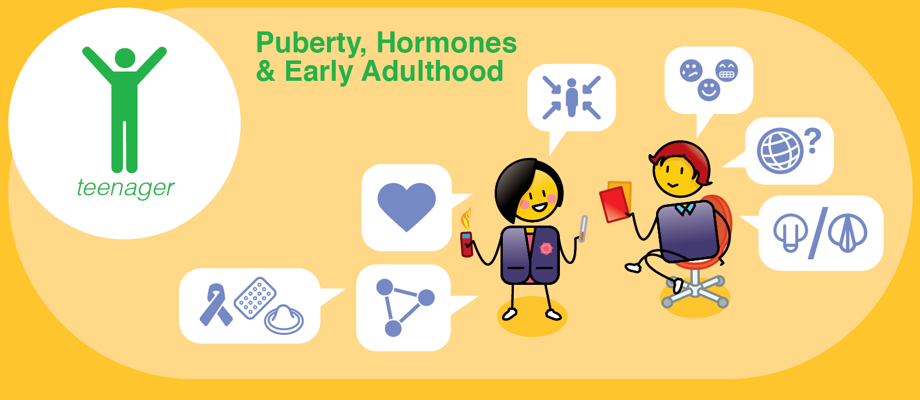
Notes:
All the way to puberty, hormones and early adulthood.

Slide 45
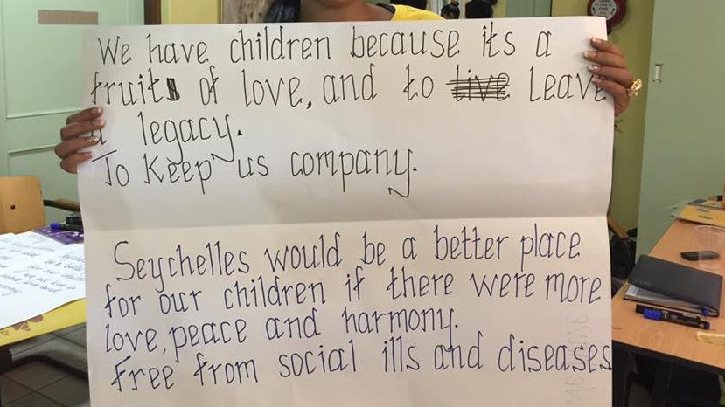
Notes:
This is an example of a community vision that a team developed in one of our workshops.

Slide 46
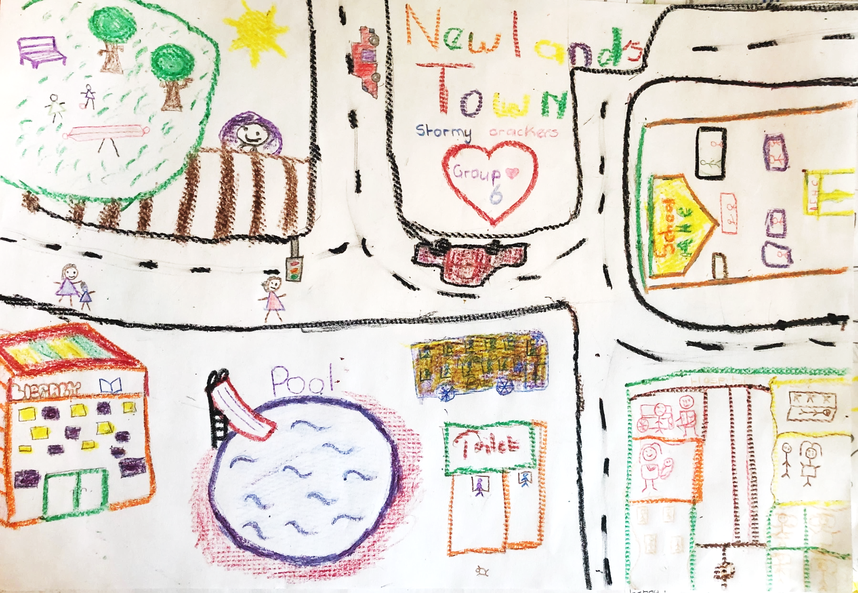
Notes:
In this vision, developed by a group of children, they have drawn and named their ideal community, which is another approach to creating a vision.

Slide 47
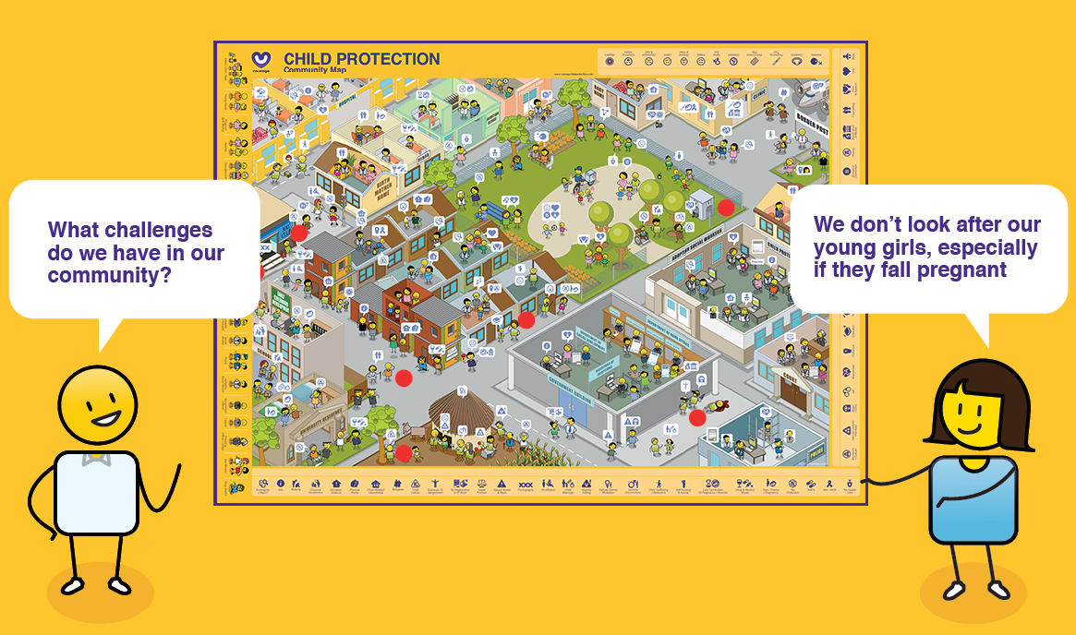
Identifying challenges
Notes:
The next step is about understanding what participants think drives child protection challenges, versus what prevents them, in their communities. We use the community map for this exercise and ask participants to identify all of the child protection challenges they have observed in their community on the map. They then need to discuss what they think are the key causes of these challenges and what they think could prevent them. This is a powerful exercise that creates a foundation for the rest of the workshop, as it creates an overview of what the participants are dealing with in each of their unique communities.

Slide 48
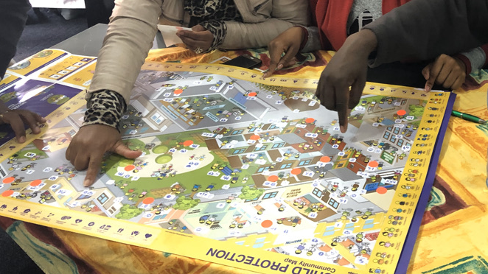
Notes:
This was a group of social workers identifying the child protection challenges in their community. Once they had acknowledged that the challenges existed, they could start to work towards solutions to solve them.

Slide 49
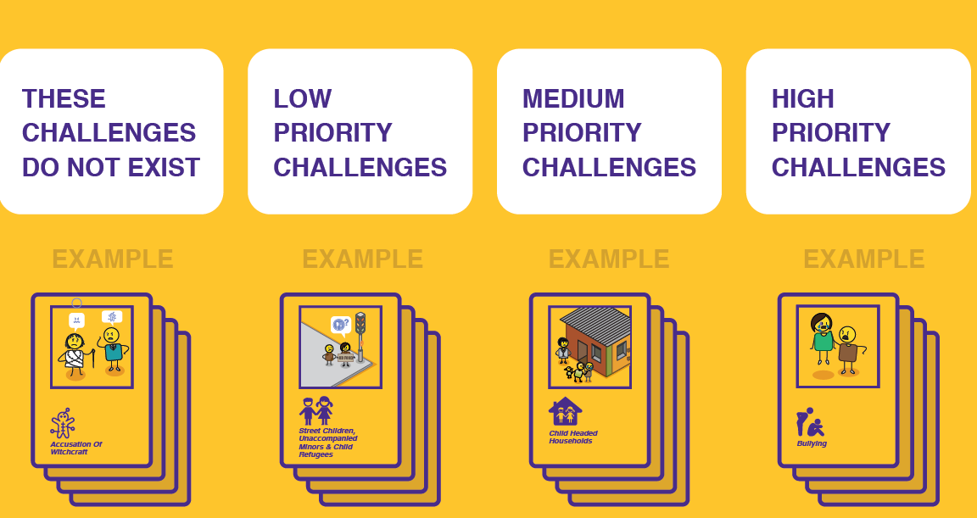
Understanding & prioritising
Notes:
After defining a vision for our community and then acknowledging that challenges exist its important to start thinking strategically about how to solve them. Courage has identified nearly 50 unique child protection challenges that children are experiencing around the world. Each is represented by a card that details what the challenge is and what needs to be considered in terms of its impact on the children and the community they live in. At this point in the workshop, participants are encouraged to go through all the cards, to understand what the challenges are, if they are happening in their community, and if yes, to prioritise the challenge as a low, medium or high problems.

Slide 50
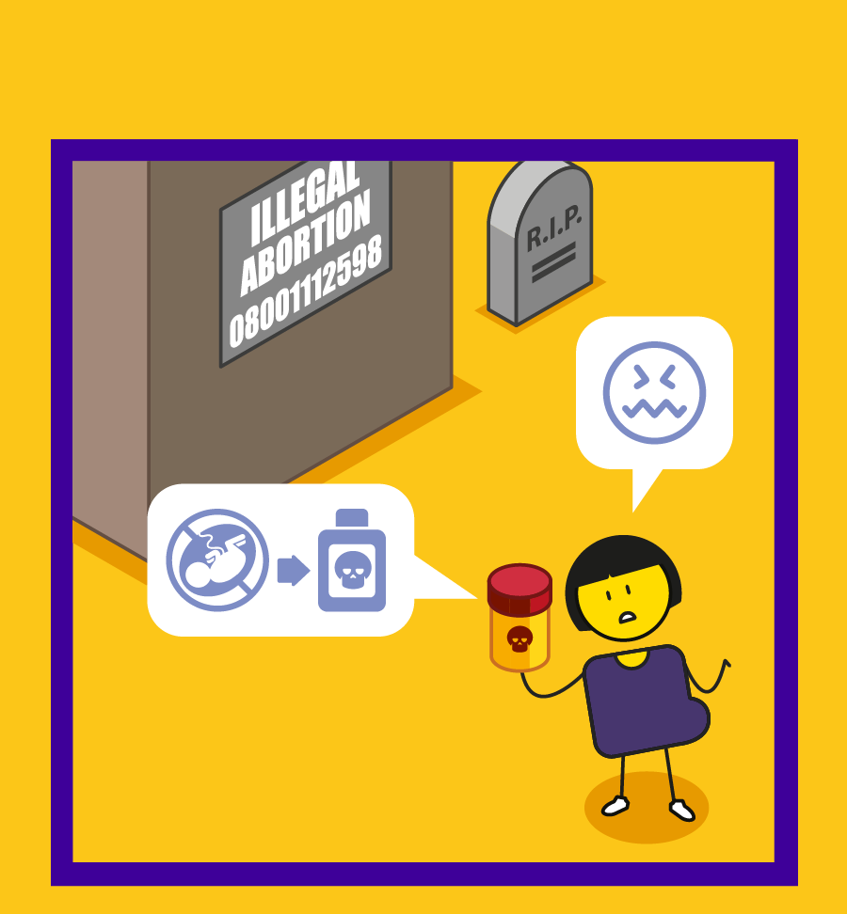
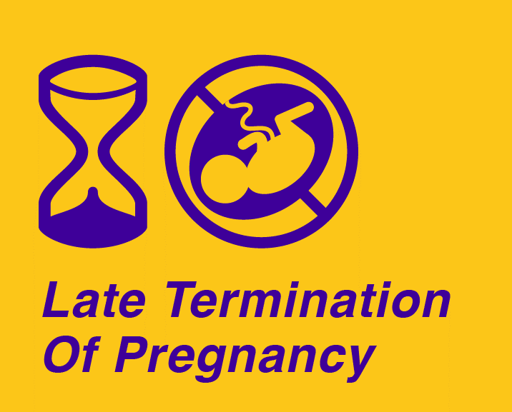
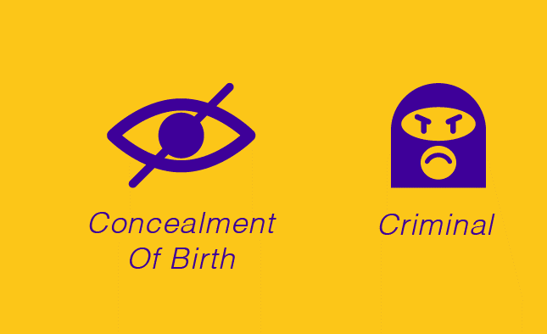
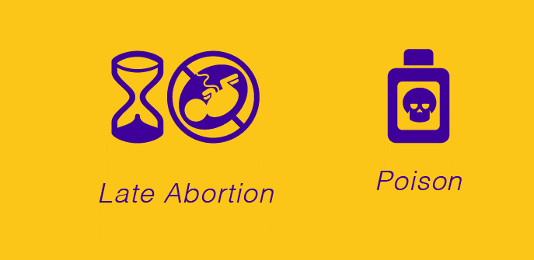
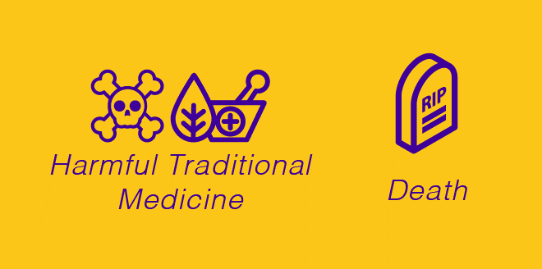
Notes:
This is an example of the late termination of pregnancy or late abortion card, which is often not understood as a child protection challenge, as the child has yet to be born.

Slide 51
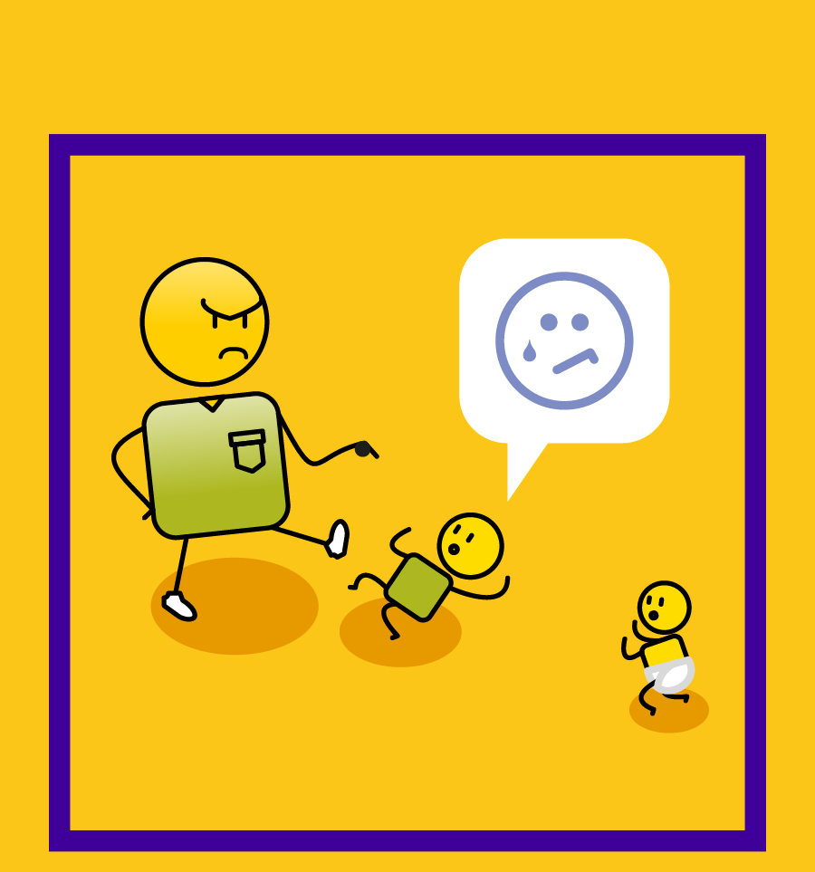




Notes:
This illustrates how child protection challenges can manifest, as in the example of physical abuse.

Slide 52





Notes:
And how the challenge impacts negatively on a children’s rights and psychosocial development.

Slide 53

Notes:
Participants discuss each challenge in the context of their community and then decide what impact it is having. They then place the card in the high, medium, low or does not exist pile. This is the first step in building understanding in the process of change.

Slide 54

From disempowered to empowered solutions
Notes:
Now that problems have been identified, understood and prioritised, it is important that solutions are found. Participants get to map their high priority challenges to the disempowerment drivers causing them, based on their experience in their community. Then using the opposite empowerment driver, they start to create solutions.

Slide 55

Notes:
The key to this exercise is getting participants to think through an empowered approach to problem solving, by firstly identifying what the problem is, then understand what is driving the problem, and finally looking at empowered solutions to solve it.

Slide 56


Notes:
In this particular example, children from a school noted how their teachers often emotionally abused the learners. The children associated the challenge with the disempowerment driver of abuse and then decided that the best way to solve the problem was to use love. They came up with an in-class campaign entitled “love your teacher, and your teacher will love you”, learning that love is often a far more powerful way to solve conflict than violence.

Slide 57

Understanding the process
Notes:
The next exercise is sharing a pragmatic step-by-step approaches to solving child protection challenges as defined by our Children’s Act, primarily the child protection and safeguarding process in the event of child abandonment, neglect, abuse or exploitation. Other child protection processes have also been developed by the Courage team, which include…

Slide 58




Sex, conception & pregnancy
Notes:
Discussing sex, birth control, conception and pregnancy

Slide 59








Option counselling
OPTION COUNSELLING
X ILLEGAL OPTION
Notes:
Option counselling for crisis pregnancy.

Slide 60










Positive Parenting
Notes:
Positive parenting approaches.

Slide 61





Adoption
Notes:
And the process of adoption, all of which you can find on the Courage child protection website.

Slide 62

Community Partnerships
Notes:
One of the most important things to remember in child protection, is that no person is an island. It is crucial to identity and then develop relationships with community partners that can support you in your efforts. The next exercise is developing a community partnership strategy, which is a two step approach. First you must identity who your partners in your community are, and then you must develop win/win relationships with each of them.

Slide 63

Notes:
In this example, these social workers are using the Courage community map to identify possible partnerships that they can develop in the communities they work in.

Slide 64

Notes:
Participants then develop a win/win partnership plan, as illustrated in this example, where they firstly agree their shared vision and then define what each partner needs from the other to achieve this vision.

Slide 65

Rights & responsibilities
Notes:
Towards the end of the workshop we return to our vision statement that we defined at the start and ask ourselves, “what values will drive the behaviours that will help us to achieve our vision”. As stimulus for this exercise, participants are encouraged to look at the children’s rights that were defined at the start of the workshop and understand that for every right, such as a right to education or legal protection, there is an equally important responsibility, such as working hard or abiding by the law.

Slide 66

Notes:
Participants get to map the human rights cards to the relevant human responsibility card. It is important that this matching process is accompanied by group discussion and engagement.

Slide 67

Notes:
Once participants have understood how their rights link to responsibilities, they will need to define and agree the values that will help them achieve their vision for themselves and their community.

Slide 68

Action planning
Notes:
The final step in a Courage Community workshop is defining what actions people will take once the workshop is over. Participants agree what they will need to stop doing, now that they understand children’s rights and child protection. What they will need to start doing. And importantly what they will need to continue doing, which are things they were already doing and are still relevant to achieving their child protection vision. The most common response from participants at the close of a workshop is, “I will speak up more”, which indicates how many challenges are happening all around us, that are not being addressed.

Slide 69

Notes:
Sometimes the action planning is done at a very personal level, as with this example of a personal vision plan that was developed for a high-school workshop. What was important in this exercise, is that each child signed and dated a personal action plan which they could use to hold themselves to account.

Slide 70
LOVE & HARMONY
SELF ESTEEM & SELF WORTH
VISION & PURPOSE
Drivers of empowerment?
PARTNERSHIP & COLLABORATION
KNOWLEDGE & INSIGHT
VALUES & BELIEFS
PRESENCE & ACTION
Notes:
To understand all of the Courage tools and process in more detail, watch each of the workshop videos for a detailed look at how to facilitate the individual exercises with your community participants.

Slide 71

stay strong
take
www.couragechildprotection.com
Notes:
Thanks for watching.
For more information visit Courage Child Protection dot com
Be sure to like this video and subscribe to our Courage Channel.
Stay strong and take courage.

