Slide 1
Moving from disempowered to empowered child protection solutions
www.couragechildprotection.com
Notes:
This Courage Presentation helps you to understand the disempowerment drivers causing the child protection challenges in your community and then to develop empowered solutions to solve them.

Slide 2
Now that we have identified, prioritised and understood all of the child protection challenges in our community
Notes:
Now that we have identified, prioritised and understood all of the child protection challenges in our community

Slide 3
We need to understand what is driving these challenges, specifically the disempowerment drivers
Notes:
We need to understand what is driving these challenges, specifically the disempowerment drivers that are enabling child protection challenges in our community

Slide 4
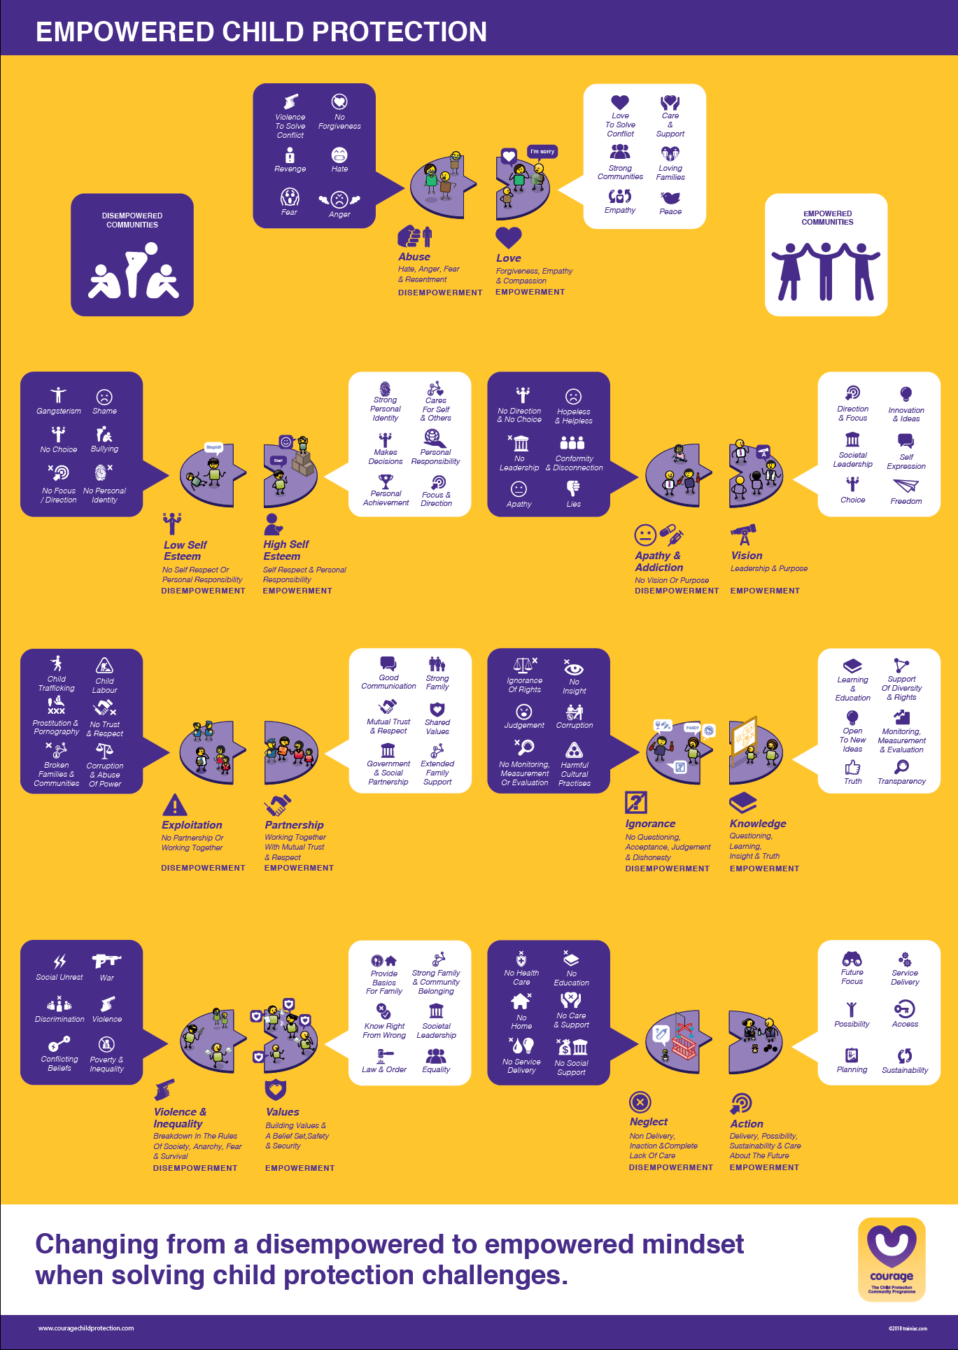
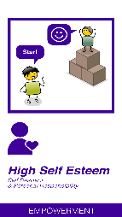
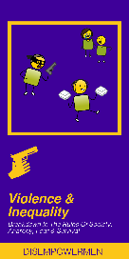
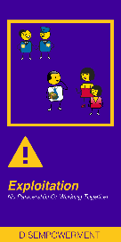
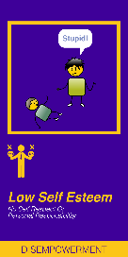
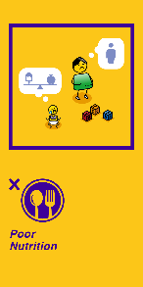
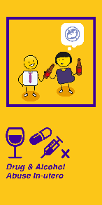
Useful courage tools
EMPOWERED CHILD PROTECTION SOLUTIONS MOVIE/PRESENTATION
CP CHALLENGES, DISEMPOWERMENT & EMPOWERMENT CARDS
or
EMPOWERED CHILD PROTECTION POSTER
or
Notes:
Some useful tools to help you think through empowered solutions to your child protection challenges include
The Courage disempowerment and empowerment cards (which are the purple & yellow packs), or
The A1 Courage empowered child protection poster.
Or watching this Courage movie or presentation all of which you can download from the Courage website.

Slide 5
Love & harmony
Notes:
The purpose of this exercise is to empower your participants and community to solve your child protection challenges in an empowered rather than a disempowered way. We do this by using love, understanding and focussing on creating harmony, rather than hate, anger and violence to solve conflict.
If we can help to build loving and peaceful families, we will create loving and peaceful communities and societies, that are resilient and strong, and defined by their care and support of each other.

Slide 6
From disempowered to empowered child protection solutions
What are the drivers of the child protection challenges in our community?
Notes:
So how do we identity our disempowerment drivers and move them into empowered solutions?

Slide 7
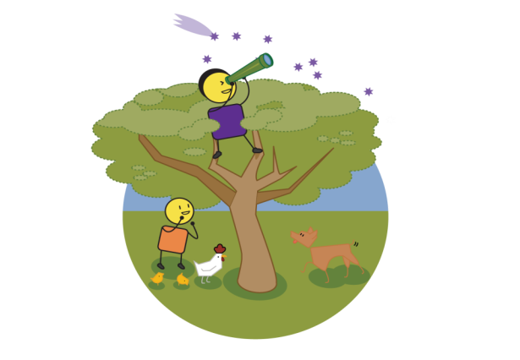
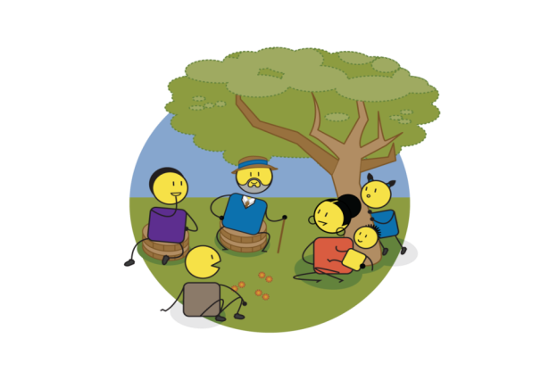
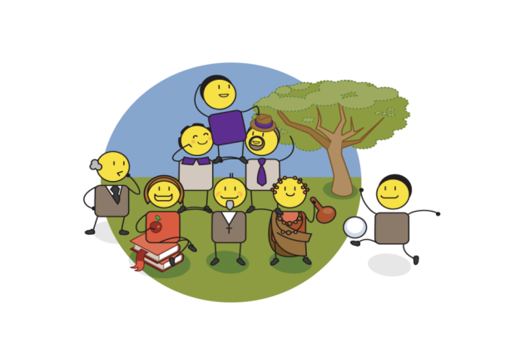
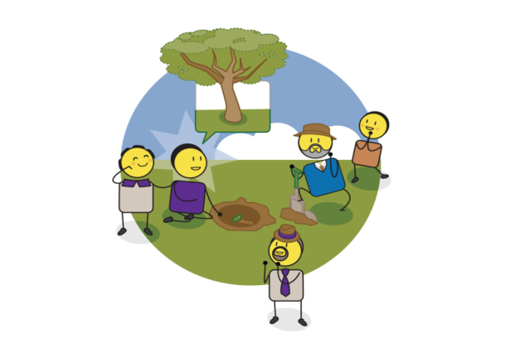
LOVE & HARMONY
VISION & PURPOSE
SELF ESTEEM & SELF WORTH
Empowerment
Drivers
PARTNERSHIP & COLLABORATION
KNOWLEDGE & INSIGHT
VALUES & BELIEFS
PRESENCE
& ACTION
Notes:
Lets start with the end in mind, by looking at the Courage drivers of individual and community empowerment. To understand how empowered you are, try to answer each of these questions, 1) Firstly, what are your values and beliefs? 2) Who do you partner with and how do you partner them? 3) What is your level of self esteem and self worth? 4) How are you building love, harmony and a sense of togetherness in your life and community, rather than getting everyone to compete against each other for your favour? 5) What is your vision and purpose? 6) How do you continue to build this through ongoing knowledge and insight? 7) And finally, how are you turning all of these good things into real and tangible actions every day? As the picture illustrates, if you want to grow a tree tomorrow, you have to plant a seed today! If you can answer all of these questions comfortably, you are pretty empowered, but this is often not the case.

Slide 8
The opposite of each empowerment driver is a disempowerment driver
Notes:
When exploring each of the child protection challenges that exist in the world today, we were not surprised to find that each problem was driven by the opposite of our empowerment drivers. Instead of values we found violence and inequality, instead of partnership we found isolated individuals who are vulnerable to exploitation, instead of high self esteem we found low self esteem, instead of love we found abuse, hate and a lack of forgiveness, instead of vision we found apathy and often substance abuse and addiction, instead of knowledge and insight we found ignorance and instead of action we found complete inaction and neglect.

Slide 9
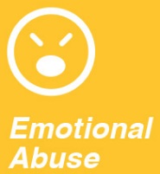
Disempowerment drives child protection challenges
Notes:
In every community, their child protection challenges are driven by different disempowerment drivers. In some communities the high level of sexual abuse and rape is driven by high levels of violence and inequality, issues such as prostitution, child trafficking and child labour are driven by individuals who want exploit children, children who have low self esteem are vulnerable to gangsterism and mental health challenges, corporal punishment and the many forms of physical, emotional and sexual abuse often flourish in an environment where abuse has been normalised.

Slide 10
Disempowerment drives child protection challenges
Notes:
The first step in this exercise is to take all of our high priority child protection challenges and try to map them to the disempowerment drivers that we think are the cause of these problems in our community. Ask yourself, “how do these challenges show up in my community?” One challenge could fall across several disempowerment drivers but try to think about which driver is most relevant in your local community context.

Slide 11
Which can only be solved through empowerment drivers
Notes:
Once you have linked your child protection challenges to a particular disempowerment driver or group of drivers, you can then look to the opposite empowerment driver to think about how to solve the problem. Instead of solving murder or attempted murder through creating more violence and inequality, we need to ask ourselves, how do we start to create values and a sense of shared commitment to these values. Instead of solving abuse with more abuse, we need to explore how we can use love. Instead of shaking our head at the ignorance that drives late termination of pregnancy or harmful cultural practices, we must start to think about how to empower people with knowledge and learning. We will now go through each of these disempowerment and opposite empowerment drivers to understand them better.

Slide 12
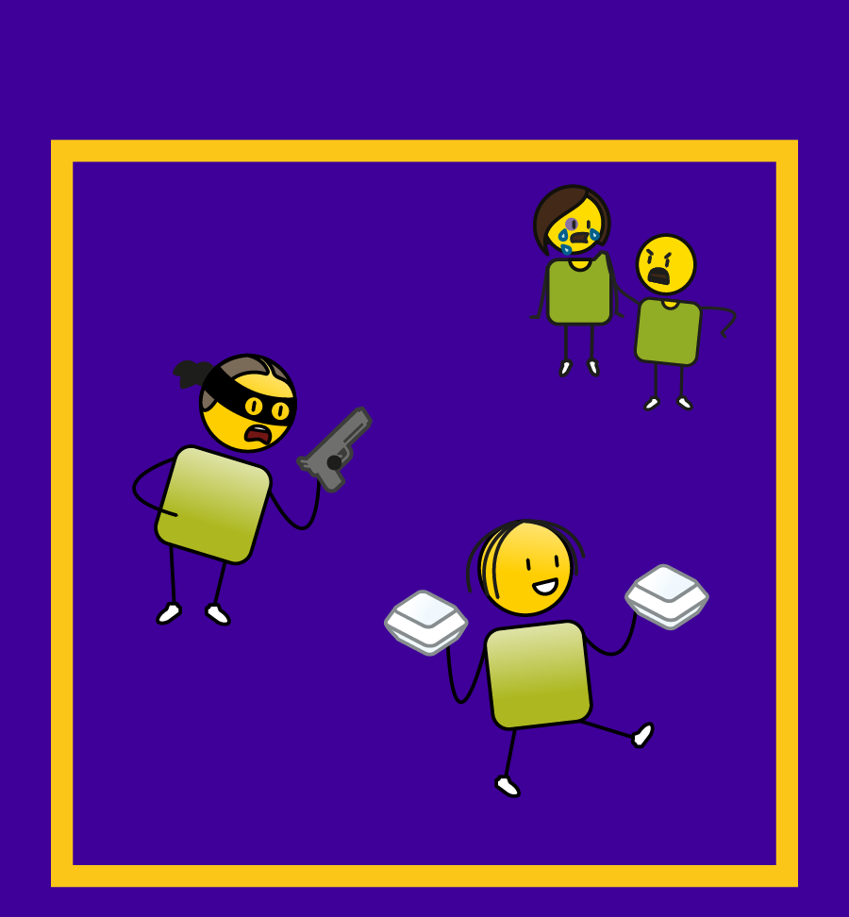
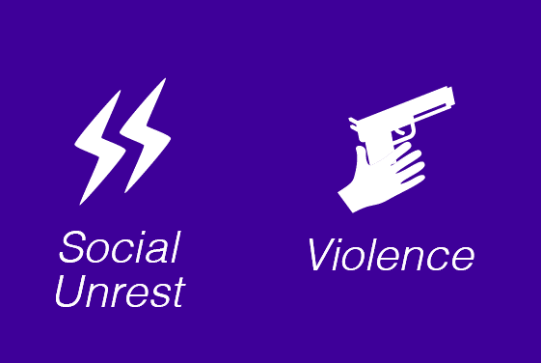
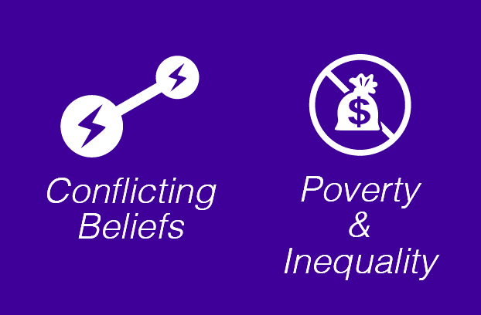
DISEMPOWERMENT
Notes:
Violence and inequality relates to a breakdown in the rules of society which leads to anarchy, fear and communities in complete survival mode. This can happen when there are high levels of social unrest, riots, violence, war, discrimination of all forms, conflicting belief systems and excessive poverty and inequality.

Slide 13
EMPOWERMENT
Notes:
In challenges driven by poverty and inequality where societal structures have broken down, the solution lies in building shared values and a belief set. This is the foundation of safety and security for communities. It also ensures that there is a shared focus on providing for the basics a family needs, including food and shelter. Building a strong sense of family and community belonging. Ensuring that law and order prevails, in an environment of equality and strong societal leadership, where all citizens know and agree what is right from what is wrong.

Slide 14
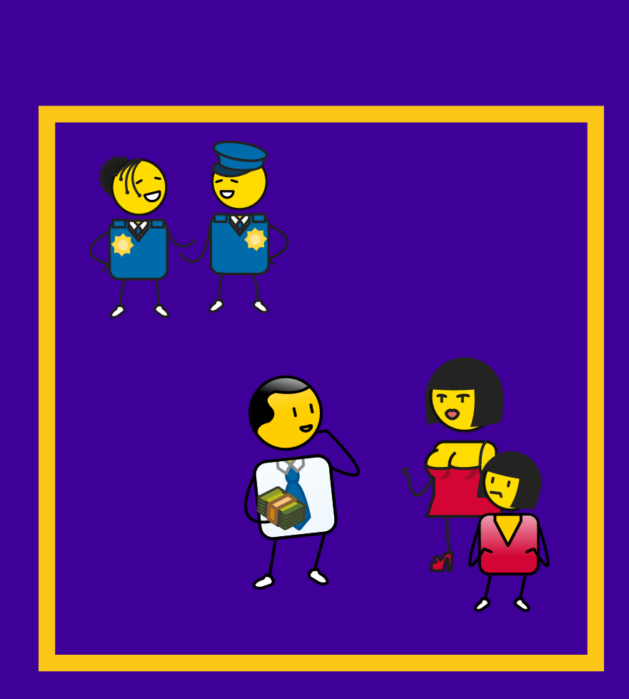
DISEMPOWERMENT
Notes:
Exploitation often takes place where individuals are isolated and have no partnerships or sense of belonging to a family or community This can lead to child protection challenges such as child trafficking, child labour, child prostitution and pornography, broken families and broken communities where there is no trust or respect and often high levels of corruption and abuse of power.

Slide 15
EMPOWERMENT
Notes:
Where child protection challenges of exploitation exist, the solution lies in partnerships, where community members work together with mutual trust and respect for each other. To ensure good partnerships one needs good communication, strong families with extended family support, shared community values, and government and community social partnerships driven by mutual trust and respect.

Slide 16
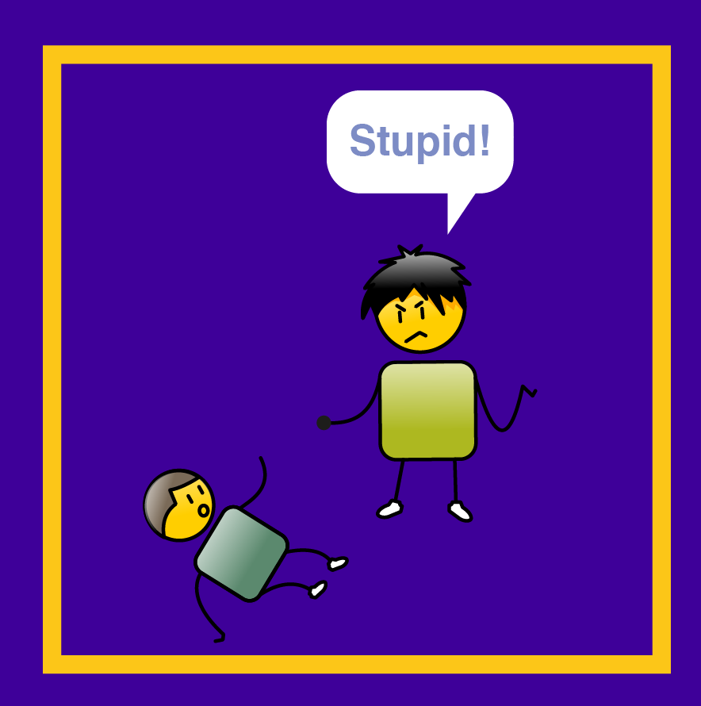
DISEMPOWERMENT
Notes:
The disempowerment driver of low self esteem is a result of having no self respect or sense of personal responsibility, it can lead to a range of child protection challenges such as exposure to gangsterism and bullying. Children with with low self esteem often have no sense of focus or direction, no sense of personal identity, they often believe they have no choices in life and frequently feel shame for who they are and the choices they make.

Slide 17
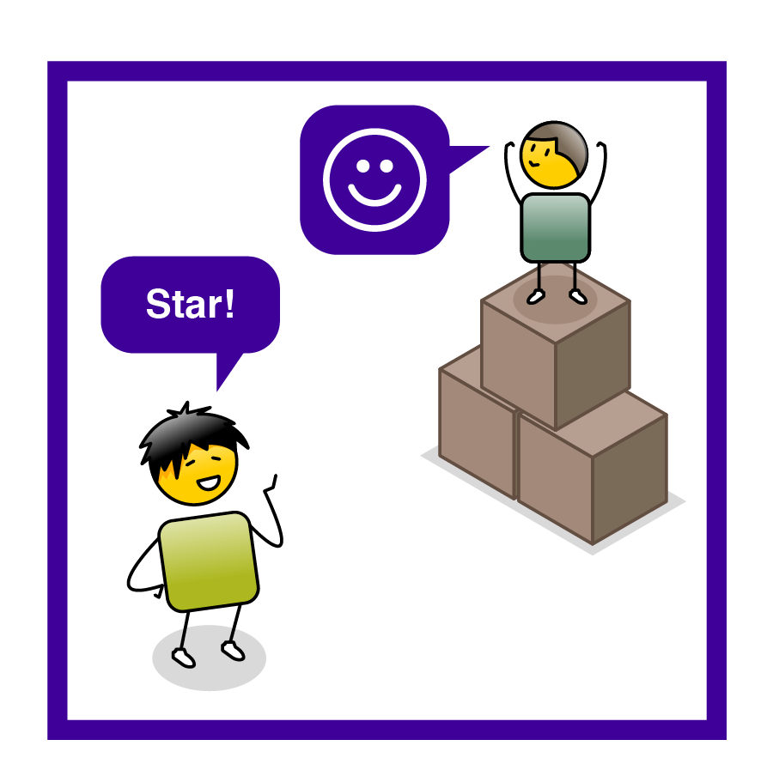
EMPOWERMENT
Notes:
To address low self esteem, we need to build high self esteem in children, where they respect themselves and take personal responsibility for their lives and the choices they make. The first step in building a sense of self is to help children define and develop a strong personal identity, to teach them to make good decisions for themselves and to help them gain focus and direction. This will lead to personal achievement and ensure that they take responsibility for their lives and to care for themselves and others.

Slide 18
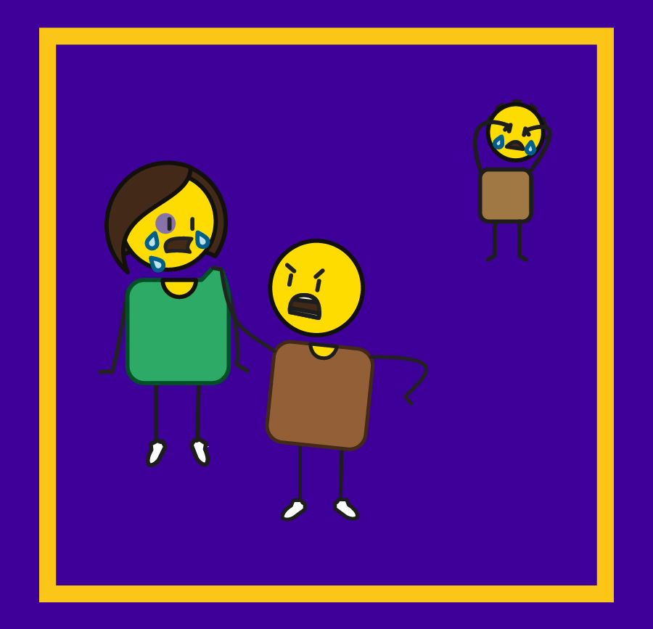
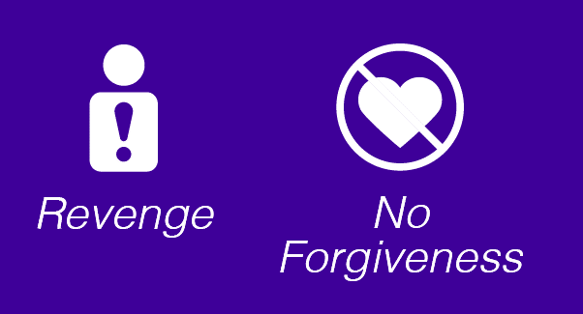
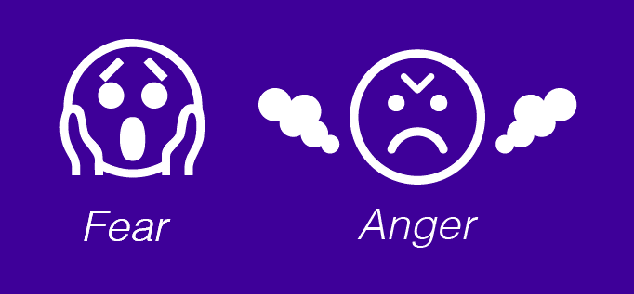
DISEMPOWERMENT
Notes:
The disempowerment driver of abuse is typified by hate, anger, fear and resentment. In environments where abuse is dominant people tend to use violence to solve conflict, they speak of hate and revenge and an inability to forgive others. Abuse is often driven by fear and anger.

Slide 19
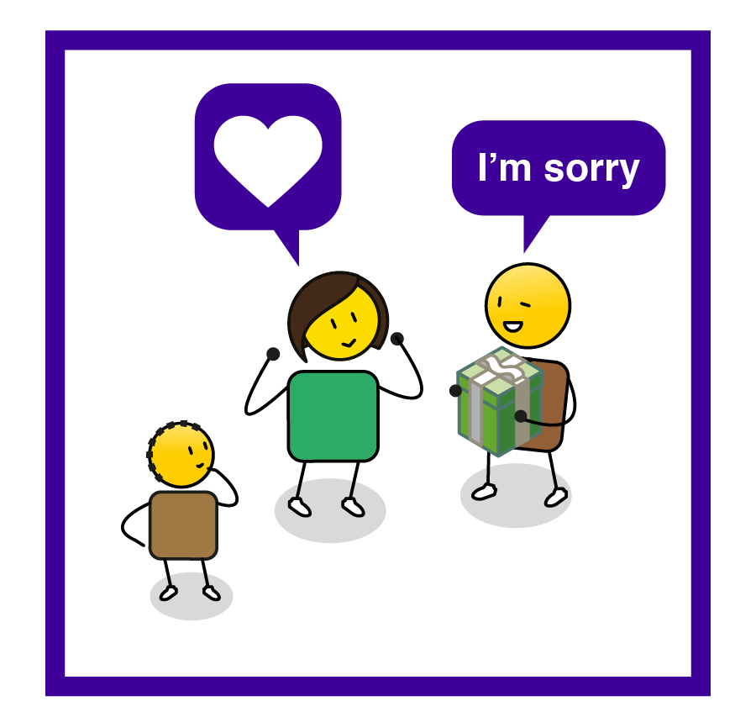
EMPOWERMENT
Notes:
The solution to abuse is love and creating an environment of care, compassion, empathy and forgiveness. In this environment people use love rather than violence to solve conflict, empathy is encouraged, and strong, loving families and communities are built, with peace and mutual care and support as their foundation.

Slide 20
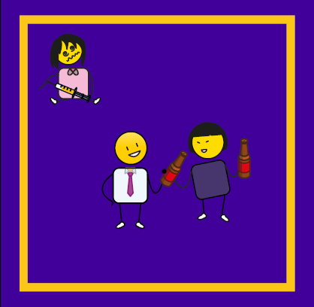
DISEMPOWERMENT
Notes:
The disempowerment driver of apathy and addiction is often caused by a complete lack of vision or purpose. Individuals have no focus or direction, there is conformity and disconnection. People tell lies and are hopeless and helpless. In these environments there is no strong or honest leadership and a sense of apathy is everywhere.

Slide 21
EMPOWERMENT
Notes:
The solution to apathy, addiction and a complete lack of focus is vision, leadership and purpose. People with vision have focus and direction, there is space for self expression, people have freedom of choice and action. In these environments you find strong societal leadership and an abundance of innovation and new ideas.

Slide 22
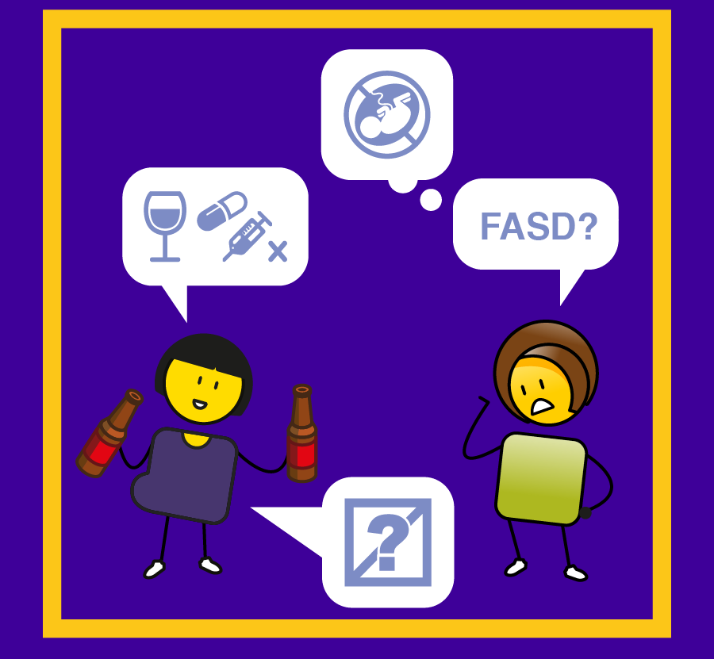
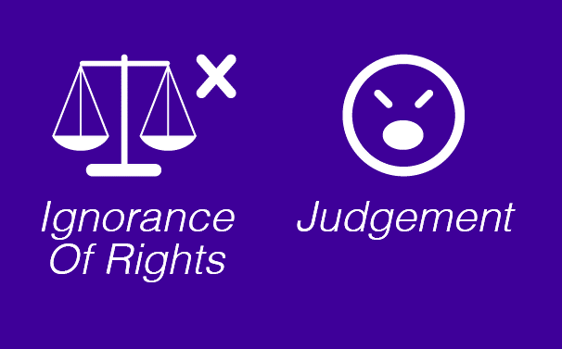
DISEMPOWERMENT
Notes:
The disempowerment driver of ignorance happens when people stop questioning and just accept what they are told, there is often judgement of others and an overwhelming sense of dishonesty. In these environments there is no understanding of individual rights, people are judged for being different, there is no knowledge or insight, no monitoring, measurement or evaluation, and harmful cultural practices and corruption thrive.

Slide 23
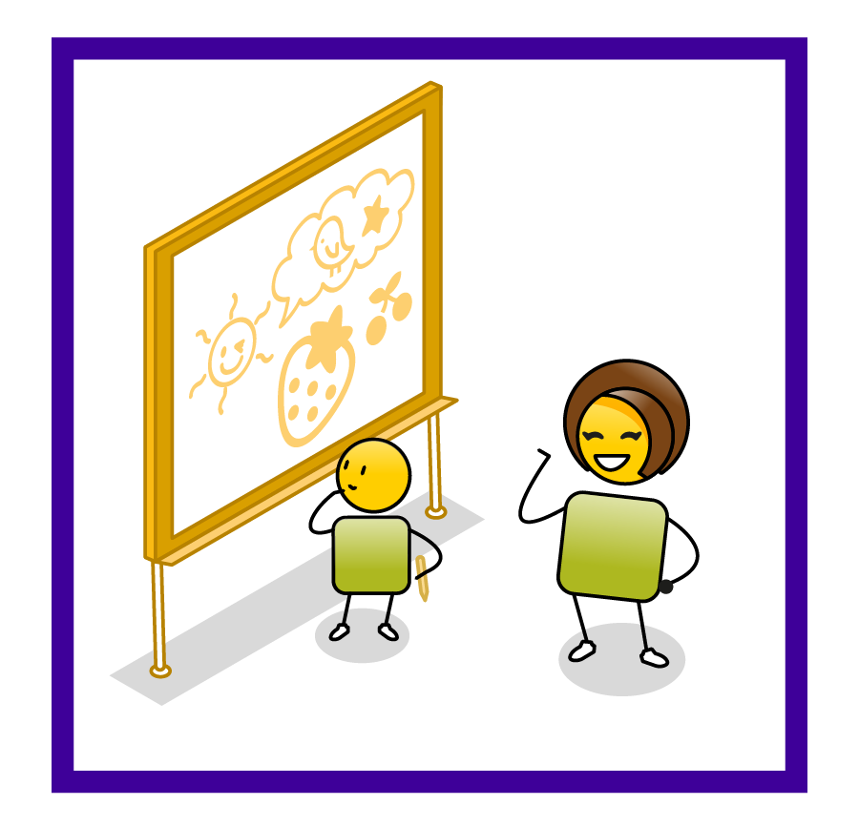
EMPOWERMENT
Notes:
The solution to ignorance is knowledge, daily questioning of the status quo, learning, insight and the search for truth. These are environments that prioritize learning and education, transparency, and support of diversity and individual rights. There is monitoring, measurement and evaluation so that people know what the truth is and there is an openness to new ideas.

Slide 24
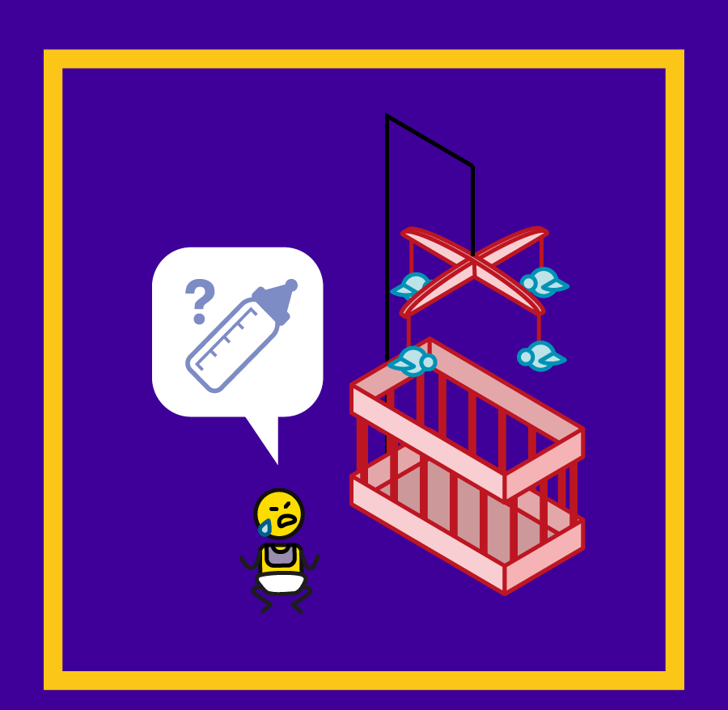
DISEMPOWERMENT
Notes:
The disempowerment driver of neglect is driven by non delivery, inaction and a complete lack of care. In these environments children have no access to health, quality education, housing or service delivery in general. There is no social support or care for those in need.

Slide 25
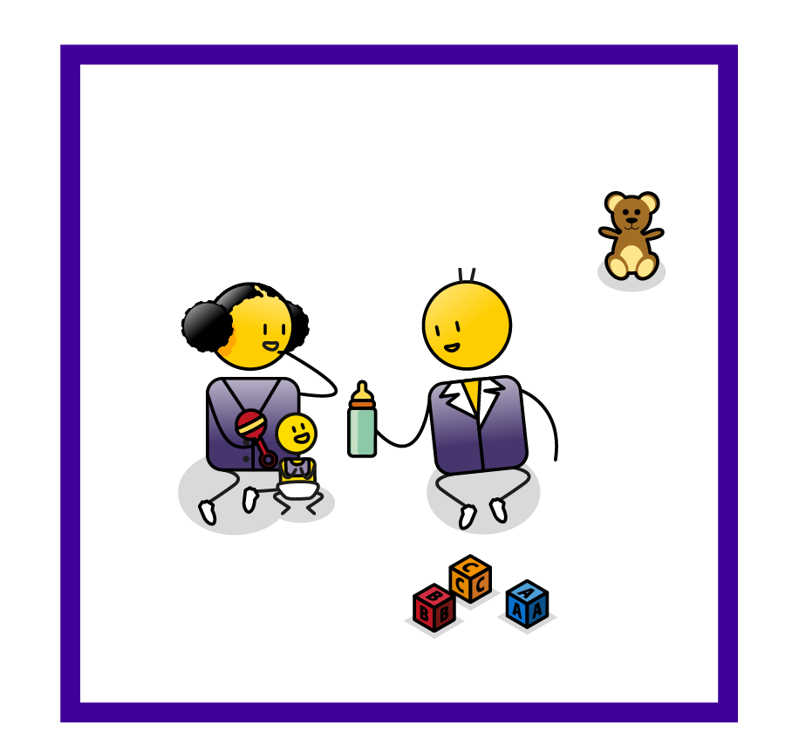
EMPOWERMENT
Notes:
The solution to neglect and inaction is to take action. Action is about delivery, possibility, sustainability and caring about the future. These environments are driven by a focus on the future, on the possibility that future can bring, on planning and access for everyone, on service delivery and on ensuing sustainable solutions for future generations.

Slide 26
What we should ask
Map your high priority cards to the relevant disempowerment drivers and then empowerment drivers
HIGH
PRIOTITY
1.
2.
3.
4.
5.
6.
7.
8.
9.
10.
Start with your high priority child protection challenges and list them from top (highest priority) to bottom (lowest priority)
Notes:
So to return to our objectives for this exercise. Start by ordering your high priority challenges in a list from the most critical to the least. Now identify your top one, three or five priorities, and just work with these at the start so that you don’t get overwhelmed. You may want to group some of these challenges together as they may relate to each other. Then identify the disempowerment drivers that you think are creating these challenges. Finally identify the opposite empowerment drivers that you can use to create real and meaningful change in your community.

Slide 27
How should you answer?
3. What is/are the empowerment driver/s that will ensure a meaningful change in behaviour/s?
(Describe as a tangible programme, campaign or specific actions you can take in your community)
2. What is/are the disempowerment driver/s?
(Describe these in the context of your community)
1. What is/are my child protection challenge/s?
(Describe how the challenge/s shows up in your community)
Notes:
This template should help you and your team or community to develop an empowered strategy for change. Start with your child protection challenges. Try to describe these in terms of how they show up in your community to ensure that they will be understood by a broader audience. Then identify the disempowerment drivers that you think are creating these child protection challenges. Again, try to describe the drivers in the context of your community and what you have actually observed happening. Finally identify the opposite empowerment drivers that will ensure meaningful behaviour change. Try to develop your empowerment drivers into a tangible programme, campaign or specific actions you intend to take forward.

Slide 28
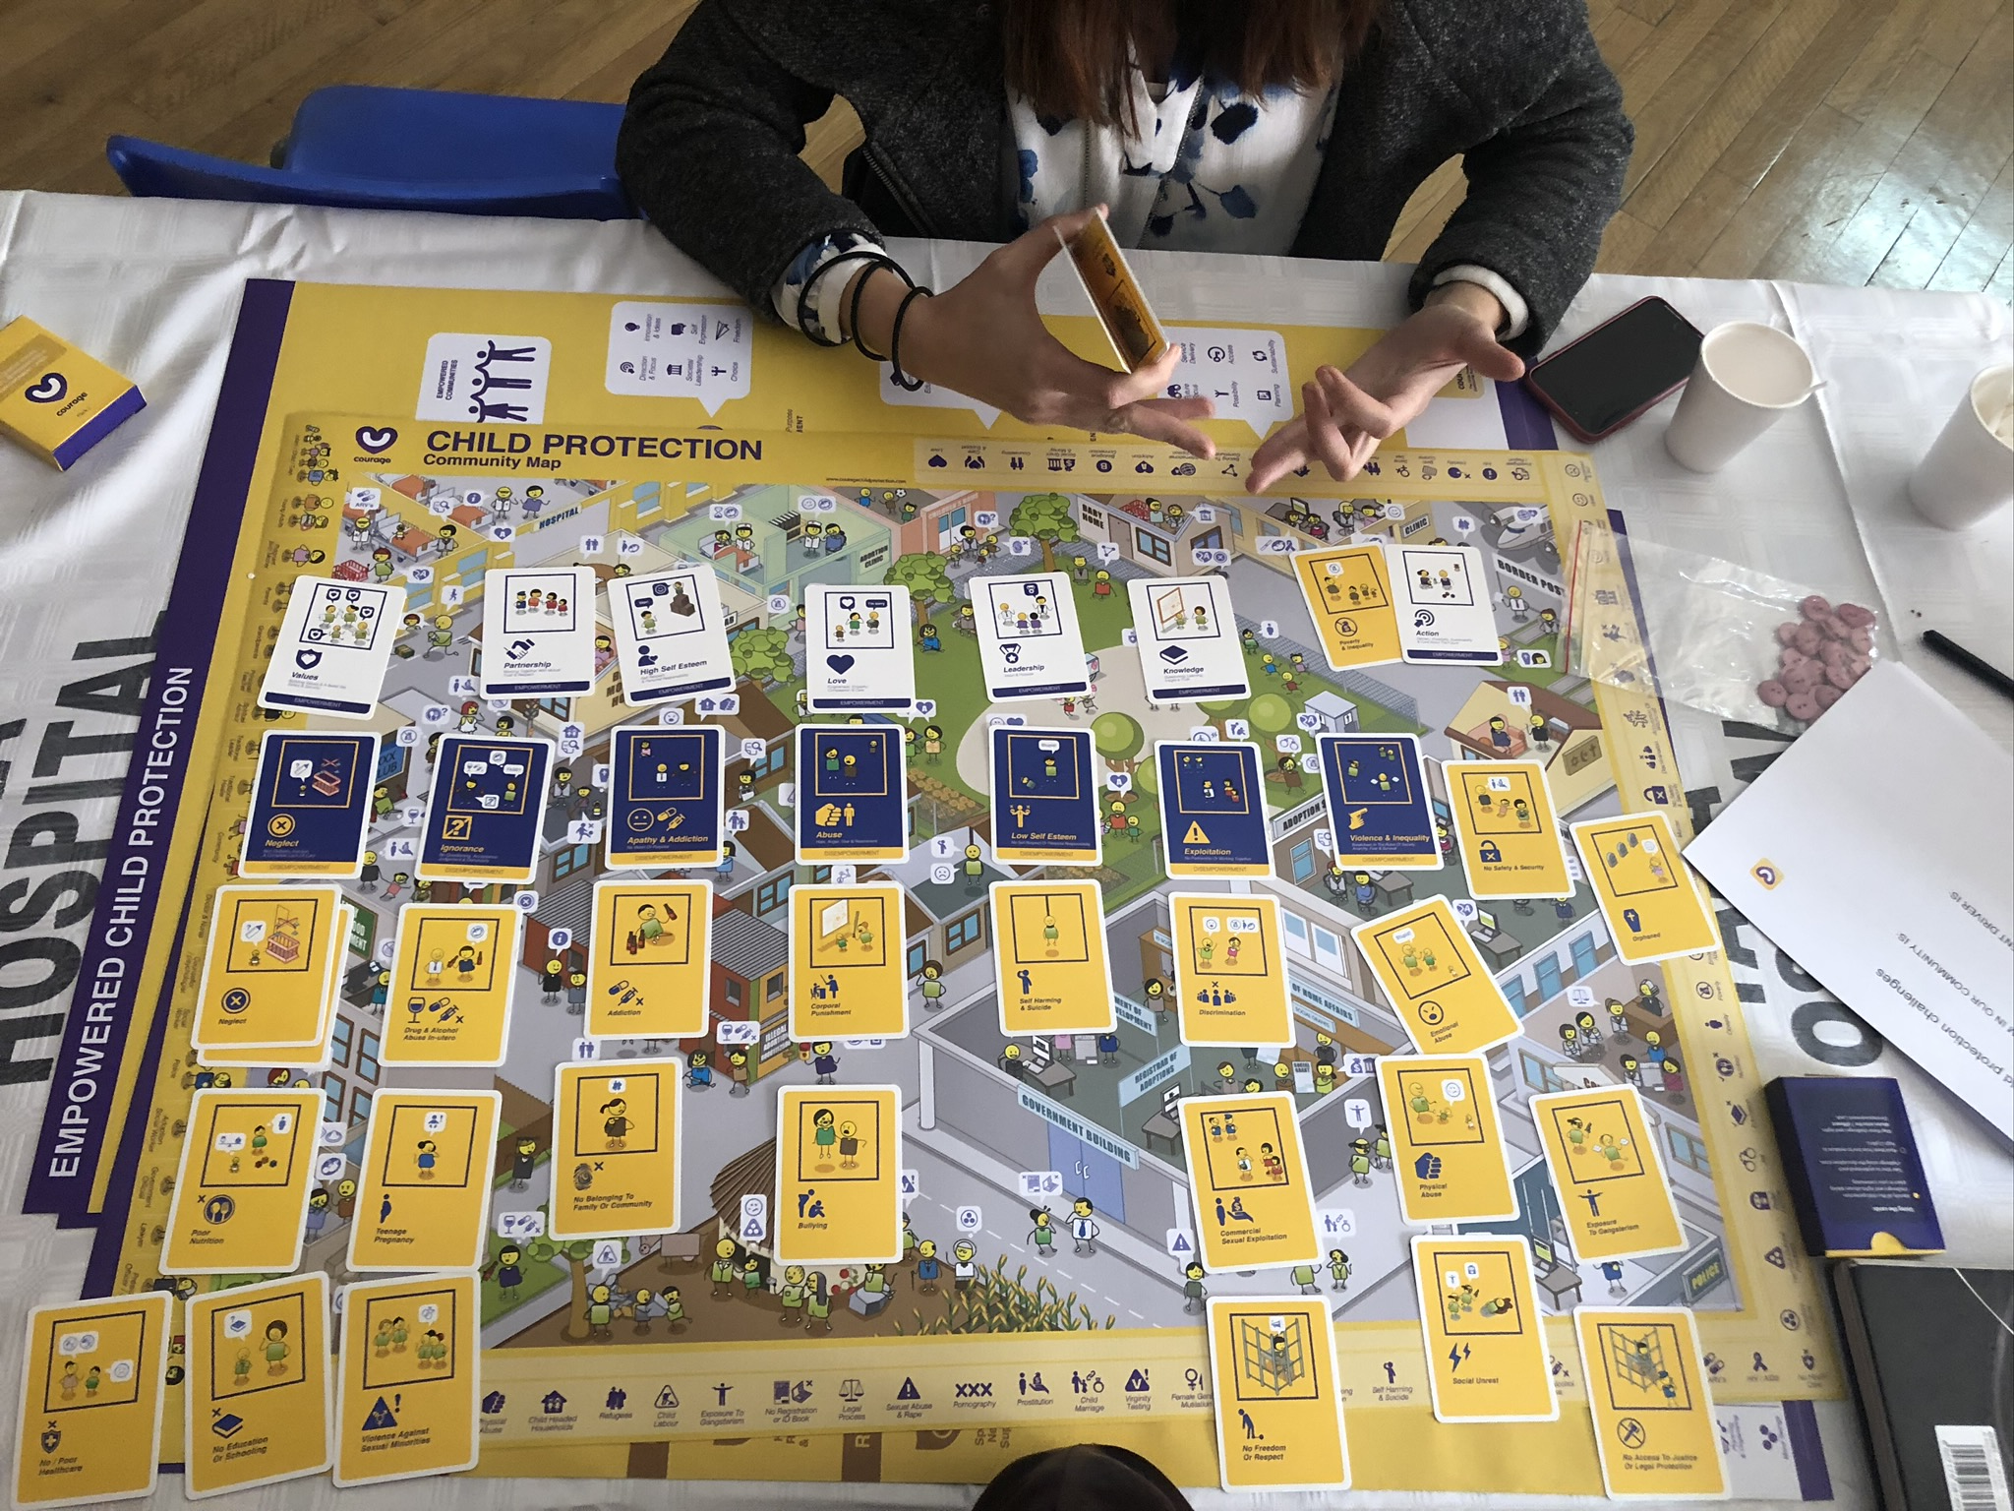
Notes:
Here we can see how some community workers in a hospital have mapped their high priority yellow cards to the purple disempowerment drivers and then placed the opposite white empowerment cards above each.

Slide 29
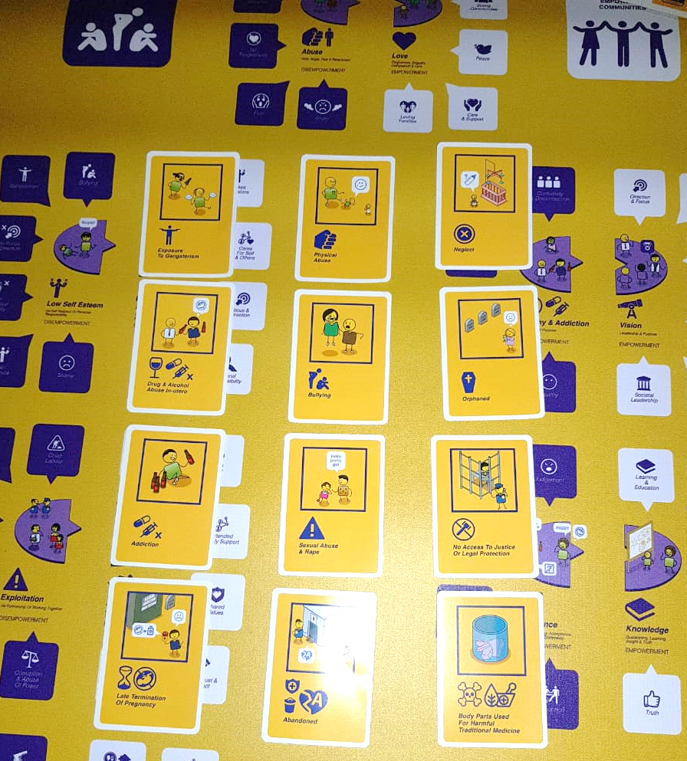
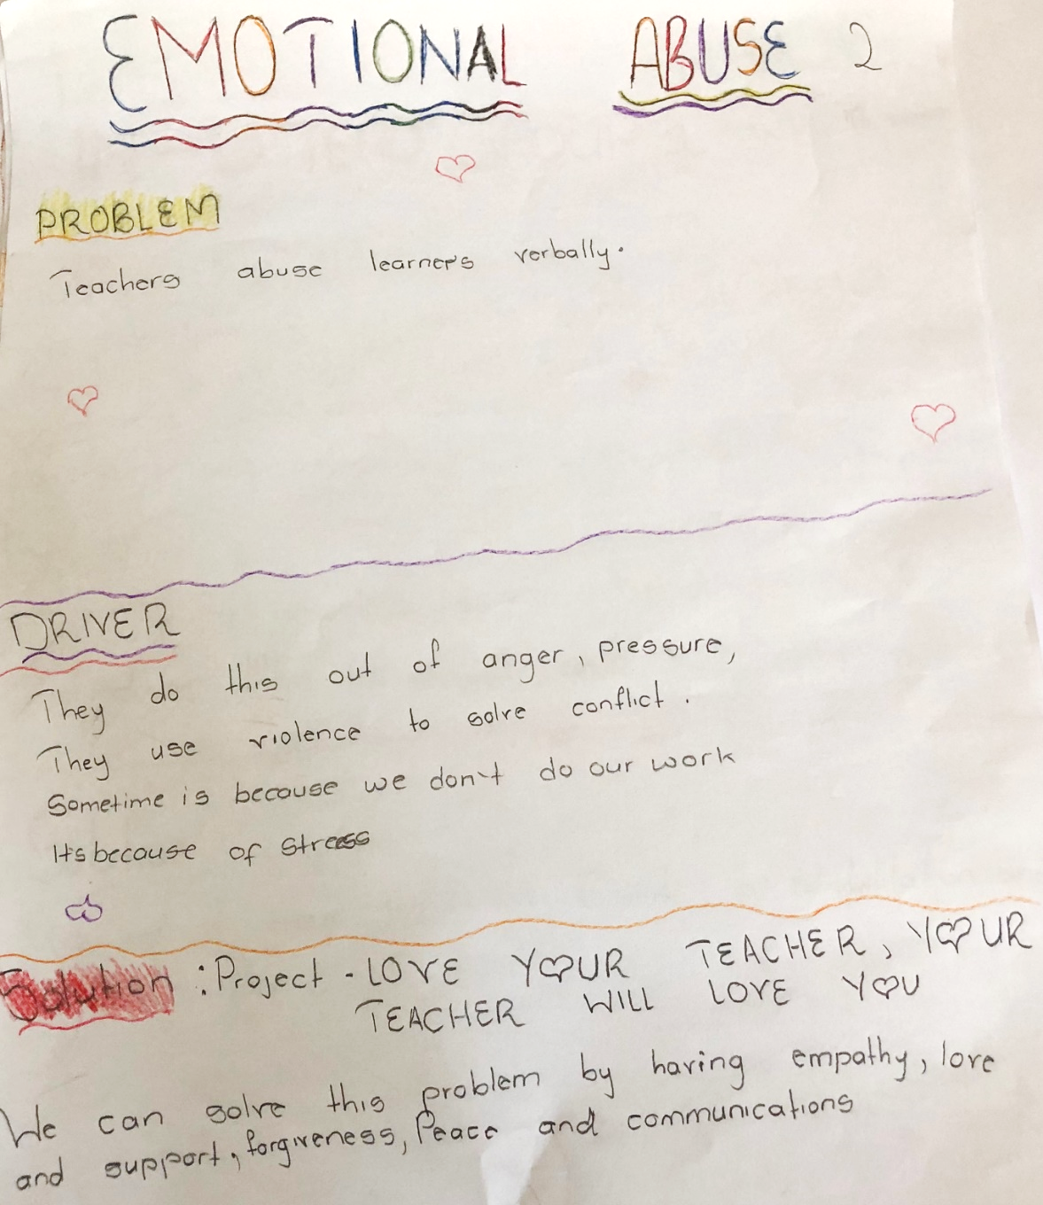
Notes:
Once you have mapped everything out, you now need to start solving your child protection challenges in an empowered way. In this example, a group of children identified that their biggest challenge was that their teachers emotionally abused them verbally in class. They discussed what they thought was driving this and decided that it was the disempowerment driver of abuse, specifically that the teachers were angry, under pressure and often used violence to solve conflict. Their solution was an in class campaign called “love your teacher and your teacher will love you”. They decided that if they modelled using love to solve conflict, their teachers would learn from their empowered approach and would in turn strop verbally abusing them.

Slide 30
Learning an empowered approach to solving problems
Notes:
The key to this exercise is learning an empowered approach to solving child protection challenges, starting with identifying the problems, then the disempowerment drivers, and finally using the empowerment drivers to create interventions that drive meaningful behaviour change.

Slide 31
stay strong
take
www.couragechildprotection.com
Notes:
Thanks for watching.
For more information visit Courage Child Protection dot com
Be sure to like this video and subscribe to our Courage Channel.
Stay strong and take courage.

