Slide 1
Identifying and creating win/win community partnerships
www.couragechildprotection.com
Notes:
This Courage presentaiton will help you to identify and then create win/win partnerships with other community members to assist you in your child protection efforts

Slide 2
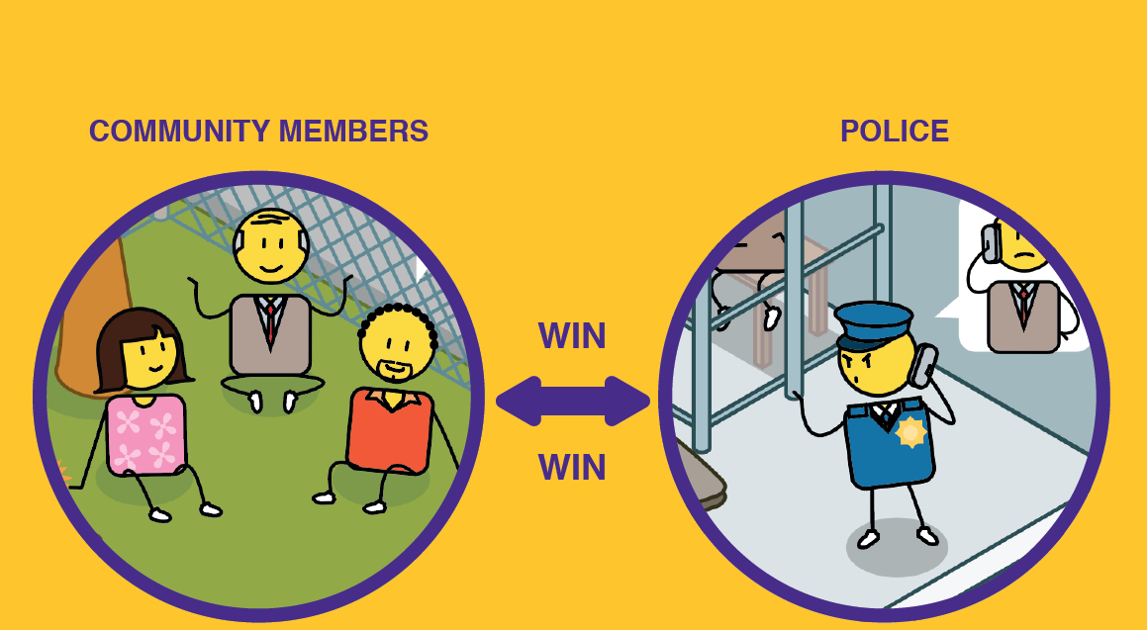
Notes:
No person is an island as the saying goes, and this is especially true when it comes to solving child protection challenges. To ensure that communities are most effective in creating a safe and empowered space for children to thrive, they must work together with other like-minded community members.

Slide 3
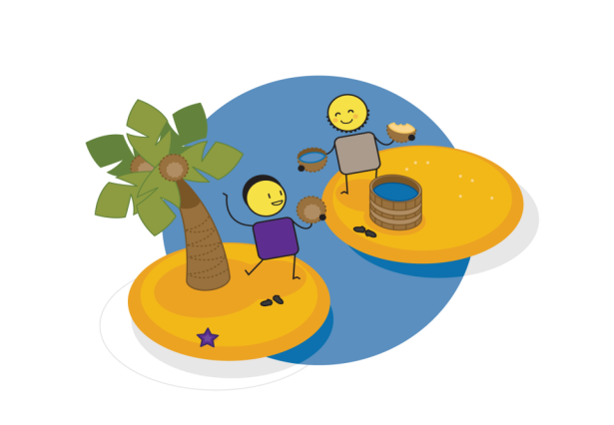
Partnership & collaboration
Notes:
True partnership and collaboration is defined by shared values, mutual trust and respect, and good communication. Partnership is critical in building strong families, ensuring extended family support and effective governments and community collaboration that ensure the best interests of children are met.

Slide 4
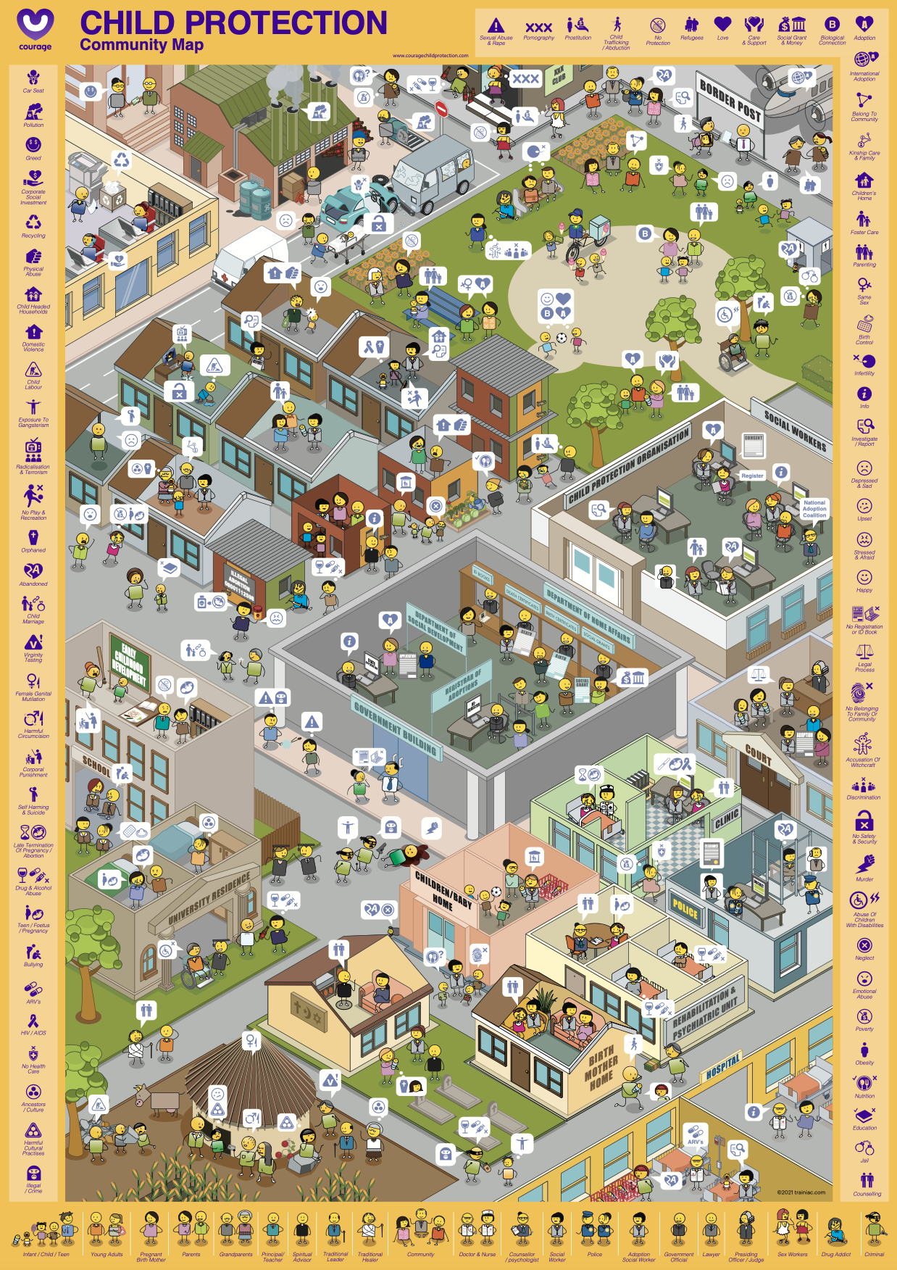
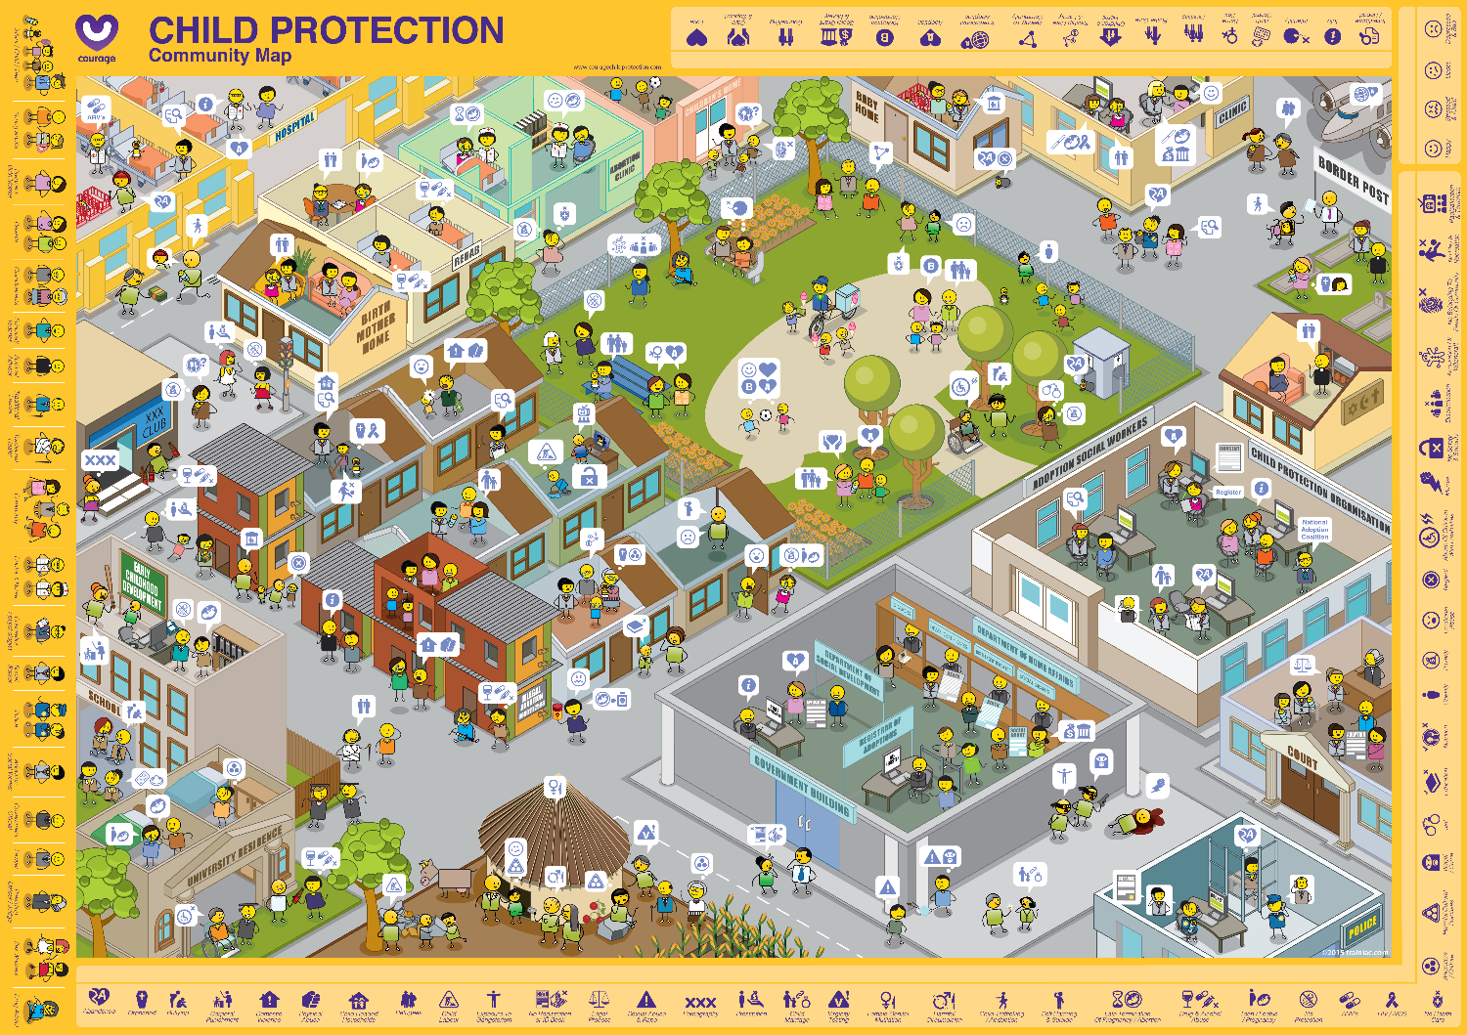
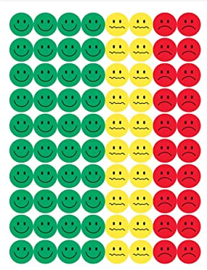
Useful courage tools
courage community map and stickers/buttons
Projection of map and white board markers
or
Notes:
These are some useful tools that will help you to identify your child protection partners in your community, which you can download from the Courage Child Protection Website or order a printed version online.
As stimulus for your child protection partnership exercise you can either use:
An A1 Courage Community Map which is available in portrait or landscape format and some coloured buttons or stickers.
Or you can play this video and ask participants to list the child protection partnerships that they think they should build in their community.
Or you can download and project the Courage Community Map from the presentation format off our website, and use coloured marker pens to identify your child protection partners.

Slide 5
Identify your partners
Create win/win relationships
Notes:
There are two steps to creating a child protection community partnership plan. The first step is to identify your community child protection partners, and the second step is to then develop win/win relationships with each of them.

Slide 6
What should we ask?
Using stickers of buttons identify all the child protection partners you could work with in your community
For each of these partnerships, you should create a win/win partnership strategy that includes your shared vision, values and expectations.
Building Win/Win Partnerships?
Notes:
Using stickers or buttons identify all the child protection partners you are or should be working with in your community. For each of these partnerships you should create a Win/Win partnerships strategy that details your shared vision and values, as well as what you expect from each other. The key to a successful partnership is ensuring that there is a balance between what you give, and you get from each other. All partnerships must be based on mutual trust, respect and integrity.

Slide 7
Notes:
This is the Courage Community Map, and represents a community anywhere in the world,

Slide 8
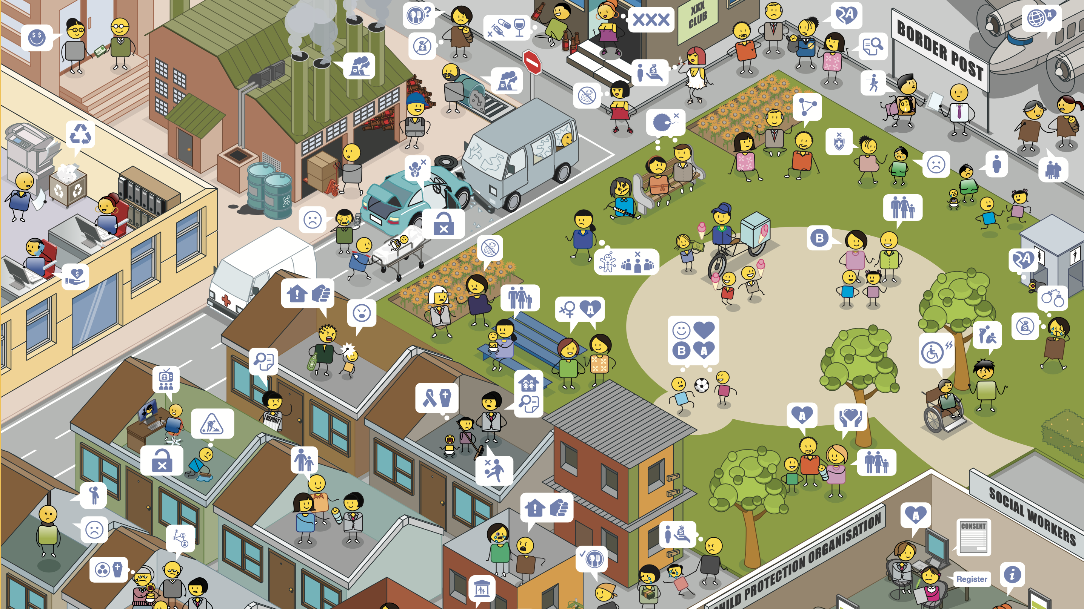
Notes:
Starting in the top left-hand corner and moving right, you will see different kinds of community partners that you can collaborate with such as corporates and business partners, community social workers, health workers and paramedics, and other community members.

Slide 9
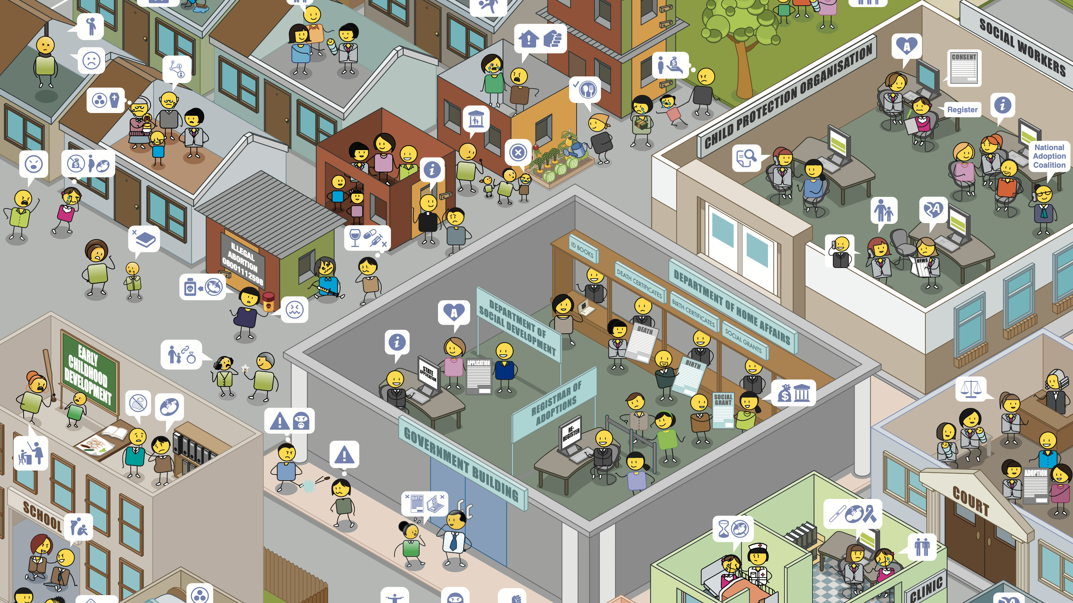
Notes:
In residential areas you can find your family and other community members, in schools you can find teachers, coaches and counselors, in government you can find a range of government departments such as social development, home affairs, health and education, in child protection you can find social workers, carers and non-profit organizations, in clinics you can find doctors and nurses, and in the courts you can find legal advice through lawyers, court officials and human rights organizations.

Slide 10
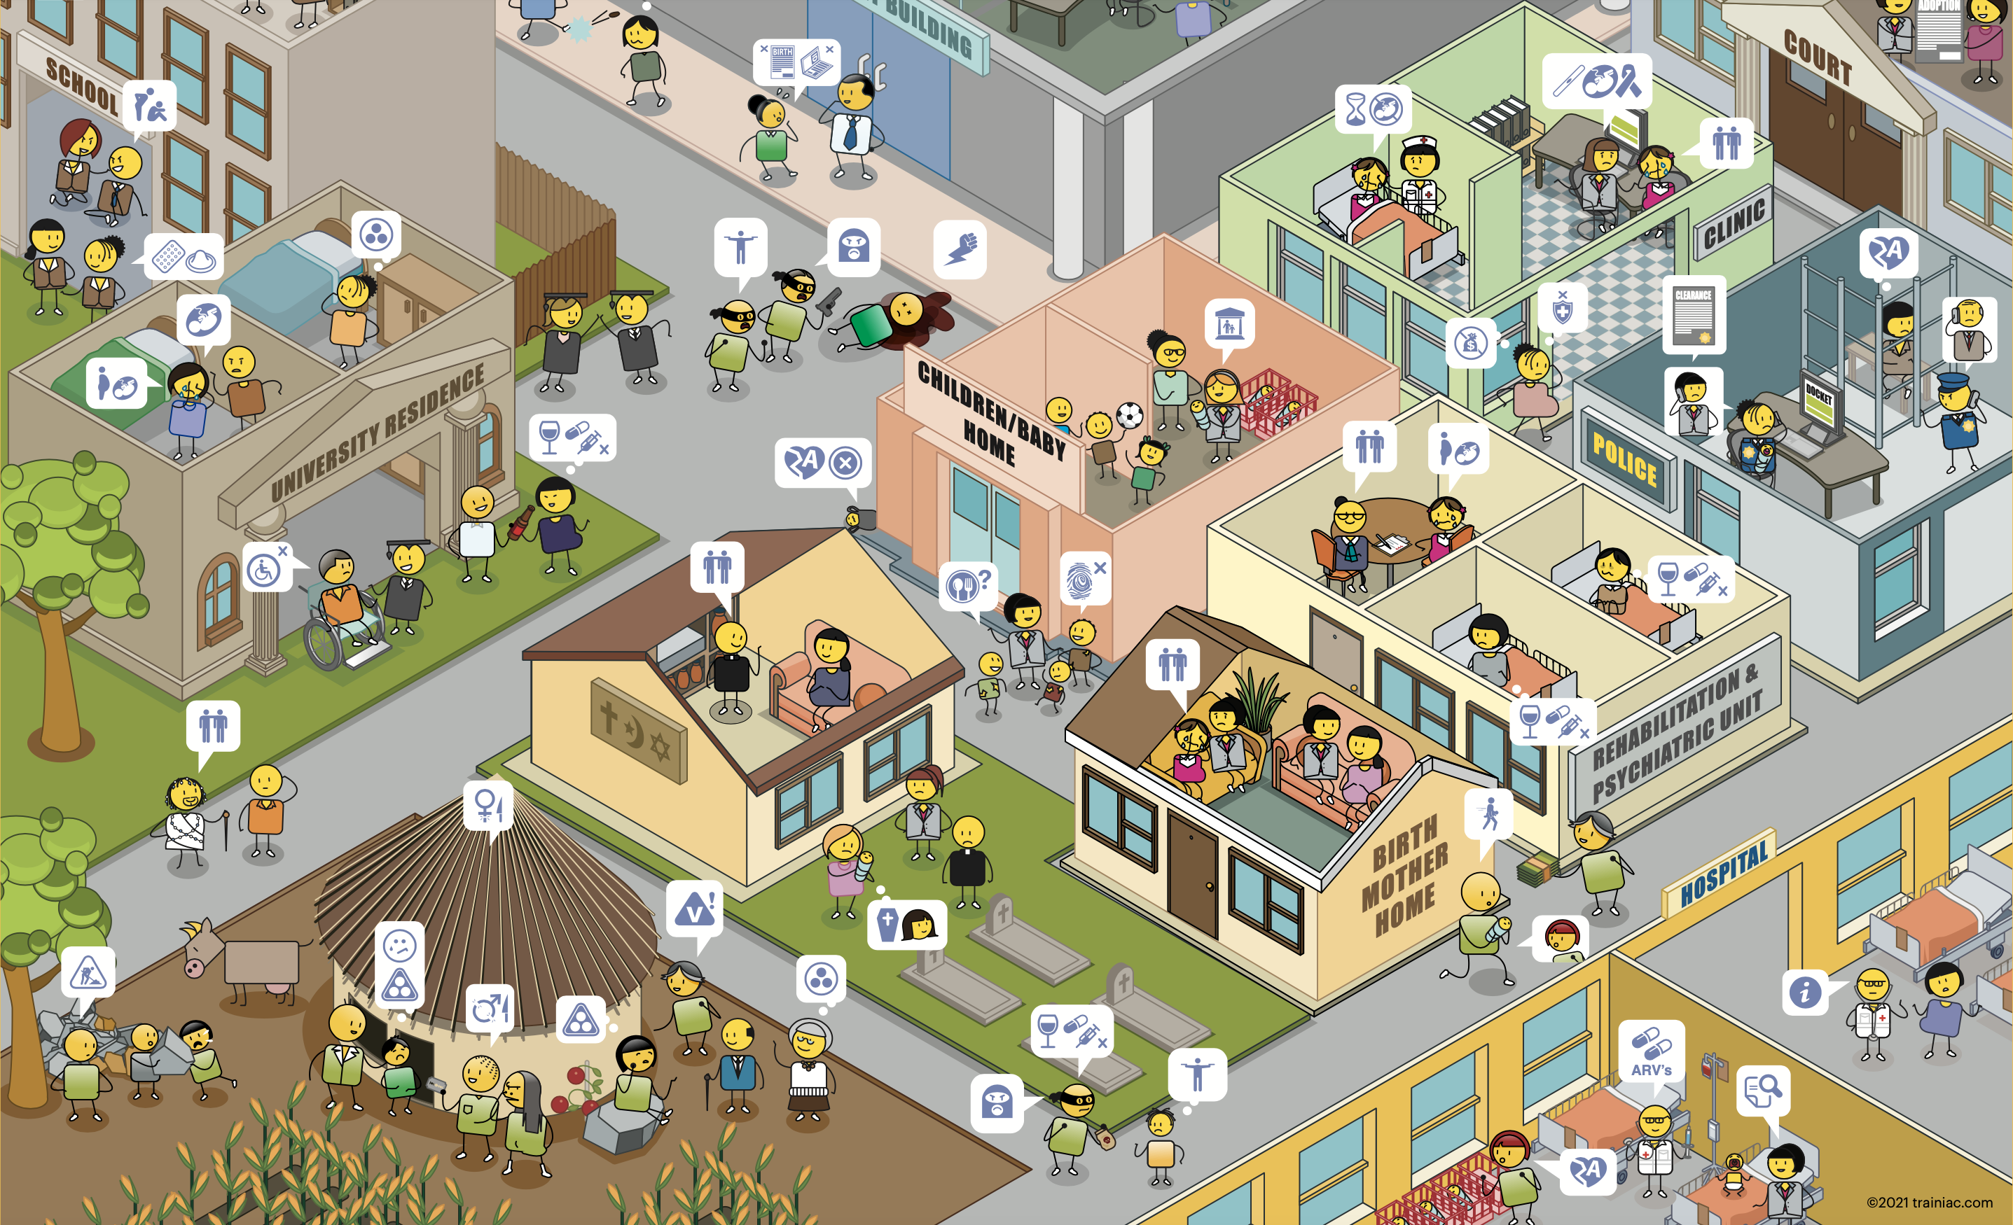
Notes:
At universities you can find health and welfare clinics and counsellors, in rural areas you can find support from extended family, other community members and traditional healers or leaders, at your chosen religious institution you can find religious counselors, in children’s homes you can find social workers, carers and non-governmental social support services, in clinics you can find health care practitioners, counselors, psychologists and psychiatrists, in police stations you can find police officers and in hospitals you can find doctors, nurses and other psycho-social support services..

Slide 11
Notes:
If you are using this presentation as the workshop stimulus, you may want to press pause now, so that participants can spend some time exploring the community map for their different partners (Press Pause Now).

Slide 12
Building win/win relationships
Partner 1
What do I/we need to get?
1. |  | 3.
2. |  | 2.
3. |  | 1.
 |  | What do I/we need to give?
Shared vision, values, objectives
I/We
Notes:
Once you have identified the people you should be partnering with, you will then need to create a win/win partnerships plan with each of them. To do this simply draw two circles, one on top of the other and then draw arrows going between them. Place your name in the bottom circle and your partners in the top and then identify what your shared vision, values and objectives are. Then ask yourself what do I need to give this partner? And what do I want to get form this partner?

Slide 13
With all of your partners
Partner 1
Partner 2
What do I/we need to get? |  | 4.
1. |  | 3.
2. |  | 2.
3. |  | 1.
4. |  | What do I/we need to give?
What do I/we need to get? |  | 4.
1. |  | 3.
2. |  | 2.
3. |  | 1.
4. |  | What do I/we need to give?
Shared vision, values, objectives
Shared vision, values, objectives
I/We
I/We
Partner 3
What do I/we need to get? |  | 4.
1. |  | 3.
2. |  | 2.
3. |  | 1.
4. |  | What do I/we need to give?
Shared vision, values, objectives
I/We
Notes:
Once you have detailed your perspective it will be important to meet with your various partners to discuss and agree your ideas, as their perspective may be slightly different to yours. Together, ensure that what you give and receive in the partnership is balanced, so that there is no resentment from either side. If you start with your shared vision, developing a partnership plan should be easy.

Slide 14
Agree partnership strategies
Identify and agree who your critical child protection partners are in your community, and make sure you know them by name and how to contact them in an emergency.
Spend time with each of these partners ensuring that you have a shared vision, values and objectives when it comes to the protection or your communities children, that your relationship is win/win, and driven by mutual trust and respect.
Building Win/Win Partnerships?
Notes:
We often know who we should be partnering with, but only get in contact with them when there is an emergency. Developing a detailed child protection partnership strategy up front, ensures that when there is an emergency, you already know who you should be talking to, and working with. You already have a relationship with them, and each member of the partnership knows what their roles and responsibilities are.

Slide 15
Notes:
In this example, these social workers are using the Courage community map to identify possible partnerships that they can develop in the communities they work in.

Slide 16
Notes:
Participants then develop a win/win partnership plan, as illustrated in this example, where the firstly agree their shared vision and then define what each partner needs from the other to achieve this vision.

Slide 17
stay strong
take
www.couragechildprotection.com
Notes:
Thanks for watching.
For more information visit Courage Child Protection dot com
Be sure to like this video and subscribe to our Courage Channel.
Stay strong and take courage.

