Slide 1
Understanding the roles and responsibilities of being a parent or caregiver
www.couragechildprotection.com
Notes:
This Courage presentation will help you to understand the roles and responsibilities of being a parent.

Slide 2
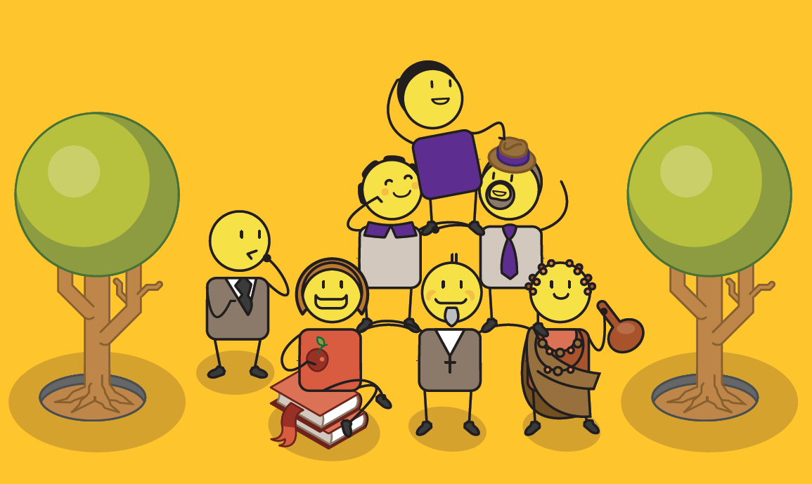
Notes:
Children are the sum total of all that has come before them in terms of their family and ancestors, but they are also shaped by their environment and how they are brought up. Every person, place and experience influences the people they become, from their parents or caregivers, to their extended family, their friends, teachers, spiritual and cultural advisors, and the people they work with.

Slide 3
Ask yourself
How do I define a family?
What makes a good parent?
1.
2.
3.
4.
5.
1.
2.
3.
4.
5.
Notes:
Before detailing the roles and responsibilities of parenting or caregiving, ask yourself, how do you define family? and what do you think makes a good parent?

Slide 4
What is the role
of a parent?
Notes:
The role of parents is often defined in a country’s Children’s Act or in their declarations on the rights and needs of children. We define the roles of parents and caregivers as follows…

Slide 5
Parent’s role?
To provide financial support to your child.
$
To ensure the health, wellbeing and development of your child.
To safeguard & promote the wellbeing of your child.
Notes:
As a parent, you must ensure the health, wellbeing and development of your child. You must provide them with financial support, and safeguard them at all times.

Slide 6
Parent’s role?
To protect your child from maltreatment, abuse, neglect, degradation, discrimination, exploitation and any physical, emotional or moral harm.
To respect, protect and promote the rights and dignity of your child.
To guide, advise and assist your child in making decisions for themselves.
Notes:
You must respect, protect and promote the rights and dignity of your child. You must protect them from maltreatment, abuse, neglect, degradation, discrimination and any physical, emotional or moral harm. You must guide, advise and assist them in making good decisions for themselves.

Slide 7
Parent’s role?
To guide, direct and secure your child’s education and upliftment through intellectual, emotional, physical, moral and cultural development that is appropriate to their age.
To apply consistent and fair discipline to your child.
To build sound and loving relationships with your child.
Notes:
You must always apply consistent and fair discipline to your child. You must guide, direct and secure your child’s education and upliftment through intellectual, emotional, physical, moral and cultural development that is appropriate for their age. And most importantly, you must build a sound and loving relationship with your child.

Slide 8
Parent’s role?
To inform, involve & encourage your child’s participation in their care & protection
To accommodate any special needs your child may have.
To find a suitable place for your child to live.
Notes:
As a parent, you will need to accommodate any special needs your child may have. You should inform, involve and encourage their participation in their care and protection, and you must ensure that they have a suitable place to live where they feel secure and protected.

Slide 9
The difference between positive parenting and negative punishment…
Notes:
Throughout your child’s growing up experience, you will need to help them to become responsible young adults. It is important that this guidance is given in the form of positive parenting rather than harsh punishment. This will ensure that you maintain a strong relationship with your child.

Slide 10
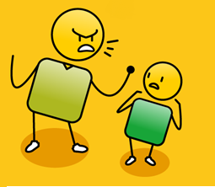
As parents we must choose
Don’t worry, we all make mistakes
How could you be so stupid!
over
positive parenting
negative punishment
Notes:
As parents, we must choose positive approaches to this guidance that empowers your child, rather than negative punishment that demeans and disempowers them.

Slide 11
Positive Parenting
I made a very bad choice and did something wrong
I still love you even when you make bad choices or do the wrong thing
reassurance of love
Notes:
Positive parenting is about reassuring your child that they will always be loved, even when they make mistakes or poor choices.

Slide 12
Negative Punishment
You are such a bad child
I don’t trust you anymore!
I made a very bad choice and did something wrong
love is conditional
Notes:
Negative punishment focusses on your child’s ‘bad’ behaviour, and makes them feel like your love is conditional. This will not help them understand their mistakes or prevent them in the future.

Slide 13
Positive Parenting
This is how you can make better choices
understand consequences of behaviour
Notes:
Positive parenting is about teaching your child by providing them with examples of good choices and explaining the consequences of their behaviour.

Slide 14
Negative Punishment
If you don’t do what I tell you to do, you will be sorry!
threats and fear to force compliance
Notes:
Negative punishment involves threatening your child, forcing compliance or trying to teach them through fear, which is very ineffective in creating behaviour change.

Slide 15
Positive Parenting
You have control over your choices and how you behave
child in control
Notes:
Positive parenting is about focussing on how your child is in control of their behaviour and as a result, the outcomes of their decisions.

Slide 16
Negative Punishment
If you don’t do what I tell you to do, I will punish you and you will be sorry!
try to control child
Notes:
Rather than trying to control your child’s behaviour through threatening them with punishment.

Slide 17
Positive Parenting
How are you feeling?
How can I help you solve this problem?
parent-child connection
Notes:
Positive parenting is about focussing on your child’s feelings and encouraging them to solve their problems by discussing them with you. This creates a strong parent-child connection.

Slide 18
Negative Punishment
Next time,
I just won’t tell
you what I did!
You always get things wrong!
You are so stupid!
parent-child disconnection
Notes:
Negative punishment focusses on negative behaviour and often fosters dishonesty to avoid negative consequences. This encourages more rebellion and will create a disconnection between you and your child.

Slide 19
How can we build our children’s self esteem
Notes:
One of the most important roles of a parent is to build your child’s self esteem.

Slide 20
Self esteem & self worth
Notes:
Self esteem and self worth is about having confidence in your own worth and abilities. It is about having a strong personal identity, making good personal decisions, caring for oneself and others around you, having a clear focus and direction for your life, achieving your personal goals and taking responsibility for your life.

Slide 21
Fun things you can do to build your child’s self esteem
Notes:
These are some fun things you can do with your child to build their self esteem.

Slide 22
The gratitude chair
Each member of your family should take turns to tell your child what they are grateful to them for.
Ask your child to sit in a chair in the middle of the room.
Notes:
The first is called the gratitude chair. Ask your child to sit in a chair in the middle of your family circle. Each member of your family should then tell your child what they are grateful to them for. You may want to do this on special occasions such as their birthday, if they have achieved something noteworthy, or just if they are feeling down and need to some positive reinforcement from their family or close friends.

Slide 23
The self esteem bowl
I am
loving
I work
hard
I am
kind
I am
creative
I love
animals
I am
helpful
I am
sporty
MY SELF ESTEEM
Notes:
The second exercise is called the self esteem bowl. Show your child a bowl, and tell them to think about this bowl as representing their self esteem, or how they feel about themselves. Ask them to think about all of the things that people say to them that makes them feel special about themselves. Then ask them to think about all of the things that people say to them, that makes them feel sad or unhappy about themselves. Explain to them that, if they allow other people to fill their self esteem bowl, they will also allow them to empty their bowl! Finally, get them to think about all of the things they think make them special and unique. The things that no-one can take out of their self esteem bowl. Get them to write these things onto little pieces of paper and put them in their bowl to remind themselves of what makes them special.

Slide 24
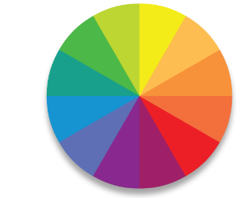
MY PERSONAL CREST
Animal/Plant?
Shield?
Colour?
Motto or Tagline?
HEAR ME ROAR!
Notes:
The final exercise is about helping your child to develop their own personal brand or crest. They do this by drawing an animal or plant that they think represents who they are or want to be, inside a shield or crest shape that speaks to them. They should use their favourite colours to draw their crest, and finally they should create a motto or tagline that defines what is important to them. You can find out more about developing a personal brand through the Courage Personal Empowerment Booklet or Video.

Slide 25
We must always focus on what is in the best interests of the children in our care
Notes:
As parents, caregivers and child protection officers we must always focus on what is in the best interests of the children in our care.

Slide 26
YOU MUST ALWAYS: | CHECK
Respect a child’s dignity.
Be fair and equitable.
Protect them from discrimination.
Inform, involve and encourage their participation throughout any protection process.
Support their disabilities, special needs or chronic illness.
Protect a child from harm which includes neglect, abuse or exploitation.
Solve a child’s problem as quickly as possible.
Respect, promote and fulfil their rights at all times.
Notes:
This means that we must always…

Slide 27
YOU MUST CONSIDER: | CHECK
The relationship between a child and their parent or caregiver?
The child’s need to grow up in a stable family environment?
The child’s physical and emotional security and development?
The child’s age, maturity, gender and stage of development?
The child’s background and current family and social context?
The attitude of the parents or caregiver to their child?
The impact any change will have on a child e.g. if separated from parents or siblings?
The child’s need for education and recreation?
Notes:
When making decisions about what is in the best interests of a child, we must consider…

Slide 28
stay strong
take
www.couragechildprotection.com
Notes:
Thanks for watching.
For more information visit Courage Child Protection dot com
Be sure to like this video and subscribe to our Courage Channel.
Stay strong and take courage.

