Slide 1
Understanding sex, conception and pregnancy and the choices you have
www.couragechildprotection.com
Notes:
This Courage video will help you to understand the process of sex, conception and pregnancy and the choices you have.

Slide 2
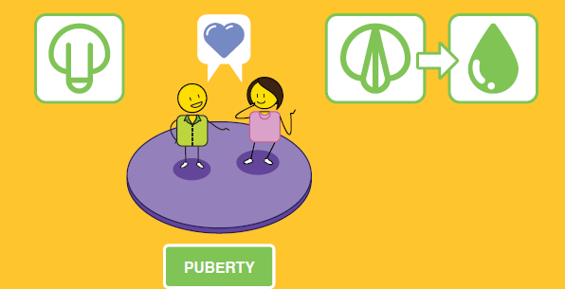
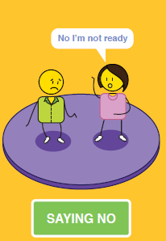
Notes:
Between the ages of 11 and 12, young boys and girls go through puberty, this can happen before or after these ages, but this is the average.
For young boys, their penis and testicles grow, and their scrotum gradually becomes darker, their pubic hair becomes thicker and curlier. underarm hair starts to grow, and they also start to sweat more.
Boys need to take extra care when it comes to personal hygiene when they reach puberty.
For girls they will get their first period, which is also referred to as menstruation or menarche, where they bleed from their vagina for three to seven days every month.
Personal hygiene is also important for girls at puberty, and they will need support with sanitary products to help them at this time.
Their pubic hair will get thicker, and some may gain a bit of weight.
Their period may be a bit erratic at first but eventually it will settle into a 28-day cycle which they should monitor.
At puberty, girls become fertile and are able to conceive and have a child, but this is not ideal until they become adults at the age of 18.
At puberty, girls and boys will both start feeling sexual attraction.
This can be for the opposite or same sex, but to fall pregnant, a girl will need to have sex with a boy.
One of the first choices we have when we are sexually attracted to someone is whether or not to have sex with them.
No one is allowed to force a girl or a boy to have sex before they are ready to do this.
This is referred to as ‘consent’, when both parties freely and voluntarily agree to have sex, they feel safe and understand what having sex is all about, and they are present or conscious of what is happening at the time.
If a girl or boy says that they do not want to have sex, but are forced to, that is referred to as sexual assault and rape, and is a criminal offence.
The age of consent to have sex is 17 years old in South Africa, this means that if someone is older than 17 and has sex with a child that is less than 17 years of age, they can be prosecuted for statutory rape, even if they believe that both parties have consented.
If someone is forcing you to have sex against your will, you must tell a child protection officer so that they can protect you. This could be a trusted adult family or community member, a teacher, a social worker, your doctor or nurse or a police officer.
Each of these people have a responsibility to protect you from sexual abuse and rape.

Slide 3
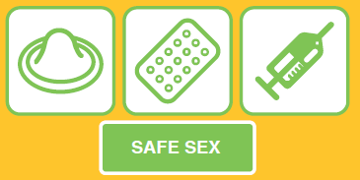
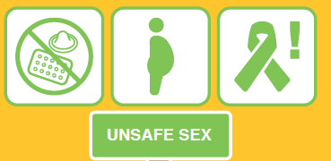
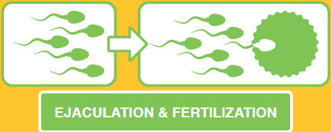
OR
Notes:
If there is consent and the boy and girl decide to have sex, they have another choice to make.
This is the choice between having safe or unsafe sex. Safe sex refers to using contraceptives whilst being sexually active, this can refer to a male condom that is placed over the boy’s penis or a female condom, diaphragm or cap, that is placed inside a girl’s vagina before and during sex.
Other forms of contraceptives that can prevent pregnancy but do not prevent sexually transmitted disease include the pill, the contraceptive injection, implant or patch or an intra-uterine device, also called an IUD or coil. Girls should consult with a gynaecologist or woman’s health care practitioner to decide which option is best suited to their needs.
Remember that no form of contraceptive is 100% safe, contraceptives such as the pill, injection and implant take at least seven days to start working and can be impacted by illness and some medications.
If you do have unprotected sex by mistake, you can speak to your doctor or pharmacist about emergency contraception, which can be taken up to five days after having unprotected sex but should only be considered in an emergency.
If the boy and girl decide to have sex without contraceptive protection, this is referred to as ‘unsafe sex’ as it can result in pregnancy or sexually transmitted diseases such as the human papilloma virus or HPV, sometimes referred to as genital warts, chlamydia, gonorrhoea and HIV which can lead to AIDS.
Pregnancy happens when the boy ejaculates his sperm into a girl’s vagina and one of his sperm fertilises one of her eggs inside her uterus. You can fall pregnant after having sex just once!

Slide 4
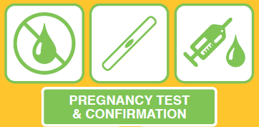
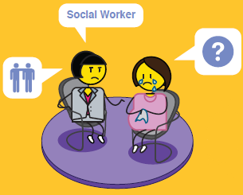
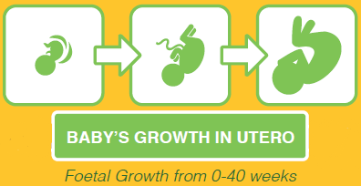
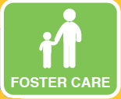
OPTION COUNSELLING
X ILLEGAL OPTION
Notes:
If fertilization takes place, a baby will start to grow inside the woman’s uterus. You will know that you are pregnant if your period or menstruation stops.
If you are sexually active and you miss a period, you should conduct a pregnancy test immediately.
You can either have a urine or blood test to find out if you are pregnant. A urine pregnancy test can be purchased at a pharmacy and should only be done after you have missed your period, which could be three to four weeks after having unprotected sex.
A blood test can identify a pregnancy around two weeks after having unprotected sex.
The sooner you know if you are pregnant or not, the better, as this can be a stressful time if the pregnancy is unplanned, and you will also have more options available to you.
If you discover that you are pregnant and this was unplanned, you should consult with a doctor, nurse, woman’s health care practitioner, social worker or counsellor about the options available to you.
These include parenting your child, abortion, which is usually only available up to 14 weeks or the end of your first trimester, kindship care, where another family member takes care of your child, foster or institutional care, which are both temporary options usually for the period of around 2 years. Or adoption, where you formally place your child into the care of another parent or family.
Some women choose to abandon their child, but this is an illegal option and should not be considered as it is detrimental to both the mother and child’s health and wellbeing.

Slide 5
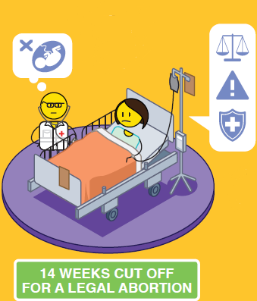
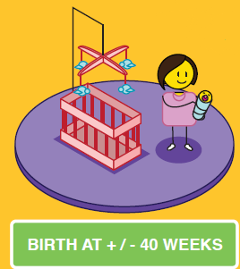
Notes:
A baby grows inside a woman’s uterus for around 40 weeks, with three distinct trimesters of just over 13 weeks each.
In the first trimester, your baby will grow from a fertilized egg into a moving fetus, with heart, eyes, ears, and working organs.
In the second trimester, your baby's features develop, and you may be able to feel your baby move inside you.
In the third trimester, your baby will grow rapidly to get ready for birth.
If you choose to have an abortion, you will need to check if these services are available and legal in your country or state, however, most countries where abortion is legal, will only conduct one up to the end of the first trimester between 12 and 14 weeks.
Abortions can be considered after this time, if the pregnancy presents a significant health risk to the mother or child. It is important to note that if you do conduct an illegal late abortion in the second or third trimester, this is a crime, and you could be found guilty of ‘concealment of birth’, should the child die.
If the child lives, which can happen after 24 weeks or in the third trimester, they can be born with a number of physical and intellectual challenges due to their prematurity at birth and could struggle with these for the rest of their lives.
If the mother takes care of herself and her baby throughout her pregnancy, goes for regular health check ups, is careful about what she eats and drinks, and has no drugs or alcohol during this time, she should give birth to a healthy baby at 37 to 40 weeks, a baby born before this may need some post natal care and support as they are considered preterm or premature.
If the mother is unable to take care of her child herself at this time, there are a number of options available to her. Please watch the Courage Option Counselling for Crisis Pregnancy Video to understand what these options are or speak to your local health care provider, social worker or counsellor.

Slide 6
stay strong
take
www.couragechildprotection.com
Notes:
Thanks for watching.
For more information visit Courage Child Protection dot com
Be sure to like this video and subscribe to our Courage Channel.
Stay strong and take courage.

