Slide 1

Sex, conception & option counselling for crisis pregnancy workshop overview
www.couragechildprotection.com
Notes:
This Courage video will help you an overview of the sex, conception and option counselling for crisis pregnancy workshop.

Slide 2
This workshop will help you to:
Develop a personal vision that gets you to think about your future and the kind of world you would like to create for yourself.
Understand puberty, consent, birth control, sex, conception and pregnancy.
Understand what causes and what can prevent crisis pregnancy in your community.
Understand the options available to someone experiencing a crisis pregnancy.
Develop an action plan to ensure that you achieve your defined vision and future for yourself.
Notes:
This workshop will help you to…
Develop a personal vision that gets you to think about your future and the kind of world you would like to create for yourself.
Understand puberty, consent, birth control, sex, conception and pregnancy.
Understand what causes and what can prevent crisis pregnancy in your community.
Understand the options available to someone experiencing a crisis pregnancy.
Develop an action plan to ensure that you achieve your defined vision and future for yourself.

Slide 3












2 HOUR SEX, CONCEPTION, PREGNANCY & OPTION COUNSELLING WORKSHOP
1 HOUR SEX, CONCEPTION & PREGNANCY WORKSHOP
1 HOUR CRISIS PREGNANCY &
OPTION COUNSELLING WORKSHOP
WELCOME &
INTRODUCTIONS 10 MINS
WELCOME/INTRO10 MINS
FUTURE VISION
EXERCISE
20 MINS
WELCOME/INTRO10 MINS
COMMUNITY MAPPING
20 MINS
FUTURE VISION
EXERCISE
20 MINS
OPTION COUNSELLING
20 MINS
TAKE
10
SEX, CONCEPTION
& PREGNANCY
20 MINS
ACTION PLAN
10 MINS
ACTION PLAN
10 MINS
SEX, CONCEPTION
& PREGNANCY
25 MINS
1 HOUR SEX, GENDER & PERSONAL
IDENITTY WORKSHOP
1 HOUR SEXUAL AND REPRODUCTIVE HEALTH RIGHTS WORKSHOP
COMMUNITY MAPPING
20 MINS
OPTION COUNSELLING
25 MINS
WELCOME/INTRO10 MINS
SEX, GENDER & ID
20 MINS
WELCOME/INTRO10 MINS
SEX & REPRODUCTIVE HEALTH RIGHTS
20 MINS
ACTION
PLANNING
10 MINS
PERSONAL IDENTITY
20 MINS
PERSONAL EMPOWERMENT
20 MINS
THANKS & CLOSE
ACTION PLAN
10 MINS
ACTION PLAN
10 MINS
THE COURAGE CHILD SEX, GENDER & SEXUALITY MATERIAL CAN BE USED IN A NUMBER OF DIFFERENT WORKSHOP FORMATS DEPENDING ON THE TIME YOU HAVE AVAILABLE AND WHICH MODULES YOU WOULD LIKE TO INCLUDE IN YOUR PROCESS
SEE WWW.COURAGECHILDPROTECTION.COM FOR MORE
Notes:
The process and timing illustrated below shows how you can run:
1) A 2 hour sex, pregnancy and option counselling workshop.
2) A 1 hour sex, conception and pregnancy workshop.
3) A 1 hour crisis pregnancy and option counselling workshop.
4) A 1 hour sex, gender and personal identity workshop.
5) A 1 hour sex and reproductive health rights and personal empowerment workshop.

Slide 4
Creating a vision for ourselves and the world we want to live in
www.couragechildprotection.com
Notes:
Our first exercise is to create a vision for ourselves and the world we want to live in.

Slide 5


What is a vision?
Notes:
So what is a vision? To have a vision or purpose is to have direction and focus.
It is about making choices and leadership at every level, from individuals to society at large.
A vision allows you to express who you are and what is important to you at a personal and community level.
Once you have defined your vision or purpose, you will feel a great sense of freedom that comes with turning your dreams and ideas for the future into reality.
The best visions are those based on new ideas and innovation, thinking differently about the world, and how you can make it better.

Slide 6
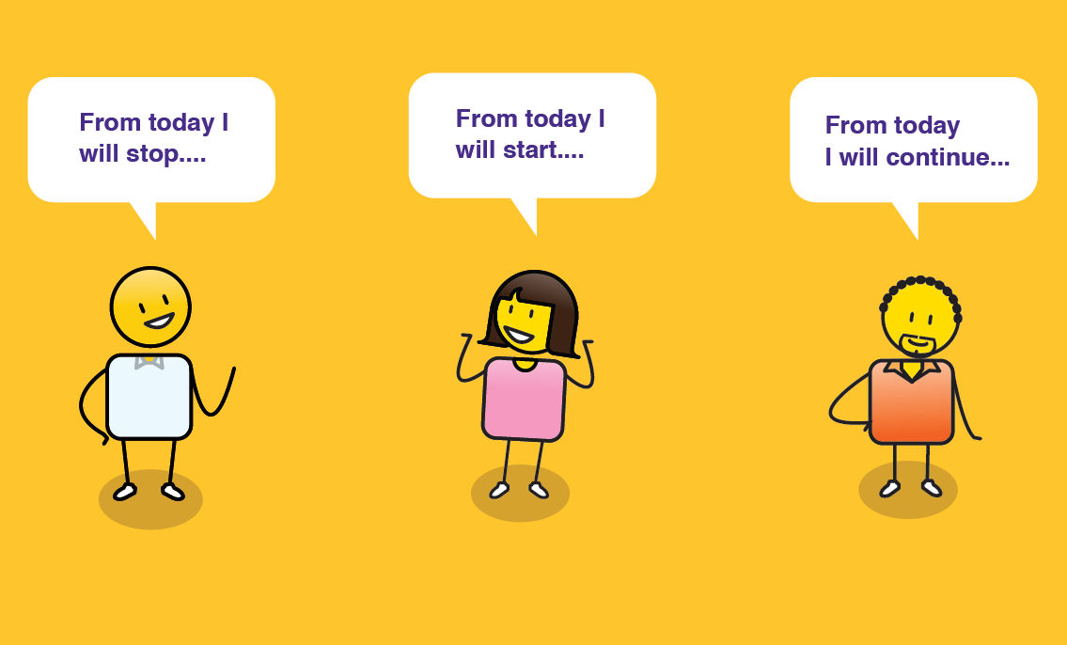
What should we ask?
The world would be a better place if…
I/We will help make this happen by…
When people see me/us they will think…
Notes:
The vision question has 3 steps to it, ask participants to answer the following questions:
The world would be a better place if… (complete the sentence by defining your insights into the world and what you think would make it a better place?)
I or we will help make this happen by… (complete the sentence by defining your vision of how you think you can make the world a better place?)
When people see me or us they will think… (create a tagline like any popular brand that sums up how you will make an impact on the world e.g. Nike – Just do it)

Slide 7
How should we answer?
The world would be a better place if…
I/We will help make this happen by…
When people see me/us they will think
Notes:
Capture your answers using this template or simply writing them down on a piece of paper.

Slide 8
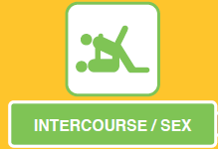

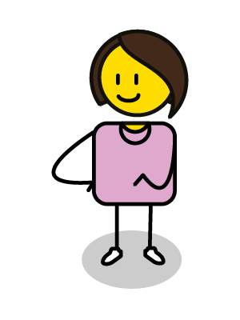
Understanding puberty, consent, birth control, sex, conception and pregnancy
www.couragechildprotection.com
Notes:
This Courage presentation will help you to understand the process of sex, conception and pregnancy and the choices you have.

Slide 9
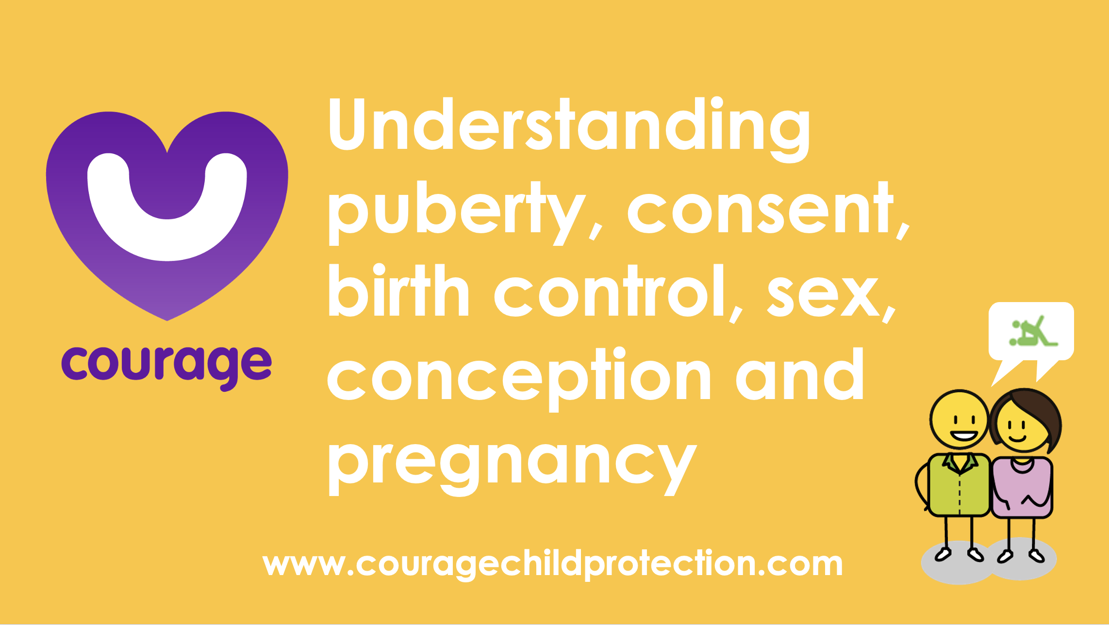
Useful Courage Tools
Sex, conception & Pregnancy Awareness Poster
Sex, Conception & Pregnancy Movie or Presentation
or
Notes:
Useful Courage Tools

Slide 10
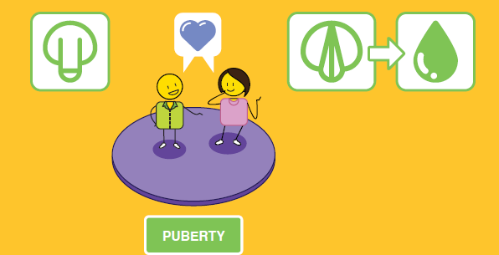
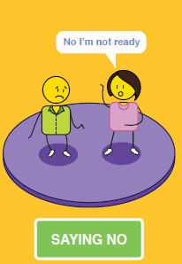

Notes:
Between the ages of 11 and 12, young boys and girls go through puberty, this can happen before or after these ages, but this is the average.
For young boys, their penis and testicles grow, and their scrotum gradually becomes darker, their pubic hair becomes thicker and curlier. underarm hair starts to grow, and they also start to sweat more.
Boys need to take extra care when it comes to personal hygiene when they reach puberty.
For girls they will get their first period, which is also referred to as menstruation or menarche, where they bleed from their vagina for three to seven days every month.
Personal hygiene is also important for girls at puberty, and they will need support with sanitary products to help them at this time.
Their pubic hair will get thicker, and some may gain a bit of weight.
Their period may be a bit erratic at first but eventually it will settle into a 28-day cycle which they should monitor.
At puberty, girls become fertile and are able to conceive and have a child, but this is not ideal until they become adults at the age of 18.
At puberty, girls and boys will both start feeling sexual attraction.
This can be for the opposite or same sex, but to fall pregnant, a girl will need to have sex with a boy.
One of the first choices we have when we are sexually attracted to someone is whether or not to have sex with them.
No one is allowed to force a girl or a boy to have sex before they are ready to do this.
This is referred to as ‘consent’, when both parties freely and voluntarily agree to have sex, they feel safe and understand what having sex is all about, and they are present or conscious of what is happening at the time.
If a girl or boy says that they do not want to have sex, but are forced to, that is referred to as sexual assault and rape, and is a criminal offence.
The age of consent to have sex is 17 years old in South Africa, this means that if someone is older than 17 and has sex with a child that is less than 17 years of age, they can be prosecuted for statutory rape, even if they believe that both parties have consented.
If someone is forcing you to have sex against your will, you must tell a child protection officer so that they can protect you. This could be a trusted adult family or community member, a teacher, a social worker, your doctor or nurse or a police officer.
Each of these people have a responsibility to protect you from sexual abuse and rape.

Slide 11
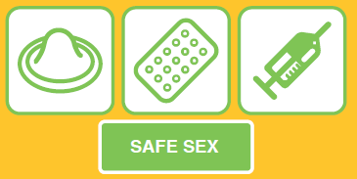
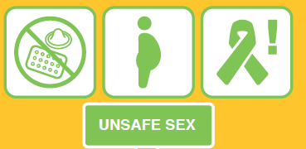
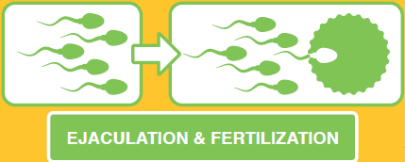
OR
Notes:
If there is consent and the boy and girl decide to have sex, they have another choice to make.
This is the choice between having safe or unsafe sex. Safe sex refers to using contraceptives whilst being sexually active, this can refer to a male condom that is placed over the boy’s penis or a female condom, diaphragm or cap, that is placed inside a girl’s vagina before and during sex.
Other forms of contraceptives that can prevent pregnancy but do not prevent sexually transmitted disease include the pill, the contraceptive injection, implant or patch or an intra-uterine device, also called an IUD or coil. Girls should consult with a gynaecologist or woman’s health care practitioner to decide which option is best suited to their needs.
Remember that no form of contraceptive is 100% safe, contraceptives such as the pill, injection and implant take at least seven days to start working and can be impacted by illness and some medications.
If you do have unprotected sex by mistake, you can speak to your doctor or pharmacist about emergency contraception, which can be taken up to five days after having unprotected sex but should only be considered in an emergency.
If the boy and girl decide to have sex without contraceptive protection, this is referred to as ‘unsafe sex’ as it can result in pregnancy or sexually transmitted diseases such as the human papilloma virus or HPV, sometimes referred to as genital warts, chlamydia, gonorrhoea and HIV which can lead to AIDS.
Pregnancy happens when the boy ejaculates his sperm into a girl’s vagina and one of his sperm fertilises one of her eggs inside her uterus. You can fall pregnant after having sex just once!

Slide 12

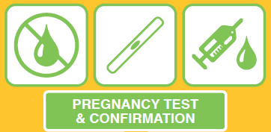
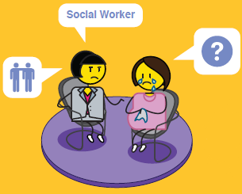
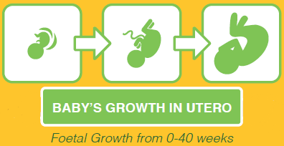



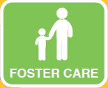



OPTION COUNSELLING
X ILLEGAL OPTION
Notes:
If fertilization takes place, a baby will start to grow inside the woman’s uterus. You will know that you are pregnant if your period or menstruation stops.
If you are sexually active and you miss a period, you should conduct a pregnancy test immediately.
You can either have a urine or blood test to find out if you are pregnant. A urine pregnancy test can be purchased at a pharmacy and should only be done after you have missed your period, which could be three to four weeks after having unprotected sex.
A blood test can identify a pregnancy around two weeks after having unprotected sex.
The sooner you know if you are pregnant or not, the better, as this can be a stressful time if the pregnancy is unplanned, and you will also have more options available to you.
If you discover that you are pregnant and this was unplanned, you should consult with a doctor, nurse, woman’s health care practitioner, social worker or counsellor about the options available to you.
These include parenting your child, abortion, which is usually only available up to 14 weeks or the end of your first trimester, kindship care, where another family member takes care of your child, foster or institutional care, which are both temporary options usually for the period of around 2 years. Or adoption, where you formally place your child into the care of another parent or family.
Some women choose to abandon their child, but this is an illegal option and should not be considered as it is detrimental to both the mother and child’s health and wellbeing.

Slide 13


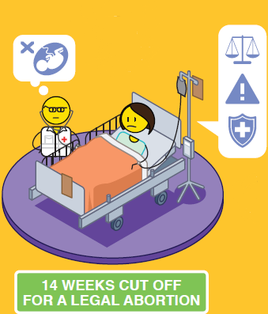
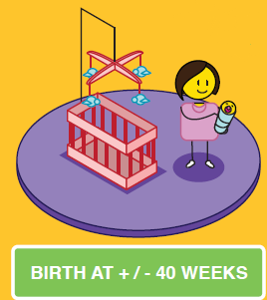
Notes:
A baby grows inside a woman’s uterus for around 40 weeks, with three distinct trimesters of just over 13 weeks each.
In the first trimester, your baby will grow from a fertilized egg into a moving fetus, with heart, eyes, ears, and working organs.
In the second trimester, your baby's features develop, and you may be able to feel your baby move inside you.
In the third trimester, your baby will grow rapidly to get ready for birth.
If you choose to have an abortion, you will need to check if these services are available and legal in your country or state, however, most countries where abortion is legal, will only conduct one up to the end of the first trimester between 12 and 14 weeks.
Abortions can be considered after this time, if the pregnancy presents a significant health risk to the mother or child. It is important to note that if you do conduct an illegal late abortion in the second or third trimester, this is a crime, and you could be found guilty of ‘concealment of birth’, should the child die.
If the child lives, which can happen after 24 weeks or in the third trimester, they can be born with a number of physical and intellectual challenges due to their prematurity at birth and could struggle with these for the rest of their lives.
If the mother takes care of herself and her baby throughout her pregnancy, goes for regular health check ups, is careful about what she eats and drinks, and has no drugs or alcohol during this time, she should give birth to a healthy baby at 37 to 40 weeks, a baby born before this may need some post natal care and support as they are considered preterm or premature.
If the mother is unable to take care of her child herself at this time, there are a number of options available to her. Please watch the Courage Option Counselling for Crisis Pregnancy Video to understand what these options are or speak to your local health care provider, social worker or counsellor.

Slide 14
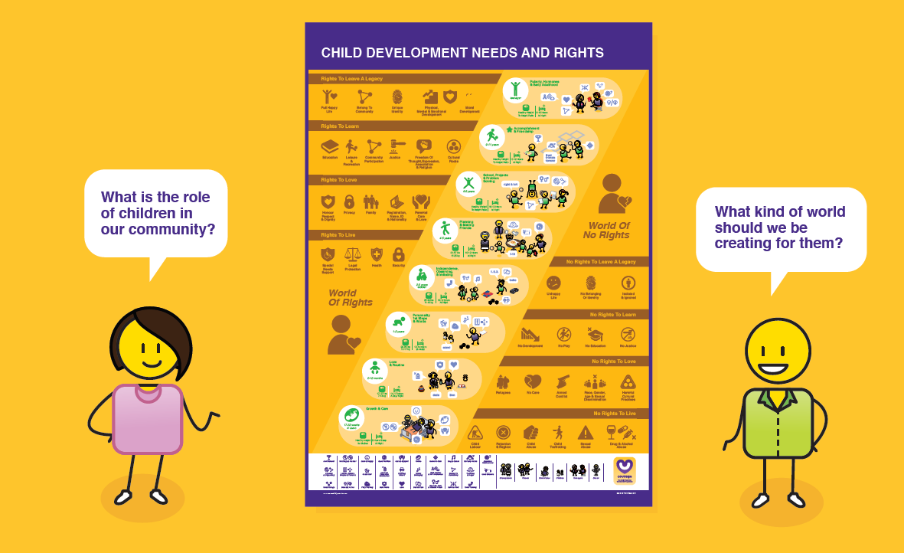
Discuss
Do you have any questions about this process?
What other sources do you use to find out about sex, birth control and pregnancy?
?
What was your experience of trying to get this information from these other sources?
Is there anything you don’t understand or would like more information about?
Notes:
Discuss
Do you have any questions about this process?
Is there anything you don’t understand or would like more information about?
What other sources do you use to find out about sex, birth control and pregnancy?
What was your experience eof trying to get information from these other sources?

Slide 15
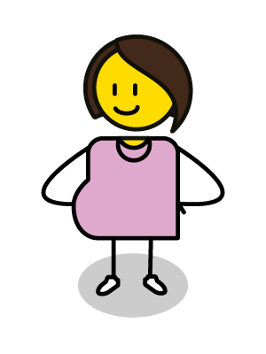
What causes and what prevents crisis pregnancy in our communities?
www.couragechildprotection.com
Notes:
This Courage presentation will help you to explore what causes and what could prevent crisis pregnancy in your community.

Slide 16
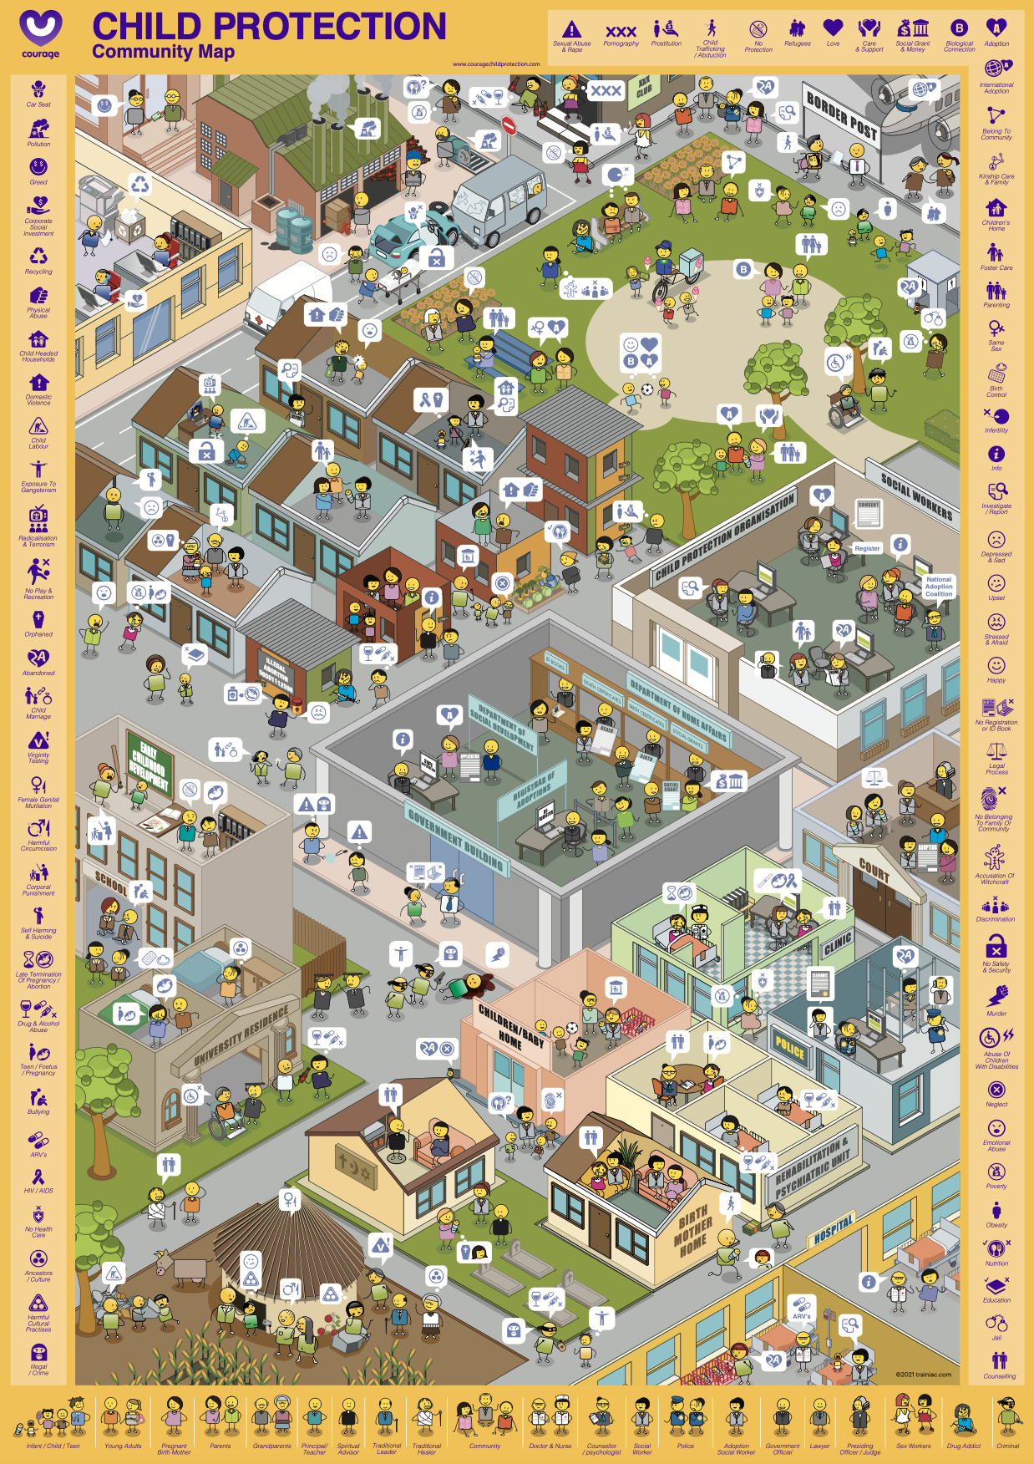
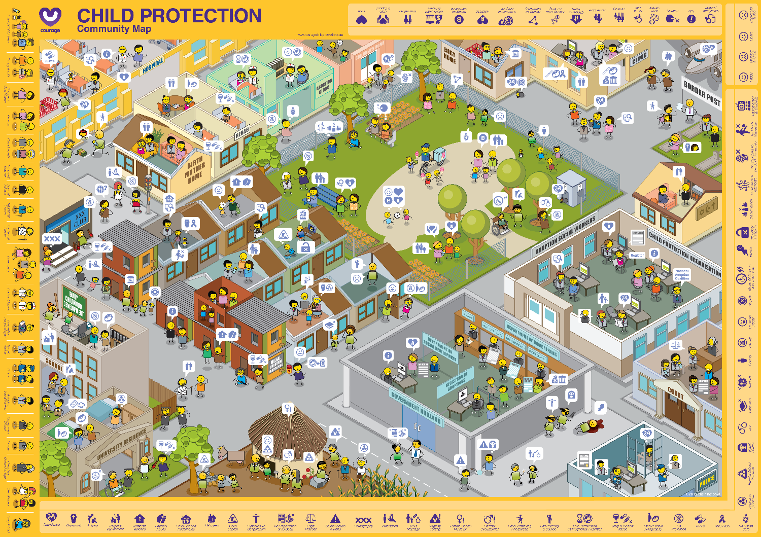

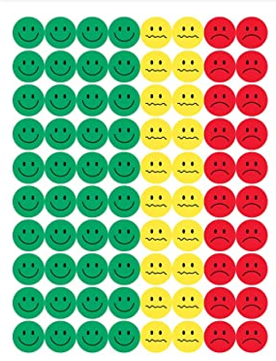

Useful courage tools
courage community map and stickers/buttons
Projection of map and white board markers
or
Notes:
These are some useful tools that will help you to identify the child protection challenges and their drivers in your community, which you can download from the Courage Child Protection Website or order a printed version online.
As stimulus for your child protection identification exercise you can either use:
An A1 Courage Community Map which is available in portrait or landscape format and some coloured buttons or stickers.
Or you can play this video and ask participants to list child protection challenges that they have seen in their community.
Or you can download and project the Courage Community Map from the presentation format off our website, and use coloured marker pens to identify your community’s child protection challenges.

Slide 17
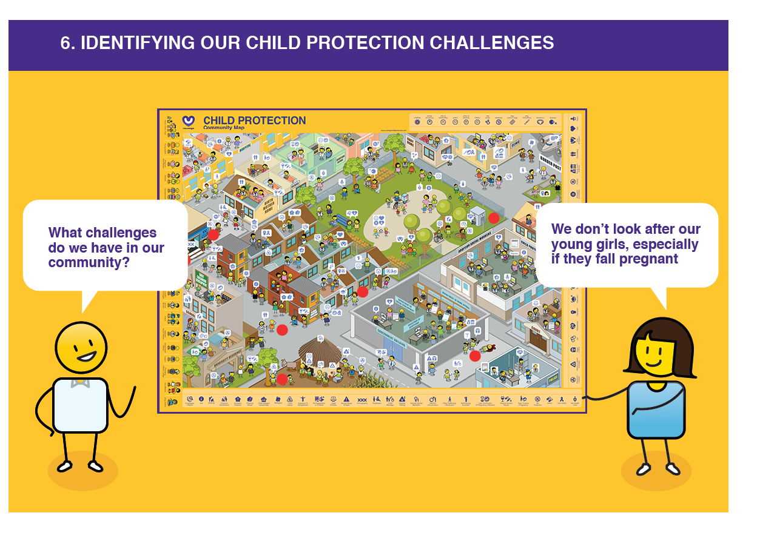
What we should ask?
What are some of the causes of crisis pregnancy in our community?
What could prevent crisis pregnancy in our community?
Notes:
For this exercise, you will want to ask your participants to identify all of the child protection challenges that they have seen or observed in their community.
They can identify these using stickers, buttons, markers on a printed or projected community map, or just by listing them on a piece of paper.
If your participants are working in a group, suggest that they spend some time describing their community to the rest of the team, so that they understand the context of the challenges that they identify.

Slide 18
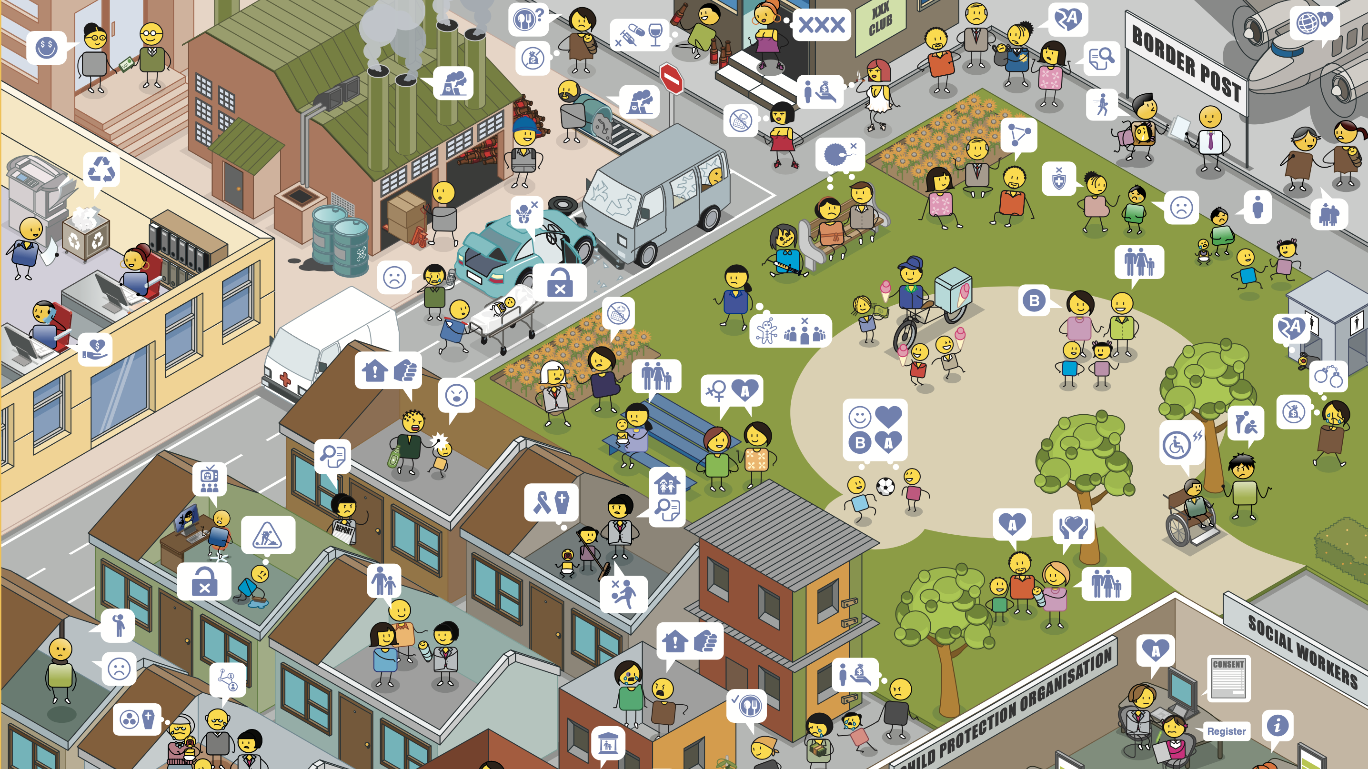
Notes:
Starting in the top left-hand corner and moving right, you will see different kinds of companies, main roads, night clubs, bars and border posts.
Moving down, you will see public spaces such as parks where people can relax and meet friends outside, and then there are different kinds of residential areas.

Slide 19
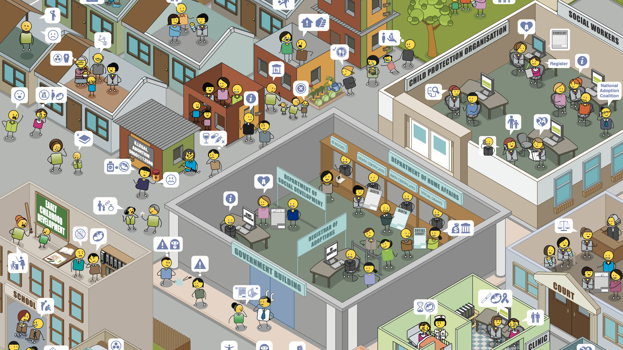
Notes:
Some residential areas have formal houses, and some have informal houses as you can see in the middle of this community map.
There are also child protection organizations, social workers, courts, clinics and government departments that span a number of different areas such as home affairs and social development.
Moving back to the left of the map, you will see early childhood development centres or creches and schools.

Slide 20
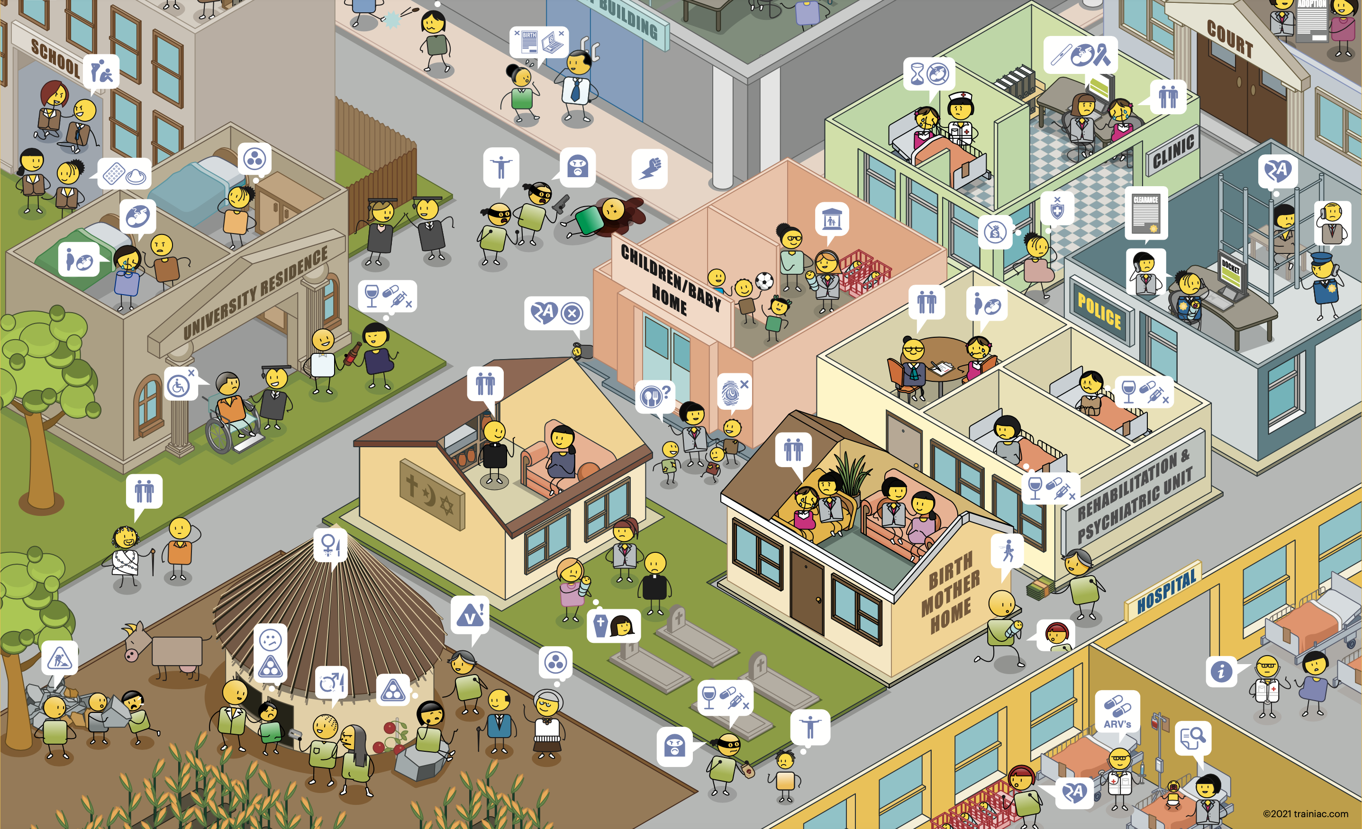
Notes:
In addition to schools there are universities and places of post graduate study.
You will also find religious intuitions, baby and children’s homes, a range of different health clinics, police stations, rehabilitation and psychiatric units, birth mother homes and hospitals.
Finally in the bottom left-hand corner you can see a home that is situated in a rural area, where people may go to visit their family and where they have come from.

Slide 21
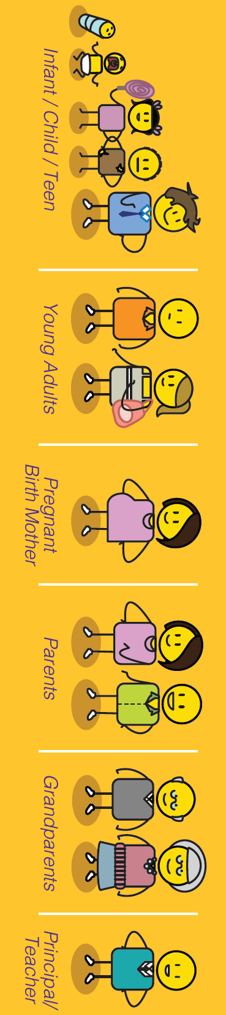
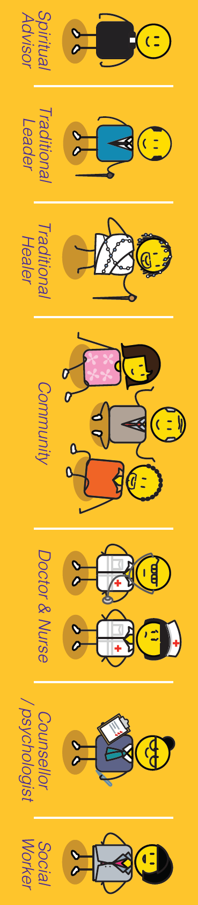
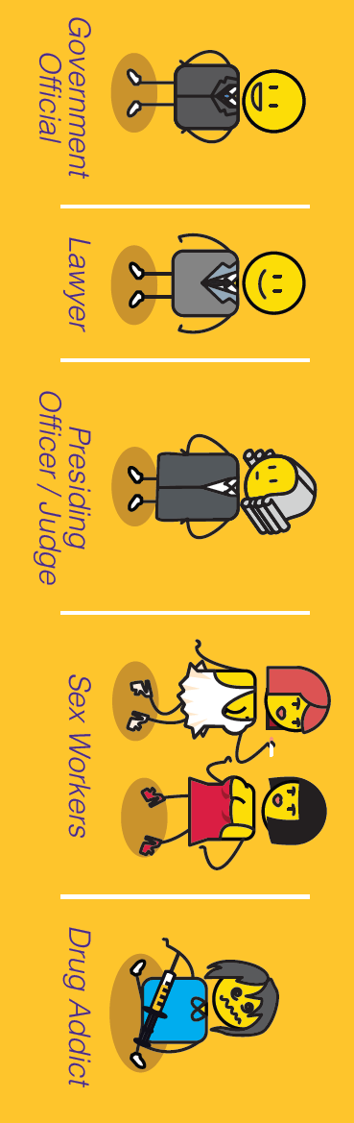



Community members
Criminal
Notes:
There are different kinds of people in this community from children to families, spiritual, traditional and community leaders, doctors, nurses, social workers, police officers and government officials. There are also people who struggle to fit into communities such as drug addicts or those with criminal intent.

Slide 22

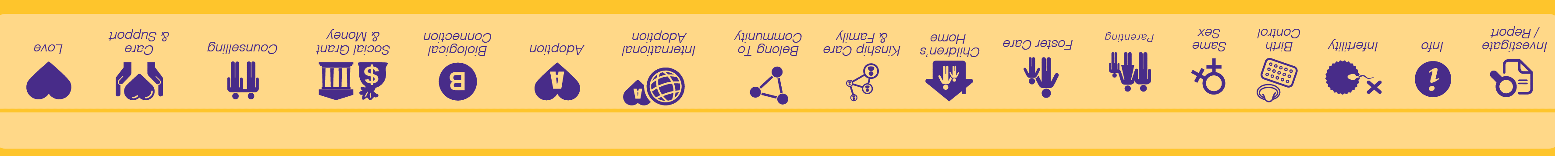






Child protection conversations
Notes:
The people in the community are having lots of different conversations about the child protection challenges happening in their community. We have used a child protection emoji language to illustrate these conversations.

Slide 23

Notes:
If you are using this presentation as the workshop stimulus, you may want to press pause now, so that participants can spend some time exploring the community map (Press Pause Now).

Slide 24


How we should answer?
What do we think is causing crisis pregnancy in our community?
What do we think could prevent crisis pregnancy in our community?
Notes:
Once they have identified all of their challenges, ask them to make a list of all of the things that they think are causing the challenges in their community and another list of all of the things that they think can prevent these challenges from taking place.

Slide 25
What are the options available to you if you are experiencing a crisis pregnancy?
www.couragechildprotection.com
Notes:
This Courage presentation will help you to understand the options available to you if you are experiencing a crisis pregnancy.

Slide 26
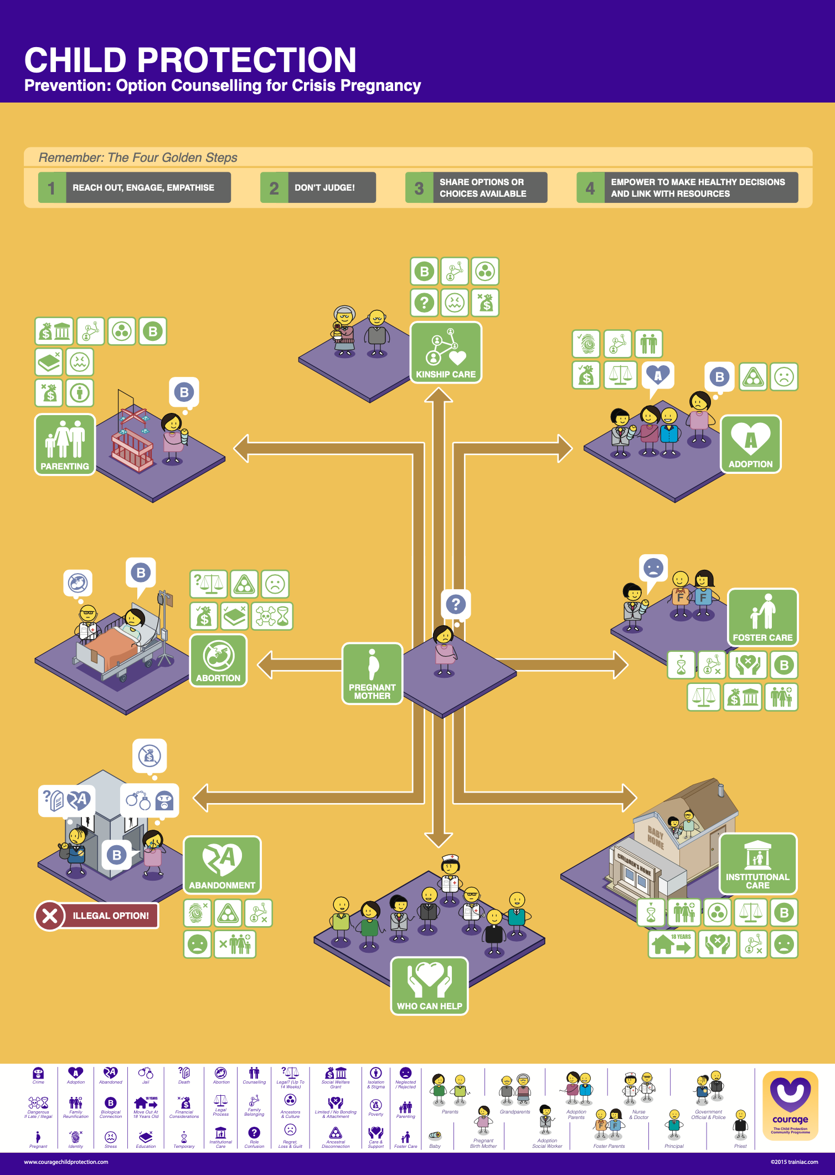
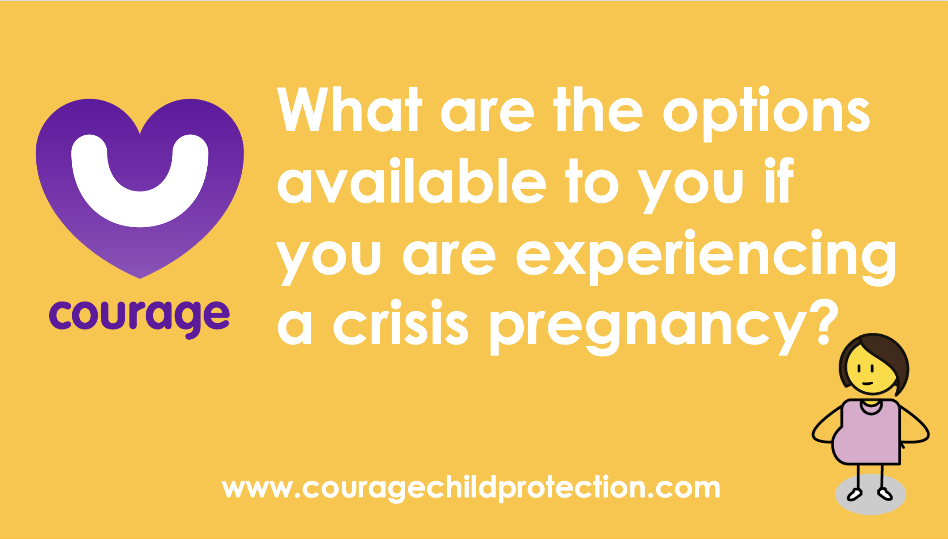
Useful Courage Tools
Option Counselling for Crisis Pregnancy Poster
Option Counselling for Crisis Pregnancy Movie or Presentation
or
Notes:
Useful Courage Tools

Slide 27
OPTION COUNSELLING
X ILLEGAL OPTION
Notes:
Unplanned and crisis pregnancy is a reality around the world.
The question is once you find yourself in this situation, what do you do about it?
Sadly, many young women ignore their pregnancy and hope that it will magically go away, some don't even know that they are pregnant until they start to feel their baby move inside them in their second trimester.
As with everything, the most important step is to acknowledge that you are pregnant and then to explore the various options available to you.
If you have fallen pregnant against your will, due to sexual abuse or rape, where someone has forced you to have sex, it is important that you inform a child protection officer.
This could be a trusted adult family or community member, a teacher, a social worker, your doctor or nurse, or a police officer. Each of these people have a responsibility to protect you from sexual abuse and rape.
Courage has identified seven different options available to someone experiencing a crisis pregnancy which includes, parenting, abortion, kinship care, foster care, institutional care, adoption and abandonment, which is the only illegal option. We will discussion each of these options and the range of considerations that you should be aware of for each in this video.

Slide 28
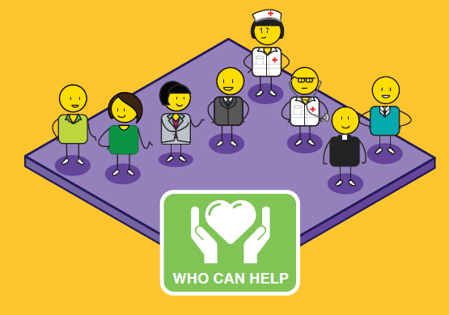
Notes:
An unplanned pregnancy is a difficult situation to handle all by yourself.
At some point you will want to talk to someone in order to share your feelings and get help with the decision-making process.
Most girls will start by telling their boyfriend. Telling your parents is never easy and many girls will need some help to do this.
Telling sisters and friends can help to share the problem but may not lead to constructive help.
Telling a clinic sister, doctor or social worker attached to an antenatal clinic or hospital, a teacher or school counsellor, minister or religious counsellor or contacting a helpline, could lead to a referral to a professional who specialises in the counselling and support of mothers facing an unplanned pregnancy.
These counsellors will help you to explore all the options and to reach a responsible decision for both yourself and the baby.

Slide 29
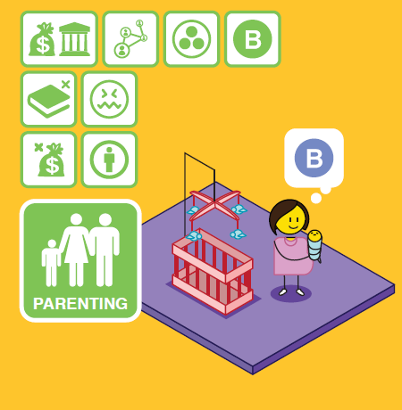
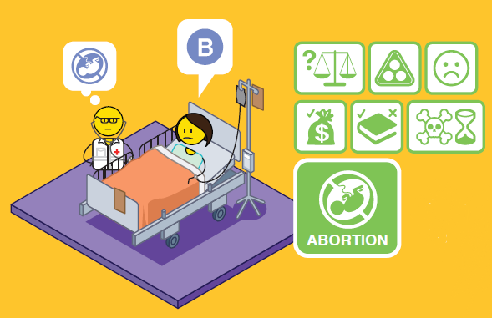
Notes:
The first option is deciding to keep your child and to raise it until adulthood as his or her parent and primary care giver.
The benefit of parenting is that your child will stay with you, his or her biological mother and/or parents.
This will meet the cultural needs of your family and ancestors, and you can apply for a child-care grant if you are struggling with money and resources.
However, you may lack the finances and family support you need to raise a child on your own.
Although you are legally entitled to stay in school you may find it difficult to do this and still care for your baby.
You may feel isolated, resentful and stressed, and be subjected to ridicule and the stigma of being a teenage mother or single mother in your community.
If you are still very young yourself, you may experience some challenges in raising a child, as you are still a child yourself.

Slide 30
Notes:
If your pregnancy is still in the first trimester (which is the first 12 to 14 weeks), you can legally seek an abortion at your local clinic or hospital if this is legal in your country or state.
Abortions can be considered after this time, if the pregnancy presents a significant health risk to the mother or child.
As with all options, having an abortion should be carefully considered.
Although your pregnancy will be terminated through this process, it will have an impact on your emotional wellbeing.
You may experience post-abortion depression and feelings of guilt and regret.
It is very important that the abortion is conducted in a legally recognised hospital or clinic, as there can be serious health consequences if you choose to abort your child after the first trimester, through illegal channels.
Choosing to abort your child illegally after 14 weeks is a criminal offence, referred to as ‘concealment of birth’, which can carry a jail sentence if the child dies.
If the child lives, which can happen after 24 weeks or in the third trimester, they can be born with a number of physical and intellectual challenges due to their prematurity at birth and could struggle with these for the rest of their lives.
Taking illegal medication to abort your child can have dire consequences on your health including the possibility of death.

Slide 31
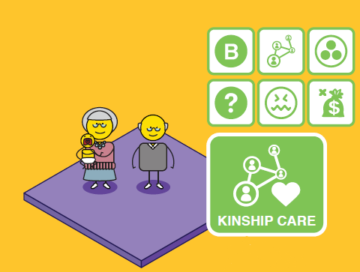
Notes:
Kinship care refers to the caring of your child by a family member, your parents, grandparents or a close relative.
This can be done through a formal foster care placement or adoption, or through an informal arrangement between you and your family.
This option will enable you to maintain a relationship with your child. You will have the emotional and financial support of your family and your child will remain within its biological family, meeting cultural needs of family and ancestors.
However, you and your child may experience ‘role confusion, if your child is brought up as your sibling, rather than as your child.
Kinship care can have a negative impact on older family members as they are expected to take care of young children, well into old age, which can lead to high levels of stress, anxiety and hypertension.
Financial considerations also need to be taken into account and whether the family member is in a financial position to take on another dependent.

Slide 32
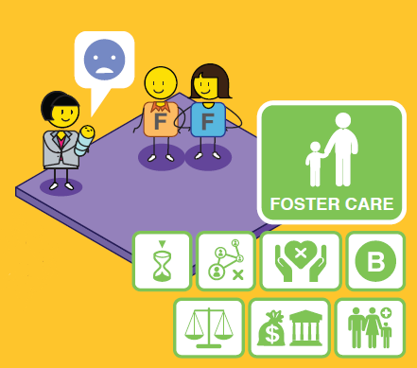
Notes:
Foster care is a temporary child protection solution to give you time as a parent to get organised and prepared to take care of your child yourself.
Foster care is legal, when conducted in accordance with the Children’s Act, and is a good temporary solution for keeping a child safe and secure if his or her own family cannot take her them.
You will be able to remain in contact with your child, but this is a temporary relief solution and should result in your reunification with your child after no longer than two years.
Foster parents are entitled to a foster care grant which they can apply for at their local Department of Social Development.
As it is a temporary solution, however, there are some concerns that you will need to be aware of, if you make this choice.
Foster care can never replace a family environment where a child has a sense of permanence and feels like they belong.
The child may struggle with the issue of having an inconsistent carer, they may not be able to bond with a primary care giver and as a result they could feel insecure and struggle with their sense of identity as they grow up.

Slide 33
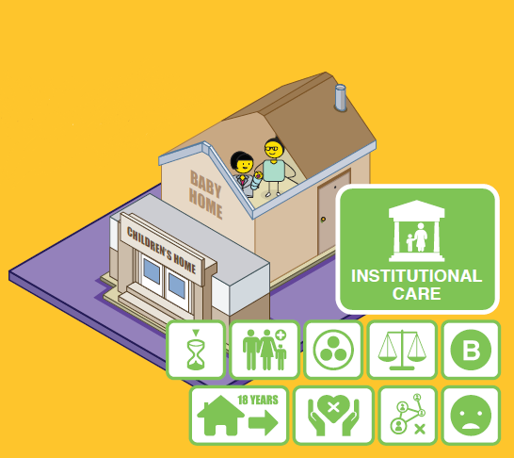
Notes:
Institutional or residential care is when a child is placed in a children’s home, or a group foster care home after going through the necessary process via court.
As with foster care, this option gives you time as a parent to get organised so that you can take care of your child yourself in the long run.
You will be able to remain in contact with your child, but this is a temporary relief solution and should result in your reunification with your child after no longer than two years.
The home will take full responsibility for the care and education of your child whilst he or she is in their care.
As it is a temporary solution, however, there are some concerns that you will need to be aware of, if you make this choice.
As with Foster Care, a children’s home can never replace a family environment where a child has a sense of permanence and feels like they belong.
The child may struggle with the issue of having an inconsistent carer as children’s homes rely on shift workers.
They may not be able to bond with a primary care giver and as a result they could feel insecure and once again struggle with their sense of identity as they grow up.

Slide 34
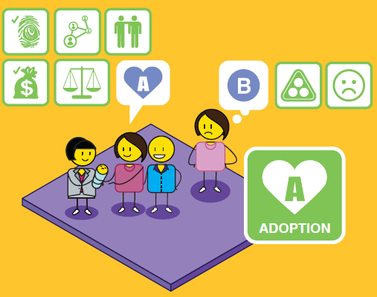
Notes:
Adoption is believed to be the best long-term solution for a child outside of being cared for by their own family.
It is a legal process that is conducted in accordance with the Children’s Act.
Should you consider this option, you would need to sign consent to the fact that you will no longer be the parent of your child, and that you have no financial or parental responsibilities towards them.
Your child would get a new family that has been carefully selected to meet their needs in a stable, permanent and loving home.
In South Africa, you need to be above the age of 18 to legally place your child up for adoption, if you are younger than 18 your parents or guardian will need to sign the adoption consent form in your place.
As your child will be brought up by another family, you may experience feelings of loss, guilt, denial, regret and grief.
Your child may wish to know who their biological family are for ancestral purposes, but they may feel rejected and resent you for placing them up for adoption and not caring for them yourself.
Some adoptees struggle with their identity formation due to living with an adopted family, rather than their biological family.
You may be able to reconnect with your child when they become an adult, but this will be at their discretion.

Slide 35
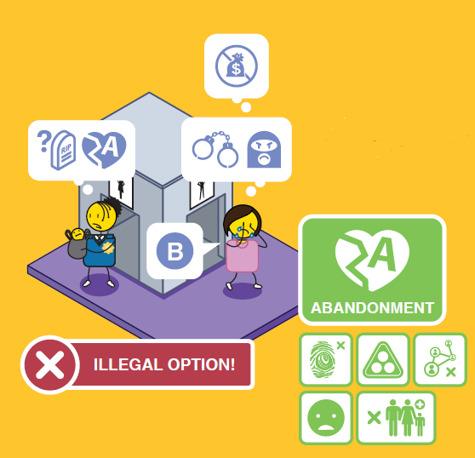
Notes:
Anonymous abandonment of your child is illegal in South Africa, whether you leave your child in a safe or unsafe place and can carry a prison sentence if you are found guilty.
Abandonment places your child at great physical risk and could lead to their death if they are not found in time.
An abandoned child has no sense of identity and no way of tracing their biological family or ancestors.
They may experience feelings of neglect, rejection and resentment towards their biological parents.
If you abandon your child,and have no contact with them for the period of at least three months, your parental rights can be removed by the courts and your child will be placed up for adoption.

Slide 36









A
18+?
Notes:
If you do counsel someone experiencing a crisis pregnancy remember to reach out, engage and empathise with them
Don’t judge them, you don’t know what the circumstances of their pregnancy are
Share the various options or choices available to them
And empower them to make healthy decisions for themselves and their unborn child by linking them to the appropriate resources.
As a child protection officer, you must be sensitive to the rights of the biological mother and her wishes,
Especially when it comes to confidentiality. This will also be guided by the applicable laws in your country.
You must consider the right of other potential parties to be involved in any child protection process, this includes the biological mother, the biological father, and the maternal and paternal extended families.
Ensure that you are aware of the age of majority in your country for choosing the various options, as there are legal implications when the expecting mother and/or biological father are still legally regarded as minorities.
Some options outlined in the option counselling map may be illegal in certain countries such as abortion and abandonment, and should therefore be dealt with sensitively.
The decision to place a child up for adoption is significant and has long term implications. If this option is chosen, a number of interviews and counselling will be required.

Slide 37
Role play exercise
‘Role play’ exercise where one participant pretends to be pregnant and the other participant tries to counsel them on the options available to them using the Courage poster (swap roles half way).
Notes:
‘Role play’ where one participant pretends to be pregnant ‘Role play’ exercise where one participant pretends to be pregnant and the other participant tries to counsel them on the options available to them using the Courage poster (swap roles half way).
the other participant is trying to counsel them on the options available to them using the Courage poster (swap roles half way)

Slide 38
Discuss
Do you have any questions about the options presented?
What was it like to pretend you were experiencing a crisis pregnancy?
?
What was it like to counsel someone experiencing a crisis pregnancy?
Is there anything you don’t understand or would like more information about?
Notes:
Discuss
Do you have any questions about the options presented?
Is there anything you don’t understand or would like more information about?
What was it like to pretend you were experiencing a crisis pregnancy?
What was it like to counsel someone experiencing a crisis pregnancy?

Slide 39
Action planning to achieve our vision
for ourselves
www.couragechildprotection.com
Notes:
This Courage presentation will help you to define the actions you will need to take to achieve your vision for yourself.

Slide 40


Presence & action
Notes:
Presence and action are the final drivers of personal and community empowerment and should always be the final exercise you run in a Courage process. As this picture illustrates, presence and action are about focusing on what you need to do today to achieve your vision for tomorrow. If you want to grow a tree in the future, you need to plant a seed today. Presence and action are about planning, delivering on what you promise, believing in possibility, and ensuring that everyone has access to the services they need to make their dreams come true. They are also about ensuring that the difference you create is sustainable for future generations.

Slide 41
What should we ask?
Notes:
To understand what actions we need to take, we can ask three simple questions. To achieve our vision for ourselves, what do we need to stop doing? What do we need to start doing? And what do we need to continue doing, which are things we are already doing that support our vision?

Slide 42
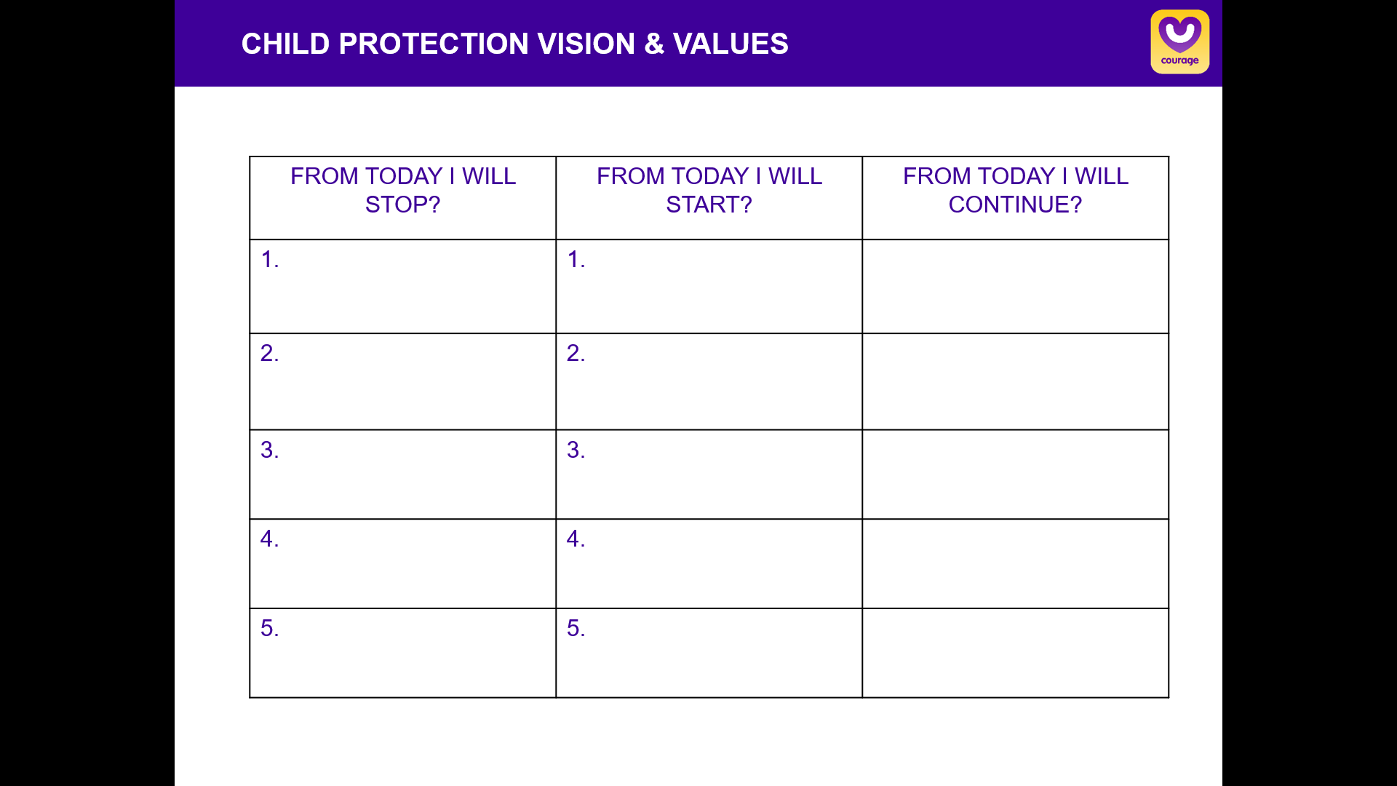
How should we answer?
From today what will can we stop doing? What can we start doing? What can we continue doing? To achieve our vision for ourselves and the world we would like to live in?
ACTION PLANNING
Notes:
As individuals or a group you can capture all of the things you plan to stop doing, all of the things you plan to start doing and all of the things you plan to continue doing. You can then commit either individually by or as a group to these actions by signing and dating your action plan.

Slide 43

stay strong
take
www.couragechildprotection.com
Notes:
Thanks for watching.
For more information visit Courage Child Protection dot com
Be sure to like this video and subscribe to our Courage Channel.
Stay strong and take courage.

