Slide 1
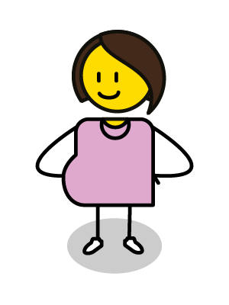
What are the options available to you if you are experiencing a crisis pregnancy?
www.couragechildprotection.com
Notes:
This Courage video will help you to understand the options available to you if you are experiencing a crisis pregnancy.

Slide 2
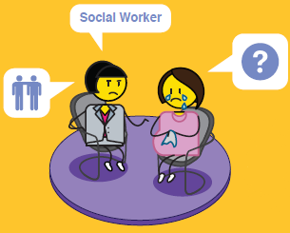
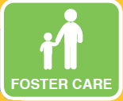
OPTION COUNSELLING
X ILLEGAL OPTION
Notes:
Unplanned and crisis pregnancy is a reality around the world.
The question is once you find yourself in this situation, what do you do about it?
Sadly, many young women ignore their pregnancy and hope that it will magically go away, some don't even know that they are pregnant until they start to feel their baby move inside them in their second trimester.
As with everything, the most important step is to acknowledge that you are pregnant and then to explore the various options available to you.
If you have fallen pregnant against your will, due to sexual abuse or rape, where someone has forced you to have sex, it is important that you inform a child protection officer.
This could be a trusted adult family or community member, a teacher, a social worker, your doctor or nurse, or a police officer. Each of these people have a responsibility to protect you from sexual abuse and rape.
Courage has identified seven different options available to someone experiencing a crisis pregnancy which includes, parenting, abortion, kinship care, foster care, institutional care, adoption and abandonment, which is the only illegal option. We will discussion each of these options and the range of considerations that you should be aware of for each in this video.

Slide 3
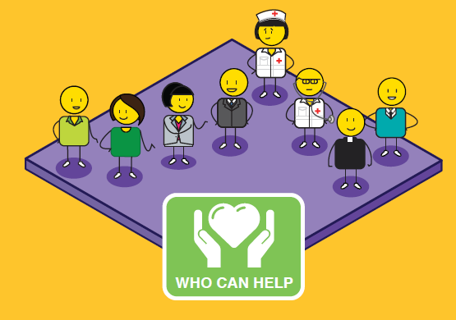
Notes:
An unplanned pregnancy is a difficult situation to handle all by yourself.
At some point you will want to talk to someone in order to share your feelings and get help with the decision-making process.
Most girls will start by telling their boyfriend. Telling your parents is never easy and many girls will need some help to do this.
Telling sisters and friends can help to share the problem but may not lead to constructive help.
Telling a clinic sister, doctor or social worker attached to an antenatal clinic or hospital, a teacher or school counsellor, minister or religious counsellor or contacting a helpline, could lead to a referral to a professional who specialises in the counselling and support of mothers facing an unplanned pregnancy.
These counsellors will help you to explore all the options and to reach a responsible decision for both yourself and the baby.

Slide 4
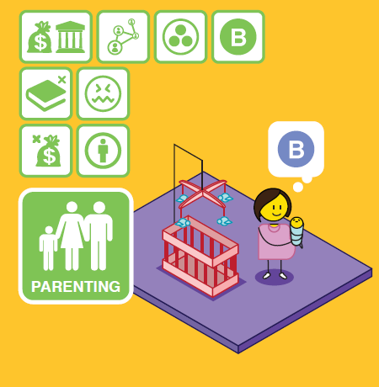
Notes:
The first option is deciding to keep your child and to raise it until adulthood as his or her parent and primary care giver.
The benefit of parenting is that your child will stay with you, his or her biological mother and/or parents.
This will meet the cultural needs of your family and ancestors, and you can apply for a child-care grant if you are struggling with money and resources.
However, you may lack the finances and family support you need to raise a child on your own.
Although you are legally entitled to stay in school you may find it difficult to do this and still care for your baby.
You may feel isolated, resentful and stressed, and be subjected to ridicule and the stigma of being a teenage mother or single mother in your community.
If you are still very young yourself, you may experience some challenges in raising a child, as you are still a child yourself.

Slide 5
Notes:
If your pregnancy is still in the first trimester (which is the first 12 to 14 weeks), you can legally seek an abortion at your local clinic or hospital if this is legal in your country or state.
Abortions can be considered after this time, if the pregnancy presents a significant health risk to the mother or child.
As with all options, having an abortion should be carefully considered.
Although your pregnancy will be terminated through this process, it will have an impact on your emotional wellbeing.
You may experience post-abortion depression and feelings of guilt and regret.
It is very important that the abortion is conducted in a legally recognised hospital or clinic, as there can be serious health consequences if you choose to abort your child after the first trimester, through illegal channels.
Choosing to abort your child illegally after 14 weeks is a criminal offence, referred to as ‘concealment of birth’, which can carry a jail sentence if the child dies.
If the child lives, which can happen after 24 weeks or in the third trimester, they can be born with a number of physical and intellectual challenges due to their prematurity at birth and could struggle with these for the rest of their lives.
Taking illegal medication to abort your child can have dire consequences on your health including the possibility of death.

Slide 6
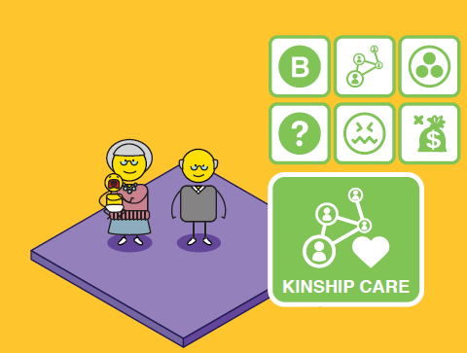
Notes:
Kinship care refers to the caring of your child by a family member, your parents, grandparents or a close relative.
This can be done through a formal foster care placement or adoption, or through an informal arrangement between you and your family.
This option will enable you to maintain a relationship with your child. You will have the emotional and financial support of your family and your child will remain within its biological family, meeting cultural needs of family and ancestors.
However, you and your child may experience ‘role confusion, if your child is brought up as your sibling, rather than as your child.
Kinship care can have a negative impact on older family members as they are expected to take care of young children, well into old age, which can lead to high levels of stress, anxiety and hypertension.
Financial considerations also need to be taken into account and whether the family member is in a financial position to take on another dependent.

Slide 7
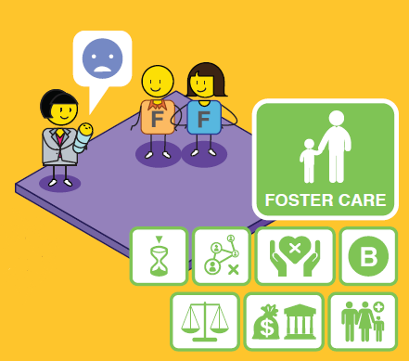
Notes:
Foster care is a temporary child protection solution to give you time as a parent to get organised and prepared to take care of your child yourself.
Foster care is legal, when conducted in accordance with the Children’s Act, and is a good temporary solution for keeping a child safe and secure if his or her own family cannot take her them.
You will be able to remain in contact with your child, but this is a temporary relief solution and should result in your reunification with your child after no longer than two years.
Foster parents are entitled to a foster care grant which they can apply for at their local Department of Social Development.
As it is a temporary solution, however, there are some concerns that you will need to be aware of, if you make this choice.
Foster care can never replace a family environment where a child has a sense of permanence and feels like they belong.
The child may struggle with the issue of having an inconsistent carer, they may not be able to bond with a primary care giver and as a result they could feel insecure and struggle with their sense of identity as they grow up.

Slide 8
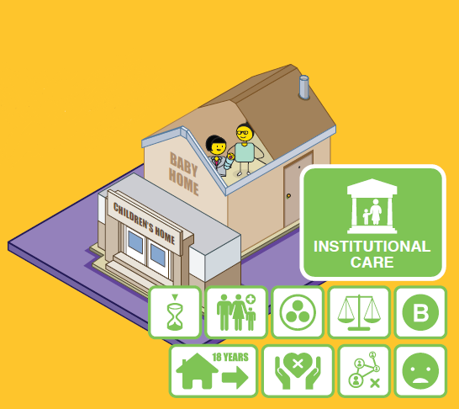
Notes:
Institutional or residential care is when a child is placed in a children’s home, or a group foster care home after going through the necessary process via court.
As with foster care, this option gives you time as a parent to get organised so that you can take care of your child yourself in the long run.
You will be able to remain in contact with your child, but this is a temporary relief solution and should result in your reunification with your child after no longer than two years.
The home will take full responsibility for the care and education of your child whilst he or she is in their care.
As it is a temporary solution, however, there are some concerns that you will need to be aware of, if you make this choice.
As with Foster Care, a children’s home can never replace a family environment where a child has a sense of permanence and feels like they belong.
The child may struggle with the issue of having an inconsistent carer as children’s homes rely on shift workers.
They may not be able to bond with a primary care giver and as a result they could feel insecure and once again struggle with their sense of identity as they grow up.

Slide 9
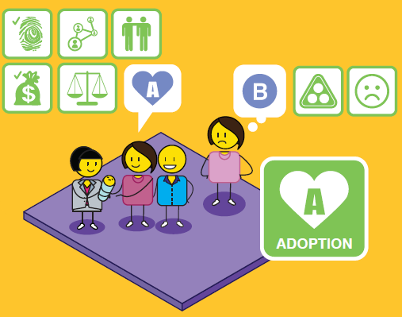
Notes:
Adoption is believed to be the best long-term solution for a child outside of being cared for by their own family.
It is a legal process that is conducted in accordance with the Children’s Act.
Should you consider this option, you would need to sign consent to the fact that you will no longer be the parent of your child, and that you have no financial or parental responsibilities towards them.
Your child would get a new family that has been carefully selected to meet their needs in a stable, permanent and loving home.
In South Africa, you need to be above the age of 18 to legally place your child up for adoption, if you are younger than 18 your parents or guardian will need to sign the adoption consent form in your place.
As your child will be brought up by another family, you may experience feelings of loss, guilt, denial, regret and grief.
Your child may wish to know who their biological family are for ancestral purposes, but they may feel rejected and resent you for placing them up for adoption and not caring for them yourself.
Some adoptees struggle with their identity formation due to living with an adopted family, rather than their biological family.
You may be able to reconnect with your child when they become an adult, but this will be at their discretion.

Slide 10
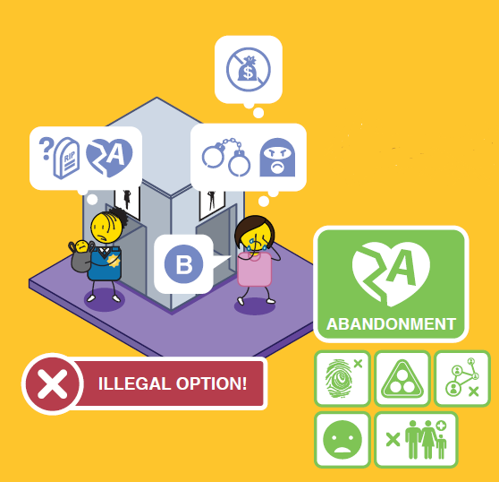
Notes:
Anonymous abandonment of your child is illegal in South Africa, whether you leave your child in a safe or unsafe place and can carry a prison sentence if you are found guilty.
Abandonment places your child at great physical risk and could lead to their death if they are not found in time.
An abandoned child has no sense of identity and no way of tracing their biological family or ancestors.
They may experience feelings of neglect, rejection and resentment towards their biological parents.
If you abandon your child,and have no contact with them for the period of at least three months, your parental rights can be removed by the courts and your child will be placed up for adoption.

Slide 11
A
18+?
Notes:
If you do counsel someone experiencing a crisis pregnancy remember to reach out, engage and empathise with them
Don’t judge them, you don’t know what the circumstances of their pregnancy are
Share the various options or choices available to them
And empower them to make healthy decisions for themselves and their unborn child by linking them to the appropriate resources.
As a child protection officer, you must be sensitive to the rights of the biological mother and her wishes,
Especially when it comes to confidentiality. This will also be guided by the applicable laws in your country.
You must consider the right of other potential parties to be involved in any child protection process, this includes the biological mother, the biological father, and the maternal and paternal extended families.
Ensure that you are aware of the age of majority in your country for choosing the various options, as there are legal implications when the expecting mother and/or biological father are still legally regarded as minorities.
Some options outlined in the option counselling map may be illegal in certain countries such as abortion and abandonment, and should therefore be dealt with sensitively.
The decision to place a child up for adoption is significant and has long term implications. If this option is chosen, a number of interviews and counselling will be required.

Slide 12
stay strong
take
www.couragechildprotection.com
Notes:
Thanks for watching.
For more information visit Courage Child Protection dot com
Be sure to like this video and subscribe to our Courage Channel.
Stay strong and take courage.

