Slide 1
Action planning
to make sure we implement our child protection strategy
www.couragechildprotection.com
Notes:
This Courage presentation will help you to define the actions you will need to take to ensure the implementation of your child protection strategy.

Slide 2
Now that we understand the importance of child protection what can we do to differently?
Notes:
We need to ask ourselves, “now that we understand the importance of child protection what can we do differently?”

Slide 3
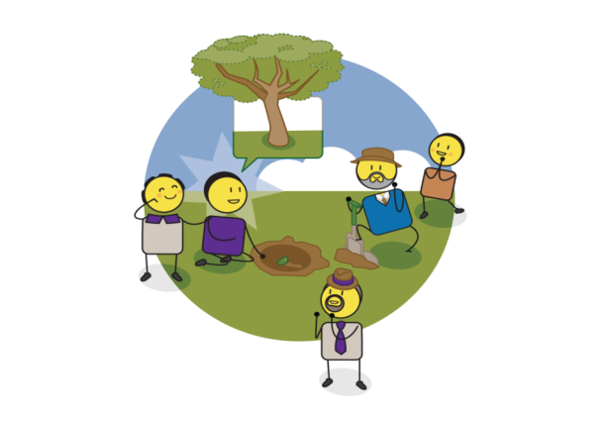
Presence & action
Notes:
Presence and action are the final drivers of personal and community empowerment and should always be the final exercise you run in a Courage process. As this picture illustrates, presence and action are about focusing on what you need to do today to achieve your vision for tomorrow. If you want to grow a tree in the future, you need to plant a seed today. Presence and action are about planning, delivering on what you promise, believing in possibility, and ensuring that everyone has access to the services they need to make their dreams come true. They are also about ensuring that the difference you create is sustainable for future generations.

Slide 4
What should we ask?
Notes:
To understand what actions we need to take, we can ask three simple questions. To achieve our child protection vision, what do we need to stop doing? What do we need to start doing? And what do we need to continue doing, which are things we are already doing that support our vision?

Slide 5
How should we answer?
From today what will can we stop doing? What can we start doing? What can we continue doing? In the protection of our children and achievement of our child protection vision?
ACTION PLANNING
Notes:
As individuals or a group you can capture all of the things you plan to stop doing, all of the things you plan to start doing and all of the things you plan to continue doing. You can then commit either individually by or as a group to these actions by signing and dating your action plan.

Slide 6
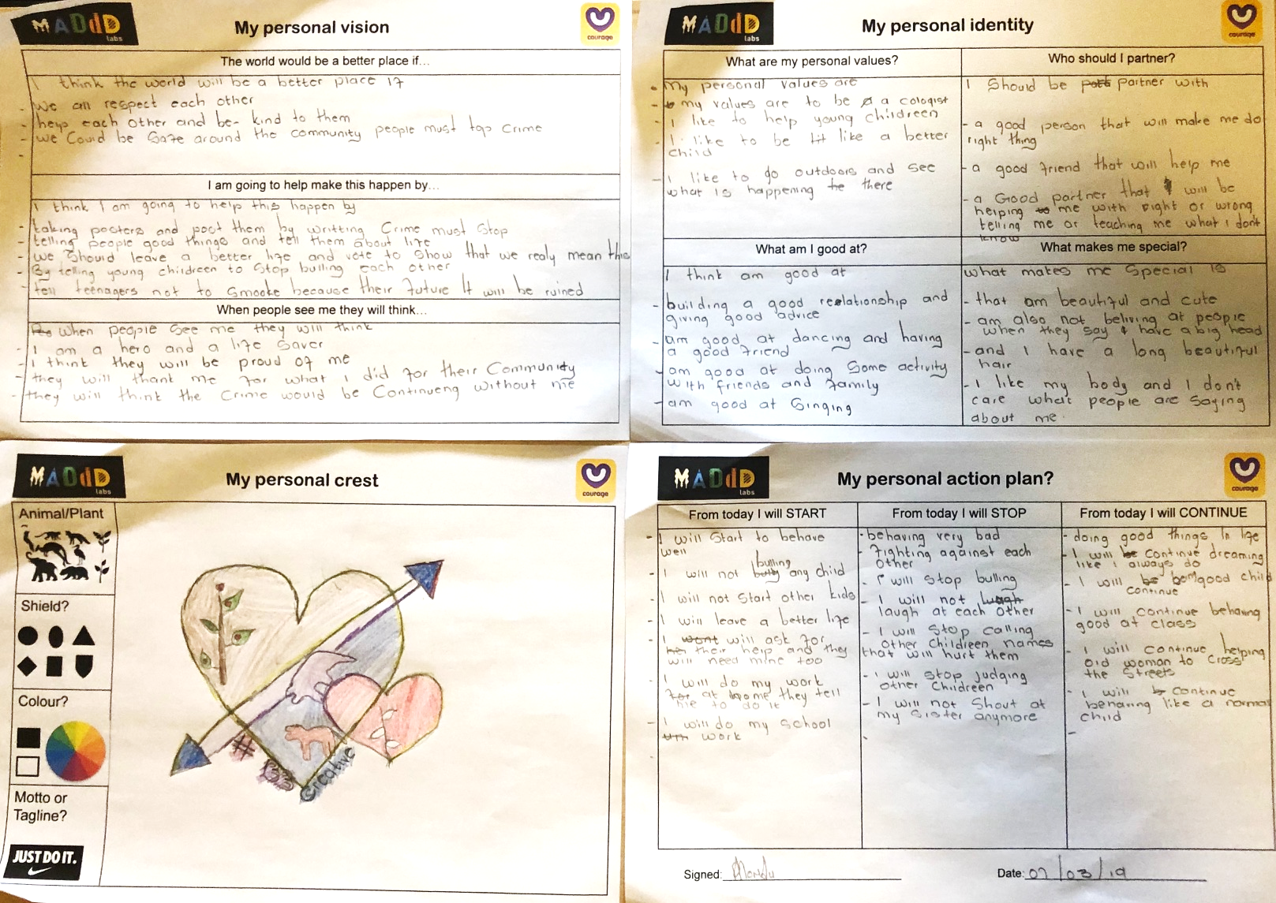
Notes:
In this example, children from a school developed their own personal empowerment plans in which defined their personal visions, their identities, their crests and action plans, which they signed and dated.

Slide 7
Creating a child protection plan
Overarching
Vision & Values for your
Child Protection Plan
What is the reality
of our children?
What do we want
to achieve?
Quarterly Review
What are our empowered child protection strategies?
Annual
Strategic Planning
Process
Action Plan
(What, Who, When,
Where, Why & How)
Partnership Plan
(Win/Win Roles & Responsibilities)
Implementation &
Measurement/Evaluation
Notes:
Some of you may want to develop a child protection strategy and plan. This plan would detail your overarching child protection vision and guiding values. A summary of the reality of what is happening in your community, which includes a list of what promotes or prevents child protection issues and you prioritised child protection challenges. A summary of what you want to achieve, which includes the mind-shifts that need to take place from disempowerment to empowerment drivers, and the empowered child protection strategies you have developed to address each challenge. You should also detail an action plan, a win/win partnership plan and how you will measure and evaluate all of your activities moving forward. This plan should be developed annually but should also be reviewed on a regular basis to ensure that you are staying on track. Details of the different templates and tools you can use are explained in the rest of this presentation.

Slide 8
Our vision and values?
THE ROLE OF CHILDREN IN OUR FAMILY/COMMUNITY (Why do we have children and what is their role in our family/community?) | OUR CHILD PROTECTION VISION FOR THE FUTURE (We would like to create a world for our children that…?) | OUR CHILD PROTECTION VALUES/BELIEFS (The values we believe in that will help us achieve our vision are?)
1. | 1. | 1.
2. | 2. | 2.
3. | 3. | 3.
4. | 4. | 4.
5. | 5. | 5.
Notes:
In this template you can capture what you see as the role of children in your family or community and what kind of world you would like to create for them, which come from the child protection visioning exercise. You can also capture the values or beliefs that will guide you in the achievement of your vision, which comes from the child rights and responsibilities exercise.

Slide 9
Community insight/assessment?
WHAT PROMOTES THE CHILD PROTECTION CHALLENGES IN OUR COMMUNITY? | WHAT PREVENTS THE CHILD PROTECTION CHALLENGES IN OUR COMMUNITY?
1. | 1.
2. | 2.
3. | 3.
4. | 4.
5. | 5.
6. | 6.
7. | 7.
8. | 8.
Notes:
In this template you can capture what you think is promoting child protection challenges in your community, versus what you think prevents them, which comes from the Courage Community Map exercise where you first identified the child protection challenges happening in your community.

Slide 10
Prioritised challenges and shift?
LIST OF HIGH PRIORTITY CHILD PROTECTION CHALLENGES (YELLOW CARDS) | DISEMPOWERED DRIVERS OF THE CHILD PROTECTION CHALLENGES (PURPLE CARDS) | EMPOWERED DRIVERS OF CHANGE FOR CHALLENGES (WHITE CARDS)
1. | 1. | 1.
2. | 2. | 2.
3. | 3. | 3.
4. | 4. | 4.
5. | 5. | 5.
6. | 6. | 6.
7. | 7. | 7.
8. | 8. | 8.
Notes:
In this template you can identify your high priority challenges in order of importance from highest to lowest. You can also list what you see as the disempowerment driver of the challenge and the empowered driver that will ensure changed behaviour.

Slide 11
Child protection strategies?
What is/are the empowerment driver/s that will ensure a meaningful change inbehaviour/s? (Describe as a tangible programme, campaign or specific actions you can take in your community)
1.
What is/are the disempowerment driver/s? (Describe these in the context of your community)
3.
What is/are my child protection challenge/s? (Describe how the challenge/s shows up in your community)
5.
Notes:
You can use this template to capture all of your child protection strategies. At the bottom starting with your child protection challenge, which you should describe in the context of your community. Moving up, you should detail the disempowerment drivers, again in the context of how they show up in your community. Finally at the top, you should detail the empowerment driver that will drive change, and the specific actions you would like to take as a community to help address the challenge you identified at the bottom.

Slide 12
Identifying priorities
SHORT TERM
MEDIUM TERM
LONG TERM
Priority 1
Priority 3
HIGH
Priority 2
WHAT IMPACT WILL THIS HAVE ON MY COMMUNITY?
MEDIUM
LOW
LOW
MEDIUM
HIGH
HOW DIFFICULT WILL THIS BE TO IMPLEMENT/SOLVE?
Notes:
Sometimes communities struggle to prioritize their challenges. This is a useful tool to think through each challenge. Ask yourself, what impact will it have on my community if we solve this challenge, which will be either high, medium or low. Then ask yourself, how difficult would it be to solve this challenge from an implementation perspective, which could be low, medium or high levels of difficulty. A challenge that will have a high impact on your community and easy to implement or solve should be what you focus on first. A challenge that will have a high impact but be more difficult to implement may be a more long-term project. Asking yourself these questions and mapping your priorities to this matrix will help you to identify your short term, medium term and long-term projects.

Slide 13
Overview of partnerships
Notes:
This template will help you to capture all of the people in your community that you think you should be partnering with in your child protection efforts.

Slide 14
Win/Win Partnership Plans
What do I/we need to get? |  |  | What do I/we need to get?
1. |  | 3. | 1. |  | 3.
2. |  | 2. | 2. |  | 2.
3. |  | 1. | 3. |  | 1.
 |  | What do I/we need to give? |  |  | What do I/we need to give?
What do I/we need to get? |  |  | What do I/we need to get?
1. |  | 3. | 1. |  | 3.
2. |  | 2. | 2. |  | 2.
3. |  | 1. | 3. |  | 1.
 |  | What do I/we need to give? |  |  | What do I/we need to give?
Notes:
These templates will help you to think through what kind of a relationship you would like with each of your partners. For each partner you should agree your shared vision and values. You should then agree what you need to get from your partner and what you need to give your partner. Ideally what you get and what you give should be balanced, this will ensure a win/win partnership.

Slide 15
Action planning
CHILD PROTECTION PRIORITY:
WHAT & WHY | MEASUREMENT & EVALUATION
Define what you want to achieve with this goal or priority? Define why you are doing it, in relation to achieving your child protection vision? Remember your empowerment drivers to ensure that you are using an empowered mindset to solve this challenge. | Identity they key measures of success for this priority? (Ask yourself, ‘what would success look like if we achieved this?’) How would you measure whether you have achieved this priority or not? How often and when would you measure whether you have achieved this priority?
HOW | WHO | WHEN
How are you going to achieve this priority? (Use the Child Protection Strategy Maps to help you answer this question) | Who is responsible for delivery? Remember to include your child protection partners. | When must it be delivered by?
Notes:
This is a typical action plan. Firstly, you should define what the child protection priority is and why its important to focus on. You should then explain how you are going to address the priority, how you would measure and evaluate whether you have addressed it, who is responsible for delivery, and when it should be delivered by.

Slide 16
Behaviour change?
FROM TODAY I WILL STOP? | FROM TODAY I WILL START? | FROM TODAY I WILL CONTINUE?
1. | 1. | 1.
2. | 2. | 2.
3. | 3. | 3.
4. | 4. | 4.
5. | 5. | 5.
Notes:
Finally, you should agree and capture all the things you are going to stop doing, all the things you are going to start doing, and all the things you will continue doing. As a final step, you can sign and date this behavior change, to ensure accountability.

Slide 17
What should we ask?
Notes:
Whether agreeing on one or two things that you are going to do differently or developing a detailed child protection strategy, the most important thing to do is agree to take action and to be accountable for this action. The most common response from participants at the close of a Courage workshop is, “I will speak up more”, which indicates how many challenges are happening all around us, that are not being addressed.

Slide 18
stay strong
take
www.couragechildprotection.com
Notes:
Thanks for watching.
For more information visit Courage Child Protection dot com
Be sure to like this video and subscribe to our Courage Channel.
Stay strong and take courage.

