Slide 1
Linking our rights to responsibilities and defining our community values
www.couragechildprotection.com
Notes:
This Courage presentation will help you to understand the responsibilities linked to all children’s rights and to develop the community values you will need to achieve your child protection vision.

Slide 2
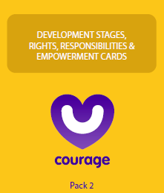
Useful courage tools
Courage child rights and responsibilities cards
or
Courage rights and responsibilities video or presentation
Notes:
Before we begin, these are some useful tools that will help you to link your children’s human rights to human responsibilities, which you can download from the Courage Child Protection Website or order a printed version online.
As stimulus for your rights, responsibilities and values exercise you can either use a pack of Courage Empowerment cards (which is the yellow pack), that includes 20 cards describing children’s rights and 20 cards describing their responsibilities.
Or you can play this video or download the original presentation from our website, complete with speaker notes, and present it yourself.

Slide 3
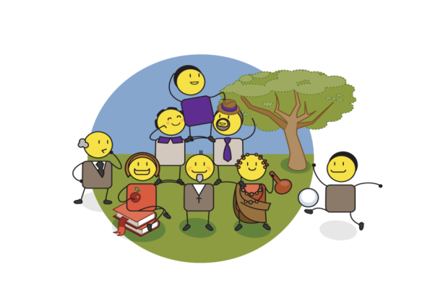
Values & beliefs
Notes:
To ensure that you deliver on your child protection vision, you will need to define the values that will drive the correct behaviours to achieve this vision. Values and beliefs are the cornerstones of your, your family and your communities identity, and should drive all of your day to day actions and choices. Values and beliefs in the context of child protection are about ensuring that we provide for the basic needs of all people in our community. Values are about creating a sense of law and order in our world, knowing right from wrong, and agreeing what is most important to us. One of the most critical values is believing in the equality of all people, this is fundamental to personal, community and societal leadership.

Slide 4
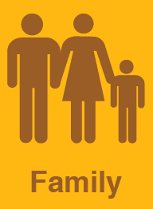
VS
Notes:
As stimulus input to defining our values, we will spend some time understanding our children’s rights and responsibilities. Courage has summarised the United Nations declaration on the Rights of the Child, UNICEF’s rights and needs of the child, our continental children’s declaration, and our country’s Children’s Act into 20 children’s rights. We have then developed 20 children’s responsibilities to match these rights.

Slide 5
Notes:
If you have the Human Rights and Human Responsibility cards illustrated here, you may want to do a fun exercise where each team has to link the 20 human rights to 20 human responsibilities cards at their workshop table as quickly as possible, you could even choose a winning team who completes the task first. You can then watch the rest of this video which details which rights link to which responsibilities, to see if they have matched them correctly. If you don’t have the cards, then try to guess what the human responsibility is for each card, before we reveal the answer, and see how many you can get right.

Slide 6
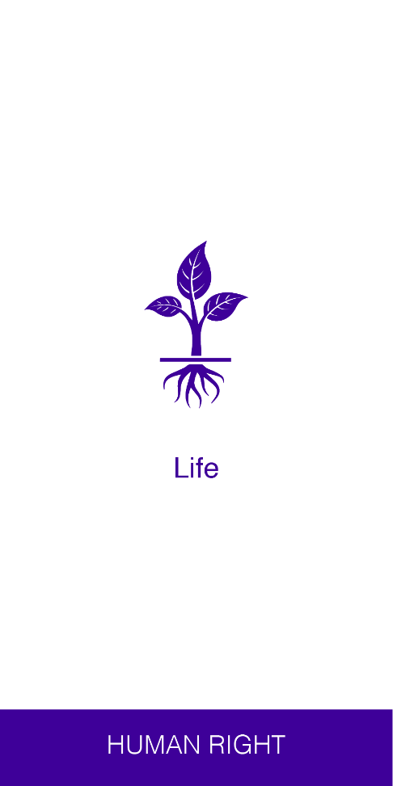
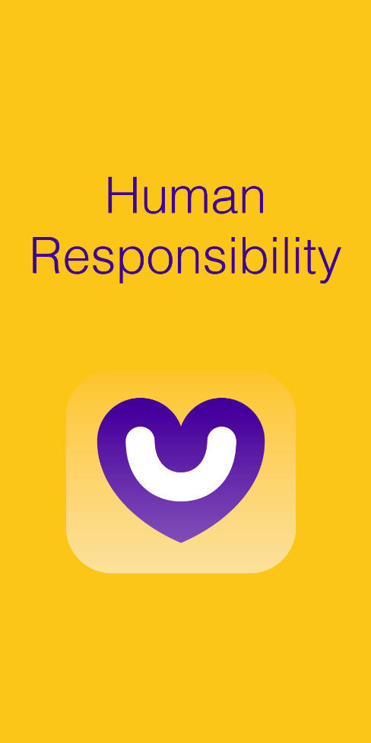
From rights…
?
Notes:
If you have a human right to life, your human responsibility is?

Slide 7
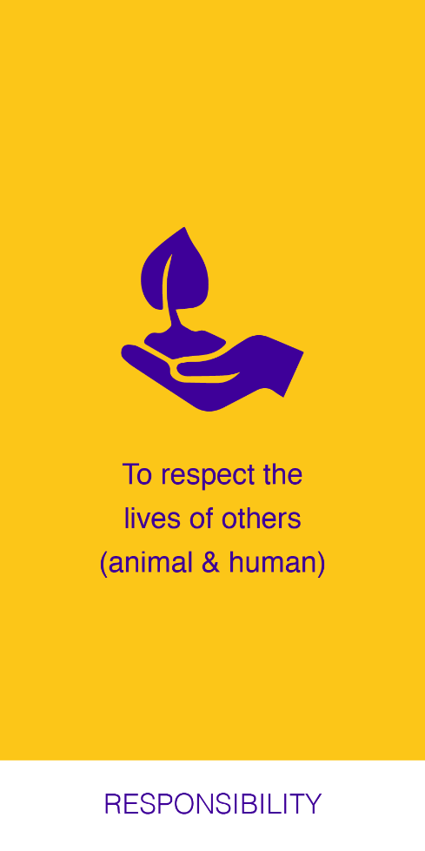
…to responsibilities
Notes:
To respect the lives of others both animal and human.

Slide 8
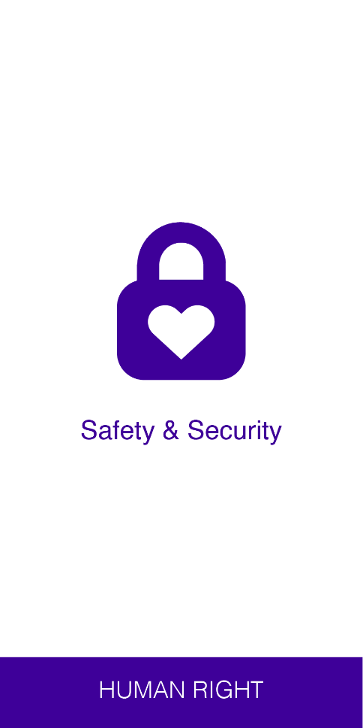
From rights…
?
Notes:
If you have a human right to safety and security, your human responsibility is?

Slide 9
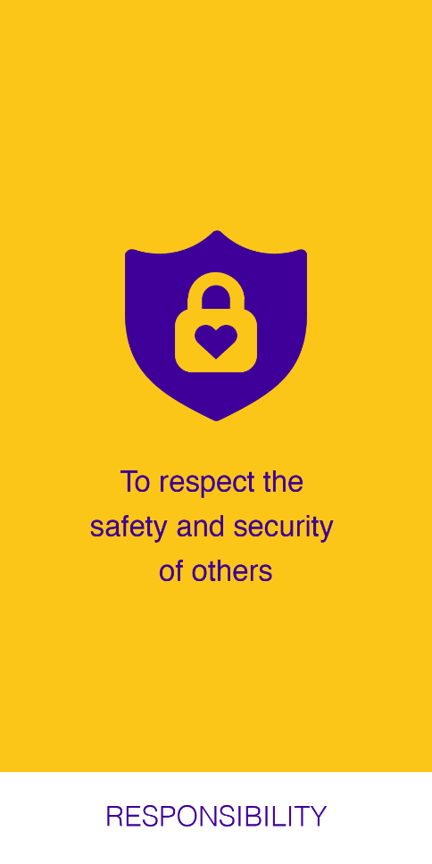
…to responsibilities
Notes:
To respect the safety and security of others.

Slide 10
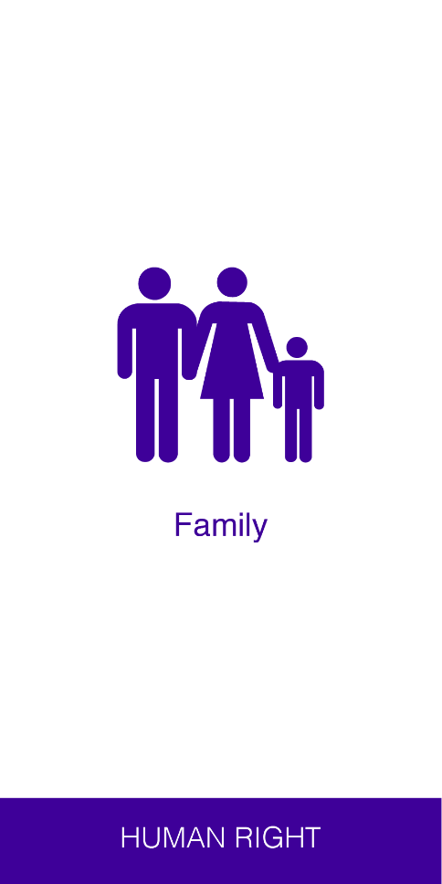
From rights…
?
Notes:
If you have a human right to family, your human responsibility is?

Slide 11
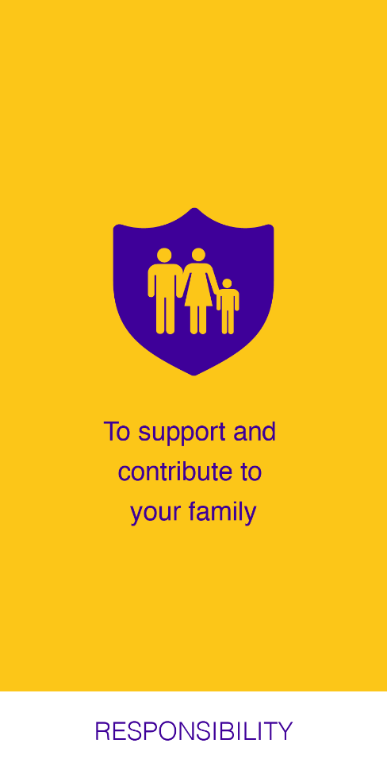
…to responsibilities
Notes:
To support and contribute to your family.

Slide 12
From rights…
?
Notes:
If you have a human right to registration, a name, identity and nationality, your human responsibility is?

Slide 13
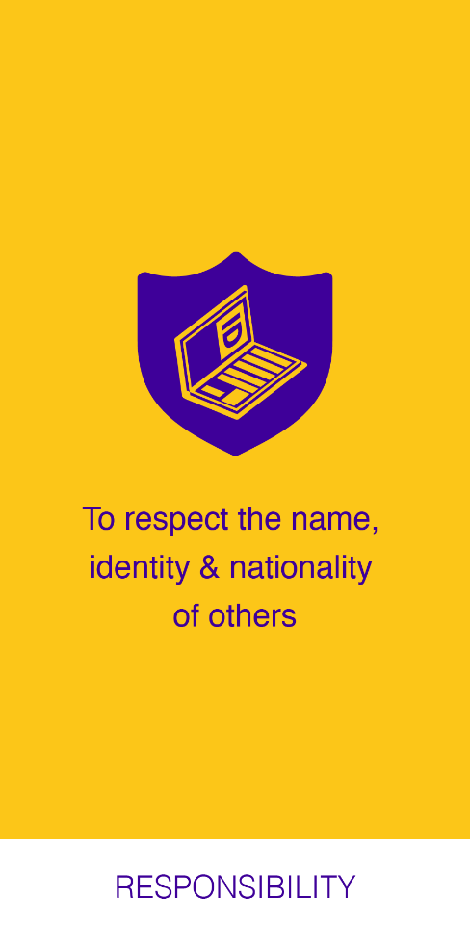
…to responsibilities
Notes:
To respect the name, identity and nationality of others.

Slide 14
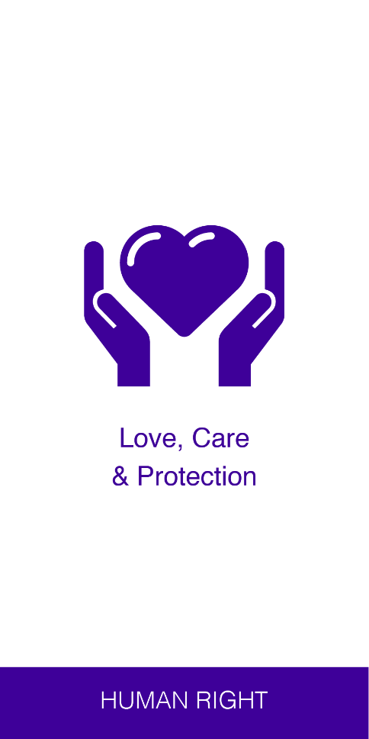
From rights…
?
Notes:
If you have a human right to love, care and protection, your human responsibility is?

Slide 15
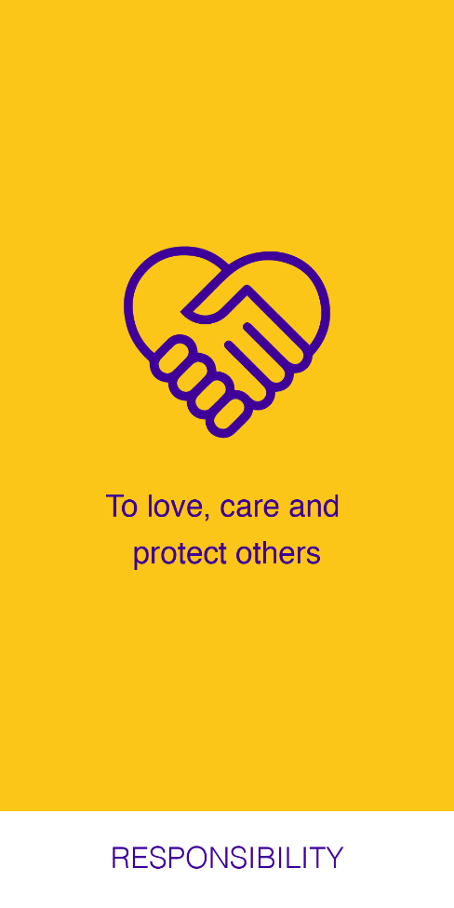
…to responsibilities
Notes:
To love, care and protect others.

Slide 16
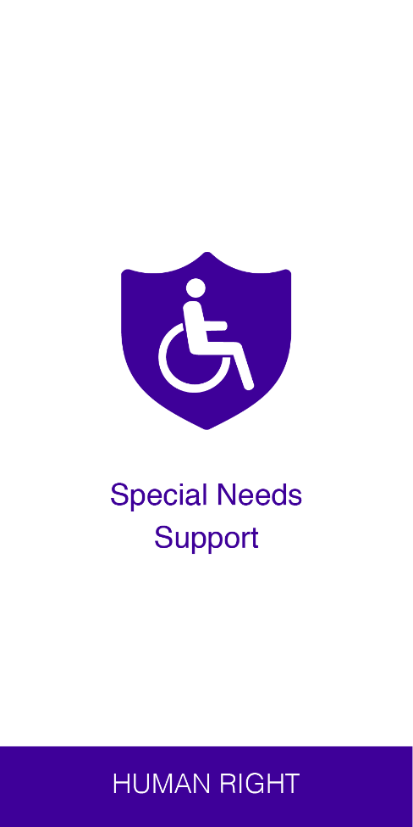
From rights…
?
Notes:
If you have a human right to special needs support, your human responsibility is?

Slide 17
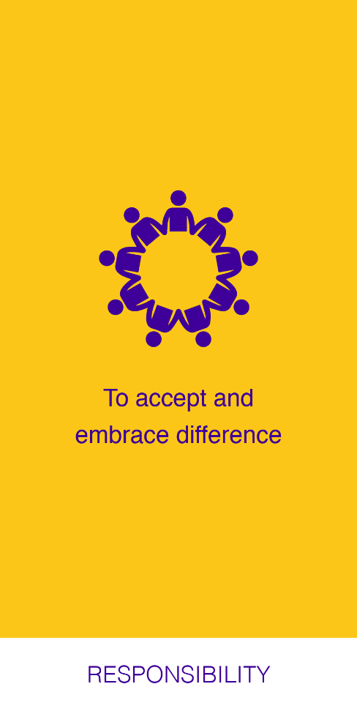
…to responsibilities
Notes:
To accept and embrace differences and diversity in others.

Slide 18
From rights…
?
Notes:
If you have a human right to legal protection and justice, your human responsibility is?

Slide 19
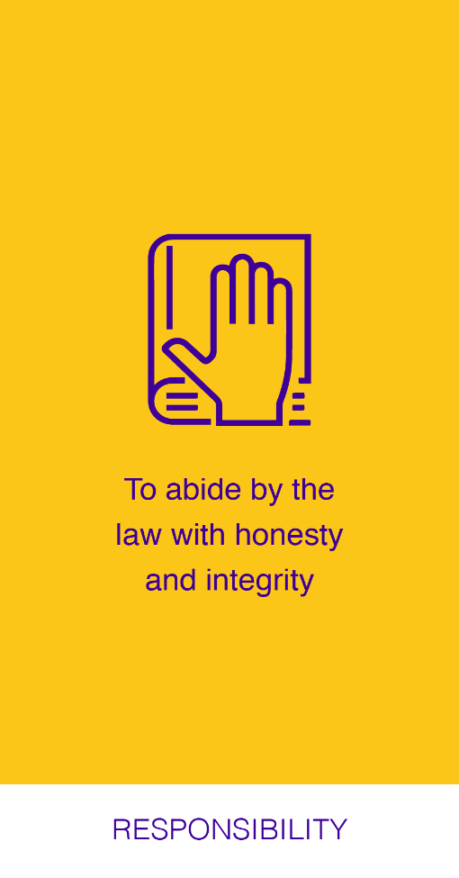
…to responsibilities
Notes:
To abide by the law with honesty and integrity.

Slide 20
From rights…
?
Notes:
If you have a human right to health, your human responsibility is?

Slide 21
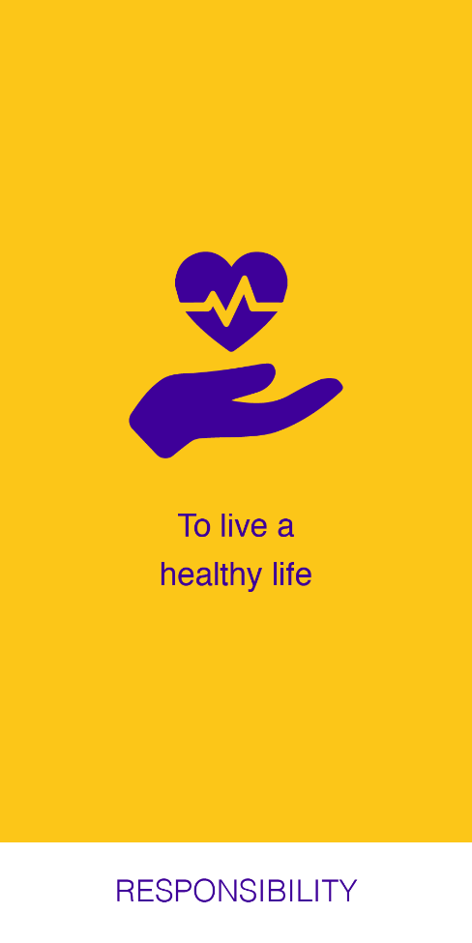
…to responsibilities
Notes:
To live a healthy life.

Slide 22
From rights…
?
Notes:
If you have a human right to honour, respect and dignity, your human responsibility is?

Slide 23
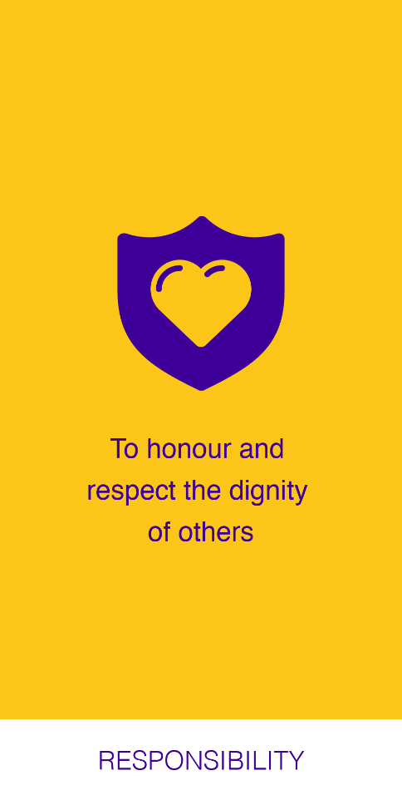
…to responsibilities
Notes:
To honour and respect the dignity of others.

Slide 24
From rights…
?
Notes:
If you have a human right to privacy, your human responsibility is?

Slide 25
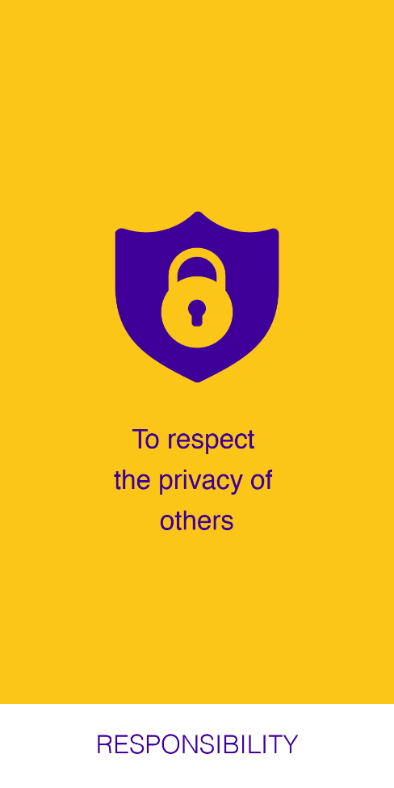
…to responsibilities
Notes:
To respect the privacy of others.

Slide 26
From rights…
?
Notes:
If you have a human right to education, your human responsibility is?

Slide 27
…to responsibilities
Notes:
To learn and work hard at your studies.

Slide 28
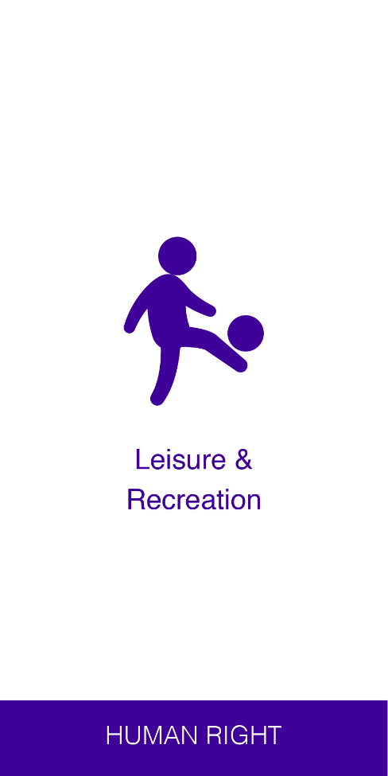
From rights…
?
Notes:
If you have a human right to leisure and recreation, your human responsibility is?

Slide 29
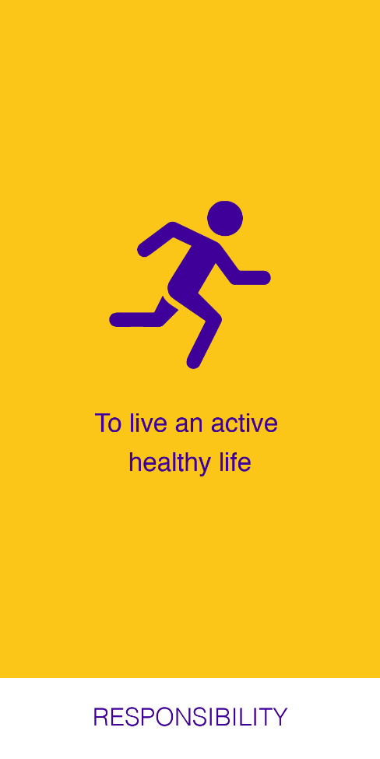
…to responsibilities
Notes:
To live an active and healthy life.

Slide 30
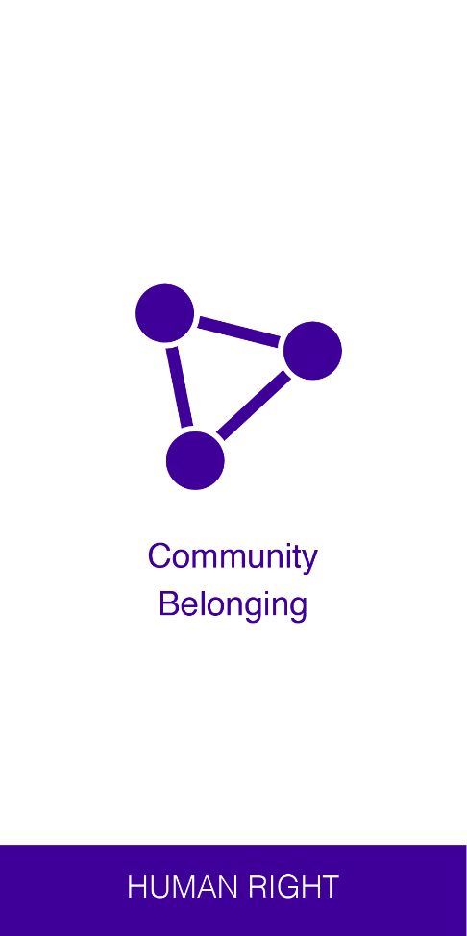
From rights…
?
Notes:
If you have a human right to community belonging, your human responsibility is?

Slide 31
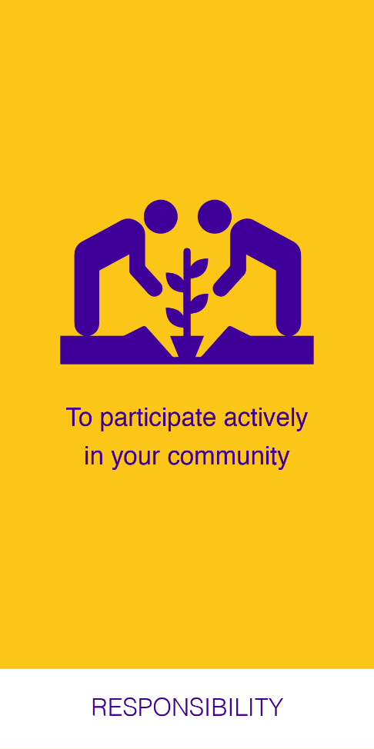
…to responsibilities
Notes:
To participate actively in your community.

Slide 32
From rights…
?
Notes:
If you have a human right to freedom of thought, expression, association and religion, your human responsibility is?

Slide 33
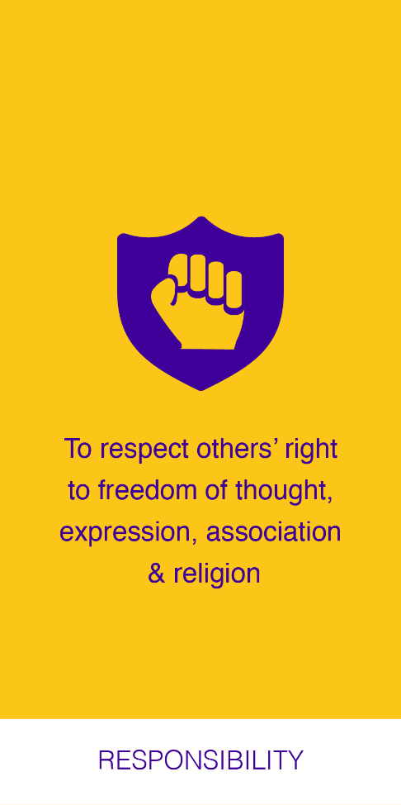
…to responsibilities
Notes:
To respect other’s right to freedom of thought, expression, association and religion.

Slide 34
From rights…
?
Notes:
If you have a human right to cultural roots, your human responsibility is?

Slide 35
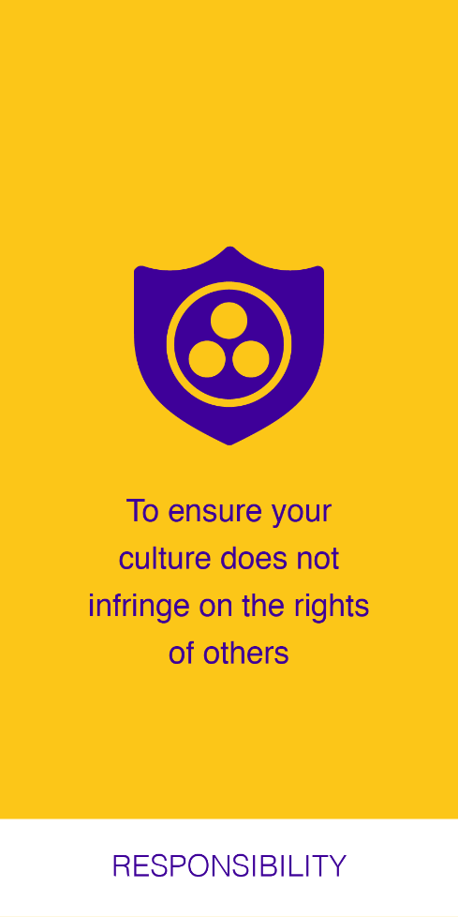
…to responsibilities
Notes:
The ensure your culture does not infringe on the rights of others.

Slide 36
…to responsibilities
?
Notes:
If you have a human right to a unique identity, your human responsibility is?

Slide 37
From rights…
Notes:
To respect the unique identity of others.

Slide 38
From rights…
?
Notes:
If you have a human right to physical, mental, social and emotional development, your human responsibility is?

Slide 39
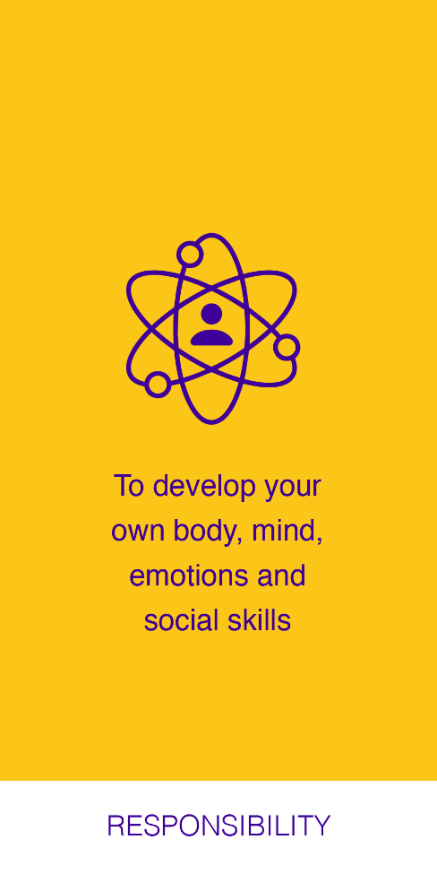
…to responsibilities
Notes:
To develop your own body, mind, emotions and social skills.

Slide 40
From rights…
?
Notes:
If you have a human right to moral development, your human responsibility is?

Slide 41
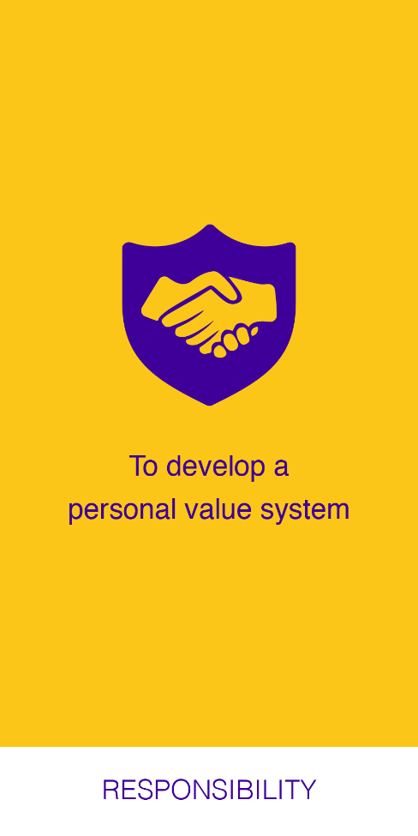
…to responsibilities
Notes:
To develop a personal value system that doesn’t infringe on the rights of others.

Slide 42
From rights…
?
Notes:
If you have a human right to a healthy planet, your human responsibility is?

Slide 43
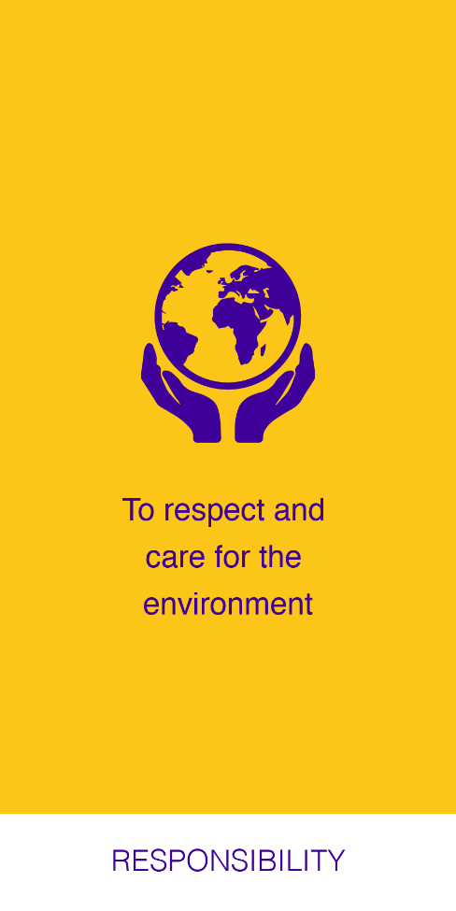
…to responsibilities
Notes:
To respect and care for the environment.

Slide 44
From rights…
?
Notes:
If you have a human right to live a full and happy life, your human responsibility is?

Slide 45
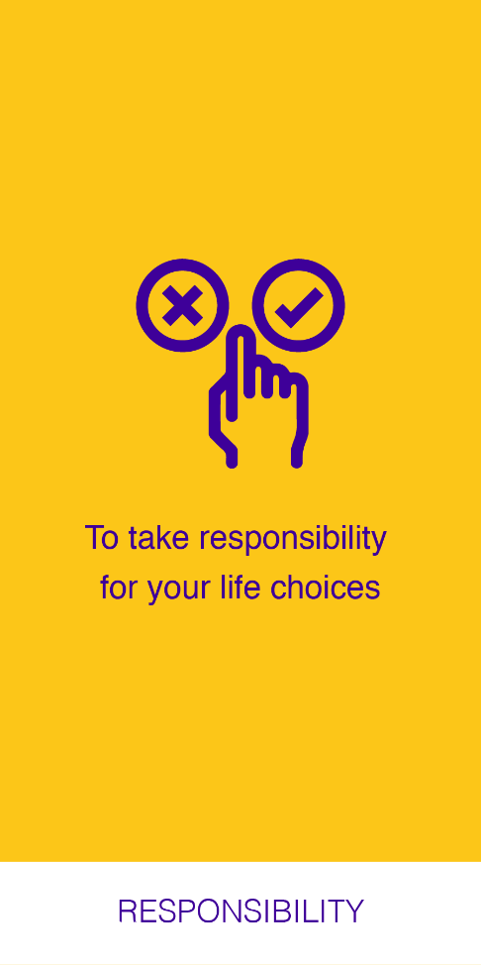
…to responsibilities
Notes:
To take responsibility for your life choices.

Slide 46
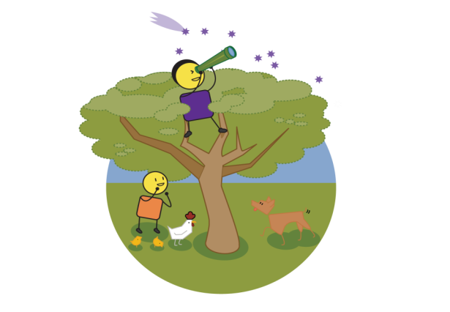
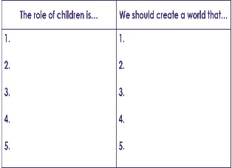
Defining our values
Values, or what we believe in, drive our day-to-day behaviour. What values will we need to believe in to ensure we achieve our child protection vision?
CHILD PROTECTION VISION
CHILD PROTECTION VALUES
Notes:
Now that you have spent some timing thinking about rights and responsibilities, we need to think about the values that will help you to achieve your child protection vison. Start with your vision statement and then think of 3 to 5 values that will help to deliver it. Ask yourself, “to achieve this vision, what will we need to believe in?” Write these values down as these should guide your behaviours, actions and choices moving forward.

Slide 47
If these are our rights, what are our personal responsibilities?
Notes:
Here we can see workshop participants matching children’s rights to responsibilities. You can also use the cards to do role play or other creative approaches to bringing the rights and responsibilities to life.

Slide 48
Notes:
In these pictures, some school children are defining the values that will help them to achieve their defined vision for themselves and the world they would like to live in.

Slide 49
stay strong
take
www.couragechildprotection.com
Notes:
Thanks for watching.
For more information visit Courage Child Protection dot com
Be sure to like this video and subscribe to our Courage Channel.
Stay strong and take courage.

